Slide 1
Welcome to the NWL23 New EIGHTS
PLANNING TO UP YOUR GAME

Slide 2
EIGHTS
IF the above word does NOT show numbered Scrabble tiles,
then make sure you view your downloaded version in PowerPoint or KeyNote
Use PowerPoint or Keynote in FULL SCREEN “SLIDE SHOW” mode on your LAPTOP or DESKTOP for best results
When you see the “ESCAPE KEY” ICON check speaker notes for additional information by hitting the escape key
Notes:
.

Slide 3
So, yes, here are all of the new EIGHTS from NWL23. BUT, we are striking through those words that are variations from words that have been covered in previous PowerPoints. For example ADULTED was a new seven, we will skip ADULTING. CHIPLET was a new seven, we won’t bother with a slide for the simple plural CHIPLETS. On the other hand, FLANKENS is addressed, because FLANKEN is an old word but taking the S is new. There is no other FRICKING form of FRICKING so we include it for the first time.
ADULTING AGARWOOD ALLYSHIP ALNICOES ALTCOINS AMBIGRAM AMIRIGHT ANGSTING APIPHOBE ARIARIES ASEXUALS ASSWIPES AUTOFILL AUTOFOCI BABYMOON BACKENDS BANDSAWN BIGENDER BIRTHERS BLIMPING BLUEWAYS BODYCAMS BORICUAS BOTOXING BOUGIEST BOUJIEST BOURGIER BOURGIES BRALETTE BRUTALER BUBKESES BULBLIKE BUPKESES BUPKISES BUPKUSES CAMGIRLS CARNITAS CERIMANS CHATBOTS CHEFFIER CHIPLETS CHIRRENS CHONKIER CHURIDAR CIDERIER CIDERIES CLAPBACK COCKSMAN COCKSMEN COHESINS COLOREDS COMITIAS COMPASES CONCASSE CONELIKE CORIVALS CORNHOLE COSPLAYS COULISES CRINGEST CRINGIER CRYPTIDS CUBESATS DABBINGS DASHCAMS DATAFILE DAYWEARS DEADNAME DEBOARDS DEBRISES DEEPFAKE DEGORGED DEGORGES DELEAFED DEMONYMS DICKHEAD DIEGESES DIEGESIS DIEGETIC DOGPILED DOGPILES DOXXINGS DYSTOPIC EGGCORNS EMAILERS EPIGYNES EPIGYNUM EYEWEARS FAECESES FASCITES FATBERGS FAUCESES FAUXHAWK FEMICIDE FINTECHS FLANKENS FLAVEDOS FLOWBACK FRICKING FUGLIEST FYNBOSES GALABEYA GEOSMINS GEOSPACE GERMLINE GLAMAZON GLAMPERS GLAMPING GNOCCHIS GREYOUTS HANDSIER HEADBUTT HOGSBANE HORCHATA IRITIDES IXNAYING JANKIEST JEGGINGS JESUITIC JESUITRY KAYFABES KETTLING KOBOCHAS KOMBUCHA LAGGIEST LANDRACE LAPSUSES LARPINGS LOSARTAN LYSERGIC MAITAKES MAQUISES MEIKLEST MELINJOS MELTIEST MEPHITES MIDLIFES MOFONGOS MOONCAKE MULATTOS MULTIHIT NACHASES NACHESES NAMASKAR NAMASTES NIHONIUM NOVOCAIN NUTBALLS OMAKASES OMNICIDE OSSICONE PAGEVIEW PALAISES PALEOART PANTSING PAROUSIA PETAFLOP PICKNEYS PIEROGIS PLUSHIES PNEUMATA POOFIEST POONTANG POTHOSES PRANAYAM PREPPERS PRETONIC RAFTABLE RAPPINIS REDNECKS REPOSTED ROWHOUSE RUFIYAAS SAVASANA SHAMINGS SHARTING SHEENEYS SHEENIES SHICKSAS SHIKSEHS SHITPOST SHITSHOW SHIVVING SHKOTZIM SHOUTOUT SIZEISMS SIZEISTS SKEEZIER SKIWEARS SLUSHEES SMISHING SNARKING SOUNDBAR SPAZZING SPEEDRUN SPONCONS STANNING STEPDOWN STIMMING STUFFIES TASERING THWAPPED TIRINGLY TOPDRESS TORTIERE TRAMADOL TSORESES TSORISES UNBANKED UNMALTED UNMUTING UNVAXXED VAQUITAS WALLIEST WHITETIP WINGSUIT WOKENESS ZEEDONKS

Slide 4
?
A A D G O O R W
ONE WORD

Slide 5
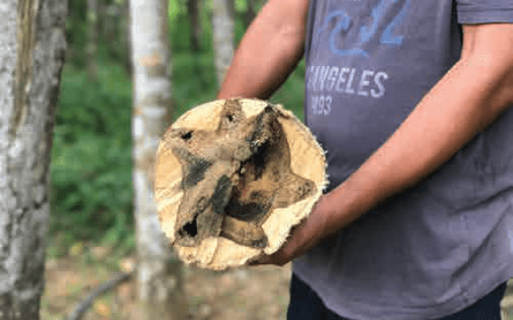
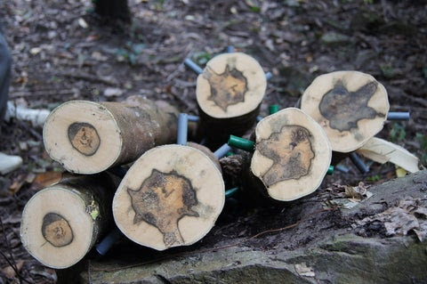
AGARWOOD
S
AGARWOOD: v. THE HEARTWOOD OF A PARTICULAR TREE WHEN INFECTED BY A PARASITE (also ALOESWOOD/S, EAGLEWOOD/S)

Slide 6
?
A H I L L P S Y
ONE WORD

Slide 7
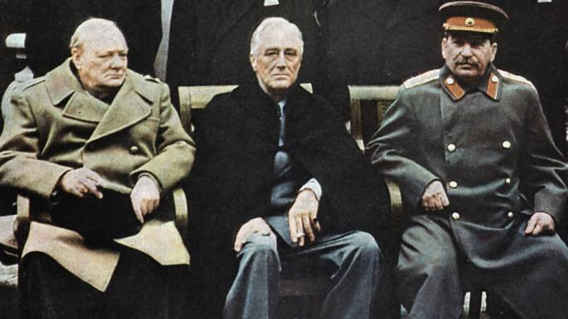
ALLYSHIP
S
ALLYSHIP: n. THE STATE OF BEING AN ALLY

Slide 8
?
A C E I L N O S
ONE WORD

Slide 9
ALNICOES
ALNICOES: NWL23 add’l pl. of ALNICO, AN ALLOY CONSISTING OF ALUMINUM, NICKEL, & COBALT
also pl. ALNICOS

Slide 10
?
A A B G I M M R
ONE WORD

Slide 11
AMBIGRAM
S
AMBIGRAM: AN IMAGE THAT SPELLS DIFFERENT WORDS IN DIFFERENT VIEWS

Slide 12
?
A G H I I M R T
ONE WORD

Slide 13
AMIRIGHT
AMIRIGHT: interj. “AM I RIGHT?” (also AMIRITE)

Slide 14
?
A B E H I O P P
ONE WORD

Slide 15
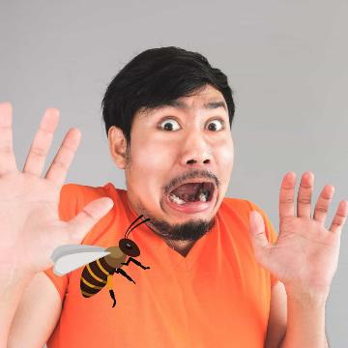
APIPHOBE
S
APIPHOBE: ONE WHO IS AFRAID OF BEES

Slide 16
?
A A E I I R R S
ONE WORD

Slide 17
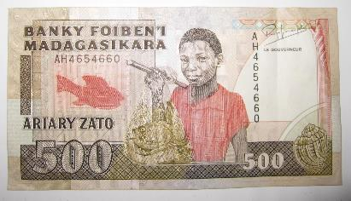
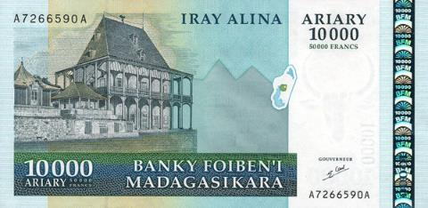
ARIARIES
ARIARIES: NWL23 pl. of ARIARY, A MONEY UNIT OF MADAGASCAR
(ARIARY is not new, but served as its own plural until now)

Slide 18
?
A A E L S S U X
ONE WORD

Slide 19
ASEXUALS
_
ASEXUALS: pl. of ASEXUAL, ONE WHO HAS NO SEXUAL FEELINGS
(ASEXUAL is not new, but was heretofore considered adjective only)

Slide 20
?
A I F L L O T U
ONE WORD

Slide 21
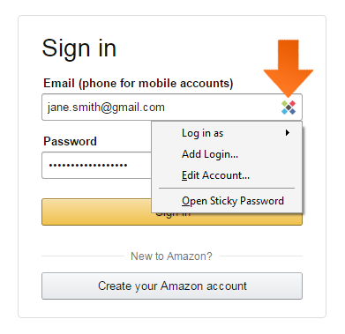
AUTOFILL
S
AUTOFILL: v. TO PROMPT A USER WITH POSSIBLY DESIRED TEXT
(AUTOFILLED, AUTOFILLING)

Slide 22
?
A C F I O O T U
ONE WORD

Slide 23
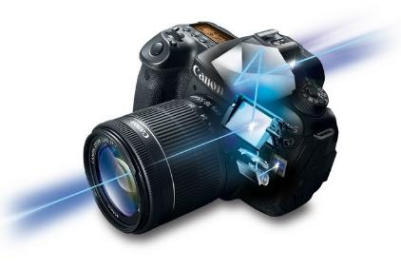
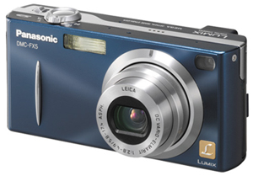
AUTOFOCI
AUTOFOCI: NWL23 pl. of AUTOFOCUS,
AN AUTOMATIC FOCUSING SYSTEM
(also v. AUTOFOCUS, AUTOFOCUSES, AUTOFOCUSED, AUTOFOCUSING and AUTOFOCUSSES, AUTOFOCUSSED, AUTOFOCUSSING)

Slide 24
?
A B B M N O O Y
ONE WORD

Slide 25
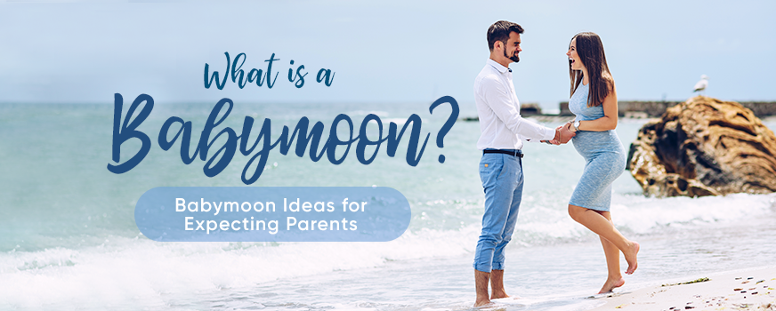
BABYMOON
S
BABYMOON: n. A HOLIDAY TAKEN BY SOON-TO-BE PARENTS

Slide 26
?
A A B D N N S W
ONE WORD

Slide 27
BANDSAWN
_
BANDSAWN: v. CUT WITH A CONTINUOUS SAW
BANDSAW
BANDSAWS
BANDSAWED
BANDSAWN
BANDSAWING

Slide 28
?
B D E E G I N R
THREE WORDS

Slide 29
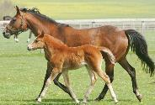
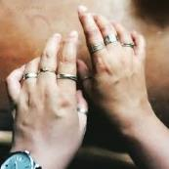
YOU COULD PLAY
BREEDING
S
BREEDING: n. UPBRINGING v. TO GIVE BIRTH
BERINGED
BERINGED: adj. ADORNED WITH RINGS
BUT MAYBE YOU SHOULD PLAY
BIGENDER
BIGENDER: adj. INCLUDING MALE AND FEMALE

Slide 30
?
A B E E L R T T
ONE WORD

Slide 31
BRALETTE
S
BRALETTE: n. A SOFT FLEXIBLE BRA

Slide 32
?
A B E L R R T U
ONE WORD

Slide 33
BRUTALER
BRUTALER: NWL23 comparative for adj. BRUTAL, SAVAGE (NWL23 superlative BRUTALEST)
Also
BRUTALLY
BRUTELY
BRUTISM/S

Slide 34
?
B B E E K S S U
ONE WORD

Slide 35
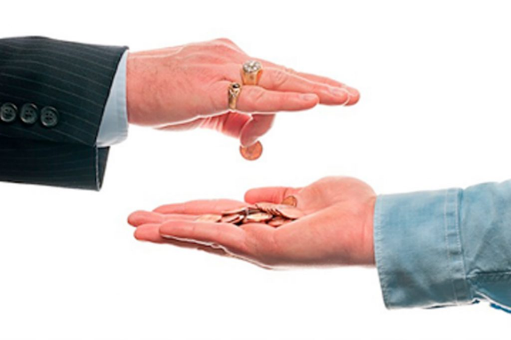
BUBKESES
BUBKESES: NWL23 pl. of n. BUBKES, THE LEAST AMOUNT
also BUPKES, BUPKESES
BUPKIS, BUPKISES
BUPKUS, BUPKUSES

Slide 36
?
B B E I K L L U
ONE WORD

Slide 37
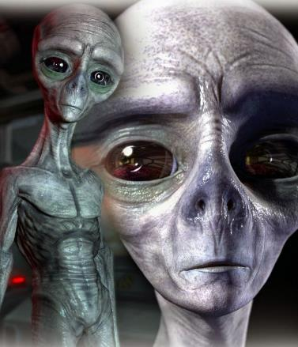
BULBLIKE
BULBLIKE: adj. RESEMBLING A BULB

Slide 38
?
A A C I N R S T
ONE WORD

Slide 39
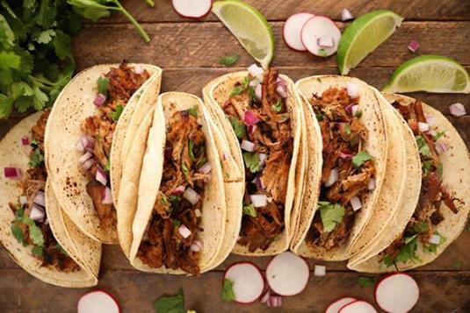
CARNITAS
STICKY
CARNITAS: n. PIECES OF MEAT IN A TACO (no singular, only ANTICAR)

Slide 40
?
C E H I N R R S
ONE WORD

Slide 41
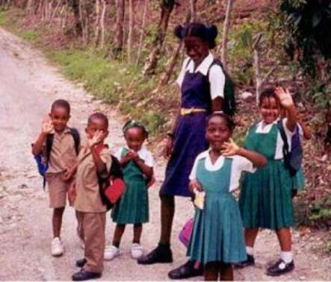
CHIRRENS
_
CHIRRENS: NWL23 pl. of n. CHIRREN, MEANING CHILDREN (although CHILDREN takes no S)

Slide 42
?
A C D H I R R U
ONE WORD

Slide 43
churidar
S
CHURIDAR: n. A STYLE OF SOUTH ASIAN TROUSERS

Slide 44
?
C D E E I I R R
ONE WORD

Slide 45
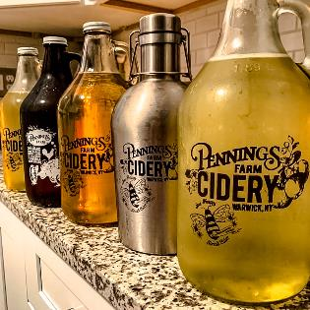
CIDERIER
CIDERIER: NWL23 comparative of CIDERY (also NWL23 superlative CIDERIEST)
WHICH TASTES CIDERIER?

Slide 46
?
A A B C C K L P
TWO WORDS

Slide 47
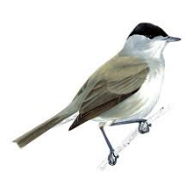
YOU COULD PLAY
BLACKCAP
S
BLACKCAP: n. A PARTICULAR SPECIES OF BIRD
BUT MAYBE YOU SHOULD PLAY
CLAPBACK
S
CLAPBACK: n. A VICIOUS COMEBACK, TYPICALLY QUICK, SHARP AND EFFECTIVE.

Slide 48
?
A C C K M N O S
ONE WORD

Slide 49
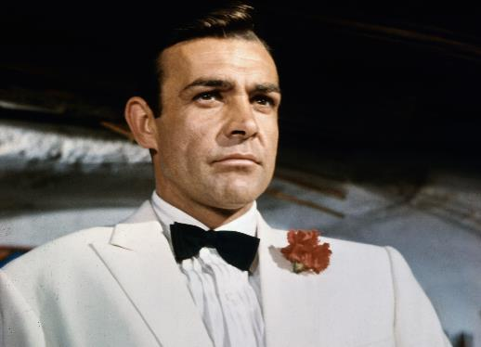
COCKSMAN
COCKSMAN: n. A MAN WITH A REPUTATION FOR GREAT SEXUAL VIRILITY (pl. COCKSMEN)

Slide 50
?
C D E L O O R S
TWO WORDS

Slide 51
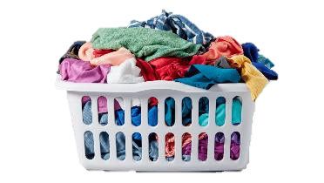
YOU COULD PLAY
_
DECOLORS
DECOLORS: v. DEPRIVES OF COLOR (DECOLORED, DECOLORING)
BUT MAYBE YOU SHOULD PLAY
COLOREDS
_
COLOREDS: n. NONWHITE LAUNDRY ITEMS
(NWL 2020 excluded this as a slur, now reinstated)

Slide 52
?
A C I I O M S T
TWO WORDS

Slide 53
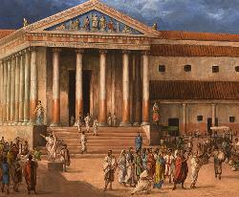
YOU COULD PLAY
IOTACISM
S
IOTACISM: n EXCESSIVE USE OF THE GREEK LETTER IOTA (!)
BUT MAYBE YOU SHOULD PLAY
COMITIAS
_
COMITIAS: NWL23 pl. of COMITIA, A PUBLIC ROMAN ASSEMBLY
COMITIA is not new, and takes an L, and now the NWL23 added S.

Slide 54
?
A C E M O P S S
ONE WORD

Slide 55
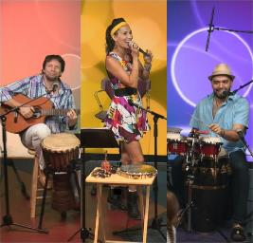
COMPASES
COMPAS: NWL23 pl. of COMPAS, A POPULAR MUSIC OF HAITI

Slide 56
?
A C C E N O S S
ONE WORD

Slide 57
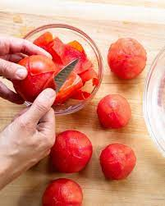
CONCASSE
S
CONCASSE: n. ROUGHLY CHOPPED FOOD

Slide 58
?
C E E I K L N O
ONE WORD

Slide 59
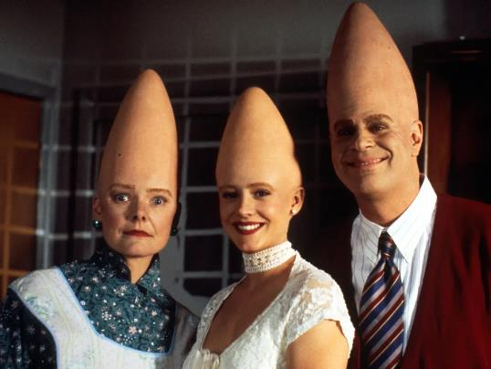
CONELIKE
CONELIKE: adj. RESEMBLING A CONE

Slide 60
?
C E H L N O O R
ONE WORD

Slide 61
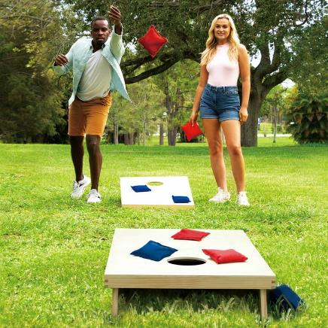
CORNHOLE
S
CORNHOLE: n. A POINT SCORED BY THROWING A BEANBAG IN A HOLE

Slide 62
?
C E I L O S S U
THREE WORDS

Slide 63
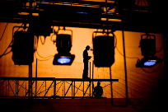
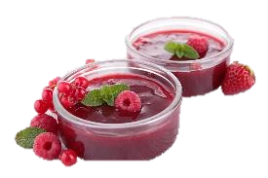
YOU COULD PLAY
COULISSE
S
COULISSE: n. A SIDE SCENE OF A THEATRE STAGE
LEUCOSIS
LEUCOSIS: LEUKEMIA, LEUKOSIS, pls. LEUCOSES, LEUKEMIAS, and LEUKOSES
BUT MAYBE YOU SHOULD PLAY
COULISES
COULISES: NWL23 pl. of the old word COULIS, A SAUCE OF PUREED FRUIT

Slide 64
?
C E G I N R S T
ONE WORD

Slide 65
CRINGEST
_
CRINGEST: NWL23 superlative of adj. CRINGE, AWKWARD

Slide 66
?
A B B D G I N S
ONE WORD

Slide 67
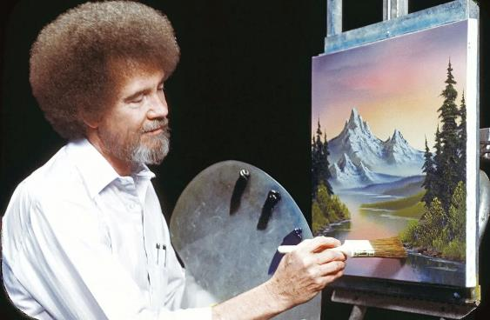
DABBINGS
_
DABBINGS: pl. of n. DABBING, THE ACT OF DABBING (also v. TOUCHING LIGHTLY (DAB, DABS, DABBED)

Slide 68
?
A A D E F I L T
ONE WORD

Slide 69
DATAFILE
S
DATAFILE: n. A DIGITAL FILE CONTAINING DATA

Slide 70
?
A A D E R S W Y
ONE WORD

Slide 71
DAYWEARS
_
DAYWEARS: NWL23 pl. of n. DAYWEAR, CLOTHING SUITABLE FOR INFORMAL OCCASIONS

Slide 72
?
A A D D E E M N
ONE WORD

Slide 73
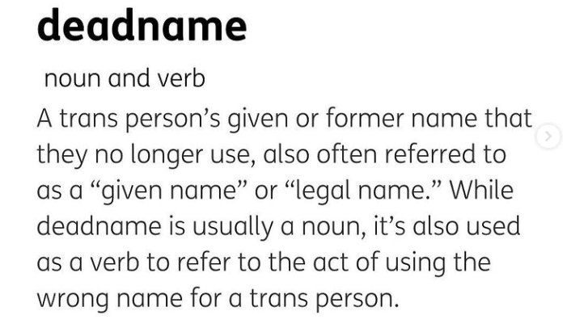
DS
DEADNAME
DEADNAME: n. & v. TO REFER TO SOMEONE BY THEIR DEPRECATED (DISAPPROVED) BIRTHNAME (DEADNAMING)

Slide 74
?
B D E E I R S S
ONE WORD

Slide 75
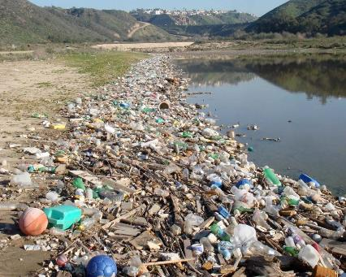
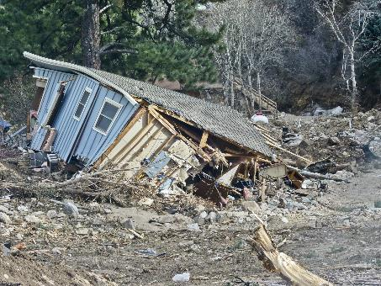
DEBRISES
DEBRISES: NWL23 pl. of n. DEBRIS, FRAGMENTS, SCATTERED REMAINS
TWO DIFFERENT KINDS OF DEBRISES?

Slide 76
?
A D E E E F K P
ONE WORD

Slide 77
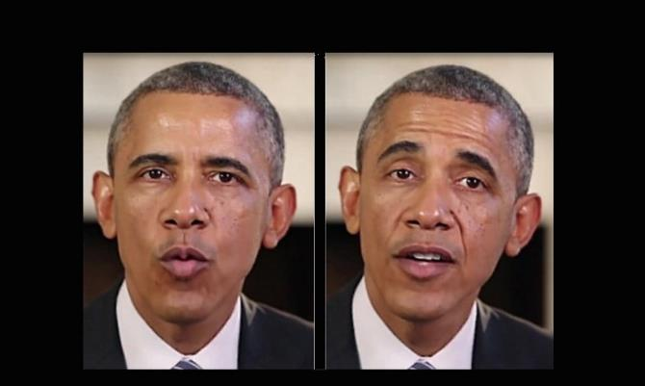
DEEPFAKE
S
DEEPFAKE: n. AN ALTERED IMAGE MISPRESENTING SOMETHING ACTUALLY DONE
ONE OF THESE IMAGES IS APPARENTLY A FAKE

Slide 78
?
A C D D E H I K
ONE WORD

Slide 79
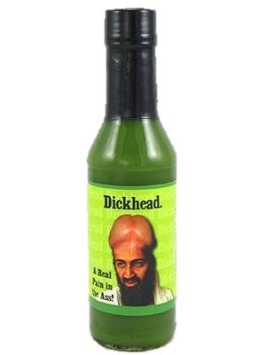
DICKHEAD
S
DICKHEAD: n. AN INEPT, FOOLISH, OR CONTEMPTIBLE PERSON

Slide 80
?
D E E G I I S S
ONE WORD

Slide 81
DIEGESIS
DIEGESIS: n. A NARRATIVE IN A FILM, OR SOUND THAT IS ORIGINATING FROM THAT SEEN ON THE SCREEN (pl. DIEGESES and adj. DIEGETIC)
https://beverlyboy.com/filmmaking/what-is-diegesis-in-film/

Slide 82
?
C D I O P S T Y
ONE WORD

Slide 83
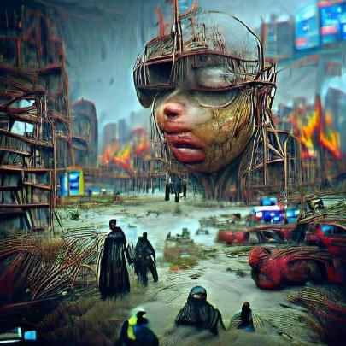
dystopic
DYSTOPIC: adj. RESEMBLING A DYSTOPIA, A WRETCHED PLACE

Slide 84
?
E G I M N P U Y
ONE WORD

Slide 85
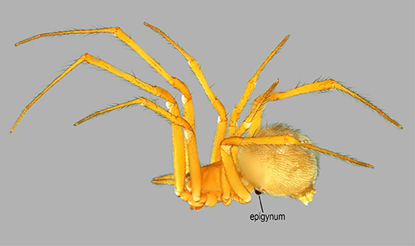
EPIGYNUM
S
EPIGYNUM: n. THE EXTERNAL REPRODUCTIVE ORGAN OF A FEMALE SPIDER (plurals EPIGYNA, EPIGYNUMS and EPIGYNE/S)

Slide 86
?
A e e e r s w y
ONE WORD

Slide 87
EYEWEARS
_
EYEWEARS: NWL23 pl. of EYEWEAR, A DEVICE WORN OVER OR ON THE EYES

Slide 88
?
A C e e e f s s
ONE WORD

Slide 89
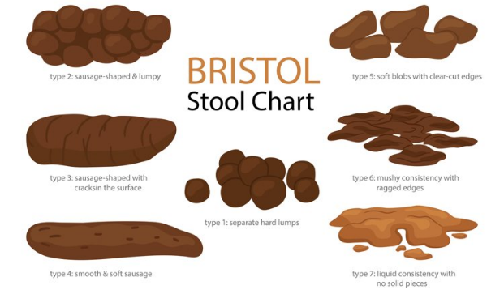
FAECESES
FAECESES: NWL23 pl. of FAECES, BODILY WASTE DISCHARGED THROUGH THE ANUS (also FECES, and NWL23 pl. FECESES)

Slide 90
?
A C E F I S S T
ONE WORD

Slide 91
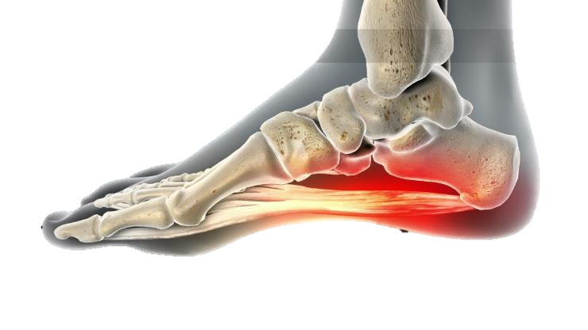
FASCITES
_
FASCITES: NWL23 pl. of FASCITIS, INFLAMMATION OF A CONNECTIVE TISSUE, also pls. FASCITIDES, FASCITISES
(also FASCIITIS, with pl. FASCIITIES, FASCIITIDES, FASCIITISES))

Slide 92
?
A C E E F S S U
ONE WORD

Slide 93
FAUCESES
FAUCESES: NWL23 pl. of FAUCES, THE PASSAGE FROM THE MOUTH TO THE PHARYNX

Slide 94
?
A A F H K U W X
ONE WORD

Slide 95
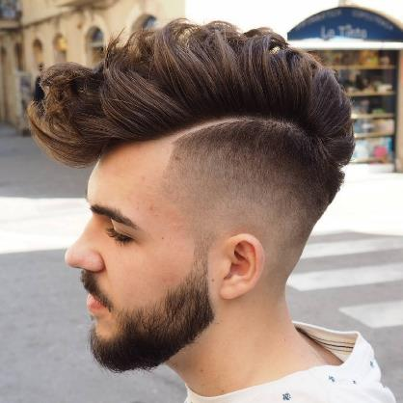
FAUXHAWK
S
FAUXHAWK: n. A HAIRSTYLE RESEMBLING A MOHAWK

Slide 96
?
C D E E F I I M
ONE WORD

Slide 97
FEMICIDE
S
FEMICIDE: n. INTENTIONAL KILLING OF A FEMALE BECAUSE OF HER GENDER

Slide 98
?
A E F K L N N S
ONE WORD

Slide 99
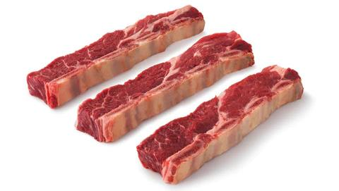
FLANKENS
_
FLANKENS: NWL23 pl. of FLANKEN, A CUT OF MEAT FROM THE SHORT RIBS

Slide 100
?
A B C F K L O W
TWO WORDS

Slide 101
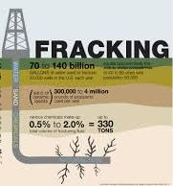
YOU COULD PLAY
BACKFLOW
S
BACKFLOW: n. A FLOWING BACK TOWARD A SOURCE
BUT MAYBE YOU SHOULD PLAY
FLOWBACK
S
FLOWBACK: n. WASTEWATER CREATED BY FRACKING

Slide 102
?
C F G I I K N R
ONE WORD

Slide 103
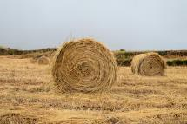
FRICKING
_
FRICKING: adj. FRIGGING
RICKING: v. PILING HAY IN STACKS

Slide 104
?
B e f n o s s y
ONE WORD

Slide 105
FYNBOSES
FYNBOSES: NWL23 pl. of n. FYNBOS, A TYPE OF BIOME IN SOUTH AFRICA

Slide 106
?
A A A B E G L Y
ONE WORD

Slide 107
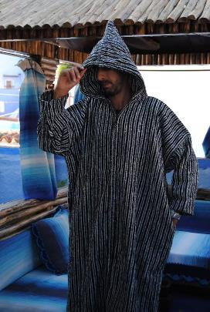
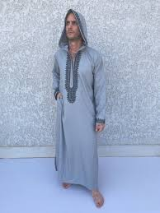
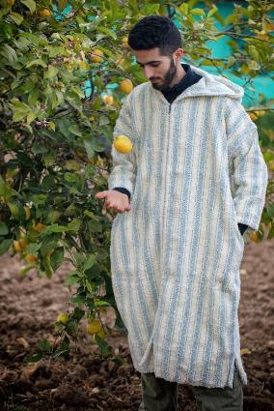
galabeya
S
GALABEYA: n. A LONG HOODED GARMENT (also DJELLABA/S,GALABIA/S, GALABIEH/S, GALABIYA/S, JELLABA/S)

Slide 108
?
A C E E G O P S
ONE WORD

Slide 109
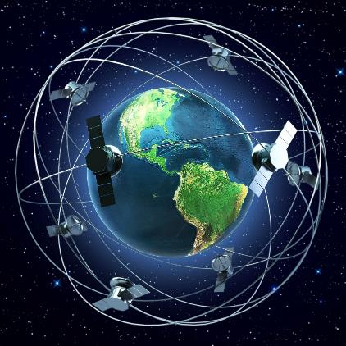
GEOSPACE
S
GEOSPACE: n. THE PART OF OUTER SPACE NEAR THE EARTH

Slide 110
?
E E G I L M N R
ONE WORD

Slide 111
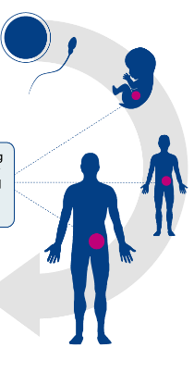
GERMLINE
S
GERMLINE: n. A SEQUENCE OF GERM CELLS DESCENDED FROM THEIR PREDECESSORS

Slide 112
?
A A G L M N O Z
ONE WORD

Slide 113
GLAMAZON
S
GLAMAZON: n. A TALL, GLAMOROUS WOMAN

Slide 114
?
C C G H I N O S
ONE WORD

Slide 115
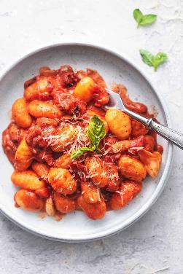
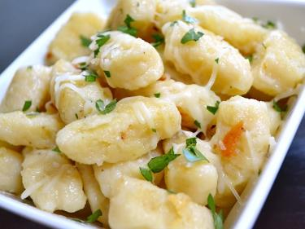
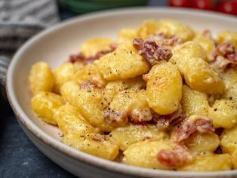
GNOCCHIS
_
GNOCCHIS: NWL23 pl. of n. GNOCCHI, A DUMPLING MADE OF PASTA

Slide 116
?
A B D E H T T U
TWO WORDS

Slide 117
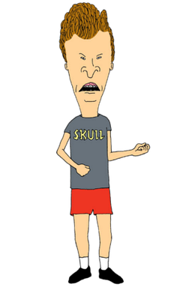
YOU COULD PLAY
BUTTHEAD
S
BUTTHEAD: n. A STUPID PERSON
BUT MAYBE YOU SHOULD PLAY
HEADBUTT
S
HEADBUTT: v. TO STRIKE WITH THE HEAD (HEADBUTTS, HEADBUTTED, HEADBUTTING)

Slide 118
?
A B E G H N O S
ONE WORD

Slide 119
HOGSBANE
S
HOGSBANE: n. A NOXIOUS WEED

Slide 120
?
A A C H H O R T
ONE WORD

Slide 121
HORCHATA
S
HORCHATA: n. A DRINK MADE FROM RICE MILK

Slide 122
?
D E I I I R S T
ONE WORD

Slide 123
IRITIDES
IRITIDES: add’l NWL23 pl. of IRITIS, AN INFLAMMATION OF THE IRIS (also pl. IRITISES)

Slide 124
?
C E I I J S T U
TWO WORDS

Slide 125
YOU COULD PLAY
JUICIEST
JUICIEST: adj. MOST JUICY, FULL OF JUICE (JUICIER)
BUT MAYBE YOU SHOULD PLAY
JESUITIC
JESUITIC: adj. PERTAINING TO A JESUIT
Also JESUITICAL, JESUITICALLY, JESUITISM/S

Slide 126
?
E I J R S T U Y
ONE WORD

Slide 127
JESUITRY
JESUITRY: THE STATE OF BEING A JESUIT (pl. JESUITRIES)

Slide 128
?
A A B E F K S Y
ONE WORD

Slide 129
KAYFABES
KAYFABES: NWL23 pl. of new word KAYFABE,
A COLLECTIVE PRETENSE OF SINCERITY
PROFESSIONAL WRESTLING COULD INCLUDE SEVERAL EXAMPLES OF KAYFABES, WITH THE PRETENSE THAT THE ACTION, RIVALRIES, ETC. ARE AUTHENTIC

Slide 130
?
A B C H K M O U
ONE WORD

Slide 131
KOMBUCHA
S
KOMBUCHA: FERMENTED BLACK TEA

Slide 132
?
A A C D E L N R
TWO WORDS

Slide 133
YOU COULD PLAY
CALENDAR
S
CALENDAR: v. (!) TO SCHEDULE (CALENDARED, CALENDARING)
BUT MAYBE YOU SHOULD PLAY
LANDRACE
S
LANDRACE: n. A LOCALLY TRADITIONALLY BRED VARIETY OF PLANT OR ANIMAL

Slide 134
?
A E L P S S S U
ONE WORD

Slide 135
LAPSUSES
LAPSUSES: NWL23 pl. of LAPSUS, A MISTAKE

Slide 136
?
A A L N O R S T
ONE WORD

Slide 137
LOSARTAN
S
LOSARTAN: A DRUG USED TO TREAT HYPERTENSION

Slide 138
?
C E G I L R S Y
ONE WORD

Slide 139
LYSERGIC
LYSERGIC: adj. TRIPPY, LIKE LSD

Slide 140
?
A E I M Q S S U
ONE WORD

Slide 141
MAQUISES
MAQUISES: NWL23 pl. of MAQUIS, THICK UNDERBRUSH
(also MAQUI)
MAQUI [UMIAQ]
MAQUIS [UMIAQS]

Slide 142
?
E E H I M P S T
TWO WORDS

Slide 143
YOU COULD PLAY
HEMPIEST
HEMPIEST: MOST HEMPY, MISCHIEVOUS (HEMPIER)
BUT MAYBE YOU SHOULD PLAY
MEPHITES
MEPHITES: add’l NWL23 pl. of MEPHITIS, AN OFFENSIVE ODOR (also NWL23 plurals MEPHITIDES and MEPHITISES)

Slide 144
?
D E F I I L M S
THREE WORDS

Slide 145
YOU COULD PLAY
MISFIELD
S
MISFIELD: v. TO FIELD BADLY (MISFIELDED, MISFIELDING)
MISFILED
_
MISFILED: FILED IN THE WRONG PLACE (MISFILE, MISFILES, MISFILING)
BUT MAYBE YOU SHOULD PLAY
MIDLIFES
_
MIDLIFES: add’l NWL23 pl. of MIDLIFE, MIDDLE AGE (also MIDLIVES)

Slide 146
?
A C E K M N O O
ONE WORD

Slide 147
MOONCAKE
S
MOONCAKE: A TYPE OF CHINESE PASTRY ITEM

Slide 148
?
H I I L M T T U
ONE WORD

Slide 149
MULTIHIT
MULTIHIT: HAVING MORE THAN ONE HIT

Slide 150
?
A A C E H N S S
ONE WORD

Slide 151
NACHASES
NACHASES: NWL23 pl. of NACHAS,
PRIDE IN ANOTHER’S ACCOMPLISHMENTS

Slide 152
?
A c e e h n s s
THREE WORDS

Slide 153
YOU COULD PLAY
ENCASHES
ENCASHES: v. TO CASH, CONVERT INTO READY MONEY (ENCASH, ENCASHED,ENCASHING)
ENCHASES
_
ENCHASES: v. PLACES IN AN ORNAMENTAL SETTING (ENCHASE, ENCHASED, ENCHASING)
BUT MAYBE YOU SHOULD PLAY
NACHESES
_
NACHESES: NWL23 pl. of NACHES, PRIDE IN ANOTHER’S ACCOMPLISHMENTS (also NACHAS, NACHASES)

Slide 154
?
A A A K M N R S
ONE WORD

Slide 155
NAMASKAR
S
NAMASKAR: A FORMAL SOUTH ASIAN GREETING

Slide 156
?
H I I M N N O U
ONE WORD

Slide 157
NIHONIUM
S
NIHONIUM: THE CHEMICAL ELEMENT WITH ATOMIC NUMBER 113

Slide 158
?
A C I N N O O V
ONE WORD

Slide 159
ES
NOVOCAIN
NOVOCAIN: NWL23 alternative name for NOVOCAINE, A TRADEMARK OF A LOCAL ANESTHETIC

Slide 160
?
C D E I I M N O
ONE WORD

Slide 161
OMNICIDE
S
OMNICIDE: n. THE DESTRUCTION OF ALL LIFE

Slide 162
?
C E I N O O S S
TWO WORDS

Slide 163
YOU COULD PLAY
CONIOSES
CONIOSES: pl. of CONIOSIS, A DISEASE CAUSED BY DUST INHALATION
BUT MAYBE YOU SHOULD PLAY
OSSICONE
S
OSSICONE: A HORNLIKE PROTUBERANCE ON A GIRAFFE OR OKAPI

Slide 164
?
A E E G I P V W
ONE WORD

Slide 165
PAGEVIEW
S
PAGEVIEW: A VIEWING OF A WEBPAGE

Slide 166
?
A A E I L P S S
ONE WORD

Slide 167
PALAISES
PALAISES: pl. of PALAIS, A PALACE

Slide 168
?
A A E L O P R T
ONE WORD

Slide 169
PALEOART
S
PALEOART: AN ARTISTIC DEPICTION OF PREHISTORIC LIFE

Slide 170
?
A A I O P R S U
ONE WORD

Slide 171
PAROUSIA
S
PAROUSIA: THE FUTURE RETURN OF CHRIST TO EARTH

Slide 172
?
A E F L O P P T
ONE WORD

Slide 173
PETAFLOP
S
PETAFLOP: ONE THOUSAND TERAFLOPS

Slide 174
?
A A E M N P T U
ONE WORD

Slide 175
PNEUMATA
PNEUMATA: one pl. of PNEUMA, THE SOUL OR SPIRIT (also pl. PNEUMAS plus PNEUMATIC/S)

Slide 176
?
A G N N O O P T
ONE WORD

Slide 177
POONTANG
S
POONTANG: SEXUAL INTERCOUSE

Slide 178
?
E H O O P S S T
ONE WORD

Slide 179
POTHOSES
STICKY
POTHOSES: pl. of POTHOS, A CLIMBING PLANT

Slide 180
?
A a a m n p r y
ONE WORD

Slide 181
PRANAYAM
AS
PRANAYAM: A TECHNIQUE OF YOGIC BREATH CONTROL
also PRANAYMA/S

Slide 182
?
C E I N O P R T
THREE WORDS

Slide 183
YOU COULD PLAY
ENTROPIC
ENTROPIC: adj. PERTAINING TO ENTROPY, A MEASURE OF DISORDER
INCEPTOR
S
INCEPTOR: n. ONE THAT INCEPTS, TAKES IN
BUT MAYBE YOU SHOULD PLAY
PRETONIC
PRETONIC: adj. PRECEDING AN ACCENTED SYLLABLE

Slide 184
?
A A B E F L R T
ONE WORD

Slide 185
RAFTABLE
D
RAFTABLE: CAPABLE OF BEING RAFTED

Slide 186
?
E H O O R S U W
ONE WORD

Slide 187
ROWHOUSE
S
ROWHOUSE: ONE OF A SERIES OF HOUSES BUILT WITHOUT SPACE BETWEEN THEM

Slide 188
?
A A F I R S U Y
ONE WORD

Slide 189
RUFIYAAS
_
RUFIYAAS: new NWL23 pl. of RUFIYAA, A MONETARY UNIT OF THE MALDIVES

Slide 190
?
A A A A N S S V
ONE WORD

Slide 191
SAVASANA
S
SAVASANA: A RESTING POSE IN YOGA

Slide 192
?
A G H I M N S S
TWO WORDS

Slide 193
YOU COULD PLAY
_
SMASHING
SMASHING: v. SHATTERING VIOLENTLY
BUT MAYBE YOU SHOULD PLAY
SHAMINGS
_
SHAMINGS: pl. of n. SHAMING, THE ACT OF SHAMING

Slide 194
?
H I O P S S T T
ONE WORD

Slide 195
SHITPOST
S
SHITPOST: v. TO POST SOMETHING DELIBERATELY PROVOCATIVE (SHITPOSTED, SHITPOSTING)

Slide 196
?
H H I O S S T W
ONE WORD

Slide 197
SHITSHOW
S
SHITSHOW: A DISASTER

Slide 198
?
H I K M O S T Z
ONE WORD

Slide 199
SHKOTZIM
SHKOTZIM: pl. of SHEGETZ, A JEWISH BOY WHO DOES NOT OBSERVE JEWISH PRECEPTS

Slide 200
?
H O O S T T U U
TWO WORDS

Slide 201
YOU COULD PLAY
OUTSHOUT
S
OUTSHOUT: v. TO SURPASS IN SHOUTING (OUTSHOUTED, OUTSHOUTING)
BUT MAYBE YOU SHOULD PLAY
SHOUTOUT
S
SHOUTOUT: AN ACKNOWLEDGEMENT

Slide 202
?
E E E K I R S Z
ONE WORD

Slide 203
SKEEZIER
SKEEZIER: adj. MORE SKEEZY, REPULSIVE (SKEEZIEST)

Slide 204
?
A E I K R S S W
ONE WORD

Slide 205
SKIWEARS
_
SKIWEARS: NWL23 pl. of SKIWEAR, CLOTHING SUITABLE FOR SKIING

Slide 206
?
G H I I M N S S
ONE WORD

Slide 207
SMISHING
S
SMISHING: n. THE ACT OF PHISHING BY TEXT MESSAGE
Smishing is a social engineering attack that uses fake mobile text messages to trick people into downloading malware, sharing sensitive information or sending money to cybercriminals. The term “smishing” is a combination of “SMS”—or “short message service,” the technology behind text messages—and “phishing.”

Slide 208
?
A B D N O R S U
TWO WORDS

Slide 209
YOU COULD PLAY
BAUDRONS
STICKY
BAUDRONS: sing. n. A CAT, pl. BAUDRONSES
A BAULDRONS WITH A CAULDRON
BUT MAYBE YOU SHOULD PLAY
SOUNDBAR
S
SOUNDBAR: AN ENCLOSURE CONTAINING SEVERAL LOUDSPEAKERS

Slide 210
?
D E E N P R S U
ONE WORD

Slide 211
SPEEDRUN
S
SPEEDRUN: n. THE PLAYING OF A GAME AS QUICKLY AS POSSIBLE
SPEEDRUN: a session or instance of play in which the goal is to finish the game or level, or meet another game-play objective, as quickly as possible:

Slide 212
?
D E N O P S T W
ONE WORD

Slide 213
STEPDOWN
S
STEPDOWN: n. A GRADUAL DECREASE

Slide 214
?
A D E H P P T W
ONE WORD

Slide 215
THWAPPED
THWAPPED: SLAPPED NOISILY (THWAP, THWAPS, THWAPPING)

Slide 216
?
G I I L N R T Y
ONE WORD

Slide 217
TIRINGLY
TIRINGLY: adv. IN A TIRING MANNER

Slide 218
?
D E O P R S S T
ONE WORD

Slide 219
TOPDRESS
TOPDRESS: v. TO SCATTER COMPOST OVER SOIL TO ENRICH IT (TOPDRESSED, TOPDRESSES, TOPDRESSING)

Slide 220
?
E E I O R R T T
ONE WORD

Slide 221
TORTIERE
S
TORTIERE: n. A FRENCH-CANADIAN MEAT PIE
(also TOURTIERE/S)

Slide 222
?
A A D L M O R T
ONE WORD

Slide 223
TRAMADOL
S
TRAMADOL: n. AN OPIOID DRUG

Slide 224
?
E E O R S S S T
ONE WORD

Slide 225
TSORESES
TSORESES: NWL23 pl. of n. TSORES, A SERIES OF MISFORTUNES
THERE ARE MANY ALTERNATE SPELLINGS OF TZURIS, A SERIES OF MISFORTUNES. THE SINGULAR AND PLURAL CAN BE SPELLED THE SAME FOR TSOURIS, TSURIS, TSOORIS, TSORIS, TSORES, TSORRISS, AND TZURIS, EXCEPT NOW WE ALSO HAVE TSURISES, TZURISES, TSORISES AND TSORESES!

Slide 226
?
E I O R S S S T
ONE WORD

Slide 227
TSORISES
TSORESES: NWL23 pl. of n. TSORIS, A SERIES OF MISFORTUNES
THERE ARE MANY ALTERNATE SPELLINGS OF TZURIS, A SERIES OF MISFORTUNES. THE SINGULAR AND PLURAL CAN BE SPELLED THE SAME FOR TSOURIS, TSURIS, TSOORIS, TSORIS, TSORES, TSORRISS, AND TZURIS, EXCEPT NOW WE ALSO HAVE TSURISES, TZURISES, TSORISES AND TSORESES!

Slide 228
?
A B D E K N N U
ONE WORD

Slide 229
UNBANKED
S
UNBANKED: surprisingly a noun! A PERSON WHO DOES NOT HAVE A BANK ACCOUNT
You are going to draw another challenge when you add the S!

Slide 230
?
A D E L M N T U
ONE WORD

Slide 231
UNMALTED
UNMALTED: adv. (?) NOT MALTED

Slide 232
?
A E I L L S T W
ONE WORD

Slide 233
_
WALLIEST
WALLIEST: NWL23 superlative adj. MOST WALLY, STURDY (WALLIER)

Slide 234
?
E H I I P T T W
ONE WORD

Slide 235
WHITETIP
S
WHITETIP: A TYPE OF SHARK

Slide 236
?
G I I N S T U W
ONE WORD

Slide 237
WINGSUIT
S
WINGSUIT: A JUMPSUIT USED FOR GLIDING WHILE SKYDIVING

Slide 238
?
E E K N O S S W
ONE WORD

Slide 239
WOKENESS
WOKENESS: n. THE CONDITION OF BEING WOKE (pl. WOKENESSES comparatives WOKER, WOKEST)

Slide 240
It’s not perfect, is it? Send suggestions for improvements to williamrsnoddy@gmail.com

