Slide 1
NEW 3’s and 4’s
From NWL 2023, ready for play as of March 1, 2024
Sanctioned by the North American Scrabble Players Association
BUT, this slideshow highlights the differences between NWL23 and WGPO’s new WOW24 word list!
Notes:
Done with a gray background, similar to the gray background found for NWL23 words with some settings on ULU.
(WGPO may disallow a few words, for example the suggested plural of ROUX: ROUXES may not be allowed. )

Slide 2
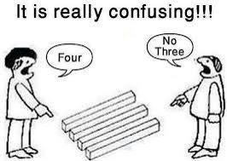
“OK, it doesn’t matter, we’ve got the New Threes and the New Fours covered here…”
And it’s really amazing, that for these 3’s and 4’s:
The only difference between the new NWL23 (NASPA) words
And the WOW24 (WGPO) list: WOW does not add the S to HAO or ZEN (so no HAOS and no ZENS)
Notes:
.

Slide 3
WORDS
IF the above does NOT show numbered Scrabble tiles, then
make sure you are viewing your downloaded version in PowerPoint or Keynote
Use PowerPoint or Keynote in FULL SCREEN “SLIDE SHOW” mode on your LAPTOP or DESKTOP for best results
When you see the “ESCAPE KEY” ICON check speaker notes for additional information by hitting the escape key
Notes:
.

Slide 4
?
A C K
ONE WORD
Notes:
.

Slide 5
BHJ
LMP
R
S
TWY
ACK! There are 11 front hooks!
_
ACK
ACK: interj. TO EXPRESS ANNOYANCE
Notes:
MACK: A WATERPROOF RAINCOAT (pl. MACKS, also MAC/S)
Shift + F5 to return to full screen

Slide 6
?
A o r
THREE WORDS
Notes:
.

Slide 7
Why play
BFHKMST
BHRS
ora
_
OAR
DL
_
S
or
When you might draw a challenge with
FT
aro
_
S
ARO: n. AN AROMANTIC, ONE LACKING ROMANTIC DESIRE
Notes:
BORA: A COLD WIND FORA: one pl. of FORUM, A MEETING PLACE HORA: AN ISRAELI DANCE
KORA: A STRINGED AFRICAN MUSICAL INSTRUMENT
MORA: A UNIT OF METRICAL TIME IN PROSODY SORA: A SPECIES OF BIRD
TORA: A LAW OR PRECEPT (TORAS, TORAH/S, TOROT, TOROTH)
FARO: A CARD GAME TARO: A TROPICAL PLANT Shift + F5 to return to full screen

Slide 8
?
A S T
THREE WORDS
Notes:
.

Slide 9
Why play
SAT
TAS
EKS
_
E
EU
_
_
or
I
When you could draw a challenge with
_
ATS
_
BCEFGHKLMOPQRTVW
@
ATS: v. RESPONDS TO SOMEONE ONLINE WITH NOTIFICATION (AT, ATTED, ATTING)
Notes:
SATI: A CREMATED HINDU WIDOW (pl. SATIS, also SUTTEE/S)
TASS: A DRINKING CUP (pl. TASSES)
GATS: pl. of GAT, A PISTOL
WATS: pl. of WAT, A HARE

Slide 10
?
A B E
ONE WORD
Notes:
.

Slide 11
S
BAE
_
_
S
BAE: n. SWEETHEART
Notes:
.

Slide 12
?
D O X
ONE WORD
Notes:
.

Slide 13
THE MONROE DOCTRINE
_
DOX
_
XY
DOXY: DOCTRINE (pl. DOXIES)
DOX: v. TO ATTACK BY PUBLISHING PRIVATE INFORMATION (DOXES, DOXED, DOXING and DOXINGS!)
(DOXX, DOXXES, DOXXED, DOXXING/S)
Notes:
"Dox" is a slang term derived from the word "docs," which is short for "documents." It refers to the act of publicly revealing or publishing private and personal information about an individual without their consent. This information can include details such as full name, address, phone number, email, and other identifying data. Doxing is often done with the intent to harass, intimidate, or harm the person whose information is exposed.
Shift + F5 to return to full screen

Slide 14
?
A F M
ONE WORD
Notes:
.

Slide 15
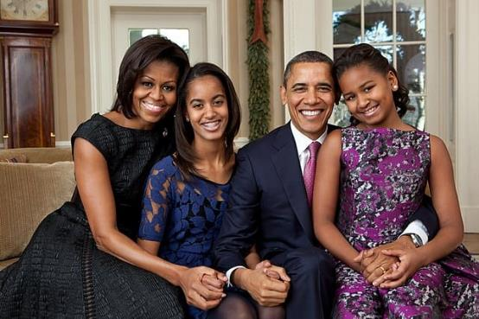
FAM
_
_
ES
FAM: n. FAMILY
Notes:
.

Slide 16
?
A F V
ONE WORD
Notes:
.

Slide 17
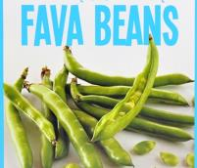
AES
FAV
_
FAV: n. A FAVORITE
also
FAVE
FAVES
FAVER
FAVEST
also FAVOURITE/S
Notes:
.

Slide 18
?
G O Y
ONE WORD
Notes:
.

Slide 19
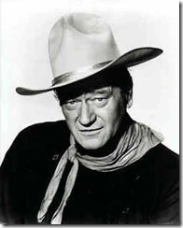
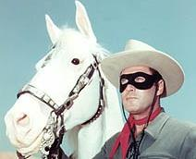
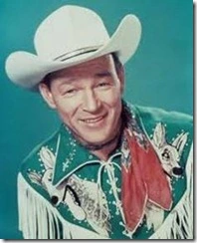
o
GOY
_
_
S
GOY: n. A NON-JEWISH PERSON
(plurals GOYS and GOYIM)
Notes:
.

Slide 20
?
H O S
FOUR WORDS
Notes:
.

Slide 21
Why play
DEGOPTW
DOS
OHS
SOH
or
_
_
_
_
SHO
_
S
When you might draw a challenge with
MPR
EST
HOS
_
_
HOS: pl. of n. HO, A PROSTITUTE
Notes:
SHOG: TO MOVE ALONG (SHOGS, SHOGGED, SHOGGING)
Shift + F5 to return to full screen

Slide 22
?
C L O
TWO WORDS
Notes:
.

Slide 23
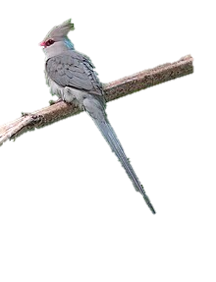
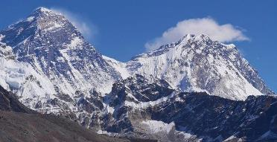
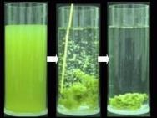
ADESTY
Why play
COL
COLY: n. AN AFRICAN BIRD (pl. COLIES)
COL: n. A DEPRESSION BETWEEN TWO MOUNTAINS
You could play
AHIKOS
LOCA: one pl. of LOCUS (also LOCI)
BF
LOC
_
FLOC: v. TO AGGREGATE INTO FLOCCULES
LOC: v. TO MAKE INTO DREADLOCKS
(LOCS, LOCING, LOCKED, LOCKING, LOCKS, LOCKABLE)
Notes:
.

Slide 24
?
N P W
ONE WORD
Notes:
.

Slide 25
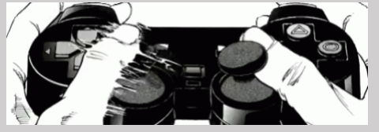
PWN
S
PWN: v. TO DOMINATE, ESPECIALLY IN COMPUTER OR VIDEO GAMES
PWNS PWNED PWNING
Notes:
There’s no word that better embodies how geeky jargon has made it into the mainstream better than “PWNED.”

Slide 26
?
A V X
ONE WORD
Notes:
.

Slide 27
VAX
X
VAX: v. TO VACCINATE
(VAXED, VAXES, VAXING)
(but also VAXX, VAXXED, VAXXES, & VAXXING)
That’s all of the NEW THREES from NWL23.
BUT HERE COME THE FOURS!
Notes:
.

Slide 28
?
A E I R
ONE WORD
Notes:
.

Slide 29
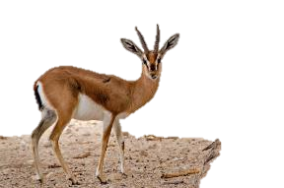
ARIE
L
ARIE: one pl. of the n. ARIA, AN ELABORATE MELODY FOR A SINGLE VOICE (also pl. ARIAS)
ARIEL: n. AN AFRICAN GAZELLE (pl. ARIELS)
Notes:
.

Slide 30
?
A O R S
FIVE WORDS
Notes:
.

Slide 31
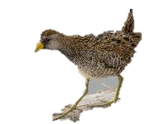
BHRS
OARS
_
_
SOAR
_
S
Why play
_
OSAR
SORA
S
OSAR: pl. of OS, A BONE
SORA: n. A MARSH BIRD
When you might draw a challenge with
FST
AROS
_
E
AROS: pl. of ARO, AN AROMANTIC, ONE LACKING ROMANTIC DESIRE
Notes:
FAROS: pl. of FARO, A CARD GAME
SAROS: n. THE ECLIPSE CYCLE OF THE SUN (pl. SAROSES)
TAROS: pl. of TARO, A TROPICAL PLANT
Shift + F5 to return to full screen

Slide 32
?
A B E S
THREE WORDS
Notes:
.

Slide 33
Why play
DRS
DRS
SABE
BASE
_
_
A
or
SABE: v. TO SAVVY, UNDERSTAND
When you might draw a challenge with
BAES
_
BAES: pl. of BAE, A SWEETHEART
Notes:
.

Slide 34
?
B H R U
TWO WORDS
Notes:
.

Slide 35
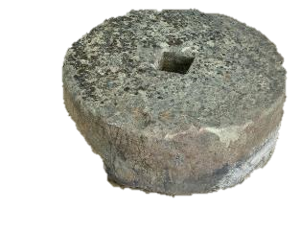
Why play
BUHR
S
BUHR: A HEAVY STONE
When you might draw a challenge with
BRUH
S
BRUH: slang BROTHER (BRO/S)
Notes:
.

Slide 36
?
A C H T
THREE WORDS
Notes:
.

Slide 37
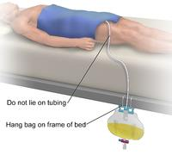
Why play
ES
_
TACH
CHAT
S
or
TACHE: n. CLASP OR BUCKLE
When you might draw a challenge with
CATH
_
S
CATH: v. CATHETERIZE (CATHS, CATHED, CATHING)
Notes:
.

Slide 38
?
C I O P
ONE WORD
Notes:
.

Slide 39
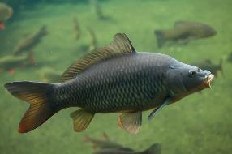
COPI
_
COPI: n. INVASIVE ASIAN CARP
(pl. COPI)
Notes:
.

Slide 40
?
A C I R
ONE WORD
Notes:
.

Slide 41
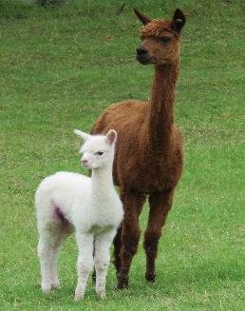
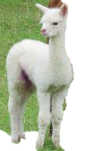
CRIA
_
S
RIA: n. A LONG NARROW INLET
CRIA: n. A BABY CAMELID
Notes:
.

Slide 42
?
C I P R
ONE WORD
Notes:
.

Slide 43
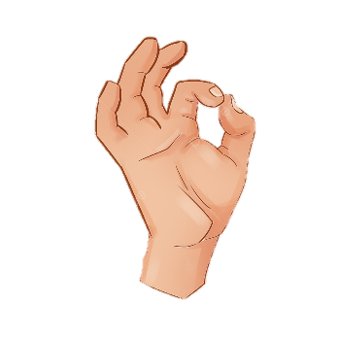
SCRIP: n. A SMALL PIECE OF PAPER
CRIPE: n. A MILD OATH (-S)
CRIP
ES
_
S
CRIP: n. SOMETHING THAT IS EASILY ACCOMPLISHED
Notes:
.

Slide 44
?
C C K U
ONE WORD
Notes:
.

Slide 45
CUCK
S
CUCK: v. TO PARTICIPATE IN AN UNFAITHFUL SEXUAL ACT
(CUCKS, CUCKED, CUCKING)
Notes:
.

Slide 46
?
D O X X
ONE WORD
Notes:
.

Slide 47
DOXX
also
DOX
DOXES
DOXED DOXING
_
DOXX: v. TO ATTACK BY PUBLISHING PRIVATE INFORMATION
(DOXXES, DOXXED, DOXXING)
Notes:
.

Slide 48
?
A F M S
ONE WORD
Notes:
.

Slide 49
FAMS
_
FAMS: pl. of FAM, FAMILY
Notes:
.

Slide 50
?
A F S V
ONE WORD
Notes:
.

Slide 51
FAVS
_
FAVS: pl. of FAV, FAVORITE (also FAVOURITE/S)
also
FAVE
FAVES
FAVER
FAVEST
Notes:
.

Slide 52
?
F L O X
ONE WORD
Notes:
.

Slide 53
FOLX
FOLX: SAME AS FOLKS, ALTHOUGH THOUGHT TO BE MORE INCLUSIVE
PHLOX: A PLANT, CAN ONLY BE SPELLED THIS WAY
FLOCS: v. TO AGGREGATE INTO FLOCCULES
Notes:
.

Slide 54
?
A G K N
ONE WORD
Notes:
.

Slide 55
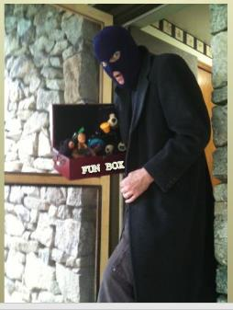
GANK
_
S
GANK: v. STEAL (GANKED, GANKING)
GAN: v. past tense of GIN, TO START or BEGIN
Notes:
.

Slide 56
?
G O S Y
ONE WORD
Notes:
.

Slide 57
GOYS
_
GOYS: one pl. of GOY, A NON-JEWISH PERSON
(also pl. GOYIM)
Notes:
.

Slide 58
?
A C G U
ONE WORD
Notes:
.

Slide 59
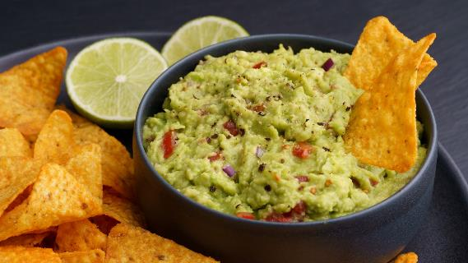
GUAC
OS
GUACO: n. A TROPICAL PLANT (pl. GUACOS)
GUAC: n. GUACAMOLE
Notes:
.

Slide 60
?
A H O S
ONE WORD
Notes:
.

Slide 61
HAOS
_
HAOS: NWL23 pl. of HAO, A MONETARY UNIT OF VIETNAM
Notes:
.

Slide 62
?
H o S S
TWO WORDS
Notes:
.

Slide 63
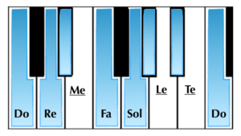
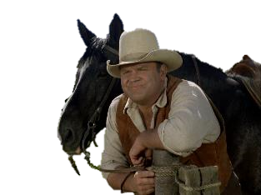
Why play
SOHS
_
_
La
SOH
You could play
HOSS
_
HOSS: n. colloq. HORSE (pl. HOSSES)
Notes:
.

Slide 64
?
D E I J
ONE WORD
Notes:
.

Slide 65
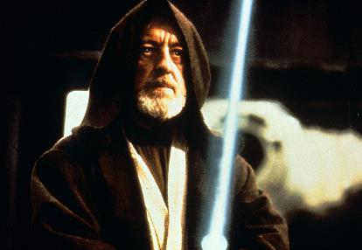
JEDI
S
JEDI: n. A PERSON WITH EXTRAORDINARY SKILLS
Notes:
.

Slide 66
?
I K O R
ONE WORD
Notes:
.

Slide 67
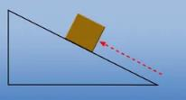
KORI
_
S
KOR: n. A HEBREW UNIT OF MEASURE (pl. KORS)
KORI: n. MONETARY UNIT OF GUINEA (also CAURI/S)
Notes:
.

Slide 68
?
A L P R
ONE WORD
Notes:
.

Slide 69
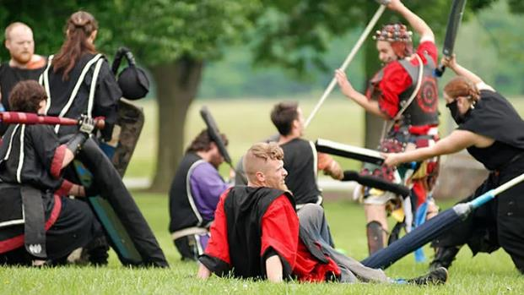
LARP
_
S
LARP: v. TO PARTICIPATE IN A LIVE-ACTION ROLE-PLAYING GAME (LARPS, LARPED, LARPING, LARPINGS! and LARPER/S!)
LAR: n. A GOD OR SPIRIT OF AN ANCIENT ROMAN HOUSEHOLD (pl. LARS)
Notes:
.

Slide 70
?
E K L W
ONE WORD
Notes:
.

Slide 71
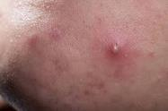
LEWK
S
LEWK: n. AN INDIVIDUAL, DISTINCTIVE, FASHION STYLE
WHELK/S: n. A PUSTULE, CAN ONLY BE SPELLED THIS WAY
Notes:
.

Slide 72
?
C L O S
TWO WORDS
Notes:
.

Slide 73
Why play
COLS
_
You could play
COLS: pl. of COL, A DEPRESSION BETWEEN TWO MOUNTAINS
BF
LOCS
_
FLOCS: v. TO AGGREGATE INTO FLOCCULES
LOCS: v. MAKES INTO DREADLOCKS
(LOCS, LOCING, LOCKED, LOCKING, LOCKS, LOCKABLE)
Notes:
.

Slide 74
?
A I M N
FOUR WORDS
Notes:
.

Slide 75
Why play
AMIN
EOS
GR
_
E
MINA
or
S
MAIN
_
A
S
MINA: n. UNIT OF WEIGHT
AMIN: n. AMINE/S
When you might draw a challenge with
ACS
MANI
_
_
MANI: n. MANICURE (pl. MANIS)
Notes:
GAMIN: AN URCHIN, A MISCHIEVOUS BOY (pl. GAMINS) RAMIN: A MALAYSIAN TREE (pl. RAMINS)
AMAIN: adv. WITH FULL STRENGTH The horses galloped amain across the open plain.
Shift + F5 to return to full screen

Slide 76
?
A G M R
TWO WORDS
Notes:
.

Slide 77
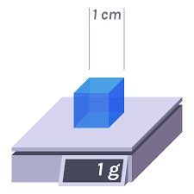
Why play
GRAMA: A PASTURE GRASS (pl. GRAMAS)
GRAM
APS
_
You could play
MARG
_
ES
MARG: n. A MARGARITA
MARGE: n. A MARGIN
Notes:
.

Slide 78
?
F I L M
TWO WORDS
Notes:
.

Slide 79
Why play
FIL: A COIN OF IRAQ & JORDAN
FILMI: MUSIC FOR INDIAN FILMS (pl. FILMIS)
FILM
ISY
_
You could play
MILF
_
S
MILF: n. AN ATTRACTIVE MATERNAL WOMAN
Notes:
.

Slide 80
?
M O P X
ONE WORD
Notes:
.

Slide 81
MPOX
_
MPOX: n. MONKEYPOX (pl. MPOXES)
Notes:
.

Slide 82
?
A E N R
THREE WORDS
Notes:
.

Slide 83
Why play
_
LY
earn
_
near
S
or
A
S
When you might draw a challenge with
_
nare
S
S
NARE: n. NOSTRIL (also NARIS)
Notes:
.

Slide 84
?
B n o o
TWO WORDS
Notes:
.

Slide 85
ABOON: adv. ABOVE
Why play
boon
_
A
S
You could play
noob
_
S
NOOB
NOOB: n. NEWCOMER, NEWBIE (also NOOBIE/S)
Notes:
.

Slide 86
?
O O P P
TWO WORDS
Notes:
.

Slide 87
Why play
S
POOP
_
Y
You could play
OPPO
S
OPPO: n. INTEL ABOUT A POLITICAL OPPONENT
Notes:
.

Slide 88
?
D E I P
TWO WORDS
Notes:
.

Slide 89
Why play
PIED
_
S
You could play
PEDI
_
S
PEDI: n. PEDICURE
Notes:
PI: 1) n. THE GREEK LETTER
2) v. TO JUMBLE OR DISORDER (PI, PIED, PIES, PIING, and PIEING!)
Shift + F5 to return to full screen

Slide 90
?
E H O P
TWO WORDS
Notes:
.

Slide 91
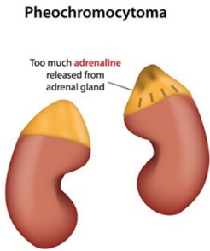
Why play
DRS
HOPE
_
_
PHEO
You could play
PHEO
S
PHEO: n. A PHEOCHROMOCYTOMA
Notes:
.

Slide 92
?
B E P U
ONE WORD
Notes:
.

Slide 93
PUBE
_
S
PUBE: n. A PUBIC HAIR
Notes:
.

Slide 94
?
N p S W
ONE WORD
Notes:
.

Slide 95
PWNS
_
PWNS: v. DOMINATES, ESPECIALLY IN COMPUTER OR VIDEO GAMES
PWN PWNS PWNED PWNING
Notes:
.

Slide 96
?
A B I R
TWO WORDS
Notes:
.

Slide 97
Why play
ABRI
S
ABRI: n. A BOMB SHELTER
when you could play
CDS
RABI
RABI: n. A SOUTH ASIAN SPRING HARVEST
RABIC: adj. PERTAINING TO RABIES
Notes:
.

Slide 98
?
D I O R
ONE WORD
Notes:
.

Slide 99
AD
ROID
S
ROID: n. AN ANABOLIC STEROID
Notes:
AROID: n. A FLOWERING PLANT
DROID: AN ANDROID, A SYNTHETIC MAN
Shift + F5 to return to full screen

Slide 100
?
A P S Z
TWO WORDS
Notes:
.

Slide 101
Why play
ZAPS
_
ZAPS: v. TO KILL OR DESTROY INSTANTANEOUSLY
when you could play
SPAZ
_
Z
SPAZ: n. ONE WHO LOSES CONTROL or v. TO LOSE CONTROL OF ONESELF
(SPAZES, SPAZZES, SPAZZED, SPAZZING)
Notes:
.

Slide 102
?
A N S T
THREE WORDS
Notes:
.

Slide 103
Why play
TANS
ANTS
_
_
Y
or
S
Y
When you could play:
TANSY: n. AN HERB
DEGKS
STAN
_
STAN: v. TO BE AN EXCESSIVELY DEVOTED FAN (STANNED, STANNING)
STANE: v. TO STONE
Notes:
.

Slide 104
?
I m s t
THREE WORDS
Notes:
.

Slide 105
Why play
SMIT: past tense SMITE
S
EH
mist
_
smit
or
Y
When you might draw a challenge with
ESY
Stim
STIME: n. A GLIMPSE (pl. STIMES)
STIM: v. TO PERFORM A REPETITIVE ACTION TO REMAIN CALM (STIMS, STIMMED, STIMMING/S)
Notes:
STIMY: v. THWART (STIMIES, STIMIED, STIMYING), same as STYMIE (STYMIES, STYMIED, STYMIEING)

Slide 106
?
A T T W
TWO WORDS
Notes:
.

Slide 107
Why play
WATT
_
_
S
WATT: n. A UNIT OF POWER
when you could play
TWAT
WAT: A HARE
_
_
S
TWAT: n. A STUPID OR ANNOYING PERSON
Notes:
.

Slide 108
?
A V X X
ONE WORD
Notes:
.

Slide 109
_
VAXX
VAXX: v. TO VACCINATE (VAXXED, VAXXES, VAXXING)
also
VAX VAXED VAXES VAXING
Notes:
.

Slide 110
?
E L P W
TWO WORDS
Notes:
.

Slide 111
Why play
PLEW
S
PLEW: n. A BEAVER SKIN
when you could play
WELP
WELP: interj. USED TO EXPRESS DISAPPOINTMENT
not a verb, not a noun, so no rear –S hook!
Notes:
.

Slide 112
?
A E J Y
ONE WORD
Notes:
.

Slide 113
YAjE
S
YAJE: n. A TROPICAL VINE OF THE AMAZON (also YAGE/S)
Notes:
.

Slide 114
?
E E T Y
TWO WORDS
Notes:
.

Slide 115
Why play
TYEE
TYEE
_
S
TYE: n. A CHAIN ON A SHIP (pl. TYES)
TYEE: n. FOOD FISH
when you could play
YEET
S
YEET: v. TO THROW RECKLESSLY (YEETED, YEETING)
Notes:
YEET means "to discard an item at a high velocity." To yeet someone, then, is to "throw" someone away, obviously metaphorically.
It also is used as an "exclamation of excitement, approval, surprise, or all-around energy, often as issued when doing a dance move or throwing something." Shift + F5 to return to full screen

Slide 116
?
E N S Z
ONE WORD
Notes:
.

Slide 117
_
ZENS
ZENS: NWL23 pl. OF ZEN, A MENTAL CALMNESS
Notes:
.

Slide 118
?
E K U Z
ONE WORD
Notes:
.

Slide 119
_
ZUKE
S
ZUKE: n. SHORT FOR ZUCCHINI
UKE: UKELELE
Notes:
.

Slide 120
That’s it for the NWL23 new 3’s and 4’s!
Notes:
.

Slide 121
Check out the slide show for the new FIVES:
But it will concentrate on the truly “new fives” and not just plurals and conjugations of new 3’s and 4’s like DOXES & ZUKES
Problems? Errors? Questions? Email Bill at williamrsnoddy@gmail.com
Notes:
.

Slide 122
Notes:
.

