Slide 1
AEERSTW
No new words from NWL23 or OWL24
Notes:
.

Slide 2
AEERSTW
IF the above alphagram does NOT show numbered Scrabble tiles,
then make sure you are viewing your downloaded version in the PowerPoint app
Notes:
.

Slide 3
AEERSTW
Use PowerPoint or Keynote in FULL SCREEN “SLIDE SHOW” mode on your LAPTOP or DESKTOP for best results
When you see the “ESCAPE KEY” ICON check speaker notes for additional information by hitting the escape key
Shift + F5 to return to full screen (or click the Џ symbol near the bottom right of your screen)
Notes:
.

Slide 4
AEERSTW
WHAT BINGO STEM
CAN BE CREATED
FROM THIS ALPHAGRAM?
Notes:
.

Slide 5
AEERSTW
SWEATER
THERE ARE NO OTHER GOOD WORDS FROM THIS ALPHAGRAM
Notes:
.

Slide 6
SWEATER
WHAT MNEMONIC PHRASE CAN WE ASSOCIATE WITH THIS BINGO STEM?
Notes:
.

Slide 7
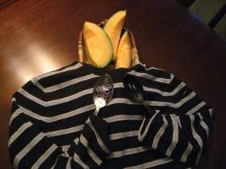
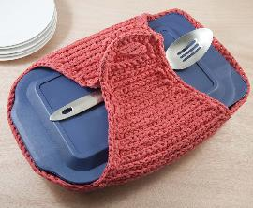
SWEATER
WARMS DISH
Notes:
SWEATER: “WARMS DISH”

Slide 8
SWEATER W
AEERSTWW
ONE WORD
Notes:
.

Slide 9
AEERSTWW
WETWARES
_
WETWARES: pl. of WETWARE, THE BRAIN WHEN CONSIDERED AS FUNCTIONALLY LIKE A COMPUTER
Notes:
.

Slide 10
SWEATER A
AAEERSTW
TWO WORDS
Notes:
.

Slide 11
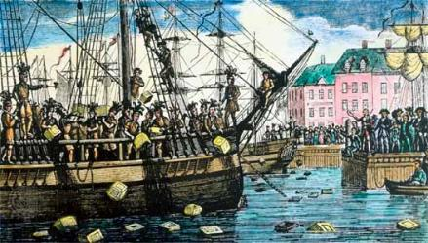
AAEERSTW
SEAWATER
TEAWARES
S
_
Notes:
.

Slide 12
SWEATER R
AEERRSTW
ONE WORD
Notes:
.

Slide 13
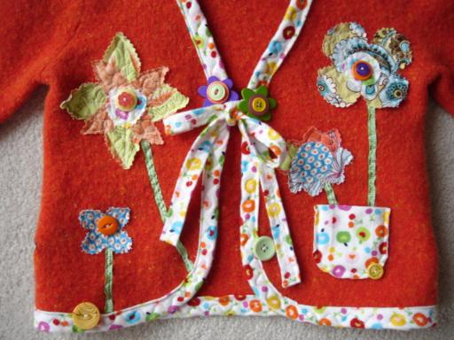
AEERRSTW
WATERERS
_
Notes:
.

Slide 14
SWEATER M
AEEMRSTW
ONE WORD
Notes:
.

Slide 15
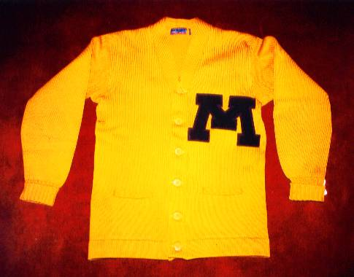
AEEMRSTW
STEMWARE
S
SWEATER WITH AN M AND STEMWARE!
HOOK/S?
STEMWARES
Notes:
.

Slide 16
SWEATER S
AEERSSTW
ONE WORD
Notes:
.

Slide 17
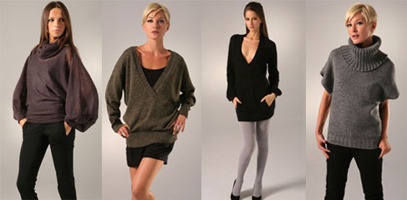
AEERSSTW
SWEATERS
_
Notes:
.

Slide 18
SWEATER D
ADEERSTW
TWO WORDS
Notes:
.

Slide 19
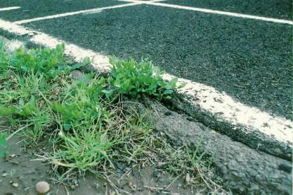
ADEERSTW
DEWATERS
TARWEEDS
_
_
DEWATER
TARWEED
[ ]
WATERED
SEDATER + W SWEATER + D
Notes:
SEDATER: “GET BEER WITH CIDER, MILK (FEEL SLEEPY)”
SWEATER: “WARMS DISH”

Slide 20
SWEATER I
AEEIRSTW
THERE ARE THREE!
Notes:
.

Slide 21
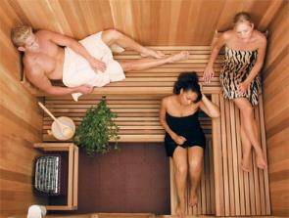
AEEIRSTW
SWEATIER
WASTERIE
WEARIEST
S
_
HOOK/S?
pl. WASTERIES
WASTERIE: WASTRY, RECKLESS EXTRAVAGANCE (WASTERY, WASTERIES & WASTRIE/S)
SHE WAS THE SWEATIER OF THE TWO WOMEN ENJOYING THE WASTERIE OF A SWEATBOX (SAUNA) AND HE WAS THE WEARIEST OF THE THREE.
WAITERS + E SERIATE + W SWEATER + I
Notes:
WAITERS: “HIRED MEN TAKE TIPS”
SERIATE: “HELPED MY NEW TERMS”
SWEATER: “WARMS DISH”

Slide 22
SWEATER H
AEEHRSTW
TWO WORDS
Notes:
.

Slide 23
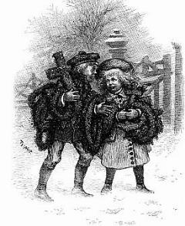
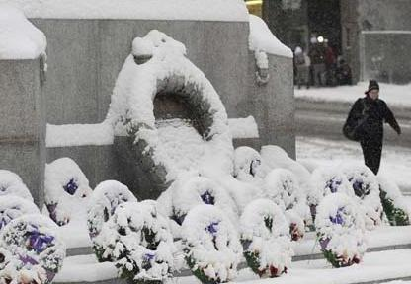
AEEHRSTW
WEATHERS
WREATHES
_
_
WEATHER
WREATHE
[ ]
WHEREAT
Notes:
.

Slide 24
SWEATER
BINGOS WORTH REVIEWING:
DEWATERS TARWEEDS WASTERIE WETWARES
Notes:
.

Slide 25
SWEATER
WHAT WAS THAT MNEMONIC PHRASE?
Notes:
.

Slide 26
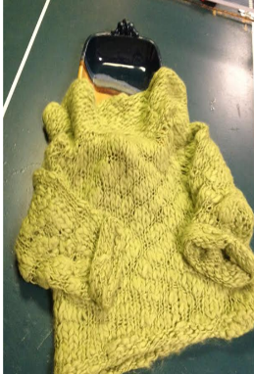
SWEATER
WARMS DISH
Notes:
.

Slide 27
SWEATER.
Notes:
.

Slide 28
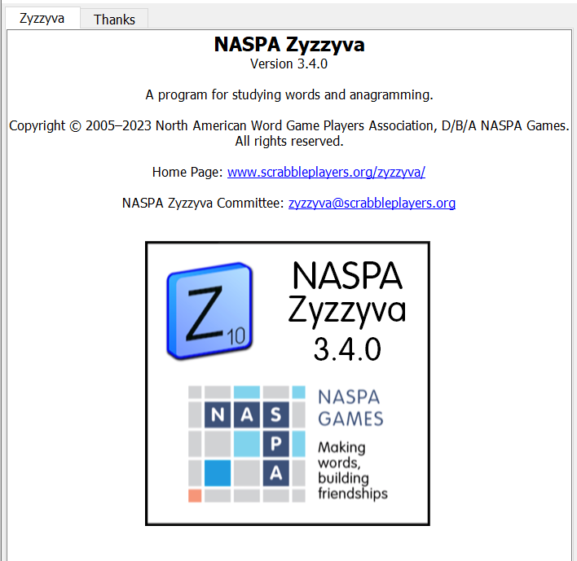
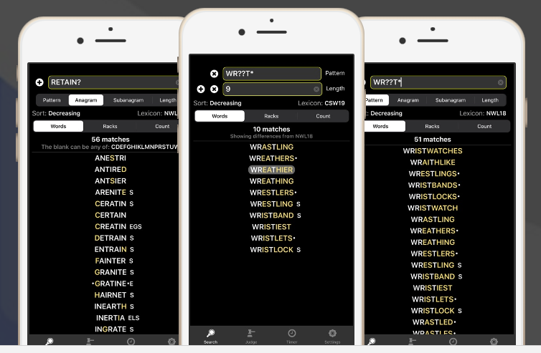
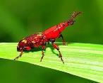
SEND suggestions or requests for additional PowerPoint slide shows to: williamrsnoddy@gmail.com
“Hey, Bill…”
Notes:
.

Slide 29
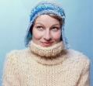
THE END
Notes:
.

