Slide 1
AEIMNOS
No new words from NWL23 or OWL24
Notes:
.

Slide 2
AEIMNOS
IF the above alphagram does NOT show numbered Scrabble tiles,
then make sure you are viewing your downloaded version in the PowerPoint app
Notes:
.

Slide 3




AEIMNOS
Use PowerPoint or Keynote in FULL SCREEN “SLIDE SHOW” mode on your LAPTOP or DESKTOP for best results
When you see the “ESCAPE KEY” ICON check speaker notes for additional information by hitting the escape key
Shift + F5 to return to full screen (or click the Џ symbol near the bottom right of your screen)
Notes:
.

Slide 4
AEIMNOS
ONLY ONE 7-LETTER WORD
CAN SERVE AS A BINGO STEM:
Notes:
.

Slide 5
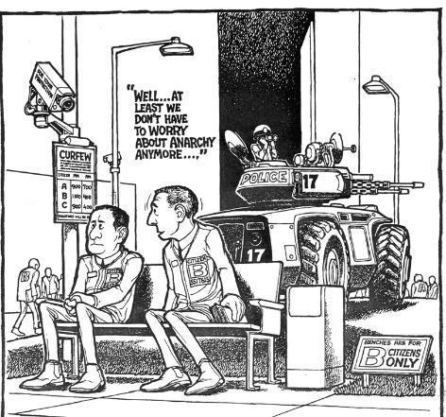
AEIMNOS
ANOMIES
_
ANOMIES: pl. of ANOMY (& ANOMIE) A TIME OF SOCIAL INSTABILITY
“WELL, AT LEAST WE DON’T HAVE TO WORRY ABOUT ANOMIES ANYMORE”
INSEAM + O I-ON-SEA + M
Notes:
INSEAM: “CARE FOR A GOOD JOKE? HOW TALL HE SEAMS!
I-ON-SEA: *MaD MiMiC aToP GRaVeL (*CoNSoNaNTS oNLY)

Slide 6
ANOMIES
WHAT MNEMONIC PHRASE CAN WE ASSOCIATE WITH THIS BINGO STEM?
Notes:
.

Slide 7

ANOMIES
*aDMiRe ouTLaWS
*CoNSoNaNTS oNLY
Notes:
ANOMIES: *aDMiRe ouTLaWS (*CoNSoNaNTS oNLY)

Slide 8
ANOMIES
D
ADEIMNOS
THERE ARE THREE!
Notes:
.

Slide 9
ADEIMNOS
AMIDONES
DAIMONES
DOMAINES
_
AMIDONES: pl. of AMIDONE, A CHEMICAL COMPOUND
STICKY
DAIMONES: one pl. of DAIMON, AN ATTENDANT SPIRIT (also pl. DAIMONS)
_
DOMAINES: pl. of DOMAINE, A VINEYARD IN BURGUNDY
ANODISE + M ANOMIES + D
Notes:
ANODISE: *ZaX aBHoRReD aeSTHeTiC MuGS (*CoNSoNaNTS oNLY)
ANOMIES: *aDMiRe ouTLaWS (*CoNSoNaNTS oNLY)

Slide 10
ANOMIES
M
AEIMMNOS
ONE WORD
Notes:
.

Slide 11
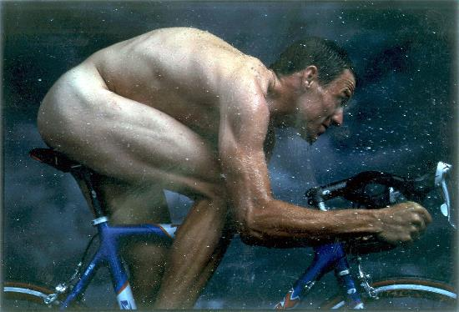

AEIMMNOS
SEMINOMA
D
s
SEMINOMA: A MALIGNANT TUMOR OF THE TESTIS
YES, MON AMIES, I HAD A SEMINOMA
Lance
HOOK/S?
SEMINOMAD & SEMINOMAS (also pl. SEMINOMATA)
Notes:
.

Slide 12
ANOMIES
R
AEIMNORS
THERE ARE THREE!
Notes:
.

Slide 13

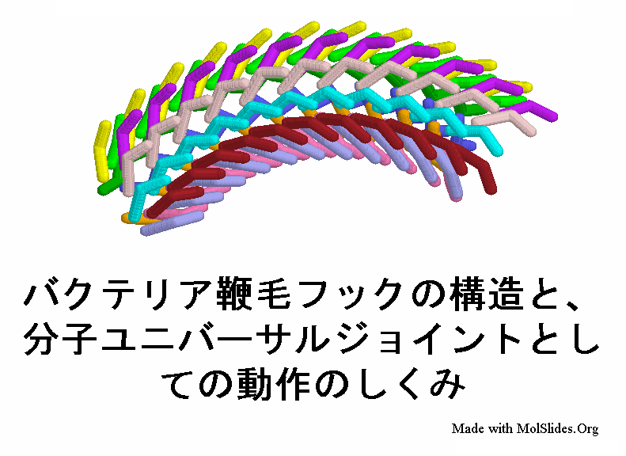
AEIMNORS
_
MORAINES
ROMAINES
ROMANISE
_
D
S
ROMANISE: TO WRITE USING THE ROMAN ALPHABET
(ROMANISED, ROMANISES, ROMANISING ) [AND WITH Z’S]
TO ROMANISE: THERE ARE ROMAINES NEAR THE MORAINES!
ERASION + M
ANOMIES + R
Notes:
ERASION: *BaFFLiNG SoMe DeTeCTiVeS (*CoNSoNaNTS Only)
ANOMIES: *aDMiRe ouTLaWS (*CoNSoNaNTS oNLY)
The 26 letter Latin alphabet is also called the Roman alphabet. Shift + F5 to return to full screen

Slide 14
ANOMIES
T
AEIMNOST
THERE ARE THREE!
Notes:
.

Slide 15
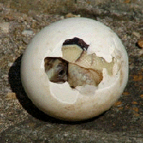

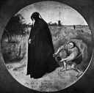
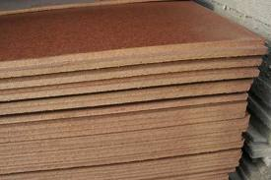
AMNIOTES
MASONITE
MISATONE
AEIMNOST
_
s
MISATONE: TO ATONE WRONGLY
D
s
ATONIES + M INMATES + O MOISTEN + A ANOMIES + T
MASONITE: A FIBERBOARD
Notes:
ATONIES: *uNBRaCeD LiMPNeSS (*CoNSoNaNTS oNLY)
INMATES: “GANEFS OR BLOCKHEADS?”
MOISTEN: “GOOD PANCAKES”
ANOMIES: *aDMiRe ouTLaWS (*CoNSoNaNTS oNLY)

Slide 16
ANOMIES
L
AEILMNOS
TWO WORDS
Notes:
.

Slide 17

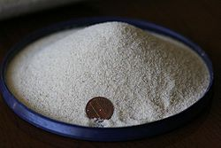


AEILMNOS
LAMINOSE
SEMOLINA
s
LAMINOSE: adj. COMPOSED OF LAMINAE, THIN SCALES, PLATES, OR LAYERS
SEMOLINA: A GRANULAR PRODUCT OF WHEAT USED FOR PASTA
ANISOLE + M ANOMIES + L
Notes:
ANISOLE: *TRaPPiNG MuSKoX (*CoNSoNaNTS oNLY)
ANOMIES: *aDMiRe ouTLaWS (*CoNSoNaNTS oNLY)

Slide 18
ANOMIES
W
AEIMNOSW
ONE WORD
Notes:
.

Slide 19



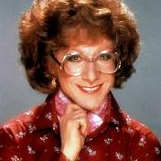
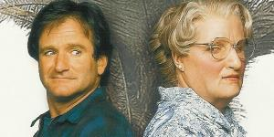
AEIMNOSW
D
WOMANISE
R
s
WOMANISE WOMANISED WOMANISER WOMANISES WOMANISING
ALSO WITH A Z: WOMANIZE WOMANIZED WOMANIZER
WOMANIZES WOMANIZING
Notes:
It was surprising to me to learn that to WOMANISE means “to make effeminate”
Shift + F5 to get back to full screen

Slide 20
ANOMIES
S
AEIMNOSS
ONE WORD
Notes:
.

Slide 21

AEIMNOSS
ANEMOSIS
THE PLURAL?
SAMISEN + O
ANOMIES + S
ANEMOSES
ANEMOSIS: A CONDITION IN THE WOOD OF SOME TREES IN WHICH THE RINGS ARE SEPARATED, AS SOME SUPPOSE, BY THE ACTION OF HIGH WINDS UPON THE TRUNK.
Notes:
SAMISEN: “STRUMMED JAZZ AT GO MATCH”
ANOMIES: *aDMiRe ouTLaWS (*CoNSoNaNTS oNLY)

Slide 22
ANOMIES
THAT’S IT! THE DIFFICULT BINGOS:
AMIDONES ANEMOSIS
DOMAINES LAMINOSE
MISATONE ROMANISE
SEMOLINA DOMAINES
SEMINOMA MASONITE
Notes:
.

Slide 23
ANOMIES
WHAT WAS THAT MNEMONIC PHRASE?
Notes:
.

Slide 24
ANOMIES
*aDMiRe ouTLaWS
*CoNSoNaNTS oNLY
Notes:
.

Slide 25
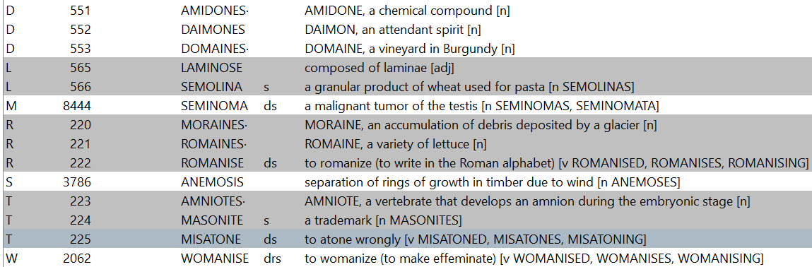
ANOMIES.
Notes:
.

Slide 26
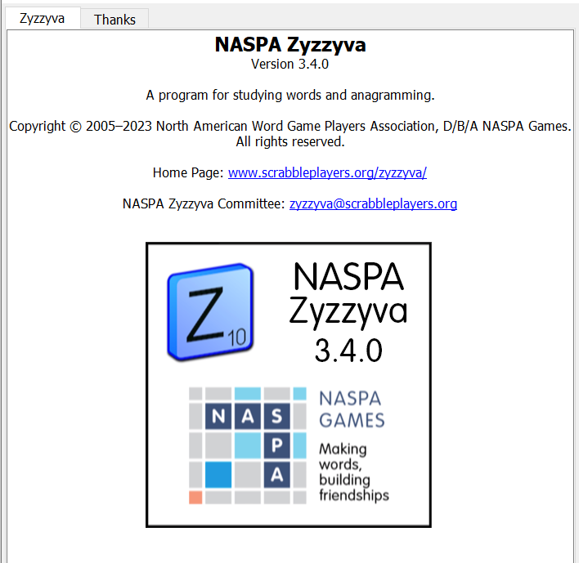
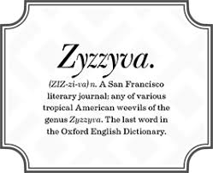
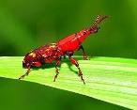
SEND suggestions or requests for additional PowerPoint slide shows to: williamrsnoddy@gmail.com
“Hey, Bill…”
Notes:
.

Slide 27



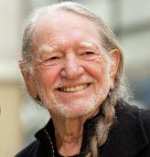

THE END
*aDMiRe ouTLaWS
Notes:
.

