Slide 1
AEENRRS
No new words from NWL23 or OWL24
Notes:
.

Slide 2
AEENRRS
IF the above alphagram does NOT show numbered Scrabble tiles,
then make sure you are viewing your downloaded version in the PowerPoint app
Notes:
.

Slide 3
AEENRRS
Use PowerPoint or Keynote in FULL SCREEN “SLIDE SHOW” mode on your LAPTOP or DESKTOP for best results
When you see the “ESCAPE KEY” ICON check speaker notes for additional information by hitting the escape key
Shift + F5 to return to full screen (or click the Џ symbol near the bottom right of your screen)
Notes:
.

Slide 4
AEENRRS
OF THE TWO 7-LETTER WORDS, WHICH IS THE BEST BINGO STEM FOR THIS ALPHAGRAM?
Notes:
.

Slide 5
AEENRRS
EARNERS
ERASER + N
RANEES + R
THE OTHER GOOD WORD IS REEARNS
Notes:
ERASER: “WIPING FINDS VICTIM’S THUMBPRINT”
RANEES: “OPT TO LOOK DOWN ON COMMON GROTTO”

Slide 6
EARNERS
WHAT MNEMONIC PHRASE CAN WE ASSOCIATE WITH THIS BINGO STEM?
Notes:
.

Slide 7
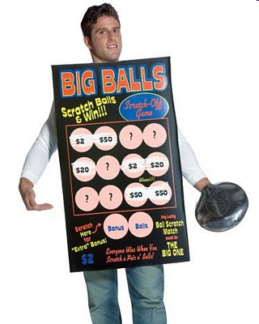
EARNERS
VOW: “NO LOONY LOTTOS”
Notes:
.

Slide 8
EARNERS V
AEENRRSV
ONE WORD
Notes:
.

Slide 9
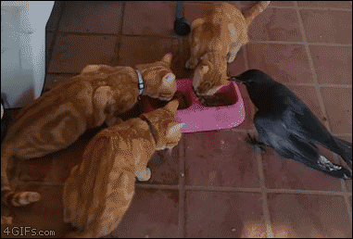
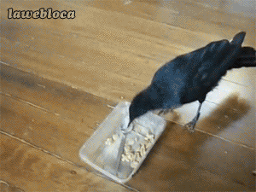
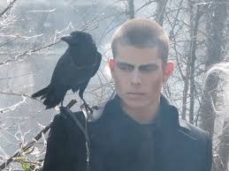
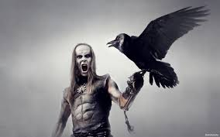
AEENRRSV
RAVENERS
_
RAVENERS: pl. of n. RAVENER, ONE THAT RAVENS, OR EATS IN A RAVENOUS WAY
Also adj. RAVEN, RAVENER, RAVENEST
But FALCONER…is noun only.
Notes:
.

Slide 10
EARNERS O
AEENORRS
ONE WORD
Notes:
.

Slide 11
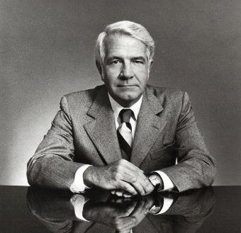
AEENORRS
REASONER
S
REASONER: ONE THAT REASONS
Notes:
.

Slide 12
EARNERS W
AEENRRSW
ONE WORD
Notes:
.

Slide 13
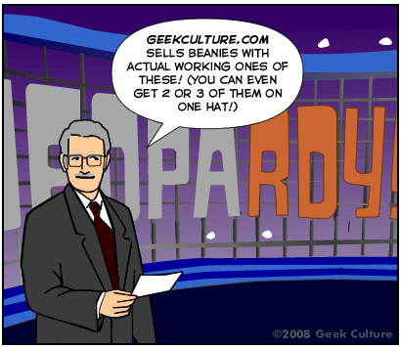
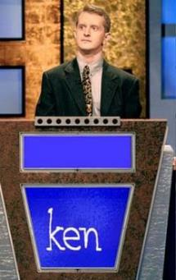
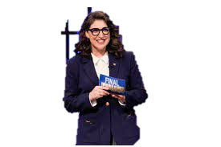
AEENRRSW
ANSWERER
S
What is a W?
“Ken, you are one of our top EARNERS, what letter would solve this problem? ANS_ERER
Notes:
.

Slide 14
EARNERS N
AEENNRRS
ONE WORD
Notes:
.

Slide 15
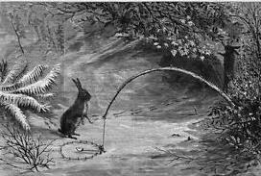
AEENNRRS
ENSNARER
_
S
YES, INSNARER AND INSNARERS ARE ALSO GOOD WORDS.
Notes:
.

Slide 16
EARNERS L
AEELNRRS
TWO WORDS
Notes:
.

Slide 17
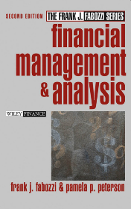
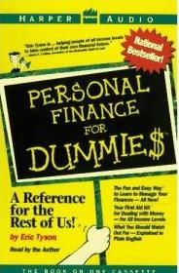
AEELNRRS
_
_
LEARNERS
RELEARNS
_
Notes:
.

Slide 18
EARNERS Y
AEENRRSY
ONE WORD
Notes:
.

Slide 19
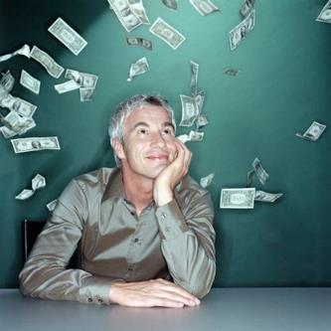
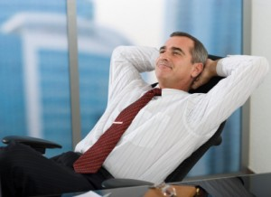
AEENRRSY
YEARNERS
_
_
Notes:
.

Slide 20
EARNERS T
AEENRRST
ONE WORD
Notes:
.

Slide 21
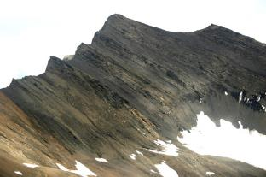
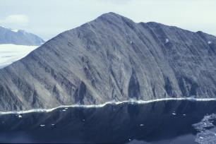
AEENRRST
TERRANES
_
TERRANES: pl. of TERRANE, A ROCK FORMATION
EASTERN + R EARNERS + T
Notes:
EASTERN: “BROUGHT JOVIAL FACES”
EARNERS: “VOW: ‘NO LOONY LOTTOS’”

Slide 22
EARNERS S
AEENRRSS
ONE WORD
Notes:
.

Slide 23
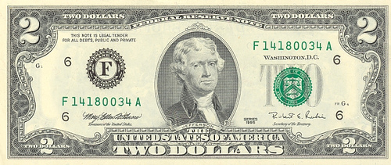
AEENRRSS
RARENESS
Notes:
.

Slide 24
EARNERS
THAT’S IT!
BINGOS WORTH REVIEWING:
TERRANES
RARENESS
RAVENERS
Notes:
.

Slide 25
EARNERS
WHAT WAS THAT MNEMONIC PHRASE?
Notes:
.

Slide 26
EARNERS
VOW: “NO LOONY LOTTOS”
Notes:
.

Slide 27
EARNERS.
Notes:
.

Slide 28
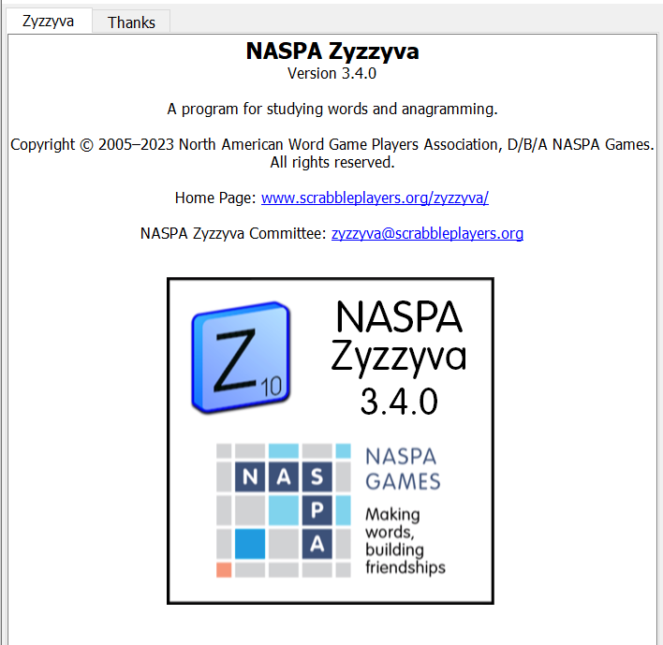
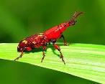
SEND suggestions or requests for additional PowerPoint slide shows to: williamrsnoddy@gmail.com
“Hey, Bill…”
Notes:
.

Slide 29
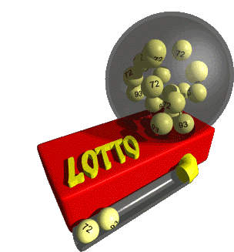
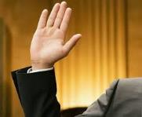
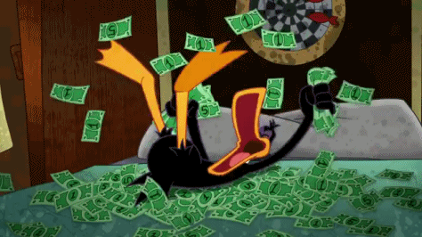
THE END!
VOW:
“NO LOONY LOTTOS”
Notes:
.

