Slide 1
AEIRSTW
No new words from NWL23 or OWL24
Notes:
.

Slide 2
AEIRSTW
IF the above alphagram does NOT show numbered Scrabble tiles,
then make sure you are viewing your downloaded version in the PowerPoint app
Notes:
.

Slide 3




AEIRSTW
Use PowerPoint or Keynote in FULL SCREEN “SLIDE SHOW” mode on your LAPTOP or DESKTOP for best results
When you see the “ESCAPE KEY” ICON check speaker notes for additional information by hitting the escape key
Shift + F5 to return to full screen (or click the Џ symbol near the bottom right of your screen)
Notes:
.

Slide 4
AEIRSTW
WHAT FOUR WORDS
CAN BE CREATED
FROM THIS ALPHAGRAM?
THIS IS SATIRE + W, SO:
Notes:
SATIRE: “BAD SPEECH REVIEW, FLAMING WIT”

Slide 5
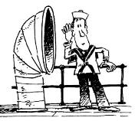
AEIRSTW
WAISTER
WAITERS
WARIEST
WASTRIE
WAISTER: A SEAMAN STATIONED IN THE MIDDLE OF A SHIP
WASTRIE: RECKLESS EXTRAVAGANCE (also WASTRY, WASTERY, & WASTERIE)
Notes:
.

Slide 6
AEIRSTW
WAISTER
WAITERS
WARIEST
WASTRIE
AND THE ONE TO CHOOSE FOR A BINGO STEM?
Notes:
.

Slide 7
WAITERS
WHAT MNEMONIC PHRASE CAN WE ASSOCIATE WITH THIS BINGO STEM?
Notes:
.

Slide 8
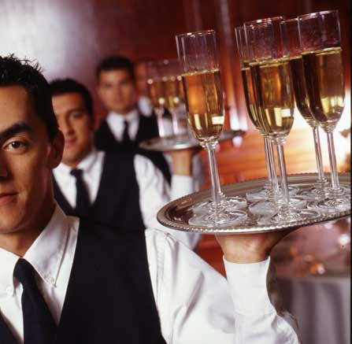
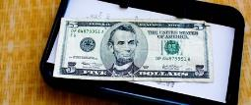
WAITERS
HIRED MEN TAKE TIPS
Notes:
WAITERS: “HIRED MEN TAKE TIPS”

Slide 9
WAITERS
H
AEHIRSTW
ONE WORD
Notes:
.

Slide 10
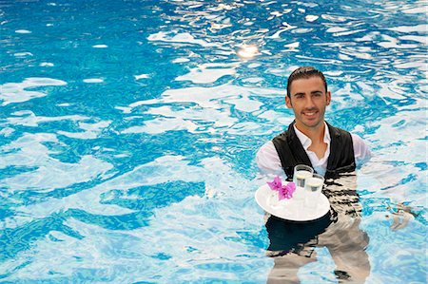
AEHIRSTW
WATERISH
WATERISH: adj. WATERY (WATERIER, WATERIEST)
HASTIER + W
WAITERS + H
Notes:
HASTIER: “PC? I WARNED YOU!”
WAITERS: “HIRED MEN TAKE TIPS”

Slide 11
WAITERS
I
AEIIRSTW
ONE WORD
Notes:
.

Slide 12

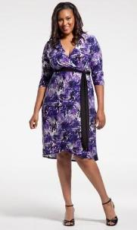

AEIIRSTW
WISTERIA
S
WISTERIA: A FLOWERING SHRUB (also WISTARIA/S)
AIRIEST + W
WAITERS + I
HOOK/S?
WISTERIAS
Notes:
AIRIEST: *ZaX iNHaLeS oPiuM aiRFLoW (*CoNSoNaNTS oNLY)
WAITERS: “HIRED MEN TAKE TIPS”

Slide 13
WAITERS
R
AEIRRSTW
ONE WORD
Notes:
.

Slide 14
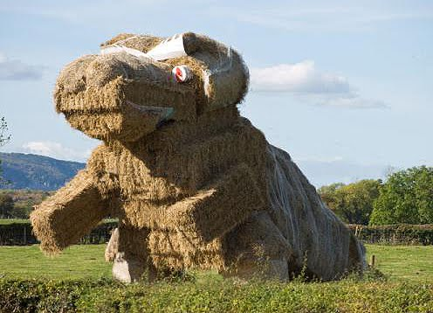
AEIRRSTW
STRAWIER
STRAWIER: MORE RESEMBLING STRAW (STRAWY, STRAWIEST)
TARRIES + W WAITERS + R
Notes:
TARRIES: “BELCHER WON’T SPLIT”
WAITERS: “HIRED MEN TAKE TIPS”

Slide 15
WAITERS
E
AEEIRSTW
THREE WORDS!
Notes:
.

Slide 16

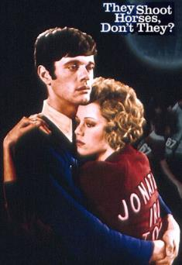
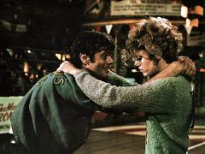
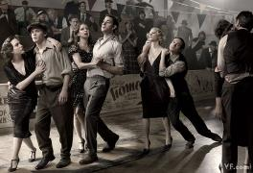
AEEIRSTW
SWEATIER
WASTERIE
WEARIEST
S
_
WASTERIE: n. THE SAME AS WASTRY, RECKLESS EXTRAVAGANCE
(pl. WASTERIES)
SWEATER + I SERIATE + W WAITERS + E
Notes:
WEARY: v. TO MAKE WEARY (WEARIES, WEARIED, WEARYING)
Shift + F5 to get back to full screen or click the Џ symbol near the bottom right of your screen)
SWEATER: “WARMS DISH”
SERIATE: “HELPED MY NEW TERMS”
WAITERS: “HIRED MEN TAKE TIPS”

Slide 17
WAITERS
D
ADEIRSTW
ONE WORD
Notes:
.

Slide 18
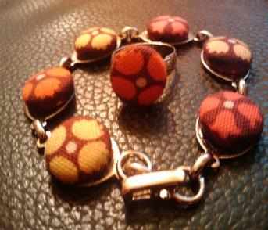
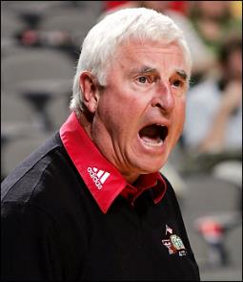
ADEIRSTW
TAWDRIES
T
TAWDRIES: pl. of n. TAWDRY, MEANING GAUDY FINERY
TIRADES + W
WAITERS + D
HOOK/S?
TAWDRY CAN ALSO BE AN ADJ. MEANING GAUDY
(TAWDRIER, TAWDRIEST plus adv. TAWDRILY)
Notes:
TIRADES: “WOMEN’S SPEECHES BLASTED MEN”
WAITERS: “HIRED MEN TAKE TIPS”

Slide 19
WAITERS
M
AEIMRSTW
ONE WORD
Notes:
.

Slide 20

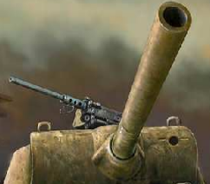

AEIMRSTW
_
WARTIMES
SMARTIE + W WAITERS + M
Notes:
SMARTIE: “VALUES KNOWING (EXPECTS DUMBNESS)”
WAITERS: “HIRED MEN TAKE TIPS”

Slide 21
WAITERS
N
AEINRSTW
ONE WORD
Notes:
.

Slide 22
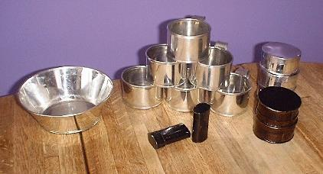

AEINRSTW
TINWARES
_
TINWARES: pl. of TINWARE, ARTICLES MADE OF TINPLATE
NASTIER + W WAITERS + N
Notes:
NASTIER: “WICKED HORRIBLE FANG STUMPS!”
WAITERS: “HIRED MEN TAKE TIPS”

Slide 23
WAITERS
T
AEIRSTTW
ONE WORD
Notes:
.

Slide 24
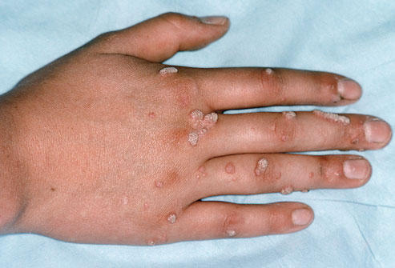
AEIRSTTW
WARTIEST
_
STRIATE + W WAITERS + T
Notes:
STRIATE: “PENNED ZEBRAS AND MADDEST CLOWNS”
WAITERS: “HIRED MEN TAKE TIPS”

Slide 25
WAITERS
A
AAEIRSTW
ONE WORD
Notes:
.

Slide 26
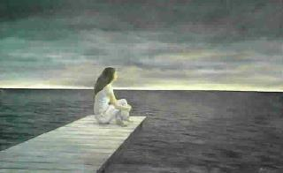
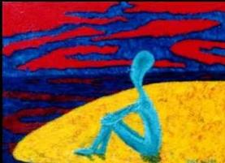
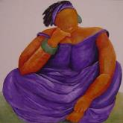
AAEIRSTW
_
_
AWAITERS
Notes:
.

Slide 27
WAITERS
K
AEIKRSTW
ONE WORD
Notes:
.

Slide 28
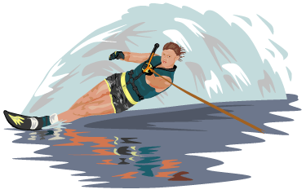
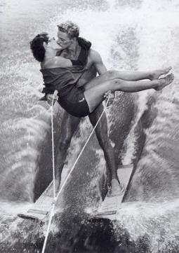
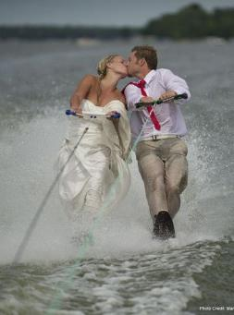
AEIKRSTW
WATERSKI
S
WATERSKI: A SKI FOR SKIING ON WATER
WATER KISS on WATERSKIS
Note: STRANGELY NOT A VERB (“SKI” CAN BE A VERB.) SO, NO waterskied* BUT WATERSKIING IS A SPORT AND TAKES AN S FOR WATERSKIINGS

Slide 29
WAITERS
P
AEIPRSTW
ONE WORD
Notes:
.

Slide 30
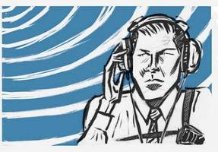

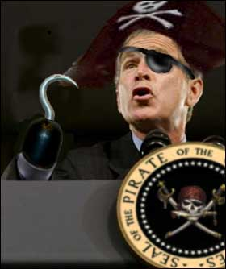
AEIPRSTW
WIRETAPS
_
WIRETAPS: VERB! INTERCEPTS MESSAGES BY MEANS OF A CONCEALED MONITORING DEVICE (WIRETAP, WIRETAPPED, WIRETAPPING)
PIRATES + W WAITERS + P
Notes:
PIRATES: “TEN ARMED SCALAWAGS INVADE MY OAKEN SHIP”
WAITERS: “HIRED MEN TAKE TIPS”

Slide 31
WAITERS
S
AEIRSSTW
THREE WORDS!
Notes:
.

Slide 32
AEIRSSTW
WAISTERS
WAITRESS
WASTRIES
_
_
WAISTERS: pl. of WAISTER, A SEAMAN
WASTRIES: pl. of WASTRIE, A RECKLESS EXTRAVAGANCE (also WASTRY & WASTERIE/S)
Notes:
.

Slide 33
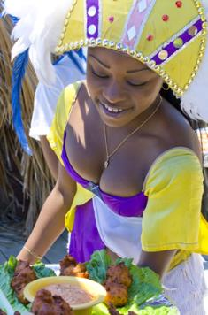
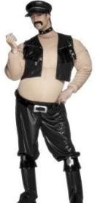
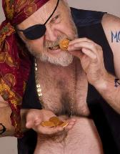
AEIRSSTW
WAISTERS
WAITRESS
WASTRIES
THE WAISTERS WERE SERVED BY THIS WAITRESS DESPITE THEIR WASTRIES!
Notes:
.

Slide 34
WAITERS
THAT’S IT! BINGOS WORTH A REVIEW:
STRAWIER TAWDRIES
WAISTERS WATERISH
WISTERIA WASTERIE
WASTRIES
WATERSKI
Notes:
.

Slide 35
WAITERS
WHAT WAS THAT MNEMONIC PHRASE?
Notes:
.

Slide 36
WAITERS
HIRED MEN TAKE TIPS
Notes:
WAITERS: “HIRED MEN TAKE TIPS”

Slide 37
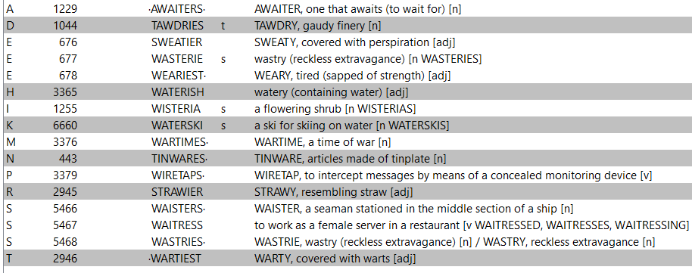
WAITERS
Notes:
.

Slide 38
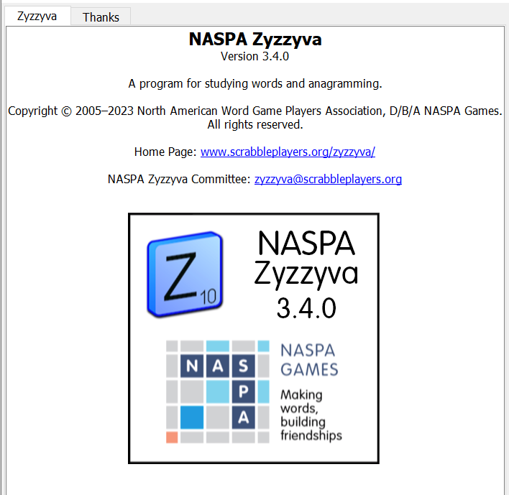

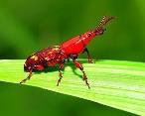
SEND suggestions or requests for additional PowerPoint slide shows to: williamrsnoddy@gmail.com
“Hey, Bill…”
Notes:
.

Slide 39



THE END!
WAITERS
HIRED MEN TAKE TIPS
Notes:
.

