Slide 1
ADEILRT
No new words from NWL23 or OWL24
Notes:
.

Slide 2
ADEILRT
IF the above alphagram does NOT show numbered Scrabble tiles,
then make sure you are viewing your downloaded version in the PowerPoint app
Notes:
.

Slide 3
ADEILRT
Use PowerPoint or Keynote in FULL SCREEN “SLIDE SHOW” mode on your LAPTOP or DESKTOP for best results
When you see the “ESCAPE KEY” ICON check speaker notes for additional information by hitting the escape key
Shift + F5 to return to full screen (or click the Џ symbol near the bottom right of your screen)
Notes:
.

Slide 4
ADEILRT
OF THE FOUR 7-LETTER WORDS, WHICH SHOULD WE USE AS A BINGO STEM?
Notes:
.

Slide 5
ADEILRT
TRAILED
THE OTHER GOOD WORDS: REDTAIL, DILATER & TRIALED
DIALER + T, TIRADE + L, RETAIL + D
Notes:
DIALER: “CALLED UP YOUR BRAVEST G.I.”
TIRADE: “SHARP TALK BY AN ANGRY, SAVVY MAN”
RETAIL: “CHUMP-Y LENDER TURNS BUCKS”

Slide 6
TRAILED
WHAT MNEMONIC PHRASE CAN WE ASSOCIATE WITH THIS BINGO STEM?
Notes:
.

Slide 7
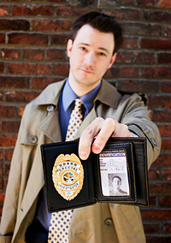
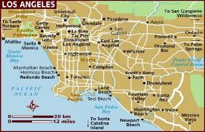
TRAILED
L.A. COP’S BEAT
Notes:
TRAILED: “L.A. COP’S BEAT”
You can surmise that the phrase is not “consonants only” because: 1) there are more consonants than vowels in the stem
2) The phrase only has three vowels, not four or five vowels like most (*CoNSoNaNTS oNLY) phrases
3) Quickly test the E and find the easy anagrams DETAILER and RETAILED plus ELATERID and know that it is therefore not “consonants only”
Shift + F5 to return to full screen (or click the Џ symbol near the bottom right of your screen)

Slide 8
TRAILED L
ADEILLRT
ONE WORD
Notes:
.

Slide 9
ADEILLRT
TRIALLED
TRIALLED: v. TO TEST SOMETHING TO ASSESS IT’S PERFORMANCE
TRIAL
TRIALS
TRIALED
TRIALING
TRIAL
TRIALS
TRIALLED
TRIALLING
Notes:
.

Slide 10
TRAILED A
AADEILRT
ONE WORD
Notes:
.

Slide 11
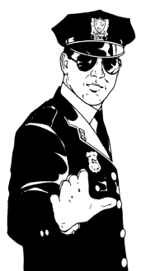
AADEILRT
LARIATED
STICKY
LARIATED: LASSOED. LARIAT IS A VERB MEANING TO LASSO (LARIAT, LARIATS, LARIATED, LARIATING)
Notes:
.

Slide 12
TRAILED C
ACDEILRT
TWO WORDS
Notes:
.

Slide 13
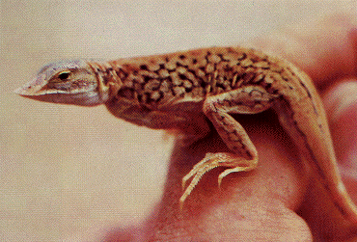
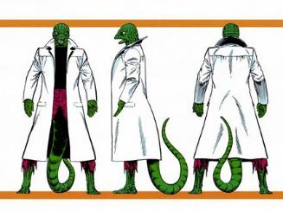
ACDEILRT
ARTICLED
LACERTID
_
ARTICLED: v. CHARGED WITH A SPECIFIC OFFENSE (ARTICLE, ARTICLED, ARTICLES, ARTICLING)
S
LACERTID: A TYPE OF LIZARD
(pl. LACERTIDS)
“HAVING BEEN ARTICLED TWICE BEFORE FOR THIS SAME OFFENSE, THIS LACERTID NEEDED ANOTHER THREE-VIEW MUG SHOT.”
Notes:
.

Slide 14
TRAILED O
ADEILORT
TWO WORDS
Notes:
.

Slide 15
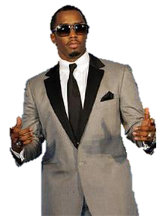
ADEILORT
IDOLATER
TAILORED
S
STICKY
IDOLATER: ONE THAT WORSHIPS IDOLS
OH, PUFF DADDY HAS MANY AN IDOLATER, AND CAN WELL AFFORD THIS TAILORED SUIT.
ALE-RIOT + D DARIOLE + T
ROAD-TIE + L
TRAILED + O
(also IDOLATOR/S)
Notes:
ALE-RIOT: “MVP BEDRENCHED FEZ”
DARIOLE: *VeXT, GaL eaTS (*CoNSoNaNTS oNLY)
ROAD-TIE: *TRuCKMaN’S SoLe CRaVaT (*CoNSoNaNTS oNLY)
TRAILED: “L.A. COP’S BEAT”

Slide 16
TRAILED P
ADEILPRT
TWO WORDS
Notes:
.

Slide 17
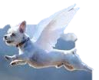
ADEILPRT
DIPTERAL
TRIPEDAL
_
DIPTERAL: adj. HAVING 2 WINGS
TRIPEDAL: adj. HAVING THREE FEET
WISHING HE WERE DIPTERAL, THIS TRIPEDAL DOG IS DREAMING.
Notes:
.

Slide 18
TRAILED S
ADEILRST
THERE ARE THREE!
Notes:
,

Slide 19
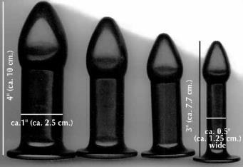
ADEILRST
DILATERS
LARDIEST
REDTAILS
_
_
Uhh…no.
DIALERS + T RETAILS + D TIRADES + L DILATES + R TRAILED + S
Notes:
DIALERS: “BELL COMPANY NUT” RETAILS: “I GET CRUMPLED STUFF, BUNK!”
TIRADES: “WOMEN’S SPEECHES BLASTED MEN” DILATES: “GREYED MYOPIC EYE”
TRAILED: “L.A. COP’S BEAT”

Slide 20
TRAILED B
ABDEILRT
ONE WORD
Notes:
.

Slide 21
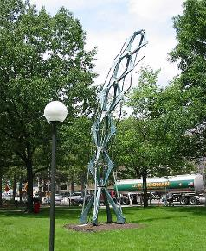
ABDEILRT
LIBRATED
_
LIBRATED: MOVED FROM SIDE TO SIDE (LIBRATE, LIBRATED, LIBRATES, LIBRATING)
DURING BLASTIER WINDS, THIS STRUCTURE ACTUALLY LIBRATES. LOOK, IT LIBRATED!
Notes:
.

Slide 22
TRAILED E
ADEEILRT
THERE ARE THREE!
Notes:
.

Slide 23
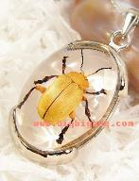
ADEEILRT
DETAILER
ELATERID
RETAILED
S
S
ELATERID: n. AN ELATER, OR CLICK BEETLE
THE DETAILER OF THE JEWELRY LINE, KNOWING THAT THE ELATERID EARRING SET RETAILED FOR PLENTY IN A FOREIGN MARKET, MADE THE SALE.
ATELIER + D, EAR-TIDE + L, TRAILED + E
Notes:
ATELIER: “LOOK! POOLROOM FOR BOZOS FOND OF TV”
EAR-TIDE: “BANG! NAVAL MAN SAW BLAST”
TRAILED: “L.A. COP’S BEAT”

Slide 24
TRAILED T
ADEILRTT
ONE WORD
Notes:
.

Slide 25
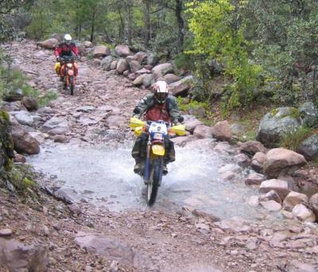
ADEILRTT
DETRITAL
DETRITAL: adj. DESCRIBING DETRITUS, PIECES OF ROCK
POLICE
Notes:
.

Slide 26
TRAILED
THAT’S IT! THE DIFFICULT BINGOS:
ARTICLED LACERTID
DIPTERAL TRIPEDAL
LIBRATED ELATERID
LARIATED DETRITAL
TRIALLED
Notes:
.

Slide 27
TRAILED
WHAT WAS THAT MNEMONIC PHRASE?
Notes:
.

Slide 28
TRAILED
L.A. COP’S BEAT
Notes:
.

Slide 29
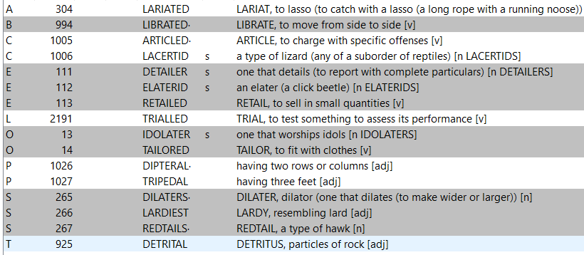
TRAILED.
Notes:
.

Slide 30
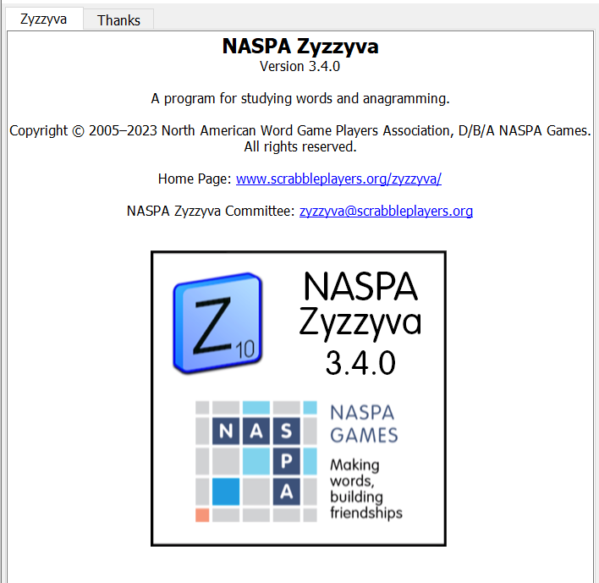
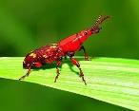
SEND suggestions or requests for additional PowerPoint slide shows to: williamrsnoddy@gmail.com
“Hey, Bill…”
Notes:
.

Slide 31
THE END!
TRAILED
L.A. COP’S BEAT
Notes:
.

