Slide 1
EEINORT
No new words from NWL23 or WOW24
Notes:
.

Slide 2
EEINORT
IF the above alphagram does NOT show numbered Scrabble tiles,
then make sure you are viewing your downloaded version in the PowerPoint app
Notes:
.

Slide 3




EEINORT
Use PowerPoint or Keynote in FULL SCREEN “SLIDE SHOW” mode on your LAPTOP or DESKTOP for best results
When you see the “ESCAPE KEY” ICON check speaker notes for additional information by hitting the escape key
Notes:
.

Slide 4
EEINORT
WHAT BINGO STEM
CAN BE CREATED
FROM THIS ALPHAGRAM?
Notes:
.

Slide 5

EEINORT
THIS IS ORIENT + E, & ENTIRE + O, SO
THERE ARE NO GOOD WORDS FROM THIS ALPHAGRAM.
WE WILL USE A HYPHENATED NONWORD AS A BINGO STEM
Notes:
ORIENT: “CUB GULPS JUJU NUTS” (no “E”)
ENTIRE: “TAPERING CHUNKS” (no “O”)
Shift + F5 to return to full screen

Slide 6
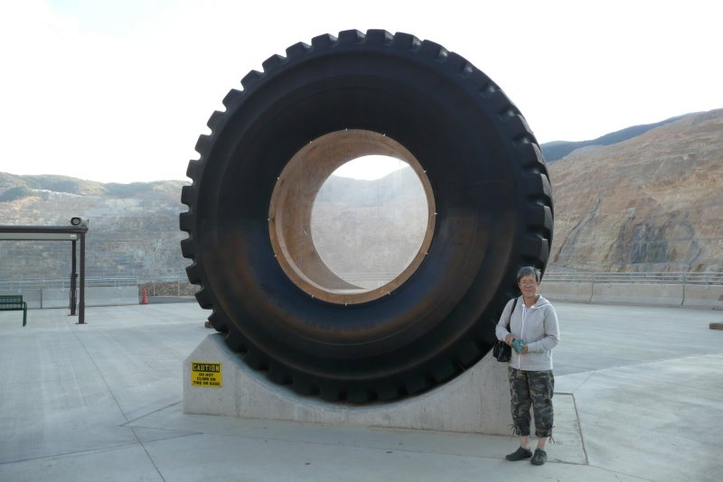
EEINORT
ONE-TIRE
Notes:
.

Slide 7
ONE-TIRE
WHAT MNEMONIC PHRASE CAN WE ASSOCIATE WITH THIS BINGO STEM?
Notes:
.

Slide 8
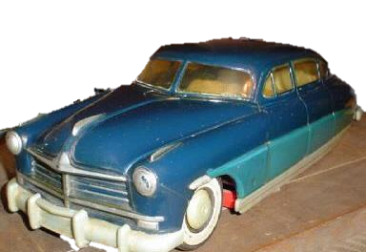

ONE-TIRE
*ouR eXHauSTeD CaR
*CoNSoNaNTS oNLY”
Notes:
ONE-TIRE: *ouR eXHauSTeD CaR (*CoNSoNaNTS oNLY)

Slide 9
ONE-TIRE
X
EEINORTX
ONE WORD
Notes:
.

Slide 10
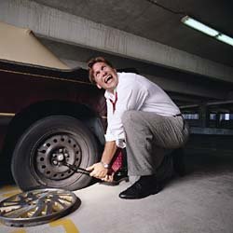
EEINORTX
EXERTION
S
EXERTION: THE ACT OF EXERTING
Notes:
.

Slide 11
ONE-TIRE
H
EEHINORT
ONE WORD
Notes:
.

Slide 12
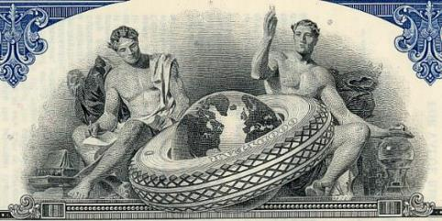
EEHINORT
T
HEREINTO
W
HEREINTO: adv. INTO THIS PLACE
HOOK/S?
THEREINTO WHEREINTO
plus HEREUNTO THEREUNTO WHEREUNTO
Notes:
.

Slide 13
ONE-TIRE
S
EEINORST
TWO WORDS
Notes:
.

Slide 14
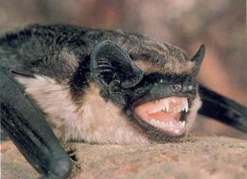

EEINORST
ONERIEST: MOST ONERY, STUBBORN, MEAN-SPIRITED (ONERIER)
ONERIEST
SEROTINE
S
SEROTINE: A EUROPEAN BAT
ONE OF THE ONERIEST MAMMALS IN EUROPE IS A SEROTINE!
also ORNERY ORNERIER ORNERIEST
ENTRIES + O, STONIER +E, SEE-IRON + T IS-ON-TEE + R, ESTRONE + I, ONE-TIRE + S
Notes:
ENTRIES: “ENTRY: CURVY FOX, MIKE’S GLAD” STONIER: “I GO PROBE ROCKS: JUST HEAVENLY”
SEE-IRON: *HoT DiVa PuMPeD iT, LooKeD GooD (*CoNSoNaNTS oNLY) IS-ON-TEE: *TiGeR’S CoMB (*CoNSoNaNTS oNLY)
ESTRONE: “MMM, FLASHING FOX” ONE-TIRE: *ouR eXHauSTeD CaR (*CoNSoNaNTS oNLY)

Slide 15
ONE-TIRE
T
EEINORTT
ONE WORD
Notes:
.

Slide 16
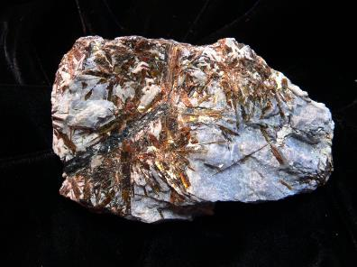




EEINORTT
TENORITE
S
TENORITE: A MINERAL
Notes:
.

Slide 17
ONE-TIRE
D
DEEINORT
ONE WORD
Notes:
.

Slide 18
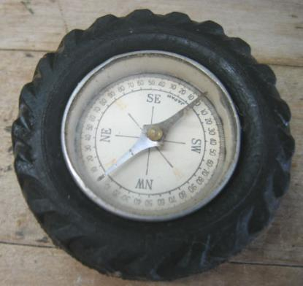
DEEINORT
ORIENTED
END-RIOT + E I-RENTED + O ONE-TIRE + D
Notes:
END-RIOT: “MAINTAINED PEACE”
I-RENTED: “TOM BROKAW’S SUV AND AX”
ONE-TIRE: *ouR eXHauSTeD CaR (*CoNSoNaNTS oNLY)

Slide 19
ONE-TIRE
C
CEEINORT
TWO WORDS
Notes:
.

Slide 20
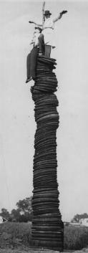
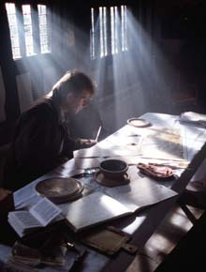

CEEINORT
ERECTION
NEOTERIC
S
S
NEOTERIC: n. (!) A MODERN AUTHOR
COINTER + E ONE-TIRE + C
Notes:
COINTER: “HE JUST FEARS A CRAMPED GRAVE”
ONE-TIRE: *ouR eXHauSTeD CaR (*CoNSoNaNTS oNLY)

Slide 21
ONE-TIRE
R
EEINORRT
THERE ARE TWO
Notes:
.

Slide 22

ORIENTER
REORIENT
EEINORRT
S
S
ORIENTERS REORIENTS [ ]
ORNERIEST
ORIENTER: ONE WHO HELPS OTHERS ADJUST TO SURROUNDINGS
Notes:
.

Slide 23
ONE-TIRE
THAT’S IT! THE DIFFICULT BINGOS:
NEOTERIC
ONERIEST
SEROTINE
ORIENTER
Notes:
.

Slide 24
ONE-TIRE
WHAT WAS THAT MNEMONIC PHRASE?
Notes:
.

Slide 25
ONE-TIRE
*ouR eXHauSTeD CaR
*CoNSoNaNTS oNLY”
Notes:
ONE-TIRE: *ouR eXHauSTeD CaR (*CoNSoNaNTS oNLY)

Slide 26
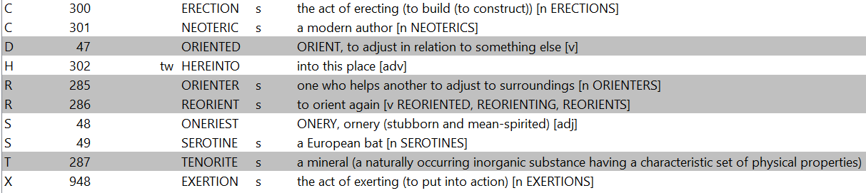
ONE-TIRE
Notes:
.

Slide 27
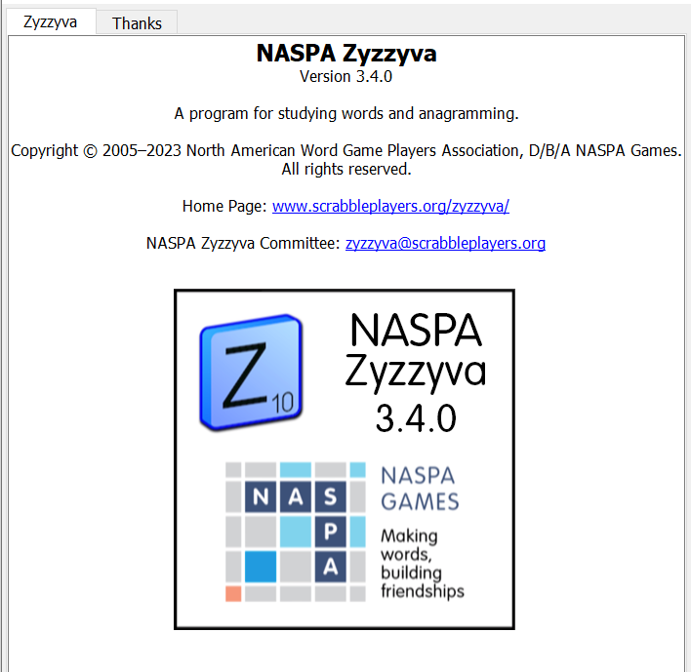
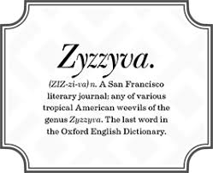
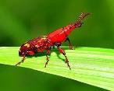
SEND suggestions or requests for additional PowerPoint slide shows to: williamrsnoddy@gmail.com
“Hey, Bill…”
Notes:
.

Slide 28
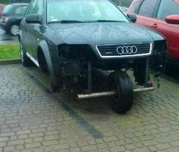
THE END
Notes:
.

