Slide 1
AEILNOT
No new words from NWL23 or WOW24
Notes:
.

Slide 2
AEILNOT
IF the above alphagram does NOT show numbered Scrabble tiles,
then make sure you are viewing your downloaded version in the PowerPoint app
Notes:
.

Slide 3
AEILNOT
Use PowerPoint or Keynote in FULL SCREEN “SLIDE SHOW” mode on your LAPTOP or DESKTOP for best results
When you see the “ESCAPE KEY” ICON check speaker notes for additional information by hitting the escape key
Notes:
.

Slide 4
AEILNOT
OF THE TWO 7-LETTER WORDS,
WHAT IS THE BEST BINGO STEM
FOR THIS ALPHAGRAM?
Notes:
.

Slide 5
AEILNOT
ELATION
TOENAIL IS THE OTHER GOOD WORD, AND SOME USE THE STEM “TOENAIL” WITH THE PHRASE “*GRiPS BeD” (*CoNSoNaNTS oNLY)
Notes:
.

Slide 6
ELATION
WHAT MNEMONIC PHRASE
CAN WE ASSOCIATE
WITH THIS BINGO STEM?
Notes:
.

Slide 7
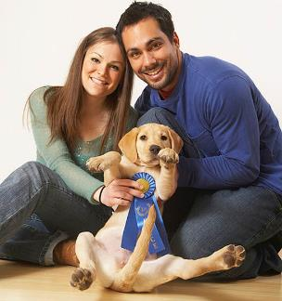
ELATION
*ouR DoG iS SuPeRB
*CoNSoNaNTS oNLY
Notes:
ELATION: *ouR DoG iS SuPeRB (*CoNSoNaNTS Only) or just *SuPeRB DoG
or ELATION: *PeGBoaRDS

Slide 8
ELATION R
AEILNORT
TWO WORDS
Notes:
.

Slide 9
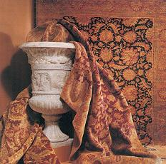
AEILNORT
ORIENTAL
RELATION
S
_
S
AIR-TONE + L AILERON + T ALE-RIOT +N LATRINE + O ANISOLE + T SLAINTE + O ELATION + R
RUGS ARE ORIENTAL, BUT A RELATION MAY BE ASIAN.
HOOK/S?
RELATIONS ORIENTALS
Notes:
AIR-TONE: “BACH’S PLAN: RAZZ AT DAD” AILERON: “CoPS GeT To aViaTe” (*CoNSoNaNTS oNLY)
ALE-RIOT: “MVP BEDRENCHED FEZ” LATRINE: “CONFUSING, SEMIOPEN IN IVY”
ANISOLE: *TRaPPiNG MuSKoX (*CoNSoNaNTS oNLY) SLAINTE: “POP CORK, BUMP CUPS, FOR VIM, VIGOR”
ELATION: *ouR DoG iS SuPeRB (*CoNSoNaNTS Only)

Slide 10
ELATION D
ADEILNOT
ONE WORD
Notes:
.

Slide 11
ADEILNOT
DELATION
_
S
DELATION: n. ACCUSATION (DELATE, DELATED, DELATING)
DELATIONS ANAGRAMS:
[ ]
INSOLATED
LENT-AID + O ELATION + D
Notes:
LENT-AID: “FOP GAVE BOND”
ELATION: *ouR DoG iS SuPeRB (*CoNSoNaNTS Only)

Slide 12
ELATION G
AEGILNOT
TWO WORDS
Notes:
.

Slide 13
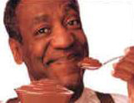
AEGILNOT
_
GELATION
LEGATION
S
S
LEGATION: THE SENDING OF AN OFFICIAL ENVOY
HOOK/S?
GELATIONS LEGATIONS
←YEARS AGO: THE GELATION LEGATION
GENITAL + O ELATION + G
Notes:
GENITAL: “XXX BAZOOMS GAVE PECKER A HARD ON” NOTE: hardon* is not a good word in Scrabble..
ELATION: *ouR DoG iS SuPeRB (*CoNSoNaNTS Only)

Slide 14
ELATION S
AEILNOST
THREE WORDS
Notes:
.

Slide 15
AEILNOST
D
_
ELATIONS
INSOLATE
TOENAILS
G
R
D
S
_
INSOLATE: v. TO EXPOSE TO SUNLIGHT
(INSOLATED, INSOLATES, INSOLATING)
LATINOS + E ISOLATE + N ENTOILS + A ATONIES + L ANISOLE + T SLAINTE +O ELATION + S
HOOKS?
DELATIONS GELATIONS RELATIONS INSOLATED INSOLATES
Notes:
LATINOS: “YEARLONG”
ISOLATE: *FeNCe KePT MoVie DoGS iN (*CoNSoNaNTS oNLY)
ENTOILS: “WRAPAROUND HAVOC”
ATONIES: *uNBRaCeD LiMPNeSS (*CoNSoNaNTS oNLY)
ANISOLE: *TRaPPiNG MuSKoX (*CoNSoNaNTS oNLY)
SLAINTE: POP CORK, BUMP CUPS FOR VIM, VIGOR
ELATION: *ouR DoG iS SuPeRB (*CoNSoNaNTS Only)

Slide 16
ELATION P
AEILNOPT
ONE WORD
Notes:
.

Slide 17
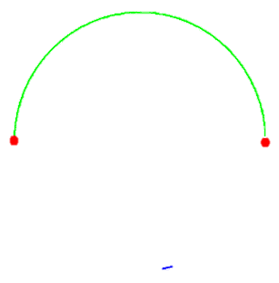
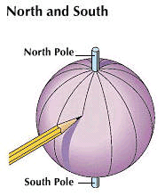
AEILNOPT
ANTIPOLE
S
ANTIPOLE: n. THE OPPOSITE POLE (adj. ANTIPOLAR)
HOOK/S?
Notes:
.

Slide 18
ELATION B
ABEILNOT
ONE WORD
Notes:
.

Slide 19
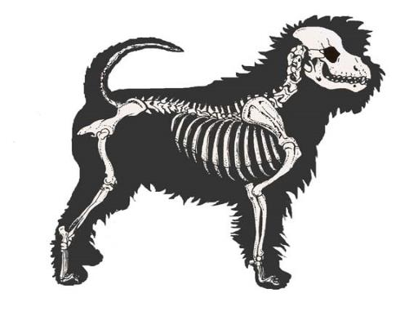
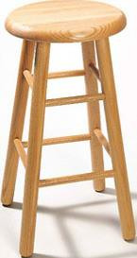
ABEILNOT
TAILBONE
S
DOGTAIL HAS BECOME A GOOD WORD!
Notes:
DOGTAIL, DOGTAILS
DOGSTAIL, DOGSTAILS
Shift + F5 to return to full screen

Slide 20
ELATION
THAT’S IT! BINGOS TO REVIEW:
ANTIPOLE
INSOLATE
LEGATION
TAILBONE
Notes:
.

Slide 21
ELATION
WHAT WAS THAT MNEMONIC PHRASE?
Notes:
.

Slide 22
ELATION
*ouR DoG iS SuPeRB
* CoNSoNaNTS oNLY
Notes:
.

Slide 23
ELATION.
Notes:
.

Slide 24
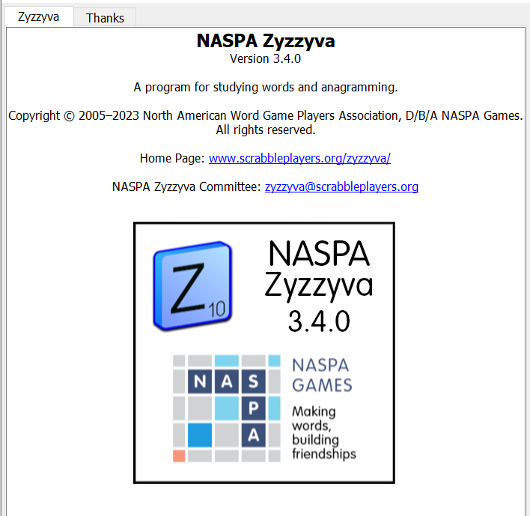
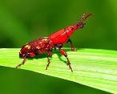
SEND suggestions or requests for additional PowerPoint slide shows to: williamrsnoddy@gmail.com
“Hey, Bill…”
Notes:
.

Slide 25
THE END!
iS SuPeRB
*ouR DoG
ELATION:
Notes:
.

