Slide 1
AEINSST
No new words from NWL23 or WOW24
Notes:
.

Slide 2
AEINSST
IF the above alphagram does NOT show numbered Scrabble tiles,
then make sure you are viewing your downloaded version in the PowerPoint app
Notes:
.

Slide 3
AEINSST
Use PowerPoint or Keynote in FULL SCREEN “SLIDE SHOW” mode on your LAPTOP or DESKTOP for best results
When you see the “ESCAPE KEY” ICON check speaker notes for additional information by hitting the escape key
3
Notes:
.

Slide 4
AEINSST
OF THE SIX POSSIBLE 7-LETTER WORDS, WHAT BINGO STEM SHOULD WE USE FOR THIS ALPHAGRAM?
Notes:
.

Slide 5
AEINSST
SESTINA
SESTINA: A TYPE OF VERSE FORM
OTHER GOOD WORDS ARE NASTIES, ENTASIS, TISANES, TANSIES, AND SEITANS
TISANE + S STEINS + A
Notes:
SESTINA: a poem with six stanzas of six lines and a final triplet, all stanzas having the same six words at the line-ends in six different sequences that follow a fixed pattern, and with all six words appearing in the closing three-line envoi. Shift + F5 to return to full screen
TISANE: “TUCKSHOP WIZ JUST FIXED MEDICINAL BEVERAGE”
STEINS: “IF PARCHED, HAVE A FLAGON OF WARM ALE”

Slide 6
SESTINA
WHAT MNEMONIC PHRASE CAN WE ASSOCIATE WITH THIS BINGO STEM?
Notes:
.

Slide 7
SESTINA
THIS POEM LACKED BURNING SEX
Notes:
SESTINA: “THIS POEM LACKED BURNING SEX”

Slide 8
SESTINA T
AEINSSTT
THERE ARE FIVE!
Notes:
.

Slide 9
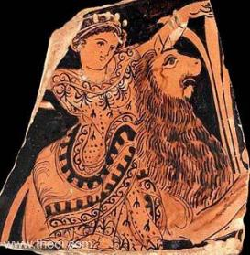
AEINSSTT
ANTSIEST
INSTATES
NASTIEST
SATINETS
TITANESS
_
_
_
TITANESS: A FEMALE TITAN, A PERSON OF GREAT SIZE (pl. TITANESSES)
INSTATE + S SESTINA + T
Notes:
INSTATE: “A FEW STRANGERS PREACHED”
SESTINA: “THIS POEM LACKED BURNING SEX”

Slide 10
SESTINA H
AEHINSST
THERE ARE FOUR!
Notes:
.

Slide 11
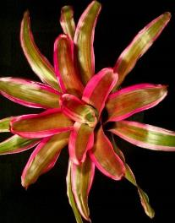
AEHINSST
ANTHESIS
SHANTIES
SHEITANS
STHENIAS
STICKY
_
_
A
ANTHESIS: THE FULL BLOOM OF A FLOWER (pl. ANTHESES)
Notes:
.

Slide 12
SESTINA I
AEIINSST
THERE ARE FOUR!
Notes:
.

Slide 13
AEIINSST
_
ISATINES
SANITIES
SANITISE
TENIASIS
D
S
TENIASIS: AN INFESTATION WITH TAPEWORMS (pl. TENIASES)
SENITIS + A SESTINA + I
HOOK/S?
SANITISED SANITISES
Notes:
note: SANITIZER can only be spelled this way Shift + F5 to get back to full screen
SENITIS: “HER BAD APNOEA”
SESTINA: “THIS POEM LACKED BURNING SEX”

Slide 14
SESTINA S
AEINSSST
ONE WORD
Notes:
.

Slide 15
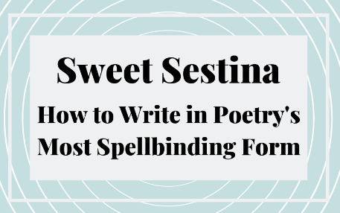
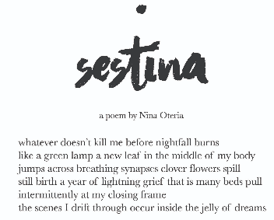
AEINSSST
SESTINAS
_
SESTINAS: the only pl. of SESTINA, A TYPE OF VERSE FORM
Notes:
.

Slide 16
SESTINA P
AEINPSST
THERE ARE TWO!
Notes:
.

Slide 17
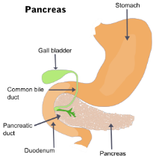
AEINPSST
SAPIENTS
_
SAPIENTS: pl. of SAPIENT, A WISE PERSON
STEAPSIN
S
STEAPSIN: A PANCREATIC ENZYME, A PROTEIN
PHYSICIANS WHO ARE SAPIENTS UNDERSTAND THE PANCREAS AND STEAPSIN.
PANTIES + S SESTINA + P
Notes:
PANTIES: “HOLD UP PORKY BUTTS”
SESTINA: “THIS POEM LACKED BURNING SEX”

Slide 18
SESTINA O
AEINOSST
ONE WORD
Notes:
.

Slide 19
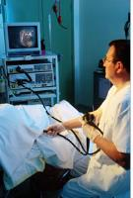
AEINOSST
ASTONIES
ASTONIES: present tense of the v. ASTONY, TO ASTONISH or FILL WITH WONDER OR SURPRISE (ASTONY, ASTONIED, ASTONYING)
THE DOCTOR ASTONIES THE PATIENT, BY USING SEDATION [ASTONIED] THAT DOES REDUCE PROCEDURE PAIN DRAMATICALLY.
NOSIEST + A SESTINA + O
Notes:
NOSIEST: “MOST INTENSE WATCHER”
SESTINA: “THIS POEM LACKED BURNING SEX”

Slide 20
SESTINA E
AEEINSST
TWO WORDS
Notes:
.

Slide 21
AEEINSST
ETESIANS
TENIASES
_
TENIASES: pl. of TENIASIS, AN INFESTATION WITH TAPEWORMS
ETESIAN + S SESTINA + E
Notes:
ETESIAN: “oVeRCoMeS CaTBiRDS (*CoNSoNaNTS oNLY)
SESTINA: “THIS POEM LACKED BURNING SEX”

Slide 22
SESTINA M
AEIMNSST
TWO WORDS
Notes:
.

Slide 23
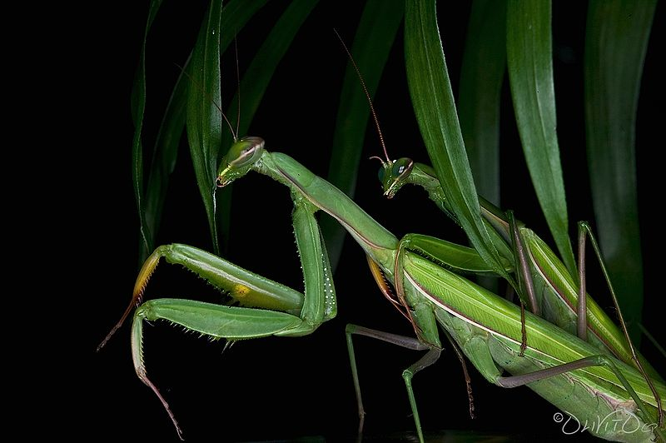
AEIMNSST
MATINESS
MANTISES
INMATES + S SAMISEN + T SESTINA + M
Notes:
INMATES: “GANEFS OR BLOCKHEADS?”
SAMISEN: “STRUMMED JAZZ AT GO MATCH”
SESTINA: “THIS POEM LACKED BURNING SEX”

Slide 24
Notes:
.

Slide 25
SESTINA L
AEILNSST
THERE ARE FOUR!
Notes:
.

Slide 26
AEILNSST
_
ELASTINS
NAILSETS
SALIENTS
SALTINES
_
SLAINTE + S SESTINA + L
_
_
S
SALIENTS: THE PLURAL OF SALIENT, A PART OF A FORTIFICATION NEAREST TO THE ENEMY
HOOK/S?
EASY TO MISS S FOR SALTINESS
Notes:
SLAINTE: “POP CORK, BUMP CUPS, FOR VIM, VIGOR”
SESTINA: “THIS POEM LACKED BURNING SEX”

Slide 27
SESTINA A
AAEINSST
ONE WORD
Notes:
.

Slide 28
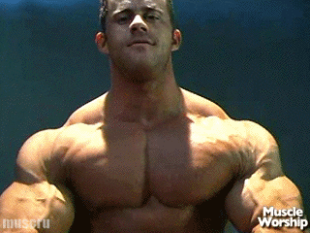
AAEINSST
ENTASIAS
_
ENTASIA: pl. of ENTASIA, A SPASMODIC CONTRACTION OF A MUSCLE
Notes:
.

Slide 29
SESTINA C
ACEINSST
TWO WORDS
Notes:
.

Slide 30
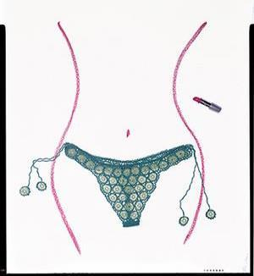
ACEINSST
_
CINEASTS
SCANTIES
SCANTIES: BRIEF PANTIES
T
STICKY
SCANTIEST
HOOKS?
CINEAST + S SESTINA + C
CINEASTS INTRIGUED BY SCANTIES
Notes:
You cannot drop the final S in SCANTIES, although of course SCANTY is good. also CINEASTE/S Shift + F5 to return to full screen
CINEAST: “OLD FANS OF THE DIRTY MOVIE BIZ”
SESTINA: “THIS POEM LACKED BURNING SEX”

Slide 31
SESTINA K
AEIKNSST
ONE WORD
Notes:
.

Slide 32
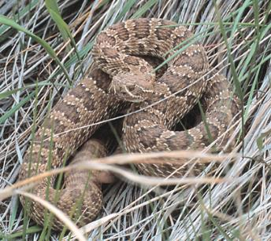
AEIKNSST
SNAKIEST
SNAKY SNAKIER SNAKIEST
Notes:
.

Slide 33
SESTINA D
ADEINSST
TWO WORDS
Notes:
.

Slide 34
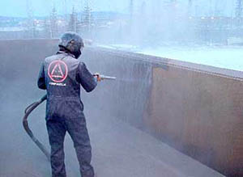
ADEINSST
DESTAINS
SANDIEST
_
STICKY
HE DESTAINS WITH THE SANDIEST OF METHODS, USING A SANDBLASTER.
SAINTED + S SESTINA + D
PECAN sandies* ARE NOT GOOD!
Notes:
SAINTED: “BEGETS IMPROVED TOUCH”
SESTINA: “THIS POEM LACKED BURNING SEX”

Slide 35
ADEINSST
OR
Notes:
.

Slide 36
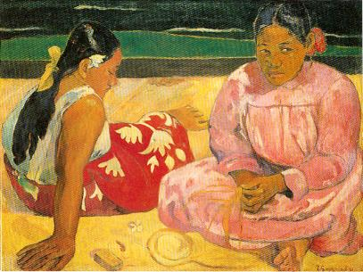
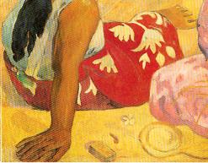
ADEINSST
DESTAINS
SANDIEST
_
STICKY
THE ART RESTORER SO FAR DESTAINS ALL BUT THE SANDIEST PORTION OF THE PAINTING.
SAINTED + S SESTINA + D
Notes:
SAINTED: “BEGETS IMPROVED TOUCH”
SESTINA: “THIS POEM LACKED BURNING SEX”

Slide 37
SESTINA B
ABEINSST
TWO WORDS
Notes:
.

Slide 38
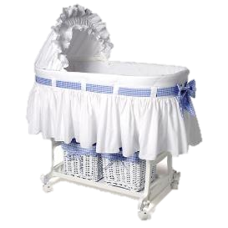
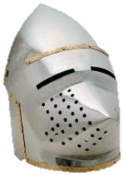
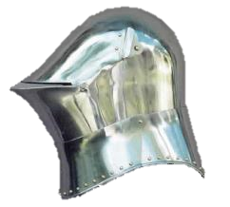
ABEINSST
BASINETS
BASSINET
_
S
Notes:
.

Slide 39
SESTINA U
AEINSSTU
ONE WORD
Notes:
.

Slide 40
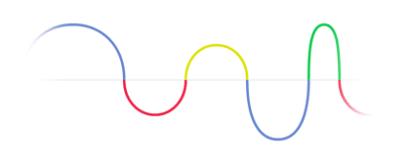
AEINSSTU
SINUATES
_
SINUATES:VERB, CURVES IN AND OUT (SINUATE, SINUATED, SINUATING)
Notes:
.

Slide 41
SESTINA R
AEINRSST
THERE ARE FOUR!
Notes:
.

Slide 42
AEINRSST
ARTINESS
RETSINAS
STAINERS
STEARINS
T
_
_
_
NASTIER + S SESTINA + R
TARTINESS
HOOK/S?
Notes:
NASTIER: “WICKED HORRIBLE FANG STUMPS!”
SESTINA: “THIS POEM LACKED BURNING SEX”

Slide 43
SESTINA N
AEINNSST
TWO WORDS
Notes:
.

Slide 44
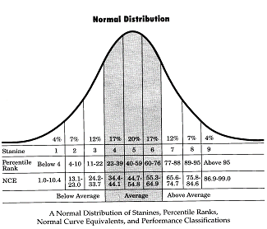
AEINNSST
INSANEST
STANINES
_
ONE OF THE INSANEST WAYS TO COMMUNICATE, UNLESS YOU ARE AN ADVANCED STATISTICIAN, INVOLVES THE USE OF STANINES REPRESENTING THE NINE CLASSES INTO WHICH A SET OF NORMALIZED STANDARD SCORES ARE ARRANGED.
1 2 3 4 5 6 7 8 9
Notes:
.

Slide 45
SESTINA G
AEGINSST
THERE ARE FOUR!
Notes:
.

Slide 46
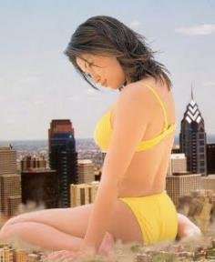
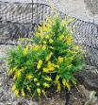
AEGINSST
TEASING + S SESTINA + G
_
B
EASTINGS
GENISTAS
GIANTESS
SEATINGS
_
_
_
EASTINGS: pl. of EASTING, A MOVEMENT TO THE EAST (WESTING/S, SOUTHING/S, NORTHING/S)
GENISTAS: pl. of GENISTA, A SHRUB WITH FLOWERS
GIANTESS: A FEMALE GIANT (pl. GIANTESSES)
HOOK/S?
Notes:
EASTINGS TAKES A B FOR BEASTINGS BUT…YOU CANNOT DROP THE S IN BEASTINGS!
Shift + F5 to get back to full screen
TEASING: “FUZZY NURD THUMBS UGLY VW”
SESTINA: “THIS POEM LACKED BURNING SEX”

Slide 47
SESTINA X
AEINSSTX
ONE WORD
Notes:
.

Slide 48
AEINSSTX
SEXTAINS
_
SEXTAINS : pl. of SEXTAIN, A STANZA OF SIX LINES
HAD WE BUT WORLD ENOUGH, AND TIME,
THIS COYNESS, LADY, WOULD BE NO CRIME
WE WOULD SIT DOWN AND THINK WHICH WAY
TO WALK AND PASS OUR LONG LOVE'S DAY…
BUT AT MY BACK I ALWAYS HEAR
TIME'S WINGÈD CHARIOT HURRYING NEAR.
Notes:
.

Slide 49
SESTINA
THAT’S IT! THE DIFFICULT BINGOS:
ANTHESIS ASTONIES
GIANTESS STEAPSIN
SCANTIES SANITIES
TENIASES TENIASIS
TITANESS SAPIENTS
GENISTAS
Notes:
.

Slide 50
SESTINA
WHAT WAS THAT MNEMONIC PHRASE?
Notes:
.

Slide 51
SESTINA
THIS POEM LACKED BURNING SEX
Notes:
SESTINA: “THIS POEM LACKED BURNING SEX”

Slide 52
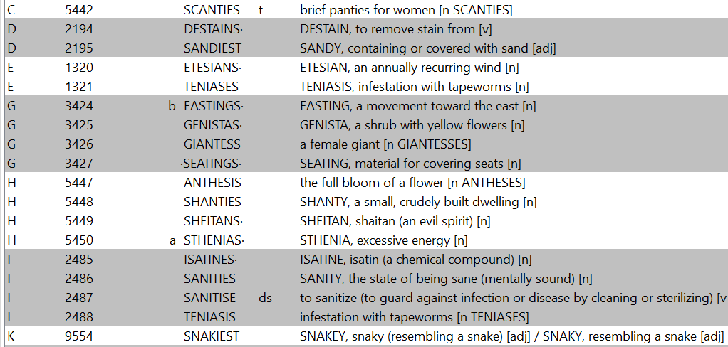
SESTINA.
Continued…
Notes:
.

Slide 53
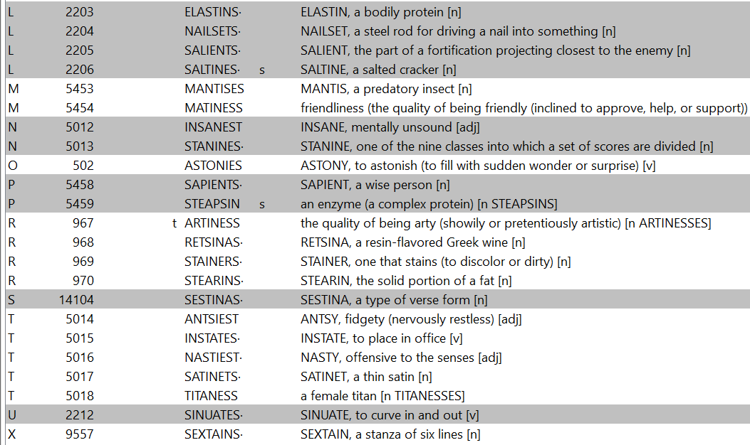
SESTINA.
Continued…
Notes:
,

Slide 54
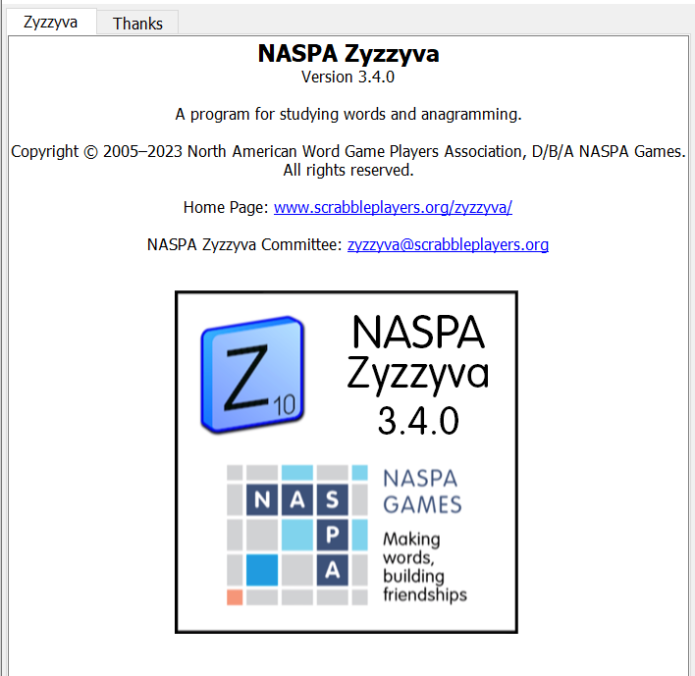
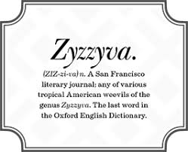
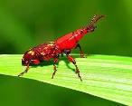
SEND suggestions or requests for additional PowerPoint slide shows to: williamrsnoddy@gmail.com
“Hey, Bill…”
Notes:
.

Slide 55
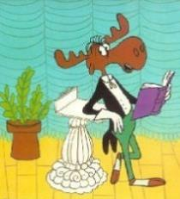
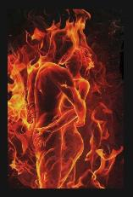
THE END!
THIS POEM LACKED BURNING SEX
Notes:
.

