Slide 1
AEGINOS
No new words from NWL23 or WOW24
Notes:
.

Slide 2
AEGINOS
IF the above alphagram does NOT show numbered Scrabble tiles,
then make sure you are viewing your downloaded version in the PowerPoint app
Notes:
.

Slide 3
AEGINOS
Use PowerPoint or Keynote in FULL SCREEN “SLIDE SHOW” mode on your LAPTOP or DESKTOP for best results
When you see the “ESCAPE KEY” ICON check speaker notes for additional information by hitting the escape key
Notes:
.

Slide 4
AEGINOS
OF THE TWO 7-LETTER WORDS,
WHICH BINGO STEM WILL WE CHOOSE
FOR THIS ALPHAGRAM?
Notes:
.

Slide 5
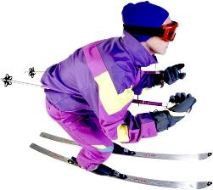
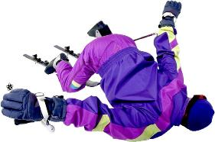
AEGINOS
AGONIES
AGONISE
I-ON-SEA + G SOIGNE + A EASING + O
OF THESE TWO WORDS, LET’S CHOOSE…
Notes:
I-ON-SEA: *MaD MiMiC aToP GRaVeL (*CoNSoNaNTS oNLY)
SOIGNE: “JAWED, BELCHED PROUDLY”
EASING: “BOOK, COMFORT, GULP ON OUZO”

Slide 6
AGONISE
WHAT MNEMONIC PHRASE CAN WE ASSOCIATE WITH THIS BINGO STEM?
Notes:
.

Slide 7
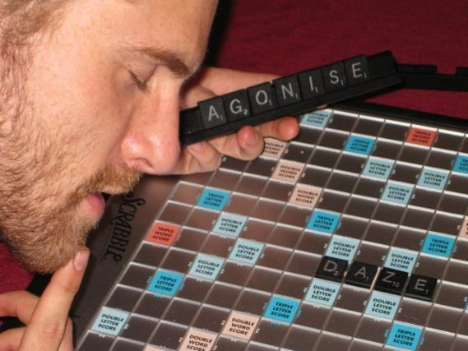
AGONISE
*ouR SCRaBBLiNG DaZe
*CoNSoNaNTS oNLY
Notes:
AGONISE: *ouR SCRaBBLiNG DaZe (*CoNSoNaNTS oNLY)

Slide 8
AGONISE S
AEGINOSS
ONE WORD
Notes:
.

Slide 9
AEGINOSS
AGONISES
_
Notes:
.

Slide 10
AGONISE C
ACEGINOS
ONE WORD
Notes:
.

Slide 11
ACEGINOS
COINAGES
_
COINAGES: pl. of COINAGE, THE ACT OF MAKING COINS
Notes:
.

Slide 12
AGONISE R
AEGINORS
ONE WORD
Notes:
.

Slide 13
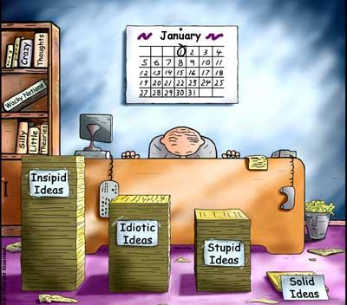
AEGINORS
D
ORGANISE
R
S
ORGANISE ORGANISED ORGANISER ORGANISES ORGANISING
ORGANIZE ORGANIZED ORGANIZER ORGANIZES ORGANIZING
GAINERS + O, ERASION + G, REGIONS + A, AGONISE + R
Notes:
GAINERS: “DANGER, WAVY STOMACH PROBLEM”
ERASION: *BaFFLiNG SoMe DeTeCTiVeS (*CoNSoNaNTS oNLY)
REGIONS: “BAD WINTRY PLACES”
AGONISE: *ouR SCRaBBLiNG DaZe (*CoNSoNaNTS oNLY)

Slide 14
AGONISE B
ABEGINOS
ONE WORD
Notes:
.

Slide 15
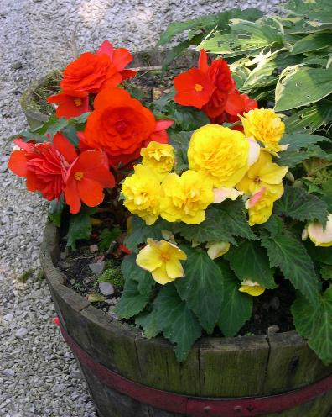
ABEGINOS
BEGONIAS
_
Notes:
.

Slide 16
AGONISE L
AEGILNOS
ONE WORD
Notes:
.

Slide 17
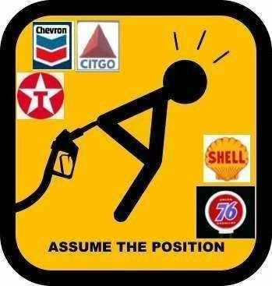
AEGILNOS
GASOLINE
S
AGONISE
GEE! ANISOLE GASOLINE
“L!!”
ANISOLE
ANISOLE + G
AGONISE + L
ALSO GASOLENE/S
Notes:
ANISOLE: *TRaPPiNG MuSKoX (*CoNSoNaNTS oNLY)
AGONISE: *ouR SCRaBBLiNG DaZe (*CoNSoNaNTS oNLY)

Slide 18
AGONISE N
AEGINNOS
ONE WORD
Notes:
.

Slide 19
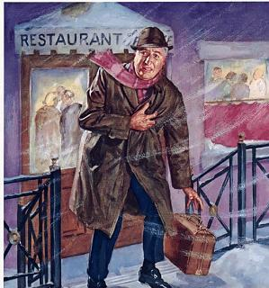
AEGINNOS
ANGINOSE
ANGINOSE: adj. ANGINA-LIKE CHEST PAIN (also ANGINAL, ANGINOUS)
Notes:
.

Slide 20
AGONISE G
AEGGINOS
ONE WORD
Notes:
.

Slide 21
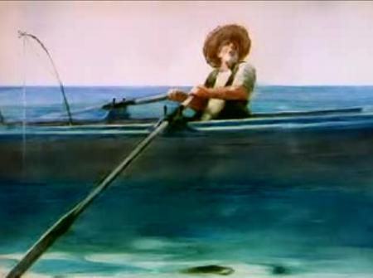
AEGGINOS
SEAGOING
Notes:
It’s amusing that adding a Y would give you EASYGOING, but nine letter words are not common in Scrabble.
Shift + F5 to get back to full screen.

Slide 22
AGONISE D
ADEGINOS
TWO WORDS
Notes:
.

Slide 23
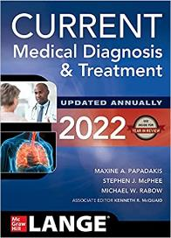
ADEGINOS
AGONISED
DIAGNOSE
_
D
S
SAN DIEGO
ANODISE + G AGONISE + D
Notes:
The only word for one who diagnoses is a diagnostician. Shift + F5 to get back to full screen.
ANODISE: *ZaX aBHoRReD aeSTHeTiC MuGS (*CoNSoNaNTS oNLY)
AGONISE: *ouR SCRaBBLiNG DaZe (*CoNSoNaNTS oNLY)

Slide 24
AGONISE Z
AEGINOSZ
ONE WORD
Notes:
.

Slide 25
AEGINOSZ
AGONIZES
_
Notes:
.

Slide 26
AGONISE
THAT’S IT! THE DIFFICULT BINGOS:
COINAGES
ANGINOSE
Notes:
.

Slide 27
AGONISE
WHAT WAS THAT MNEMONIC PHRASE?
Notes:
.

Slide 28
AGONISE
*ouR SCRaBBLiNG DaZe
*CoNSoNaNTS oNLY
Notes:
.

Slide 29
AGONISE.
Notes:
.

Slide 30
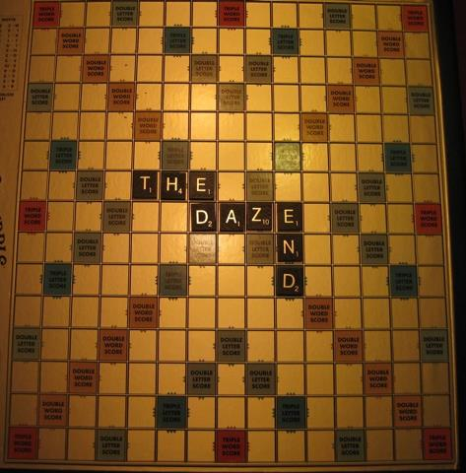
Notes:
.

