Slide 1
EGINRST
TWO NEW WORDS from NASPA’s NWL23 word list, neither of which are acceptable in WGPO’s WOW24 word list.
Notes:
.

Slide 2
EGINRST
IF the above alphagram does NOT show numbered Scrabble tiles,
then make sure you are viewing your downloaded version in the PowerPoint app
Notes:
.

Slide 3




EGINRST
Use PowerPoint or Keynote in FULL SCREEN “SLIDE SHOW” mode on your LAPTOP or DESKTOP for best results
When you see the “ESCAPE KEY” ICON check speaker notes for additional information by hitting the escape key
Notes:
.

Slide 4
EGINRST
OF THE TWO 7-LETTER WORDS,
WHAT BINGO STEM CAN BE CREATED
FROM THIS ALPHAGRAM?
Notes:
.

Slide 5
EGINRST
RESTING
THE ONLY OTHER GOOD WORD IS STINGER
SINGER + T INSERT + G INGEST + R TIGERS + N ENGIRT + S
Notes:
SINGER: “WE LOVE THE CRAZY POP SOUND OF BOY GEORGE”
INSERT: “DOPES WOULD LOVE TO MAKE A FEW CHANGES”
INGEST: “WIZARD IN TUX: UNUSUAL JAVA HABIT”
TIGERS: “UNUSUAL FOR OUR SAVANNAH”
ENGIRT: “SIMULTANEOUSLY”

Slide 6
RESTING
WHAT MNEMONIC PHRASE CAN WE ASSOCIATE WITH THIS BINGO STEM?
Notes:
.

Slide 7
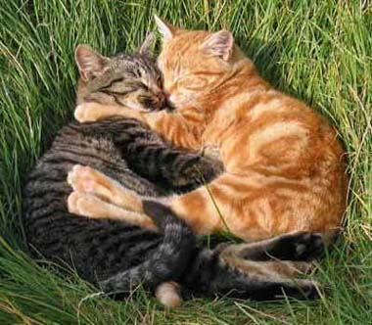
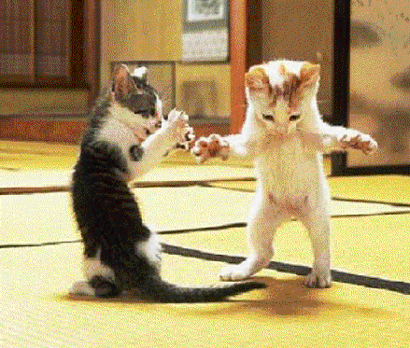
RESTING
TWO IDLE CATS REST
PICTURE
Notes:
RESTING: “TWO IDLE CATS REST”

Slide 8
RESTING
T
EGINRSTT
ONE WORD
Notes:
.

Slide 9

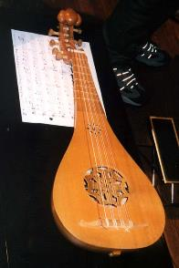
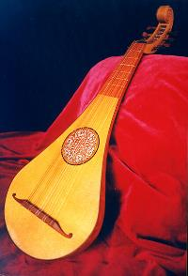

EGINRSTT
GITTERNS
_
GITTERNS: pl. of GITTERN, A MEDIEVAL GUITAR
ENGIRT + T + S
Notes:
ENGIRT: “SIMULTANEOUSLY”
other medieval guitars: CITHER/S, CITHARA/S, KITHARA/S, CITHERN/S, CITHREN/S, CITTERN/S, CITOLA/S, CITOLE/S
Shift + F5 to get back to full screen

Slide 10
RESTING
W
EGINRSTW
TWO WORDS
Notes:
.

Slide 11

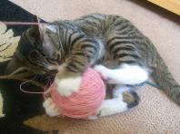
EGINRSTW
STREWING
WRESTING
_
STREWING: SCATTERING ABOUT (STREW, STREWS, STREWED)
WRESTING: TO TAKE AWAY BY FORCE (WREST, WRESTS, WRESTED)
Notes:
.

Slide 12
RESTING
O
EGINORST
ONE WORD
Notes:
.

Slide 13
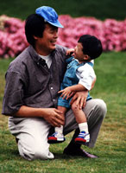

EGINORST
GENITORS
_
STONIER + G, REGIONS + T, RESTING + O, ENGIRT + O + S
Notes:
STONIER: “I GO PROBE ROCKS: JUST HEAVENLY”
REGIONS: “BAD WINTRY PLACES”
RESTING: “TWO IDLE CATS REST”
ENGIRT: “SIMULTANEOUSLY”

Slide 14
RESTING
I
EGIINRST
THERE ARE THREE!
Notes:
.

Slide 15
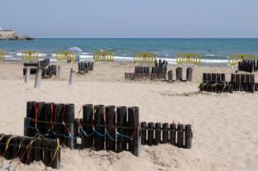
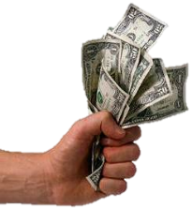

EGIINRST
IGNITERS
RESITING
STINGIER
_
rs
Also IGNITOR/S
SIN-RITE + G RESTING + I
ENGIRT + I + S + [2]
Notes:
SIN-RITE: “VAMP STABBED, SO HULK CAGED”
RESTING: “TWO IDLE CATS REST”
ENGIRT: “SIMULTANEOUSLY”

Slide 16
RESTING
D
DEGINRST
ONE WORD
Notes:
.

Slide 17
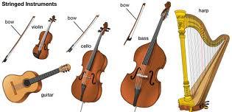
DEGINRST
STRINGED
A
STRINGED: v. TO PROVIDE WITH STRINGS OR SLENDER CORDS (STRING, STRINGS, STRINGING)
HOOK/S?
ASTRINGED
Notes:
.

Slide 18
RESTING
L
EGILNRST
THERE ARE THREE!
Notes:
.

Slide 19

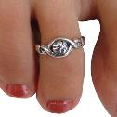
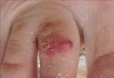
EGILNRST
RINGLETS
STERLING
TINGLERS
_
S
_
TINGLERS: pl. of TINGLER, ONE THAT TINGLES OR CAUSES A PRICKLY SENSATION
LINTERS + G RESTING + L
ENGIRT + L X 2 + S + [ ]
THE RINGLETS OF STERLING BECAME TINGLERS
Notes:
LINTERS: “GO AID MAKEUP”
RESTING: “TWO IDLE CATS REST”
ENGIRT: “SIMULTANEOUSLY”

Slide 20
RESTING
E
EEGINRST
THERE ARE FOUR
Notes:
.

Slide 21
EEGINRST
_
GENTRIES
INTEGERS
REESTING
STEERING
A
_
HOOK/S?
REESTING: BALKING, STOPPING SHORT AND REFUSING TO PROCEED (REEST, REESTED, REESTS)
S
GREISEN + T, ENTRIES + G, RESTING + E
Notes:
AGENTRIES [GRATINEES, RESEATING, STINGAREE] STINGAREE IS A STING RAY
Shift + F5 to return to full screen
GREISEN: “THE STONE THAT COVERED UP THE VACANT TOMB WAS ROLLED OFF”
ENTRIES: “ENTRY: CURVY FOX, MIKE’S GLAD”
RESTING: “TWO IDLE CATS REST”

Slide 22

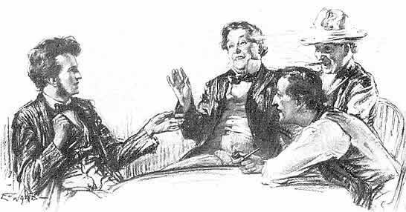
EEGINRST
“SPEAK TO ME NO MORE, OF SEVEN OVER FOUR!”
SOME MEMBERS OF THE LANDED GENTRIES WHO WERE LESS-EDUCATED, FOUND THAT WHEN THE TOPIC SHIFTED BEYOND INTEGERS TO UNCOMMON FRACTIONS, THEY WERE ABSOLUTELY REESTING AND QUICKLY WERE ALREADY STEERING THE CONVERSATION AWAY FROM MATHEMATICS.
Notes:
.

Slide 23
RESTING
C
CEGINRST
ONE OR TWO WORDS?
Notes:
.

Slide 24




CEGINRST
HOOK/S?
_
CRESTING
S
CRESTING: n. A DECORATIVE COPING, THE TOP PART OF A WALL
also verb: CREST CRESTS CRESTED CRESTING CRESTINGS
_
CRINGEST
CRINGEST: NWL23 adj. MOST CRINGE, MOST CRINGY, MOST AWKWARD
Notes:
Alternating hooks because CRESTING takes an S, but RESTING does not.
CRINGEST is not good in WGPO’s WOW24 word list.
Shift + F5 to return to full screen

Slide 25
RESTING
A
AEGINRST
THERE ARE EIGHT or NINE!
Notes:
.

Slide 26
AEGINRST
HOOKS??
H
ANGRIEST
ANGSTIER
ASTRINGE
GANISTER
GANTRIES
GRANITES
INGRATES
RANGIEST
ANGSTIER: MORE ANGSTY, HAVING ANGST, ANXIETY, DREAD (ANGSTIEST)
D
ASTRINGE: TO BIND OR DRAW TOGETHER
S
S
ASTRINGED, ASTRINGES, ASTRINGING
GANISTER: A TYPE OF ROCK, SANDSTONE
_
GAINERS + T GRANITE + S TEASING + R NASTIER + G GAITERS + N STRANGE + I RESTING + A
_
O
AND?
Notes:
GAINERS: “DANGER, WAVY STOMACH PROBLEM” GRANITE: “EXCAVATED SLABS MAKE CHEAP WALLS”
TEASING: “FUZZY NURD THUMBS UGLY VW” NASTIER: “WICKED HORRIBLE FANG STUMPS!”
GAITERS: *CLoMPiNG FaVe (*CoNSoNaNTS oNLY) STRANGE: “WEIRD FOG LAMPS”
RESTING: “TWO IDLE CATS REST”

Slide 27

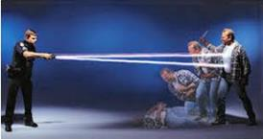
ANGRIEST
ANGSTIER
ASTRINGE
GANISTER
GANTRIES
GRANITES
INGRATES
RANGIEST
TASERING
This is thought-provoking.
TASERING is a new good word in NWL23
But tasering* is NOT good in WOW24
Notes:
TASERING: NWL23 conjugation of v. TASER, (TASERS, TASERED)
but WGPO’s WOW24 only recognizes the verb TASE, TASES, TASED, and TASING and n. TASER/S
Shift + F5 to return to full screen

Slide 28
RESTING
S
EGINRSST
THERE ARE THREE!
Notes:
.

Slide 29



EGINRSST
STINGERS
TRESSING
TRIGNESS
_
S
TRESSING: ARRANGING THE HAIR IN LONG LOCKS (TRESS, TRESSED, TRESSES)
TRIGNESS: THE STATE OF BEING TRIG, A STATE OF CLEANLINESS AND ORDER (TRIGGER, TRIGGEST)
ALTHOUGH WITHOUT STINGERS, THE LADIES IN HONEYBEE COSTUMES HAD BEEN TRESSING THEIR HAIR. HONEYBEES: THE ULTIMATE IN TRIGNESS
Notes:
.

Slide 30
RESTING
R
EGINRRST
THERE ARE THREE!
Notes:
.

Slide 31

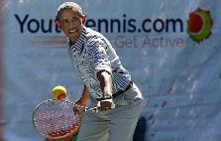
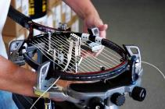
EGINRRST
RESTRING
RINGSTER
STRINGER
S
S
S
RINGSTER:ONE OF A GROUP OF PEOPLE UNITED FOR POLITICAL OR ECONOMIC REASONS
VOWING HE WOULD NEVER RESTRING HIS RACQUET BY HAND, THE SEASONED RINGSTER WOULD USE A MECHANICAL STRINGER.
Notes:
.

Slide 32
RESTING
THAT’S IT! THE DIFFICULT BINGOS:
TRIGNESS ASTRINGE
GANISTER REESTING
GITTERNS GENITORS
ANGSTIER TRESSING
RINGSTER
Notes:
.

Slide 33
RESTING
WHAT WAS THAT MNEMONIC PHRASE?
Notes:
.

Slide 34
RESTING
TWO IDLE CATS REST
PICTURE
Notes:
.

Slide 35
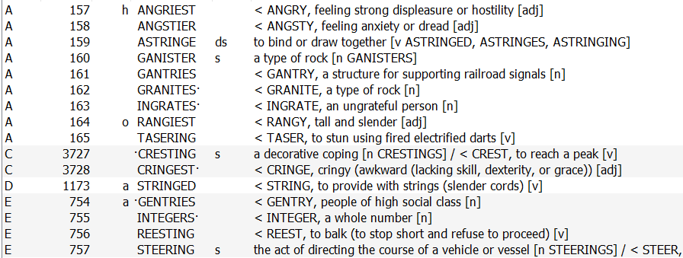
RESTING.
Continued…
Notes:
.

Slide 36
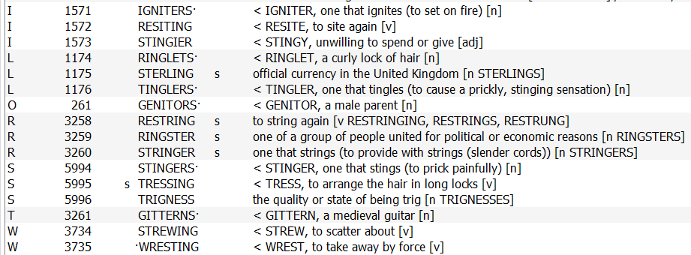
RESTING.
Continued…
Notes:
.

Slide 37
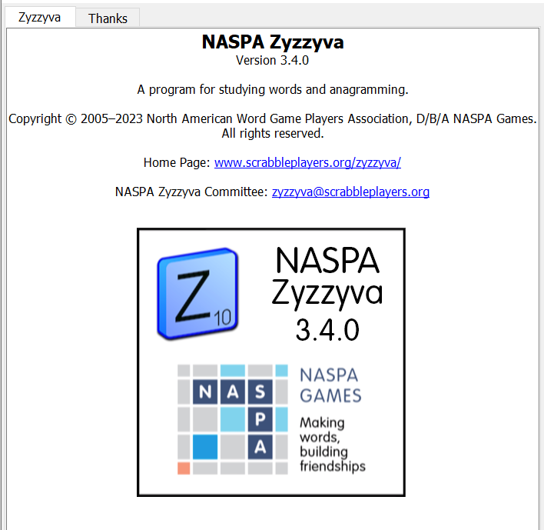

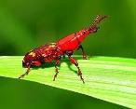
SEND suggestions or requests for additional PowerPoint slide shows to: williamrsnoddy@gmail.com
“Hey, Bill…”
Notes:
.

Slide 38

THE END!
RESTING
TWO IDLE CATS REST
Notes:
.

