Slide 1
AEIMNST
Nothing new from NASPA’s NWL23 or WGPO’s WOW24 word lists.
Notes:
.

Slide 2
AEIMNST
IF the above alphagram does NOT show numbered Scrabble tiles,
then make sure you are viewing your downloaded version in the PowerPoint app
Notes:
.

Slide 3




AEIMNST
Use PowerPoint or Keynote in FULL SCREEN “SLIDE SHOW” mode on your LAPTOP or DESKTOP for best results
When you see the “ESCAPE KEY” ICON check speaker notes for additional information by hitting the escape key
Notes:
.

Slide 4
AEIMNST
WHAT ARE THE 3 GOOD 7-LETTER WORDS FROM THIS ALPHAGRAM?
Notes:
.

Slide 5
AEIMNST
ETAMINSINMATES
TAMEINS
LET’S USE THE MOST COMMON OF THESE FOR A BINGO STEM:
INMATE + S, INSEAM + T, TISANE + M
Notes:
INMATE: “RELAXING BY HIS CELL DOOR”
INSEAM: “CARE FOR A GOOD JOKE, HOW TALL HE SEAMS”
TISANE: “TUCK SHOP WIZ JUST FIXED MEDICINAL BEVERAGE”

Slide 6
INMATES
WHAT MNEMONIC PHRASE CAN WE ASSOCIATE WITH THIS BINGO STEM?
Notes:
.

Slide 7

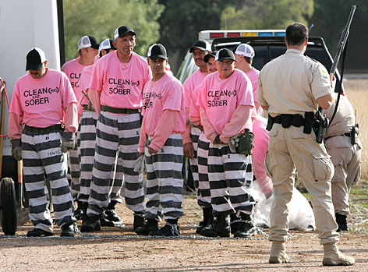
INMATES
GANEFS OR BLOCKHEADS?
Notes:
GANEF/S, GANEV/S, GANOF/S, GONEF/S, GONIF/S, GONIFF/S, GONOF/S, GONOPH/S all mean THIEF or THIEVES
Shift + F5 to get back to full screen
INMATES: “GANEFS OR BLOCKHEADS?”

Slide 8
INMATES
G
AEGIMNST
INMATE + G + S
THERE ARE FOUR!
Notes:
.

Slide 9
AEGIMNST
Mangiest
Mintages
Misagent
Steaming
_
S
_
MISAGENT: n. A BAD AGENT
HOOK/S?
MISAGENTS
TEASING + M
INMATES + G
Notes:
NOTE MANGY AND MANGEY EACH COMPARE TO MANGIER AND MANGIEST
TEGMINA is the plural of TEGMEN and does not take a rear S Shift + F5 to get back to full screen
TEASING: “FUZZY NURD THUMBS UGLY VW”
INMATES: “GANEFS OR BLOCKHEADS?”

Slide 10
INMATES
A
AAEIMNST
INMATE + A + S
TWO WORDS
Notes:
.

Slide 11
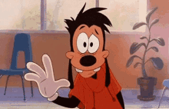

AAEIMNST
AMENTIAS
ANIMATES
AMENTIAS: pl. of AMENTIA, MENTAL DEFICIENCY
_
_
ANIMATE, ANIMATED, ANIMATING, & ANIMATER/S & ANIMATOR/S
NEEDING A CHARACTER WITH AMENTIAS, THE CARTOONIST ANIMATES THIS GOOFY DOG INMATE!
Notes:
.

Slide 12
INMATES
N
AEIMNNST
ONE WORD
Notes:
.

Slide 13
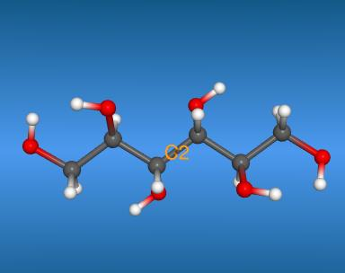

AEIMNNST
MANNITES
_
MANNITES: pl. of MANNITE, AN ALCOHOL COMPOUND (adj. MANNITIC, also MANNITOL/S)
Notes:
.

Slide 14
INMATES
E
AEEIMNST
THERE ARE THREE!
Notes:
.

Slide 15
AEEIMNST
ETAMINES
MATINEES
MISEATEN
K
_
_
MISEAT MISEATS MISATE MISEATEN MISEATING
ETAMINES: pl. of ETAMINE, A LOOSELY WOVEN FABRIC (also ETAMIN/S)
HOOK/S?
KETAMINES
Notes:
.

Slide 16

AEEIMNST
ETAMINES
MATINEES
MISEATEN
MATIN
ETESIAN + M INMATES + E
WEARING ETAMINES, ATTENDING MATINEES,
HAVING MISEATEN.
Notes:
ETESIAN: “oVeRCoMeS CaTBiRDS (*CoNSoNaNTS oNLY)
INMATES: “GANEFS OR BLOCKHEADS?”

Slide 17
INMATES
F
AEFIMNST
ONE WORD
Notes:
.

Slide 18

AEFIMNST
MANIFEST
O
S
MANIFEST: v. TO SHOW CLEARLY
(MANIFESTS, MANIFESTED, MANIFESTING)
MANIFESTOS
MANIFESTOES MANIFESTOED MANIFESTOING
HOOK/S?
Notes:
.

Slide 19
INMATES
S
AEIMNSST
TWO WORDS
Notes:
.

Slide 20
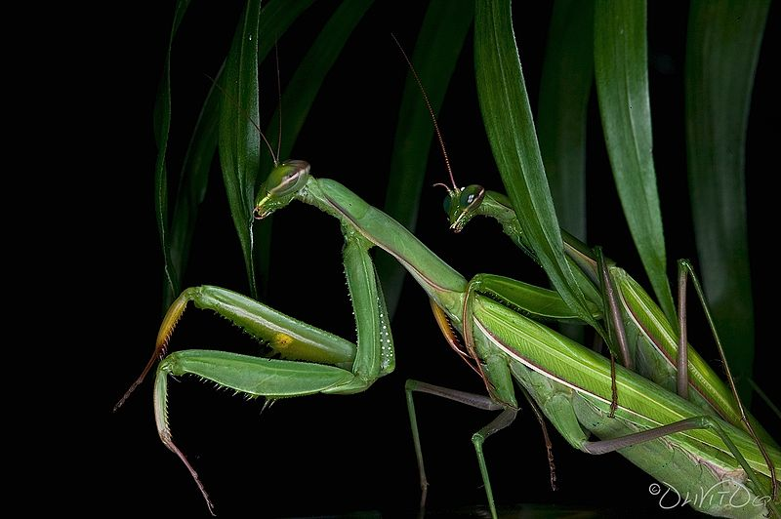
AEIMNSST
MATINESS
MANTISES
SESTINA + M SAMISEN + T INMATES + S
http://www.youtube.com/watch?v=0aSCPmabRpM
Notes:
SESTINA: “THIS POEM LACKED BURNING SEX”
SAMISEN: “STRUMMED JAZZ AT GO MATCH”
INMATES: “GANEFS OR BLOCKHEADS?”

Slide 21
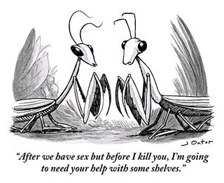
MANTISES & MATINESS
Notes:
.

Slide 22
INMATES
O
AEIMNOST
INMATE + O + S
THERE ARE THREE!
Notes:
INMATE: “RELAXING BY HIS CELL DOOR”

Slide 23
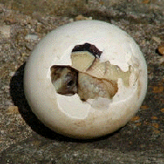
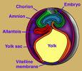
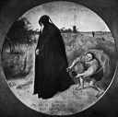
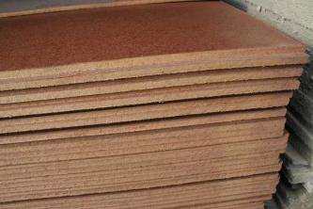
AMNIOTES
MASONITE
MISATONE
AEIMNOST
_
S
MISATONE: TO ATONE WRONGLY
D
(MISATONING)
S
HOOK/S?
ATONIES + M ANOMIES + T INMATES + O
MASONITE: A FIBERBOARD
Notes:
ATONIES: *uNBRaCeD LiMPNeSS (*CoNSoNaNTS oNLY)
ANOMIES: *aDMiRe ouTLaWS (*CoNSoNaNTS oNLY)
INMATES: “GANEFS OR BLOCKHEADS?”

Slide 24
INMATES
R
AEIMNRST
INMATE + R + S
TWO WORDS
Notes:
INMATE: “RELAXING BY HIS CELL DOOR”

Slide 25
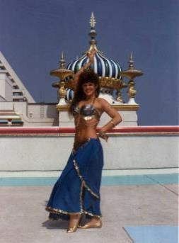
AEIMNRST
MINARETS
RAIMENTS
_
_
SEVERAL MINARETS ARE SEEN BEHIND THE PRETTY LADY DRESSED IN ARABIC RAIMENTS.
NASTIER + M SMARTIE + N INMATES + R
RETINA + M + S
Notes:
NASTIER: “WICKED HORRIBLE FANG STUMPS!”
SMARTIE: VALUES “KNOWING” EXPECTS “DUMBNESS”
INMATES: “GANEFS OR BLOCKHEADS?”
RETINA: “THE RED PUPIL PREFERS MUCH WINKING”

Slide 26
INMATES
B
ABEIMNST
INMATE + B + S
ONE WORD
Notes:
INMATE: “RELAXING BY HIS CELL DOOR”

Slide 27
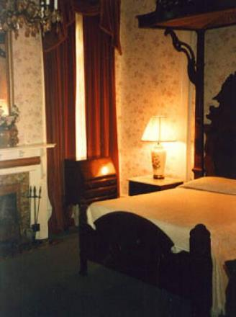
ABEIMNST
AMBIENTS
_
AMBIENT: adj. SURROUNDING, ENCIRCLING (e.g. AMBIENT SOUND & AMBIENT AIR)
however, AMBIENT can also be a noun meaning AMBIENCE or AMBIANCE, THEREFORE CAN TAKE AN S FOR AMBIENTS.
Notes:
.

Slide 28
INMATES
L
AEILMNST
INMATE + L + S
THERE ARE FIVE!
Notes:
.

Slide 29
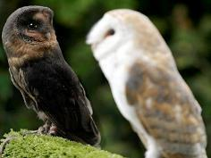

AEILMNST
AILMENTS
ALIMENTS
MANLIEST
MELANIST
SMALTINE
B
_
MELANIST: A MELANIC, ONE WHO HAS MELANISM, AN ABNORMALLY DARK PIGMENTATION
_
S
S
SMALTINE: SAME AS SMALTITE, A MINERAL
SLAINTE + M
ITS-MALE + N INMATES + L
HOOK/S?
Notes:
SLAINTE: “POP CORK, BUMP CUPS, FOR VIM, VIGOR”
ITS-MALE: “PROCUMBENT FUNKY DUDE”
INMATES: “GANEFS OR BLOCKHEADS?”

Slide 30
INMATES
C
ACEIMNST
THERE ARE THREE
Notes:
.

Slide 31
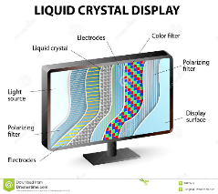


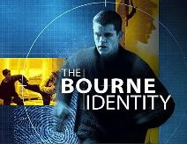


ACEIMNST
CINEAST + M INMATES + C
AMNESTIC: adj. PERTAINING TO MEMORY LOSS
AMNESTIC
NEMATICS
SEMANTIC
_
NEMATICS: pl. of n. NEMATIC, A STAGE OF LIQUID CRYSTAL
S
SEMANTIC: adj. PERTAINING TO MEANING
YET STILL TAKES AN S FOR SEMANTICS
A CINEAST MIGHT KNOW THESE MOVIES WITH AN AMNESTIC THEME, OR AMNESIAC THEME. OH WELL, LIKE LIQUID CRYSTALS VS. NEMATICS, IT’S JUST A SEMANTIC DIFFERENCE.
Notes:
ERRATIC is both an adjective and a noun and takes an S. However, AMNESTIC is an adj. only, and does not take an S.
Shift + F5 to get back to full screen
CINEAST: “OLD FANS OF THE DIRTY MOVIE BIZ”
INMATES: “GANEFS OR BLOCKHEADS?”

Slide 32
INMATES
K
AEIKMNST
THERE ARE TWO
Notes:
.

Slide 33
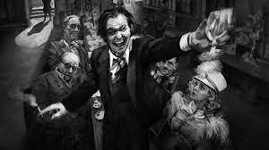
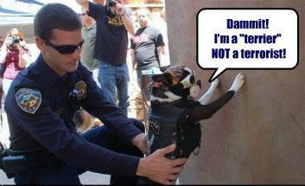

AEIKMNST
MANKIEST
MISTAKEN
MANKIEST: MOST MANKY, INFERIOR, DEFECTIVE (MANKIER)
_
THE MANKIEST DETECTIVE IS MISTAKEN MANY TIMES.
Y
Notes:
.

Slide 34
INMATES
H
AEHIMNST
INMATE + H + S
ONE WORD
Notes:
INMATE: “RELAXING BY HIS CELL DOOR”

Slide 35
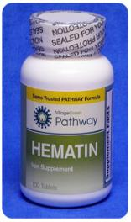

AEHIMNST
HEMATINS
_
HEMATINS: pl. of HEMATIN, also HEME/S, HEMATINE/S, HEMATEIN/S, & HAEMATIN/S. ALL ARE IRON-CONTAINING COMPONENTS OF HEMOGLOBIN
Notes:
.

Slide 36
INMATES
D
ADEIMNST
INMATE + D + S
ONE WORD
Notes:
.

Slide 37
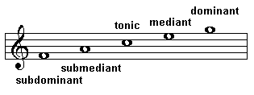
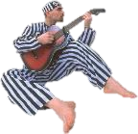
ADEIMNST
MEDIANTS
_
DETAIN + M , INMATE + D = MEDIANT
MEDIANTS: pl. of MEDIANT, A TYPE OF MUSICAL TONE
SAINTED + M INMATES + D
Notes:
SAINTED: “BEGETS IMPROVED TOUCH”
INMATES: “GANEFS OR BLOCKHEADS?”

Slide 38
INMATES
THAT’S IT! THE DIFFICULT BINGOS:
AMBIENTS AMNESTIC
MISEATEN MISAGENT
HEMATINS MATINESS
AMENTIAS MELANIST
SMALTINE misatone
Mankiest nematics
Notes:
.

Slide 39
INMATES
WHAT WAS THAT MNEMONIC PHRASE?
Notes:
.

Slide 40
INMATES
GANEFS OR BLOCKHEADS?
Notes:
GANEF/S, GANEV/S, GANOF/S, GONEF/S, GONIF/S, GONIFF/S, GONOF/S, GONOPH/S all mean THIEF/THIEVES
Shift + F5 to return to full screen

Slide 41
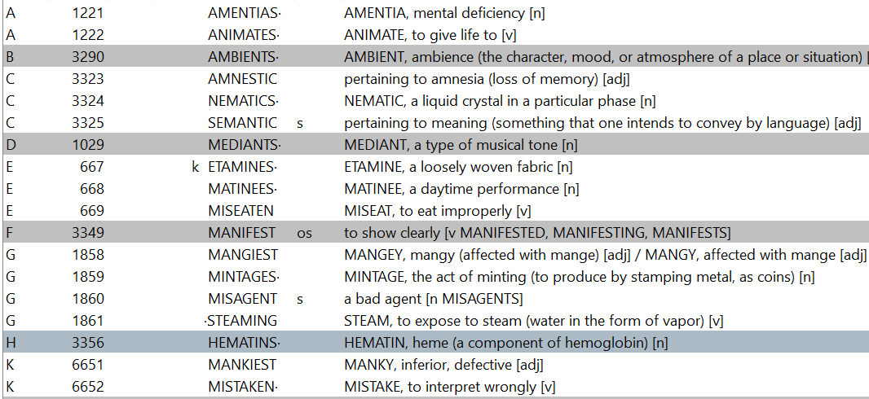
INMATES.
Continued…
Notes:
.

Slide 42
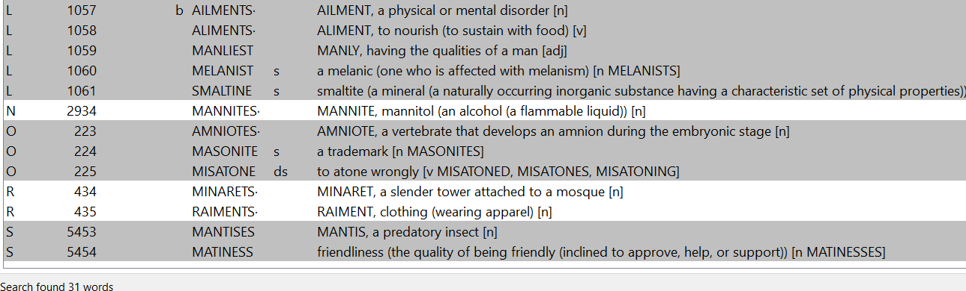
INMATES.
Continued…
Notes:
.

Slide 43
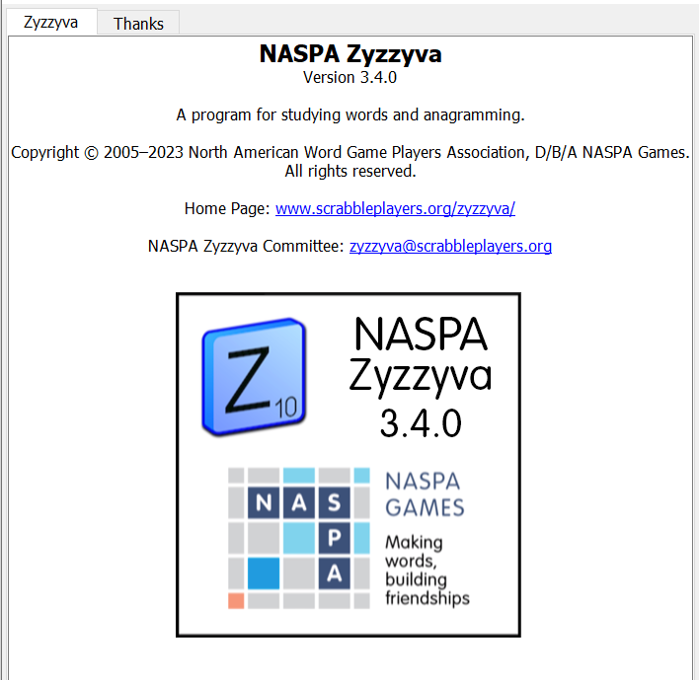
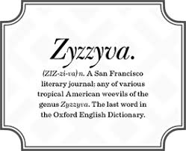
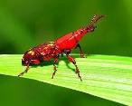
SEND suggestions or requests for additional PowerPoint slide shows to: williamrsnoddy@gmail.com
“Hey, Bill…”
Notes:
.

Slide 44





THE END!
INMATES
GANEFS OR BLOCKHEADS?
Notes:
.

