Slide 1
AEHIRST
Nothing new from NWL23 or OWL24
Notes:
.

Slide 2
AEHIRST
IF the above alphagram does NOT show numbered Scrabble tiles,
then make sure you are viewing your downloaded version in the PowerPoint app
Notes:
.

Slide 3
AEHIRST
Use PowerPoint or Keynote in FULL SCREEN “SLIDE SHOW” mode on your LAPTOP or DESKTOP for best results
When you see the “ESCAPE KEY” ICON check speaker notes for additional information by hitting the escape key
Notes:
.

Slide 4
AEHIRST
WHAT ONE WORD
WILL SERVE AS A BINGO STEM
FOR THIS ALPHAGRAM?
THIS IS SATIRE PLUS AN H. THERE IS ONLY ONE GOOD WORD.
Notes:
SATIRE: “BAD SPEECH REVIEW, FLAMING WIT”

Slide 5
HASTIER
WHAT MNEMONIC PHRASE CAN WE ASSOCIATE WITH THIS BINGO STEM?
Notes:
.

Slide 6
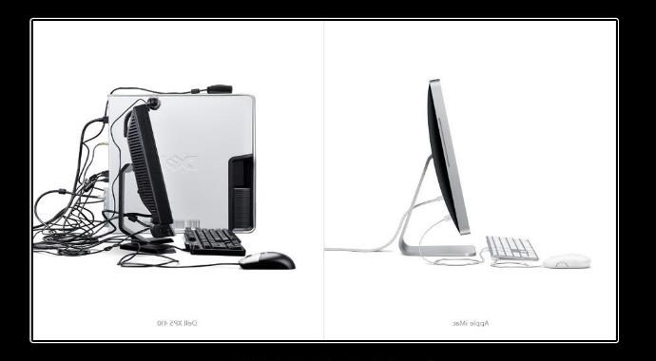
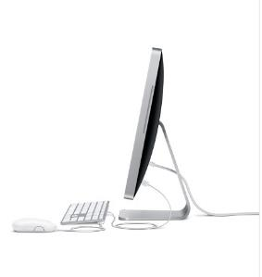
HASTIER
PC? I WARNED YOU!
PC?
I WARNED YOU!
Notes:
HASTIER: “PC? I WARNED YOU!”

Slide 7
HASTIER P
AEHIPRST
ONE WORD
Notes:
.

Slide 8
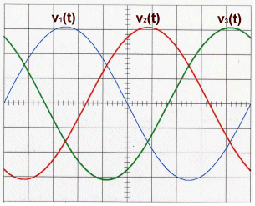
AEHIPRST
TRIPHASE
TRIPHASE: adj. HAVING THREE PHASES
HOOK/S?
UH…NO.
PIRATES + H HASTIER + P
Notes:
PIRATES: “TEN ARMED SCALAWAGS INVADE MY OAKEN SHIP”
HASTIER: “PC? I WARNED YOU”

Slide 9
HASTIER C
ACEHIRST
TWO WORDS
Notes:
.

Slide 10
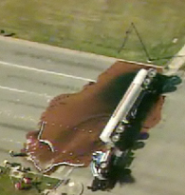
ACEHIRST
CHARIEST
THERIACS
CHARIEST: MOST CHARY, CAUTIOUS (CHARIER)
_
THERIACS: pl. of THERIAC, A MOLASSES AND MEDICATION MIXTURE THOUGHT TO BE A CURE-ALL (also THERIACA/S and THERIACAL)
NOT THE CHARIEST OF DRIVERS, THE VERMONT TRUCKER COVERED THE HIGHWAY WITH THERIACS.
Notes:
.

Slide 11
HASTIER I
AEHIIRST
ONE WORD
Notes:
.

Slide 12
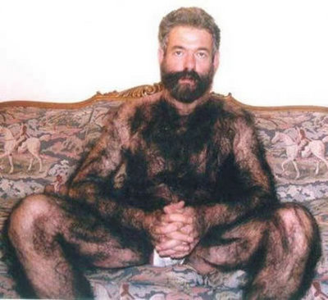
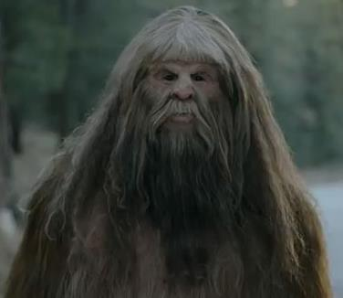
AEHIIRST
HAIRIEST
_
AIRIEST + H
HASTIER + I
Notes:
AIRIEST: *ZaX iNHaLeS oPiuM aiRFLoW (*CoNSoNaNTS oNLY)
HASTIER: “PC? I WARNED YOU”

Slide 13
HASTIER W
AEHIRSTW
ONE WORD
Notes:
.

Slide 14
AEHIRSTW
WATERISH
WATERISH: adj. WATERY
WAITERS + H HASTIER + W
Notes:
WAITERS: “HIRED MEN TAKE TIPS”
HASTIER: “PC? I WARNED YOU”

Slide 15
HASTIER A
AAEHIRST
ONE WORD
Notes:
.

Slide 16
AAEHIRST
HETAIRAS
HETAIRAS: one of the 2 plurals of HETAIRA, A CONCUBINE, OR MISTRESS (also pl. HETAIRAI) [HETAERA, HETAERAS, HETAERAE] plus HETAERIC
Notes:
.

Slide 17
HASTIER R
AEHIRRST
ONE WORD
Notes:
.

Slide 18
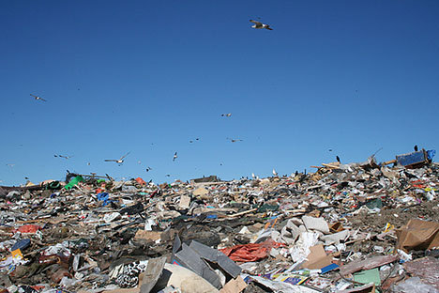
AEHIRRST
TRASHIER
TARRIES + H
HASTIER + R
Notes:
TARRIES: “BELCHER WON’T SPLIT”
HASTIER: “PC? I WARNED YOU”

Slide 19
HASTIER N
AEHINRST
THREE WORDS!
Notes:
.

Slide 20
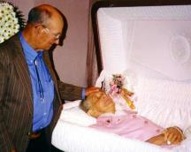
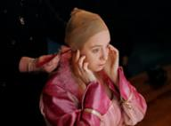
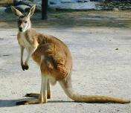
AEHINRST
HAIRNETS
INEARTHS
THERIANS
_
_
INEARTHS: BURIES
THERIANS: pl. of THERIAN, THOSE IN A CERTAIN SUBCLASS OF MAMMALS
_
SHE WORE HAIRNETS SO OFTEN, HE INEARTHS HER WHILE SHE IS WEARING ONE. THERIANS IS A NEWISH WORD.
NASTIER + H HASTIER + N
Notes:
NASTIER: “WICKED HORRIBLE FANG STUMPS!”
HASTIER: “PC? I WARNED YOU”

Slide 21
HASTIER E
AEEHIRST
ONE WORD
Notes:
.

Slide 22
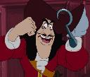
AEEHIRST
HEARTIES
T
AHOY THERE, ME HEARTIES…COULD THERE BE A HOOK, CAPTAIN?
HEARTIEST
HEARTIES: pl. of HEARTY, A CLOSE FRIEND OR COMRADE
SERIATE + H
HASTIER + E
Notes:
SERIATE: “HELPED MY NEW TERMS”
HASTIER: “PC? I WARNED YOU”

Slide 23
HASTIER D
ADEHIRST
ONE WORD
Notes:
.

Slide 24
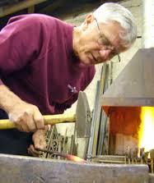
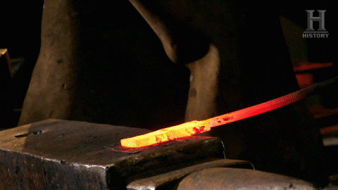
ADEHIRST
HARDIEST
_
HARDIEST: THE MOST HARDY, OR STURDY (HARDIER)
HARDIES: pl. of HARDY, A BLACKSMITH’S CHISEL
TIRADES + H HASTIER + D
Notes:
TIRADES: “WOMEN’S SPEECHES BLASTED MEN”
HASTIER: “PC? I WARNED YOU”

Slide 25
HASTIER Y
AEHIRSTY
ONE WORD
Notes:
.

Slide 26
AEHIRSTY
HYSTERIA
S
HYSTERIA: n. UNCONTROLLABLE EXCITEMENT OR FEAR (also n. HYSTERIC/S)
Notes:
.

Slide 27
HASTIER O
AEHIORST
ONE WORD
Notes:
.

Slide 28
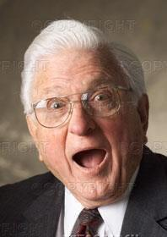
AEHIORST
HOARIEST
AIR-TOES + H
HASTIER + O
HOARIEST: WHITEST WITH AGE (HOARY, HOARIER, HOARIEST)
Notes:
AIR-TOES: “DURN! CHUMP HURT MJ! VUM!”
HASTIER: “PC? I WARNED YOU”

Slide 29
HASTIER U
AEHIRSTU
ONE WORD
Notes:
.

Slide 30
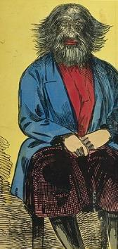
AEHIRSTU
THESAURI
THESAURI: one pl. of THESAURUS, A DICTIONARY OF SYNONYMS & ANTONYMS (also THESAURUSES)
“A HIRSUTE” GUY WITH SEVERAL THESAURI
Notes:
.

Slide 31
HASTIER
THAT’S IT! REVIEW THESE:
HETAIRAS CHARIEST
THERIACS THESAURI
WATERISH TRIPHASE
THERIANS
Notes:
.

Slide 32
HASTIER
WHAT WAS THAT MNEMONIC PHRASE?
Notes:
.

Slide 33
HASTIER
PC? I WARNED YOU!
PC?
I WARNED YOU!
Notes:
HASTIER: “PC? I WARNED YOU!”

Slide 34
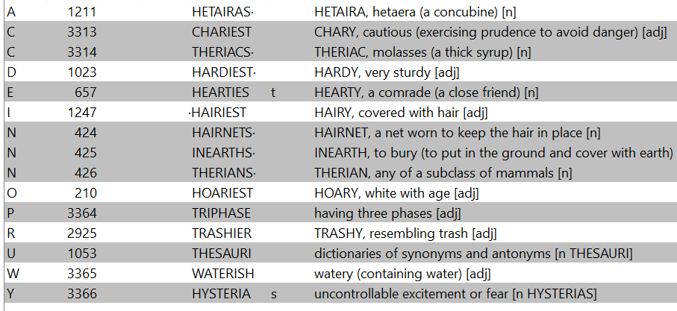
HASTIER.
Notes:
.

Slide 35
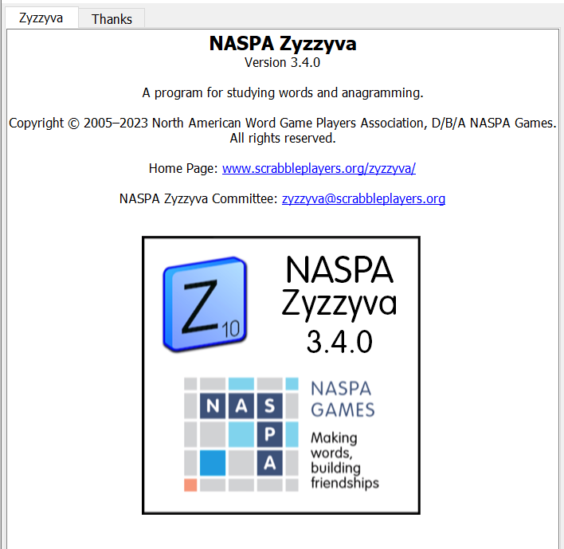
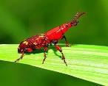
SEND suggestions or requests for additional PowerPoint slide shows to: williamrsnoddy@gmail.com
“Hey, Bill…”
Notes:
.

Slide 36
THE END!
THE END IS COMING!
PC?
I WARNED YOU!
Notes:
.

