Slide 1
AAEINRT
Nothing new from NWL 2023 or WOW24
Notes:
Nothing new from NWL 2023 or WOW24

Slide 2
AAEINRT
IF the above alphagram does NOT show numbered Scrabble tiles,
then make sure you are viewing your downloaded version in the PowerPoint app
Notes:
.

Slide 3




AAEINRT
Use PowerPoint or Keynote in FULL SCREEN “SLIDE SHOW” mode on your LAPTOP or DESKTOP for best results
When you see the “ESCAPE KEY” ICON check speaker notes for additional information by hitting the escape key
Notes:
.

Slide 4
AAEINRT
WHAT BINGO STEM
CAN BE CREATED
FROM THIS ALPHAGRAM?
WAIT, THIS IS RETINA + A, SO THERE IS NO WORD!
RETINA: “THE RED PUPIL PREFERS MUCH WINKING”
A HYPHENATED NON-WORD WILL SERVE AS A BINGO STEM:
Notes:
.

Slide 5




AAEINRT
TEA-RAIN
Notes:
.

Slide 6
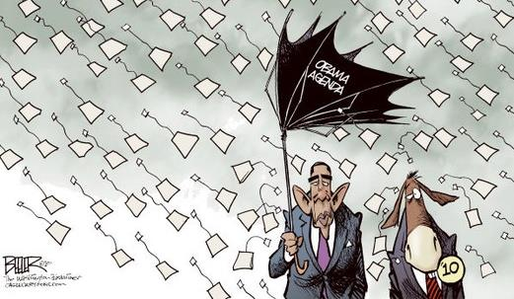



AAEINRT
TEA-RAIN
Notes:
.

Slide 7
TEA-RAIN
WHAT MNEMONIC PHRASE CAN WE ASSOCIATE WITH THIS BINGO STEM?
Notes:
.

Slide 8
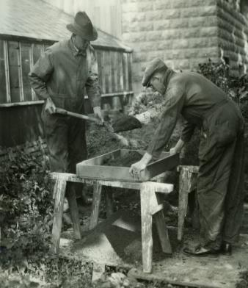




TEA-RAIN
TWO BOZOS GOT COMPOST
COMPOST
Notes:
TEA-RAIN: “TWO BOZOS GOT COMPOST”

Slide 9
TEA-RAIN
T
AAEINRTT
TWO WORDS
Notes:
.

Slide 10
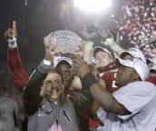
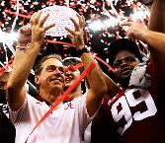
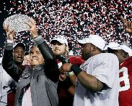
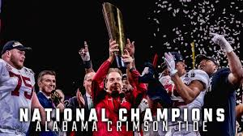
AAEINRTT
ATTAINER
REATTAIN
S
S
ATTAINER: ONE THAT ATTAINS (GAINS OR ACHIEVES BY MENTAL OR PHYSICAL EFFORT)
REATTAIN: ATTAINS AGAIN (REATTAINMENT/S)
2009
2011
2012
2015
2017
2020
Notes:
.

Slide 11
TEA-RAIN
W
AAEINRTW
ONE WORD
Notes:
.

Slide 12
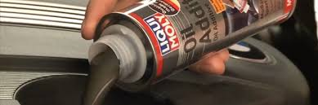
AAEINRTW
ANTIWEAR
ANTIWEAR: adj. DESIGNED TO REDUCE THE EFFECTS OF LONG OR HARD USE (ESPECIALLY REGARDING MOTOR OILS WITH CERTAIN ADDITIVES)
Notes:
.

Slide 13
TEA-RAIN
O
AAEINORT
ONE WORD
Notes:
.

Slide 14
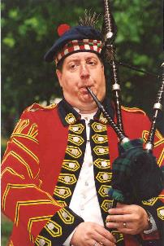

AAEINORT
AERATION
S
AERATION: THE ACT OF AERATING, OR SUPPLYING WITH AIR
AIR-TONE + A
TEA-RAIN + O
Notes:
AIR-TONE: “BACH’S PLAN: RAZZ AT DAD”
TEA-RAIN: “TWO BOZOS GOT COMPOST”

Slide 15
TEA-RAIN
B
AABEINRT
ONE WORD
Notes:
.

Slide 16
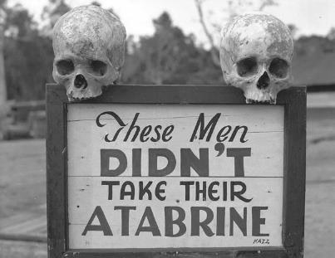
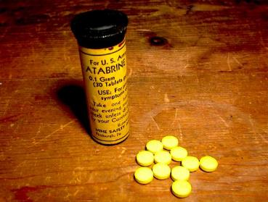
ATABRINE
AABEINRT
S
ATABRINE: A DRUG TO TREAT MALARIA
Notes:
.

Slide 17
TEA-RAIN
Z
AAEINRTZ
ONE WORD
Notes:
.

Slide 18
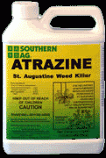
AAEINRTZ
ATRAZINE
S
ATRAZINE: AN HERBICIDE
Notes:
.

Slide 19
TEA-RAIN
S
AAEINRST
THERE ARE FIVE!
Notes:
.

Slide 20
AAEINRST
ANTISERA: pl. of ANTISERUM CONTAINING ANTIBODIES
ANTISERA
ARTESIAN
RATANIES
SANTERIA
SEATRAIN
ARTESIAN: adj. PERTAINING TO A TYPE OF WELL
RATANIES: pl. of RATANY, A SHRUB (also RATANIES)
SANTERIA: A RELIGION OF THE CARRIBEAN REGION
S
S
SEATRAIN: A SHIP EQUIPPED TO CARRY RAILROAD CARS
TEA-RAIN + S NASTIER + A
Notes:
NASTIER: “WICKED HORRIBLE FANG STUMPS!”
TEA-RAIN: “TWO BOZOS GOT COMPOST”

Slide 21
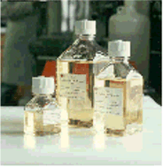
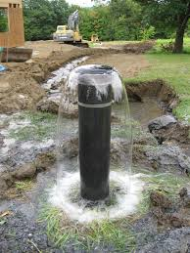
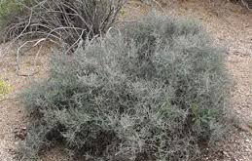
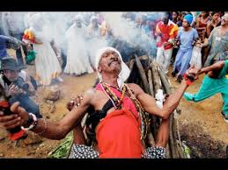
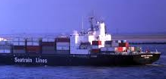
AAEINRST
ANTISERA
ARTESIAN
RATANIES
SANTERIA
SEATRAIN
Notes:
.

Slide 22
TEA-RAIN
G
AAEGINRT
ONE WORD
Notes:
.

Slide 23
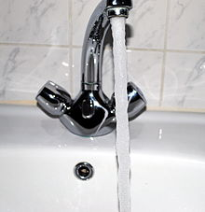
AAEGINRT
AERATING
GRANITE + A TEA-RAIN + G
Notes:
GRANITE: “EXCAVATED SLABS MAKE CHEAP WALLS”
TEA-RAIN: “TWO BOZOS GOT COMPOST”

Slide 24
TEA-RAIN
C
AACEINRT
TWO WORDS
Notes:
.

Slide 25
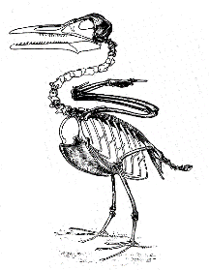
AACEINRT
CARINATE
CRANIATE
D
S
CARINATE: adj. SHAPED LIKE THE KEEL OF A SHIP
CRANIATE: noun (!) ONE THAT HAS A SKULL
A CARINATE CHEST CAGE FOR THIS CRANIATE
Notes:
.

Slide 26
TEA-RAIN
M
AAEIMNRT
TWO WORDS
Notes:
.

Slide 27

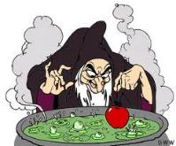
AAEIMNRT
ANIMATER
MARINATE
_
S
D
S
ANIMATER: ONE THAT GIVES LIFE TO (also ANIMATOR/S)
MARINATE: TO SOAK IN A SEASONED LIQUID
(MARINATING also MARINADE etc. plus MARINATION/S)
THE ANIMATER DEPICTS HOW THE WICKED WITCH WILL MARINATE THE POISONED APPLE.
Notes:
.

Slide 28
TEA-RAIN
P
AAEINPRT
ONE WORD
Notes:
.

Slide 29

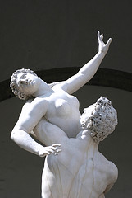
AAEINPRT
ANTIRAPE
PAINTER + A
TEA-RAIN + P
Notes:
PAINTER: “GATHERED OILS”
TEA-RAIN: “TWO BOZOS GOT COMPOST”

Slide 30
TEA-RAIN
THAT’S IT! THE DIFFICULT BINGOS:
CARINATE SANTERIA
CRANIATE ANTIRAPE
ANTIWEAR ATRAZINE
RATANIES ATABRAIN
SANTERIA ARTESIAN
Notes:
.

Slide 31
TEA-RAIN
WHAT WAS THAT MNEMONIC PHRASE?
Notes:
.

Slide 32

TEA-RAIN
TWO BOZOS GOT COMPOST
COMPOST
Notes:
TEA-RAIN: “TWO BOZOS GOT COMPOST”

Slide 33
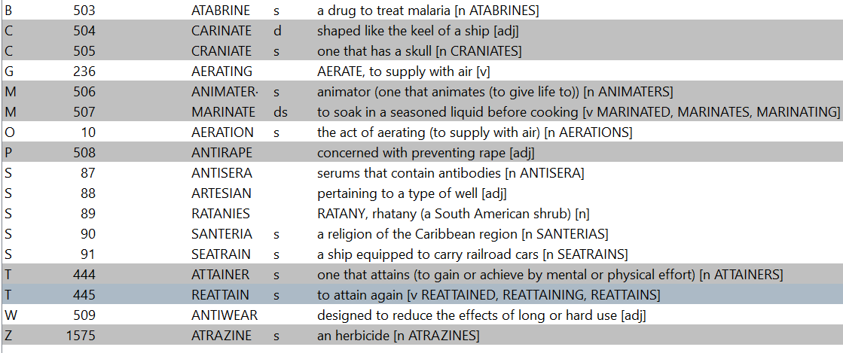
TEA-RAIN.
Notes:
.

Slide 34
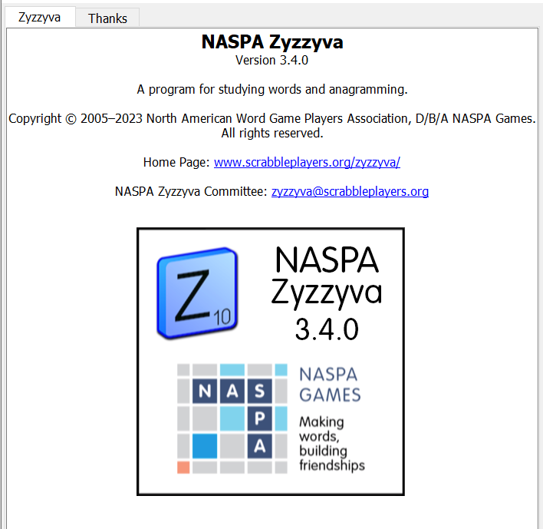

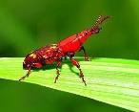
SEND suggestions or requests for additional PowerPoint slide shows to: williamrsnoddy@gmail.com
“Hey, Bill…”
Notes:
.

Slide 35






THE END!
TEA RAIN
TWO BOZOS GOT COMPOST
Notes:
.

