Slide 1
ACEERS
No new words from NWL23 or OWL24
Notes:
.

Slide 2
ACEERS
IF the above alphagram does NOT show numbered Scrabble tiles,
then make sure you are viewing your downloaded version in the PowerPoint app
Notes:
.

Slide 3
ACEERS
Use PowerPoint or Keynote in FULL SCREEN “SLIDE SHOW” mode on your LAPTOP or DESKTOP for best results
When you see the “ESCAPE KEY” ICON check speaker notes for additional information by hitting the escape key
Shift + F5 to return to full screen (or click the Џ symbol near the bottom right of your screen)
Notes:
.

Slide 4
ACEERS
WHAT IS THE BINGO STEM FOR THIS ALPHAGRAM?
Notes:
.

Slide 5
ACEERS
CREASE
THERE ARE NO OTHER 6-LETTER WORDS FROM THIS ALPHAGRAM
Notes:
.

Slide 6
CREASE
WHAT MNEMONIC PHRASE
CAN WE ASSOCIATE
WITH THIS BINGO STEM?
Notes:
.

Slide 7
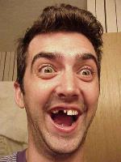
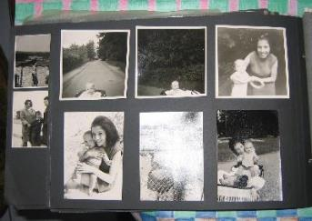
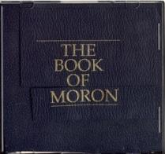
CReASE
DON’T FOLD UP
PHOTOS, MORON!
DON'T FOLD UP
Notes:
CREASE: “DON’T FOLD UP PHOTOS, MORON!”

Slide 8
CREASE D
ACDEERS
TWO WORDS
Notes:
.

Slide 9
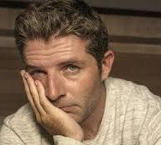
ACDEERS
RESEDA + C CREASE + D
CREASED
DECARES
_
_
DECARES?
DECARES??
HIS BROW CREASED WHEN TRYING TO REMEMBER THE DEFINITION OF DECARES, WHICH HAS TO DO WITH MEASURES OF SURFACE AREA EQUAL TO TEN ACRES (syn. DEKARE/S)
ADD “R” FOR AN OWL3 “8” + ANAGRAM:
SACREDER [ ]
SCAREDER
Notes:
RESEDA: “MINX PICKS THRIVING LIMB’S TWIGS”
CREASE: “DON’T FOLD UP PHOTOS, MORON!”

Slide 10
CREASE O
ACEEORS
ONE WORD
Notes:
.

Slide 11
ACEEORS
ACEROSE
ACEROSE: adj. NEEDLE-SHAPED
SEE-ORA + C CREASE + O
ACEROUS, ACIFORM, ACERATE, & ACERATED
Notes:
SEE-ORA: *See BLuNT CaViTieS (*CoNSoNaNTS oNLY)
CREASE: “DON’T FOLD UP PHOTOS, MORON!”

Slide 12
CREASE N
ACEENRS
THREE WORDS
Notes:
.

Slide 13
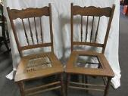
ACEENRS
CAREENS
CASERNE
RECANES
_
_
S
_
CASERNE: A BARRACKS FOR SOLDIERS (also CASERN/S)
HOOK/S?
THE SOLDIER CAREENS BACK TO THE CASERNE WHERE HE RECANES CHAIRS.
CASERNES
RANEES + C CREASE + N
Notes:
RANEES: “OPT TO LOOK DOWN ON COMMON GROTTO”
CREASE: “DON’T FOLD UP PHOTOS, MORON!”

Slide 14
CREASE T
ACEERST
THREE WORDS
Notes:
.

Slide 15
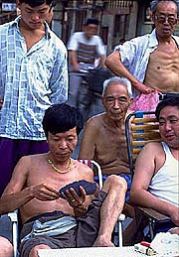
ACEERST
CATERS + E EASTER + C CREASE + T
CERATES
CREATES
ECARTES
_
_
_
_
CERATES: pl. of CERATE, A MEDICATED OINTMENT
ECARTES: pl. of ECARTE, A FRENCH CARD GAME
STICKY HANDS FROM APPLYING CERATES CREATES DIFFICULTY WHEN DEALING DURING ECARTES!
Notes:
CERATES: PREPARATIONS FOR EXTERNAL APPLICATION, MAINLY WAX MIXED WITH OIL, LARD, AND MEDICINAL INGREDIENTS
ECARTES : pl. of ECARTE, A TWO-HANDED CARD GAME WHICH IS PLAYED WITH A 32-CARD PACK
Shift + F5 to return to full screen (or click the Џ symbol near the bottom right of your screen)
CATERS: “HE SELLS DRINKS AT YOUR PARTY”
EASTER: “CHRIST BACK UP, GOD WILL FIX MAN”
CREASE: “DON’T FOLD UP PHOTOS, MORON!”

Slide 16
CREASE F
ACEEFRS
ONE WORD
Notes:
.

Slide 17
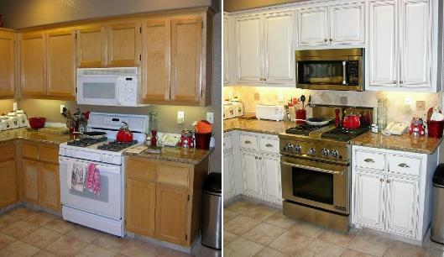
ACEEFRS
REFACES
P
_
REFACES: v. REPAIRS THE OUTER SURFACE OF (REFACE, REFACED, REFACING)
HOOK/S?
PREFACES
An example of how adding a front hook “P” can change the entire meaning of a word.
Notes:
REFACE. You can do it, but you cannot “be it.” (there is no –er form)
Shift + F5 to return to full screen (or click the Џ symbol near the bottom right of your screen)

Slide 18
CREASE L
ACEELRS
FOUR WORDS
Notes:
.

Slide 19
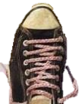
ACEELRS
_
CEREALS
RELACES
RESCALE
SCLERAE
_
D
S
_
SCLERAE: one pl. of SCLERA, THE WHITE, FIBROUS OUTER COAT OF THE EYEBALL (also pl. SCLERAS, adj. SCLERAL)
HOOK/S?
RESCALED RESCALES
SCALER + E RESALE + C CREASE + L
Notes:
SCALER: “THIS AVOWED MOUNTAINEER CLIMBED PEAKS”
RESALE: “HOCKEY TICKET DID GET EXPENSIVE”
CREASE: “DON’T FOLD UP PHOTOS, MORON!”

Slide 20
CREASE U
ACEERSU
ONE WORD
Notes:
.

Slide 21
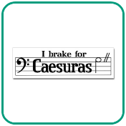
ACEERSU
CESURAE
_
CESURAE: one pl. of CESURA, A PAUSE IN A LINE OF VERSE OR MUSIC, also pl. CESURAS (also CAESURA, pl. CAESURAS, CAESURAE, adj. CAESURAL, CAESURIC)
CESURAE
Notes:
.

Slide 22
CREASE P
ACEEPRS
THERE ARE THREE!
Notes:
.

Slide 23
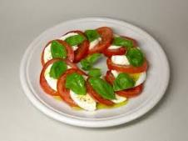
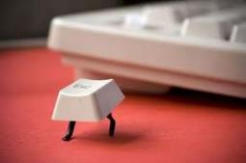
ACEEPRS
S
CAPRESE: n. A SALAD
CAPRESE
ESCAPER
RESPACE
_
S
D
S
RESPACE: v. TO SPACE AGAIN OR DIFFERENTLY
HOOK/S?
CAPRESES ESCAPERS RESPACED RESPACES
Notes:
CAPRESE: A SALAD CONTAINING MOZZARELLA, TOMATOES, BASIL, AND OLIVE OIL
Shift + F5 to return to full screen (or click the Џ symbol near the bottom right of your screen)

Slide 24
CREASE H
ACEEHRS
ONE WORD
Notes:
.

Slide 25
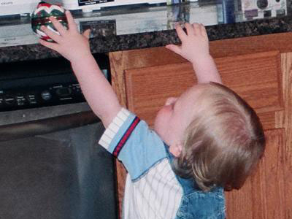
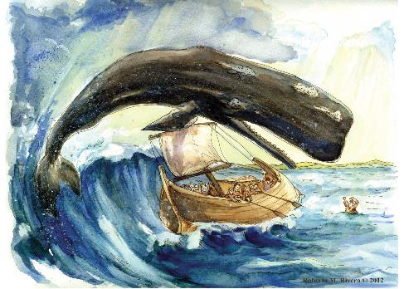
ACEEHRS
B
REACHES
P
HOOK/S?
BREACHES
PREACHES
“Jonah…”
Notes:
.

Slide 26
CREASE S
ACEERSS
ONE WORD
Notes:
.

Slide 27
ACEERSS
CREASES
_
Notes:
.

Slide 28
CREASE M
ACEEMRS
TWO WORDS
Notes:
.

Slide 29
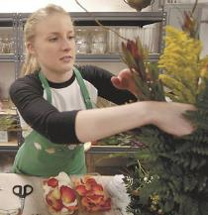
ACEEMRS
AMERCES: v. PUNISHES BY IMPOSING AN ARBITRARY FINE (AMERCE, AMERCED, AMERCING)
_
_
AMERCES
RACEMES
_
RACEMES: pl. of RACEME, A MODE OF ARRANGING FLOWERS ALONG AN AXIS (adj. RACEMED, RACEMIC)
THE UPSCALE FLORIST AMERCES ITS EMPLOYEES IF THEY FAIL TO INCLUDE ENOUGH RACEMES IN ARRANGEMENTS.
Notes:
THE ADJECTIVE RACEMIC COMES FROM A DIFFERENT ORIGIN, RACEMATE (RACEMATES, RACEMISM/S)
MERCE: A REWARD (pl. MERCES)
Shift + F5 to return to full screen (or click the Џ symbol near the bottom right of your screen)

Slide 30
CREASE R
ACEERRS
TWO WORDS
Notes:
.

Slide 31
ACEERRS
CAREERS
CREASER
_
_
S
SINCE SOME CAREERS REQUIRE DRESSING SHARPLY, THE INTERVIEWEE IS A CAREFUL CREASER.
ERASER + C CREASE + R
ADD “D” FOR TWO “EIGHTS”
SACREDER & SCAREDER
Notes:
ERASER: “WIPING FINDS VICTIM’S THUMBPRINT”
CREASE: “DON’T FOLD UP PHOTOS, MORON!”

Slide 32
CREASE
THAT’S IT!
WHAT WAS THAT MNEMONIC PHRASE?
Notes:
.

Slide 33
CReASE
DON’T FOLD UP
PHOTOS, MORON!
DON'T FOLD UP
Notes:
CREASE: “DON’T FOLD UP PHOTOS, MORON!”

Slide 34
CREASE
BINGOS WORTH REVIEWING:
DECARES SCLERAE
ACEROSE CESURAE
CASERNE AMERCES
ECARTES RACEMES
CERATES CAPRESE
Notes:
.

Slide 35
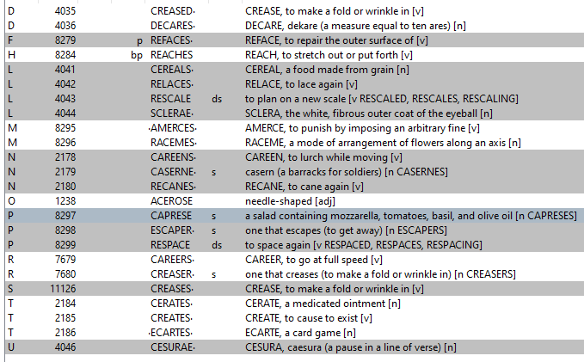
CREASE
Notes:
.

Slide 36
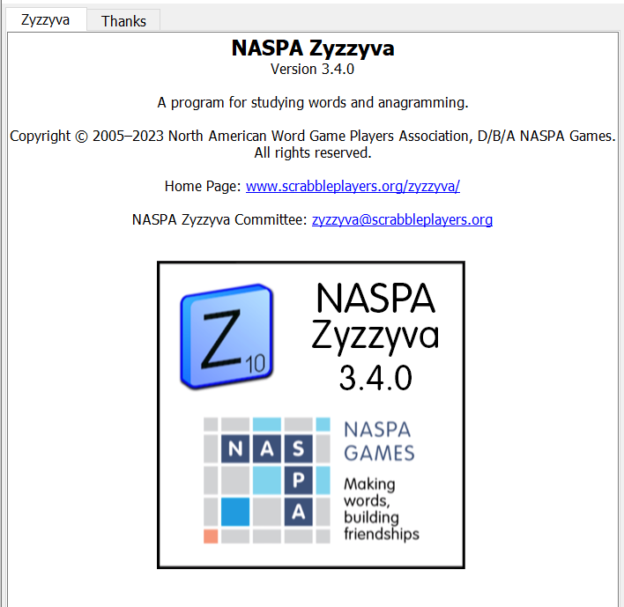
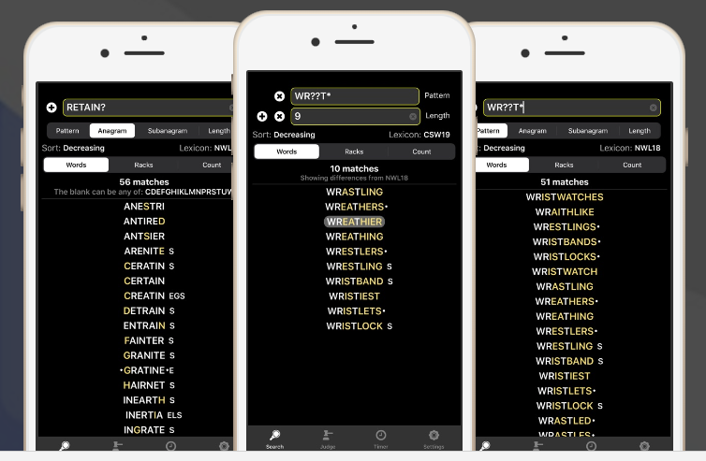
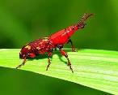
SEND suggestions or requests for additional PowerPoint slide shows to: williamrsnoddy@gmail.com
“Hey, Bill…”
Notes:
.

Slide 37
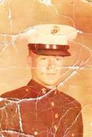
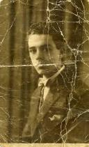
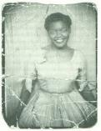
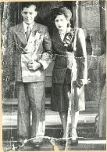
THE END!
Notes:
.

