Slide 1
EIRSTU
No new words from NWL23 or OWL24
Notes:
.

Slide 2
EIRSTU
IF the above alphagram does NOT show numbered Scrabble tiles,
then make sure you are viewing your downloaded version in the PowerPoint app
Notes:
.

Slide 3
EIRSTU
Use PowerPoint or Keynote in FULL SCREEN “SLIDE SHOW” mode on your LAPTOP or DESKTOP for best results
When you see the “ESCAPE KEY” ICON check speaker notes for additional information by hitting the escape key
Shift + F5 to return to full screen (or click the Џ symbol near the bottom right of your screen)
Notes:
.

Slide 4
EIRSTU
ONLY ONE GOOD BINGO STEM
CAN BE CREATED
FROM THIS ALPHAGRAM:
Notes:
.

Slide 5
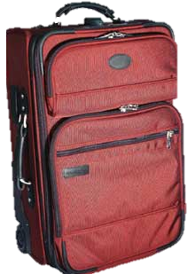
EIRSTU
SUITER
SUITER: A SUITCASE HOLDING SUITS
Notes:
.

Slide 6
SUITER
WHAT MNEMONIC PHRASE CAN WE ASSOCIATE WITH THIS BINGO STEM?
Notes:
.

Slide 7
SUITER
“I JUST SOLD MY IDIOT BOSS A BIKE THAT WON’T LAST A MONTH! GOT MY SUITER ‘CAUSE I’M OUT OF HERE!”
SO THE PHRASE:
Notes:
.

Slide 8
SUITER
GOOK FOOLS DOM QOPH (CONS BOSS) VROOM!
Notes:
SUITER: “GOOK FOOLS DOM QOPH (CONS BOSS) VROOM!”
Yes, sorry, GOOK is derogatory, but still good in Scrabble because it also means “goo, a sticky or viscous substance.”
(adj. GOOKY, but it does not compare)
Also DUMMKOPF doesn’t work as well for our purposes here, so DOM QOPH it is.

Slide 9
SUITER G
EGIRSTU
TWO WORDS
Notes:
.

Slide 10
EGIRSTU
GUSTIER
GUTSIER
WHEN THE WINDS ARE SHIFTING AND GUSTIER, IT TAKES A GUTSIER GUIDE TO GET CLOSE TO A TIGER.
TIGERS + U SUITER + G
Notes:
TIGERS: “UNUSUAL FOR OUR SAVANNAH”
SUITER: “GOOK FOOLS DOM QOPH (CONS BOSS) VROOM!”

Slide 11
SUITER O
EIORSTU
ONE WORD
Notes:
.

Slide 12
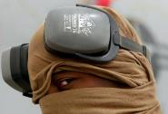
EIORSTU
STOURIE
NAVAL
NAVAL
SORTIE + U SUITER + O {STOURIE + ?}
STOURIE: adj. DUSTY (also adj. STOURY)
STOUR/S AND STOURE/S BOTH MEAN “DUST”
Notes:
SORTIE: “U.S. CHUMS DROP BOMBS ON GULF”
SUITER: “GOOK FOOLS DOM QOPH (CONS BOSS) VROOM!”
STOURIE: “NAVAL CAMP HAD FAN”

Slide 13
SUITER K
EIKRSTU
ONE WORD
Notes:
.

Slide 14
EIKRSTU
TUSKIER
TUSKIER: adj. MORE TUSKY, HAVING TUSKS (TUSKIEST)
Notes:
.

Slide 15
SUITER F
EFIRSTU
TWO WORDS
Notes:
.

Slide 16
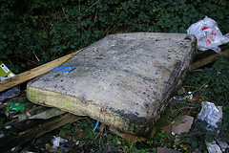
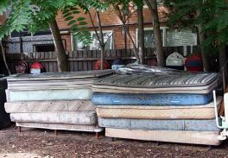
EFIRSTU
SURFEIT: verb TO SUPPLY TO EXCESS
FUSTIER
SURFEIT
SURFEITS SURFEITED SURFEITING
S
FUSTIER: MORE FUSTY, MUSTY, HAVING A STALE ODOR (FUSTIEST, also FOUSTY, FOUSTIER, FOUSTIEST)
ALTHOUGH ONE WAS MUCH FUSTIER THAN THE OTHERS, DONORS DID SURFEIT THE NEEDY WITH MATTRESSES.
Notes:
FUSTY: 1) impaired by age or dampness, moldy 2) saturated with dust and stale odors, musty 3) rigidly old-fashioned or reactionary
FOUSTY: apparently can share all of those definitions
Shift + F5 to return to full screen (or click the Џ symbol near the bottom right of your screen)

Slide 17
SUITER L
EILRSTU
THERE ARE THREE!
Notes:
.

Slide 18
EILRSTU
LUSTIER
RULIEST
RUTILES
_
_
WHAT MIGHT INDUCE A LUSTIER RESPONSE THAN, SAY, FLOWERS? THE RULIEST JEWELER MIGHT CAREFULLY CONSTRUCT A NECKLACE OF RUTILES.
RULIEST: MOST RULY, MOST ORDERLY (RULIER)
RUTILES: pl. of RUTILE, A REDDISH-BROWN MINERAL
LISTER + U SUITER + L
Notes:
UTILE: AN AFRICAN HARDWORD TREE (pl. UTILES)
Shift + F5 to return to full screen (or click the Џ symbol near the bottom right of your screen)
LISTER: “CHIEF JOB: MAKING UP LISTS”
SUITER: “GOOK FOOLS DOM QOPH (CONS BOSS) VROOM!”

Slide 19
SUITER S
EIRSSTU
ONE WORD
Notes:
.

Slide 20
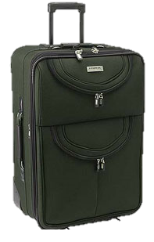
EIRSSTU
SUITERS
_
SUREST + I SISTER + U SUITER + S
SUITERS: pl. of SUITER, A SUITCASE
Notes:
SUREST: “KID CLIMBS, NO INJURY”
SISTER: “FEMALE, BUT DOESN’T EVOKE PANGS”
SUITER: “GOOK FOOLS DOM QOPH (CONS BOSS) VROOM!”

Slide 21
SUITER D
DEIRSTU
TWO WORDS
Notes:
.

Slide 22
DEIRSTU
DUSTIER
STUDIER
S
THE DUSTIER BIBLES WILL NOT LIKELY BE FOUND IN A SUITER FOR THE STUDIER HEADED TO BIBLE CAMP.
STRIDE + U SUITER + D
Notes:
STRIDE: “BRISK CHAP RUNS OVER, WINS
SUITER: “GOOK FOOLS DOM QOPH (CONS BOSS) VROOM!”

Slide 23
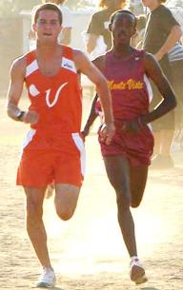
DEIRSTU
DUSTIER
STUDIER
S
STRIDE + U SUITER + D
Notes:
RESTUDY, but no studyer*
Shift + F5 to return to full screen (or click the Џ symbol near the bottom right of your screen)
STRIDE: “BRISK CHAP RUNS OVER, WINS
SUITER: “GOOK FOOLS DOM QOPH (CONS BOSS) VROOM!”

Slide 24
SUITER M
EIMRSTU
ONE WORD
Notes:
.

Slide 25
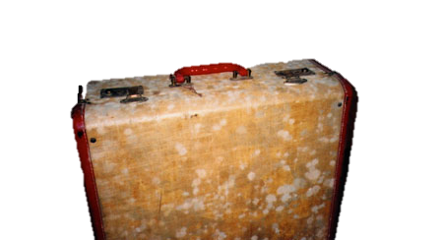
EIMRSTU
MUSTIER
MISTER + U SUITER + M
Notes:
MISTER: “MISTER LEFT BOOK OUT ON PARK BENCH”
SUITER: “GOOK FOOLS DOM QOPH (CONS BOSS) VROOM!”

Slide 26
SUITER Q
EIQRSTU
ONE WORD
Notes:
.

Slide 27
EIQRSTU
QUERIST
S
QUERIST: ONE WHO QUERIES, PUTS A QUESTION TO, INQUIRES
Notes:
.

Slide 28
SUITER P
EIPRSTU
ONE WORD
Notes:
.

Slide 29
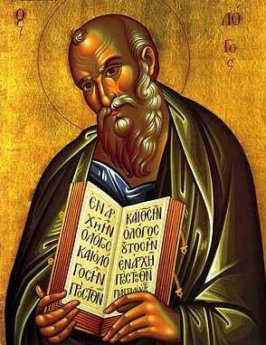
EIPRSTU
PERITUS
PERITUS: AN EXPERT THEOLOGIAN
PLURAL?
PERITI
SPRITE + U SUITER + P
Notes:
ADD “C” TO GET FOUR EIGHT-LETTER WORDS:
CREPITUS CUPRITES PICTURES PIECRUST
Shift + F5 to return to full screen (or click the Џ symbol near the bottom right of your screen)
SPRITE: “EVERY ADULT COMPLAINED OF THIRST”
SUITER: “GOOK FOOLS DOM QOPH (CONS BOSS) VROOM!”

Slide 30
SUITER H
EHIRSTU
ONE WORD
Notes:
.

Slide 31
EHIRSTU
HIRSUTE
HIRSUTE: adj. HAIRY OR COVERED WITH HAIR (HIRSUTISM/S, HIRSUTENESS, HIRSUTENESSES)
HER SUIT AND TIE
Notes:
.

Slide 32
SUITER C
CEIRSTU
TWO WORDS
Notes:
.

Slide 33
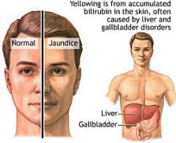
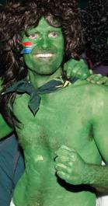
CEIRSTU
CURITES
ICTERUS
_
CURITES: pl. of CURITE, A RADIOACTIVE MATERIAL
ICTERUS: A DISEASED CONDITION OF THE LIVER (the only pl. ICTERUSES)
EXPOSURE TO CURITES DOES NOT RESULT IN GREEN BODIES, BUT YELLOW JAUNDICE CAN LATER OCCUR WITH ICTERUS.
Notes:
.

Slide 34
SUITER N
EINRSTU
THERE ARE THREE!
Notes:
.

Slide 35
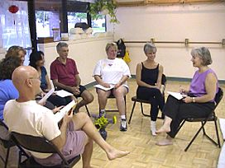
EINRSTU
NUTSIER
TRIUNES
UNITERS
_
_
_
TRIUNES: TRINITIES
THE NUTSIER PATIENTS OFTEN SUFFER FROM EXCESSIVE RELIGIOSITY AND OFTEN INSERT REFERENCES TO TRIUNES LIKE FATHER, SON, AND HOLY GHOST, BUT IN GROUP PSYCHOTHERAPY, THE UNITERS UNDERSTAND THE IMPORTANCE OF WORKING TOGETHER AS A GROUP.
TUNERS + I, UNITER + S, URINES + T, INSERT + U, SUITER + N
Notes:
\NITERS: pl. of NITER, A CHEMICAL SALT Shift + F5 to return to full screen (or click the Џ symbol near the bottom right of your screen)
TUNERS: “FINE OLD PIANOS BECOME RIGHT”
UNITER: “GRABBED MORE VOTES”
URINES: “STRONG FROWN, MOP JOB (PDQ)”
INSERT: “DOPES WOULD LOVE TO MAKE A FEW CHANGES”
SUITER: “GOOK FOOLS DOM QOPH (CONS BOSS) VROOM!”

Slide 36
SUITER B
BEIRSTU
TWO WORDS
Notes:
.

Slide 37
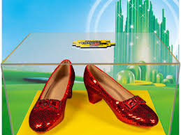
BEIRSTU
BUSTIER
RUBIEST
S
RUBIEST: MOST RUBY IN COLOR (RUBIER)
_
BUSTIER: adj. A COMPARATIVE OF BUSTY (BUSTIEST) and n. A WOMAN’S UNDERGARMENT
BUSTIER (adj.)
and
BUSTIER (n.)
and
RUBIEST
Notes:
.

Slide 38
SUITER V
EIRSTUV
THERE ARE THREE!
Notes:
.

Slide 39
EIRSTUV
REVUIST
STUIVER
VIRTUES
S
REVUIST: WRITER OF REVUES
S
STUIVER: A FORMER DUTCH COIN (also STIVER/S)
_
THE REVUIST ACCEPTED A STUIVER OR TWO TO EXTOL THE VIRTUES OF A SO-SO DUTCH MOVIE.
Notes:
REVIEW AND REVIEWER, BUT REVUE DOES NOT MEAN THAT revuer* IS GOOD, ONLY REVUIST!
Shift + F5 to return to full screen (or click the Џ symbol near the bottom right of your screen)

Slide 40
SUITER R
EIRRSTU
ONE WORD
Notes:
.

Slide 41
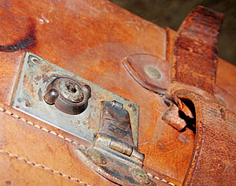
EIRRSTU
C
RUSTIER
T
HOOK/S?
CRUSTIER TRUSTIER
Notes:
.

Slide 42
SUITER
THAT’S IT! BINGOS WORTH REVIEWING:
RUBIEST CURITES
ICTERUS FUSTIER
HIRSUTE RUTILES
NUTSIER STUIVER
QUERIST REVUIST
PERITUS TUSKIER
Notes:
.

Slide 43
SUITER
WHAT WAS THAT MNEMONIC PHRASE?
Notes:
.

Slide 44
SUITER
GOOK FOOLS DOM QOPH (CONS BOSS) VROOM!
Notes:
SUITER: “GOOK FOOLS DOM QOPH (CONS BOSS) VROOM!”
Yes, sorry, GOOK is derogatory, but still good in Scrabble because it also means “goo, a sticky or viscous substance.”
Also DUMMKOPF doesn’t work as well for our purposes here, so DOM QOPH it is.

Slide 45
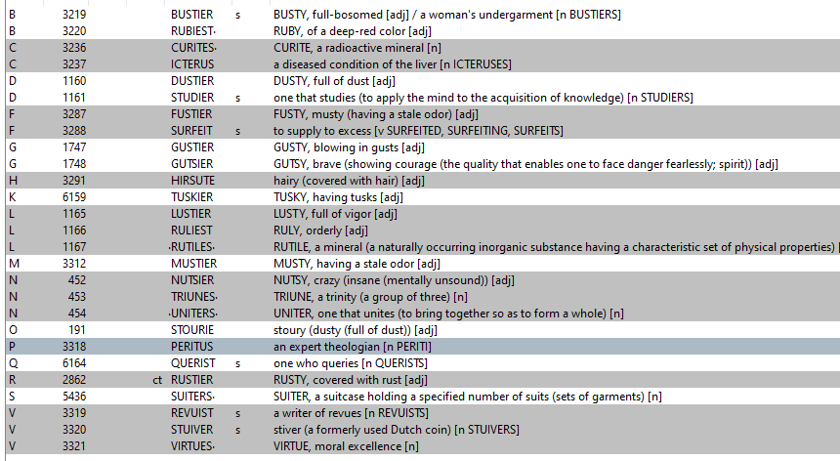
SUITER
Notes:
SUETY: adj. pertaining to the hard fatty tissue around the kidneys of cattle and sheep
But suetier* and suetiest* are no longer good in Scrabble

Slide 46
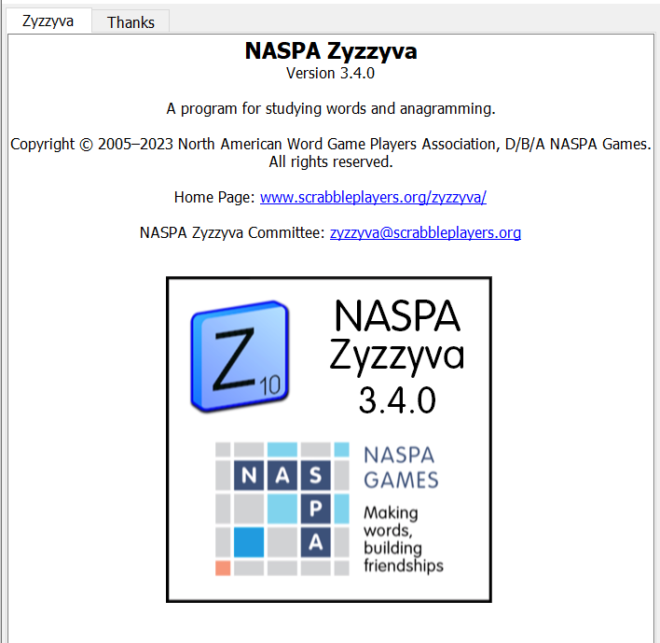
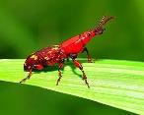
SEND suggestions or requests for additional PowerPoint slide shows to: williamrsnoddy@gmail.com
“Hey, Bill…”
Notes:
.

Slide 47
THE END
GOOK FOOLS DOM QOPH
(CONS BOSS) VROOM!
Notes:
.

