Slide 1
AELORT
No new words from NWL23 or OWL24
Notes:
.

Slide 2
AELORT
IF the above alphagram does NOT show numbered Scrabble tiles,
then make sure you are viewing your downloaded version in the PowerPoint app
Notes:
.

Slide 3




AELORT
Use PowerPoint or Keynote in FULL SCREEN “SLIDE SHOW” mode on your LAPTOP or DESKTOP for best results
When you see the “ESCAPE KEY” ICON check speaker notes for additional information by hitting the escape key
Shift + F5 to return to full screen (or click the Џ symbol near the bottom right of your screen)
Notes:
.

Slide 4

AELORT
WHAT BINGO STEM
CAN BE CREATED
FROM THIS ALPHAGRAM?
Notes:
.

Slide 5


AELORT
ALE-ROT
THERE ARE STILL NO GOOD WORDS FROM THIS ALPHAGRAM, AND ALE-ROT SERVES AS THE STEM!
Notes:
ACTUALLY, LORATE# is good in the Collins word list, and means having the form of a thong. [film at eleven]
Shift + F5 to return to full screen (or click the Џ symbol near the bottom right of your screen)

Slide 6
ALE-ROT
WHAT MNEMONIC PHRASE CAN WE ASSOCIATE WITH THIS BINGO STEM?
Notes:
.

Slide 7



ALE-ROT
GUV CHUGS CUPFUL, BLURTS “DUH!”
DUH!
ALE
Notes:
ALE-ROT: GUV CHUGS CUPFUL, BLURTS “DUH”

Slide 8
ALE-ROT
G
AEGLORT
TWO WORDS
Notes:
.

Slide 9



AEGLORT
GLOATER
LEGATOR
S
S
_
LEGATOR: ONE WHO LEGATES, BEQUEATHS, GRANTS BY TESTAMENT
“I got it, I got it!!!
THE PLURALS ARE FROM OLESTRA + G
Notes:
OLESTRA: “HELPS REDUCE BULGES; FEEL SVELTE!”

Slide 10
ALE-ROT
U
AELORTU
ONE WORD
Notes:
.

Slide 11
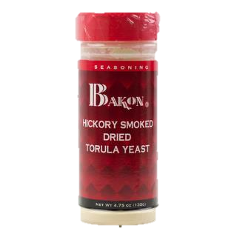
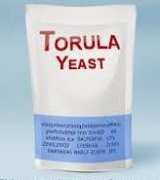
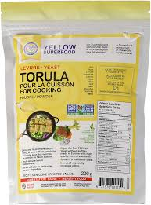
AELORTU
TORULAE
_
TORULAE: one pl. of TORULA, A KIND OF FUNGUS OR YEAST (also pl. TORULAS)
Notes:
.

Slide 12
ALE-ROT
V
AELORTV
ONE WORD
Notes:
.

Slide 13
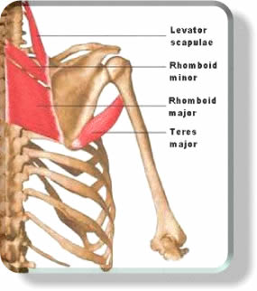
LEVATOR
AELORTV
E
S
HOOK/S?
ELEVATOR LEVATORS
also plural: LEVATORES [ELEVATORS]
LEVATORS ANAGRAMS TO:
[OVERSALT] FROM OLESTRA + V
LEVATOR: A MUSCLE THAT RAISES AN ORGAN OR PART
Notes:
OLESTRA: “HELPS REDUCE BULGES; FEEL SVELTE!”
Teres major, teres minor one TERES, two TERESES or two TERETES
Shift + F5 to return to full screen (or click the Џ symbol near the bottom right of your screen)

Slide 14
ALE-ROT
C
ACELORT
THERE ARE TWO!
Notes:
.

Slide 15
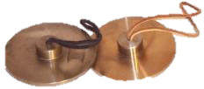


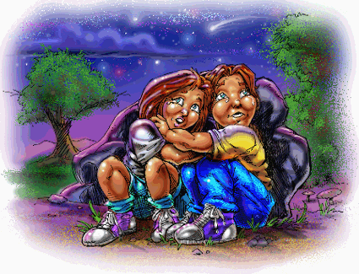
ACELORT
CROTALE
LOCATER
CROTALE: A SMALL CYMBAL (pl. CROTALES)
S
_
S
ALSO LOCATOR
ALE-ROT + C ORACLE + T
THE PLURALS ANAGRAM:
SECTORAL [OLESTRA + C]
Notes:
ALE-ROT: GUV CHUGS CUPFUL, BLURTS “DUH”
ORACLE: “JACK AND JILL, TRY THIS”
OLESTRA: “HELPS REDUCE BULGES; FEEL SVELTE!”

Slide 16
ALE-ROT
H
AEHLORT
TWO WORDS
Notes:
.

Slide 17
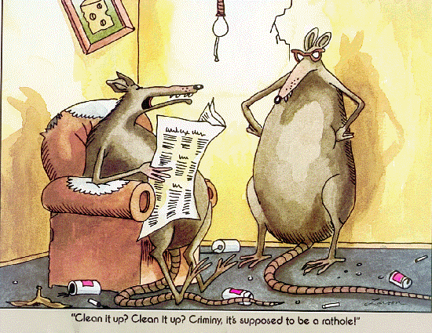
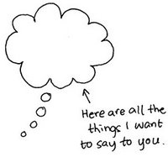
AEHLORT
_
LOATHER
RATHOLE
S
S
(LOATHING)
THE PLURALS ARE FROM OLESTRA + H
Notes:
OLESTRA: “HELPS REDUCE BULGES; FEEL SVELTE!”

Slide 18
ALE-ROT
S
AELORST
ONE WORD
Notes:
.

Slide 19
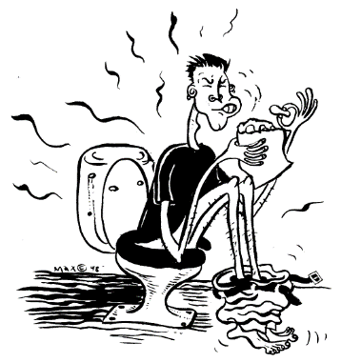
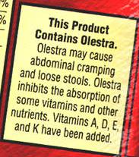

AELORST
OLESTRA
S
OLESTRA: A NON-CALORIC FAT SUBSTITUTE
SOLERA + T OSTEAL + R STEROL + A
SALTER + O ORATES + L
ALE-ROT + S
{OLESTRA + ?}
Notes:
SOLERA: “AM: HANDSOMEST, PM: ALL DOGFACE” OSTEAL: “MENDING BIZ: FIVE RIPPED, CHIPPED KNEES”
STEROL: “COMPLEMENTED ALL FIVE WHIFF JOBS” SALTER: “FIVE ICKY LUNCHES DO BUMP UP WEIGHT”
ORATES: “ADAMANT PREACHER GARBLES” ALE-ROT: GUV CHUGS CUPFUL, BLURTS “DUH”
OLESTRA: “HELPS REDUCE BULGES; FEEL SVELTE!”

Slide 20
ALE-ROT
P
AELOPRT
ONE WORD
Notes:
.

Slide 21
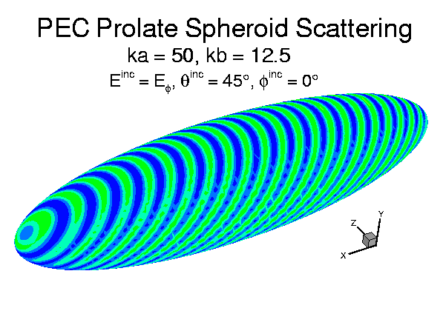
AELOPRT
PROLATE
PROLATE: adj. “EXTENDED LENGTHWISE”
Notes:
.

Slide 22
ALE-ROT
F
AEFLORT
THREE WORDS
Notes:
.

Slide 23


AEFLORT
FLOATER
FLOREAT
REFLOAT
S
S
v. TO EXPRESS A DESIRE THAT SOMEONE MIGHT FLOURISH (adj. FLOREATED, FLOREATING)
S
(REFLOATS, REFLOATED, REFLOATING)
THE PLURALS ANAGRAM:
[FORESTAL] FROM OLESTRA + F
Notes:
both NWL23 and WOW24 have deleted FLOREATS* and FLOREATING*
FLOREATED adj. having a floral architectural ornamentation
Shift + F5 to return to full screen (or click the Џ symbol near the bottom right of your screen)

Slide 24
ALE-ROT
L
AELLORT
ONE WORD
Notes:
.

Slide 25

AELLORT
REALLOT
P
S
REALLOT: TO ALLOT AGAIN (REALLOTS, REALLOTTED, REALLOTTING)
HOOK/S?
PREALLOT REALLOTS
ALLOTTER REQUIRES TWO T’S
REALLOTS IS OLESTRA + L WITH THE ANAGRAM:
[ROSTELLA]
Notes:
OLESTRA: “HELPS REDUCE BULGES; FEEL SVELTE!”

Slide 26
ALE-ROT
B
ABELORT
THERE ARE TWO!
Notes:
.

Slide 27
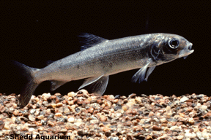
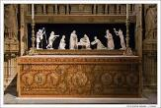
ABELORT
BLOATER
RETABLO
S
BLOATER: A SMOKED HERRING
S
RETABLO: A RAISED SHELF ABOVE AN ALTER (also RETABLE n. only)
THE PLURALS = OLESTRA + B WITH 2 OTHER ANAGRAMS:
STORABLE SORTABLE
Notes:
OLESTRA: “HELPS REDUCE BULGES; FEEL SVELTE!”

Slide 28
ALE-ROT
R
AELORRT
TWO WORDS
Notes:
.

Slide 29

AELORRT
REALTOR
RELATOR
S
S
THIS REALTOR STOOD A BIT AWAY FROM THE OTHERS, MAYBE NOT THE BEST RELATOR.
THE PLURALS ARE FROM OLESTRA + R AND ROASTER + L AND HAVE ONE OTHER ANAGRAM:
[RESTORAL]
Notes:
OLESTRA: “HELPS REDUCE BULGES; FEEL SVELTE!”
ROASTER: “CAN ROAST OUR LAMB AND PIG”

Slide 30
ALE-ROT
T
AELORTT
ONE WORD
Notes:
.

Slide 31


AELORTT
RETOTAL
S
(RETOTALS, RETOTALED, RETOTALLED, RETOTALING, RETOTALLING)
THE PLURAL IS FROM OLESTRA + T
Notes:
OLESTRA: “HELPS REDUCE BULGES; FEEL SVELTE!”

Slide 32
ALE-ROT
D
ADELORT
TWO WORDS
Notes:
.

Slide 33
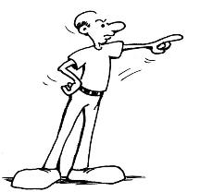

ADELORT
S
DELATOR
LEOTARD
S
DELATOR: ONE WHO ACCUSES OR DELATES, OR DID DELATE, HAS BEEN DELATING, OR EVEN ONCE DELATED, OR WAS EVER INVOLVED IN ONE OR MORE DELATION(S).
THE PLURALS ANAGRAM:
[LODESTAR] FROM OLESTRA + D
Notes:
DELATOR can only be spelled one way. OLESTRA: “HELPS REDUCE BULGES; FEEL SVELTE!”
LODESTAR, DELATORS, LEOTARDS LOADSTAR IS ALSO GOOD
Shift + F5 to return to full screen (or click the Џ symbol near the bottom right of your screen)

Slide 34
ALE-ROT
THAT’S IT! BINGOS WORTH REVIEWING:
PROLATE TORULAE
DELATOR CROTALE
RETABLO FLOREAT
Notes:
.

Slide 35
ALE-ROT
WHAT WAS THAT MNEMONIC PHRASE?
Notes:
.

Slide 36
ALE-ROT
GUV CHUGS CUPFUL, BLURTS “DUH!”
DUH!
ALE
Notes:
ALE-ROT: GUV CHUGS CUPFUL, BLURTS “DUH”

Slide 37
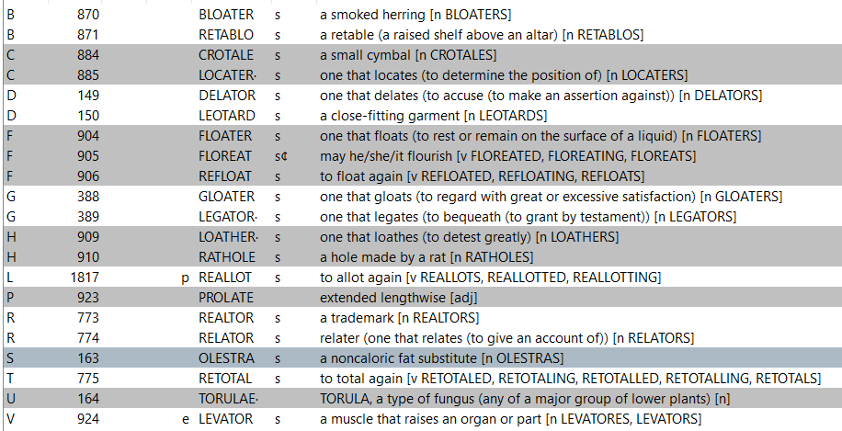
ALE-ROT
Notes:
.

Slide 38
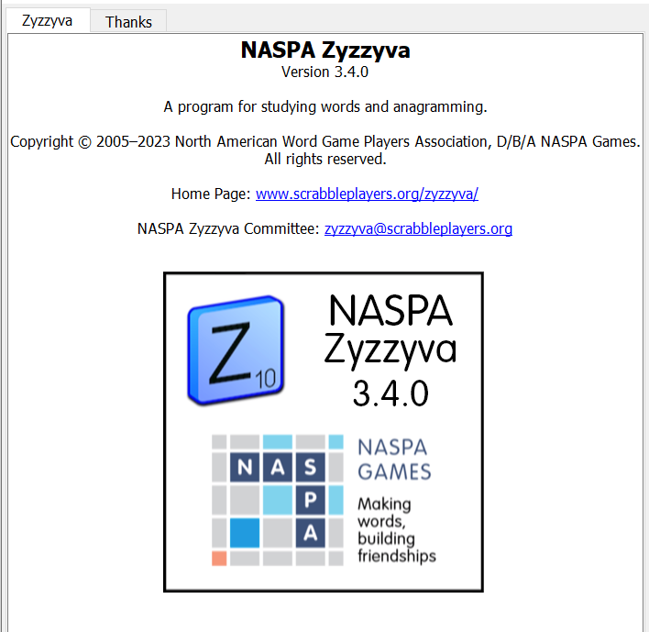

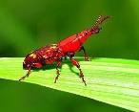
SEND suggestions or requests for additional PowerPoint slide shows to: williamrsnoddy@gmail.com
“Hey, Bill…”
Notes:
.

Slide 39

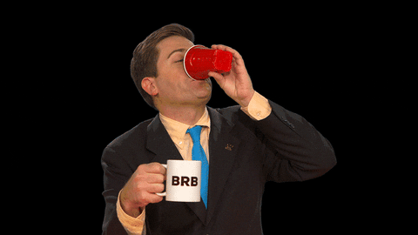
DUH END
GUV
Notes:
.

