Slide 1
EFILRT
No new words from NWL23 or OWL24
Notes:
.

Slide 2
EFILRT
IF the above alphagram does NOT show numbered Scrabble tiles,
then make sure you are viewing your downloaded version in the PowerPoint app
Notes:
.

Slide 3
EFILRT
Use PowerPoint or Keynote in FULL SCREEN “SLIDE SHOW” mode on your LAPTOP or DESKTOP for best results
When you see the “ESCAPE KEY” ICON check speaker notes for additional information by hitting the escape key
Shift + F5 to return to full screen (or click the Џ symbol near the bottom right of your screen)
Notes:
.

Slide 4
EFILRT
OF THE 3 GOOD “SIXES”
WHAT IS THE BINGO STEM
FOR THIS ALPHAGRAM?
Notes:
.

Slide 5
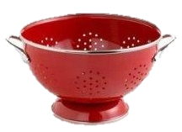
EFILRT
FILTER
also LIFTER and v. TRIFLE
Notes:
.

Slide 6
FILTER
WHAT MNEMONIC PHRASE CAN WE ASSOCIATE WITH THIS BINGO STEM?
Notes:
.

Slide 7
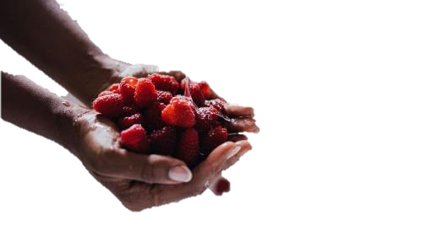
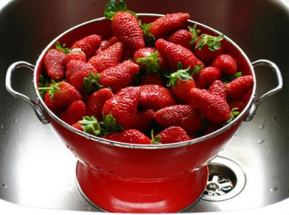
FILTER
YOUR DIRTY BERRIES
Notes:
FILTER: “YOUR DIRTY BERRIES”

Slide 8
FILTER Y
EFILRTY
ONE WORD
Notes:
.

Slide 9
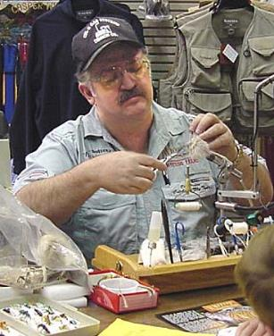
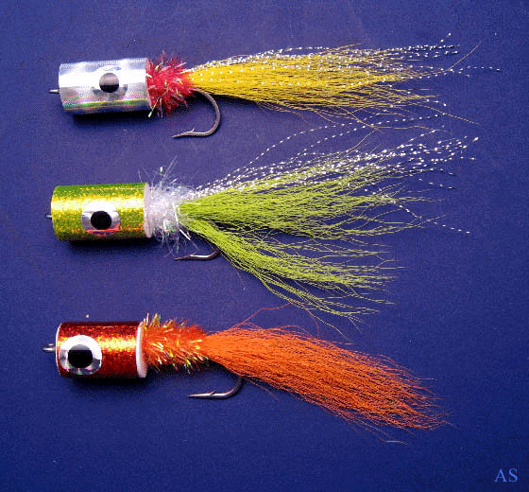
EFILRTY
FLYTIER
S
FLYTIER: A MAKER OF FISHING FLIES
HOOK/S?
FLYTE
FLYTED
FLYTES
FLYTING
FLYTIERS
FLIGHTY FLIGHTIER FLIGHTIEST
FLITE
FLITED
FLITES
FLITING
Notes:
FLY: adj. CLEVER, MENTALLY KEEN (FLY, FLIER, FLIEST) and
FLY: v. TO MOVE THROUGH THE AIR IN BASEBALL (FLY, FLEW, FLIES, FLOWN, FLIED, FLYING and n. FLIER/S)
Shift + F5 to return to full screen (or click the Џ symbol near the bottom right of your screen)

Slide 10
FILTER O
EFILORT
TWO WORDS
Notes:
.

Slide 11
EFILORT
LOFTIER
TREFOIL
LOFTIER: adj. MORE LOFTY, OR EXTENDING HIGH IN THE AIR (LOFTIEST)
S
TREFOIL: A PLANT HAVING TERNATE LEAVES (ARRANGED IN GROUPS OF THREE)
THE LOFTIER GOAL OF THE IRISHMAN AMONG MANY A TREFOIL OF CLOVER IS TO FIND THE FOUR LEAF!
HOOK/S?
TREFOILS (TOILERS + F)
Notes:
TOILERS: “COULDN’T FLIP BUS, LUV”

Slide 12
FILTER U
EFILRTU
ONE WORD
Notes:
.

Slide 13
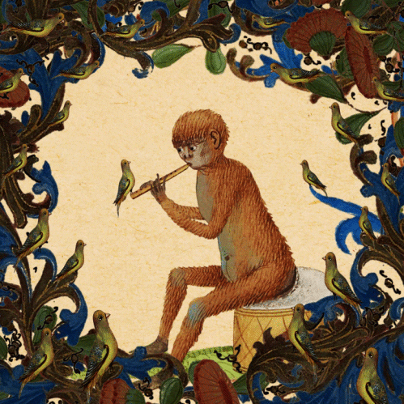
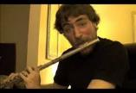
EFILRTU
FLUTIER
FLUTIER: adj. MORE FLUTY OR RESEMBLING A FLUTE IN SOUND (FLUTIEST)
also FLUTEY FLUTEYER FLUTEYEST
ONE WHO PLAYS THE FLUTE: FLUTIST/S and/or FLAUTIST/S
Notes:
.

Slide 14
FILTER R
EFILRRT
TWO WORDS
Notes:
.

Slide 15
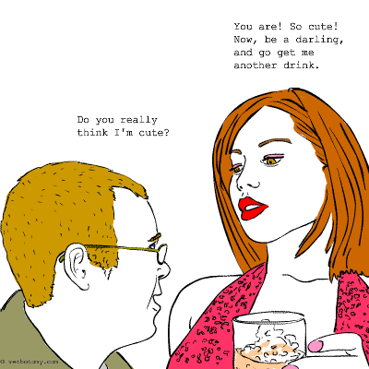
EFILRRT
FLIRTER
TRIFLER
S
_
_
S
SOMETIMES THE FLIRTER TURNS OUT TO BE JUST A TRIFLER.
TRIFLER: ONE WHO TRIFLES OR WASTES TIME
(v. TRIFLE, TRIFLED, TRIFLES, TRIFLING)
Notes:
.

Slide 16
FILTER D
DEFILRT
TWO WORDS
Notes:
.

Slide 17
DEFILRT
FLIRTED
TRIFLED
_
_
TRIFLED: v. WASTED TIME
TRIFLE TRIFLES TRIFLING
TRIFLINGS (!) TRIFLER/S
THOUGH THE DRUNK FLIRTED WILDLY, IN THE END SHE JUST TRIFLED.
Notes:
.

Slide 18
FILTER I
EFIILRT
ONE WORD
Notes:
.

Slide 19
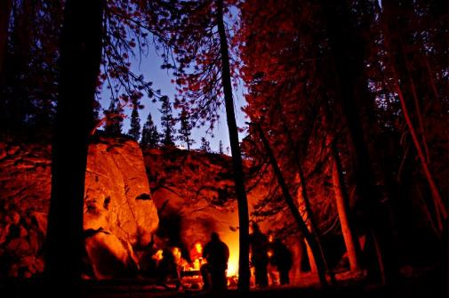
EFIILRT
FIRELIT
FIRELIT: adj. LIGHTED BY FIRELIGHT
Notes:
.

Slide 20
FILTER T
EFILRTT
ONE WORD
Notes:
.

Slide 21
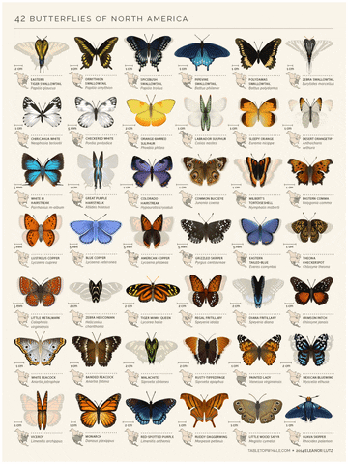
EFILRTT
FLITTER
_
S
FLITTER: v. TO FLUTTER OR WAVE RAPIDLY AND IRREGULARLY
(FLITTERS, FLITTERED, FLITTERING)
FLUTTERY BUT NOT flittery* (which will get you nowhere)
Notes:
.

Slide 22
FILTER B
BEFILRT
ONE WORD
Notes:
,

Slide 23
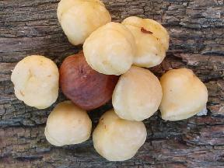
BEFILRT
FILBERT
S
FILBERT: THE EDIBLE NUT OF A EUROPEAN SHRUB, also HAZELNUT
Notes:
.

Slide 24
FILTER E
EEFILRT
TWO WORDS
Notes:
.

Slide 25
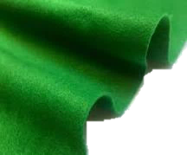
EEFILRT
FELTIER
FERTILE
FELTIER: adj. MORE FELTY, RESEMBLING A CLOTH MADE FROM WOOL (FELTIEST)
FERTILE: adj. CAPABLE OF REPRODUCING
Notes:
.

Slide 26
FILTER S
EFILRST
THERE ARE FOUR!
Notes:
.

Slide 27
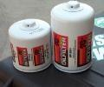
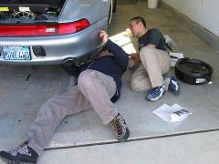
EFILRST
LISTER + F FILTER + S
_
FILTERS
LIFTERS
STIFLER
TRIFLES
_
_
S
_
_
CHANGING FILTERS WITHOUT LIFTERS WAS NOT EASY. MEANWHILE, HIS WIFE WAS THE STIFLER OF LAUGHTER, WATCHING AS HE TRIFLES AWAY MORE THAN AN HOUR TO PERFORM THE “SIMPLE TASK.”
HOOK/S…
STIFLERS
Notes:
LISTER: “CHIEF JOB: MAKING UP LISTS”
FILTER: “YOUR DIRTY BERRIES”

Slide 28
FILTER
THAT’S IT!
WHAT WAS THAT MNEMONIC PHRASE?
Notes:
.

Slide 29
FILTER
YOUR DIRTY BERRIES
Notes:
FILTER: “YOUR DIRTY BERRIES”

Slide 30
FILTER
DIFFICULT BINGOS INCLUDED:
FLYTIER TRIFLER
TREFOIL FIRELIT
FLUTIER FILBERT
FELTIER
Notes:
.

Slide 31
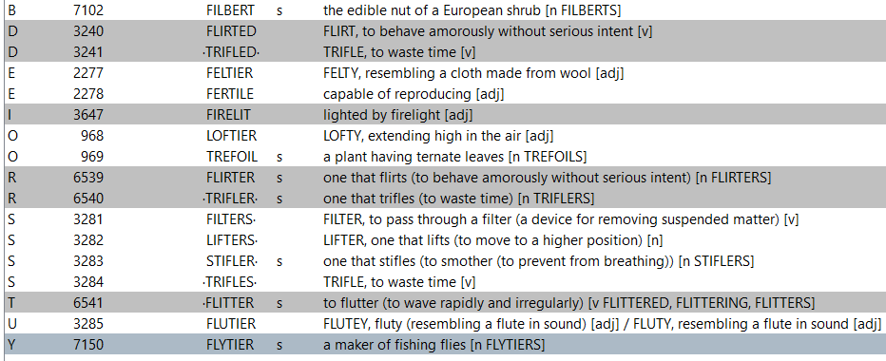
FILTER
Notes:
.

Slide 32
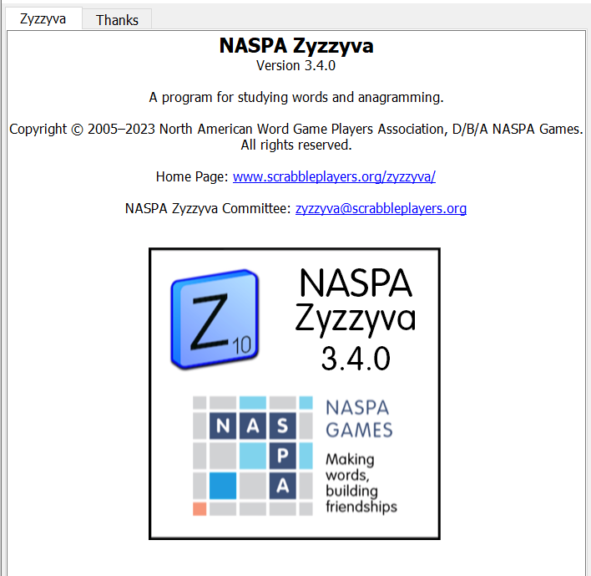
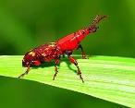
SEND suggestions or requests for additional PowerPoint slide shows to: williamrsnoddy@gmail.com
“Hey, Bill…”
Notes:
.

Slide 33
THE END!
Notes:
.

