Slide 1
ACDERT
No new words from NWL23 or WOW24
Notes:
.

Slide 2
ACDERT
IF the above alphagram does NOT show numbered Scrabble tiles,
then make sure you are viewing your downloaded version in the PowerPoint app.
Notes:
.

Slide 3
ACDERT
Use PowerPoint or Keynote in FULL SCREEN “SLIDE SHOW” mode on your LAPTOP or DESKTOP for best results
When you see the “ESCAPE KEY” ICON check speaker notes for additional information by hitting the escape key
Shift + F5 to return to full screen (or click the Џ symbol near the bottom right of your screen)
Notes:
.

Slide 4
ACDERT
OF THE 4 GOOD “SIXES” WHAT IS THE BEST BINGO STEM FOR THIS ALPHAGRAM?
Notes:
.

Slide 5
ACEDRT
TRACED
CARTED, CRATED, AND REDACT (TO PREPARE FOR PUBLICATION) ARE ALSO GOOD WORDS.
Notes:
.

Slide 6
TRACED
WHAT MNEMONIC PHRASE CAN WE ASSOCIATE WITH THIS BINGO STEM?
Notes:
.

Slide 7
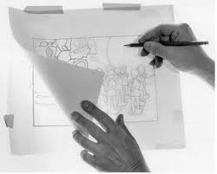
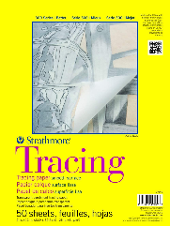
TRACED
OH, FUN NOTEBOOKS
Notes:
TRACED: “OH, FUN NOTEBOOKS”

Slide 8
TRACED O
ACDEORT
TWO WORDS
Notes:
.

Slide 9
ACDEORT
CORDATE
REDCOAT
CORDATE: adj. MEANING HEART-SHAPED
S
REDCOAT: A BRITISH SOLDIER DURING THE AMERICAN REVOLUTION
Notes:
.

Slide 10
TRACED h
ACDEHRT
ONE WORD
Notes:
.

Slide 11
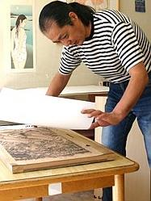
ACDEHRT
CHARTED
CHARTED: v. MAPPED OUT (CHART, CHARTS, CHARTING)
Notes:
.

Slide 12
TRACED F
ACDEFRT
TWO WORDS
Notes:
.

Slide 13
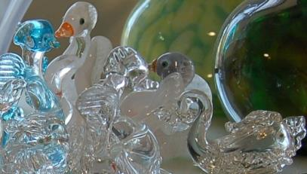
ACDEFRT
_
CRAFTED
FRACTED
CRAFTED: v. MADE BY HAND (CRAFT, CRAFTS, CRAFTING)
FRACTED: adj. MEANING BROKEN (D’ ONLY FORM)
VENETIAN GLASS IS CAREFULLY CRAFTED, BUT IF YOU DROP IT, WILL END UP FRACTED.
Notes:
D’ ONLY FORM means there is only FRACTED, no fract*, fracts*, and no fracting*
Shift + F5 to return to full screen (or click the Џ symbol near the bottom right of your screen)

Slide 14
TRACED U
ACDERTU
TWO WORDS
Notes:
.

Slide 15
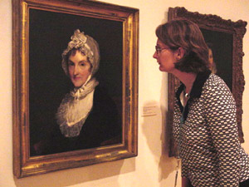
ACDERTU
_
CURATED
TRADUCE
CURATED: v. ACTED AS CURATOR OF (CURATE, CURATES, CURATING)
D
R
S
TRADUCE: v. TO DEFAME OR ATTACK THE GOOD NAME OF
AFTER SHE CURATED THE MET, SHE’D NEVER TRADUCE AN OLD MASTER LIKE REMBRANDT.
HOOK/S?
TRADUCED, TRADUCER, TRADUCES
Notes:
.

Slide 16
TRACED N
ACDENRT
ONE WORD
Notes:
.

Slide 17
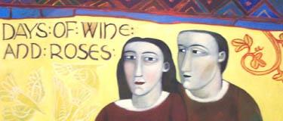
ACDENRT
_
TRANCED
TRANCED: v. PUT INTO A SEMI-CONSCIOUS STATE (TRANCE, TRANCES, TRANCING)
DECANT + R
DANCER + T TRACED + N
DECANT AND POUR, DECANT AND POUR… THE WINE TRANCED THIS COUPLE INTO DELIRIUM.
Notes:
DECANT: “POUR US ONE, EH?”
DANCER: “A POSH TUTU LIKELY”
TRACED: “OH, FUN NOTEBOOKS”

Slide 18
TRACED T
ACDERTT
ONE WORD
Notes:
.

Slide 19
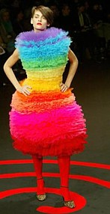
ACDERTT
DETRACT
S
DETRACT: v. TO TAKE AWAY
DETRACTS DETRACTED DETRACTING
THIS MODEL’S HIDEOUS DRESS CERTAINLY DOES DETRACT FROM HER BEAUTY.
Notes:
.

Slide 20
TRACED E
ACDEERT
FOUR WORDS
Notes:
.

Slide 21
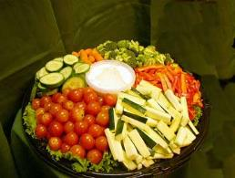
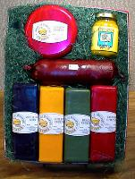
ACDEERT
CATERED
CERATED
CREATED
REACTED
A
_
_
CERATED: adj. COVERED WITH WAX (“ing-less”)
P
THE CATERED EVENT WITH CERATED CHEESES CREATED A PLEASANT DIVERSION AND GUESTS REACTED POSITIVELY.
HOOK/S?
ACERATED PREACTED
Notes:
ACERATED: adj. same as ACERATE, or ACEROSE, meaning NEEDLE-SHAPED PREACTED: v. ACTED BEFOREHAND
Shift + F5 to return to full screen (or click the Џ symbol near the bottom right of your screen)

Slide 22
TRACED B
ABCDERT
ONE WORD
Notes:
.

Slide 23
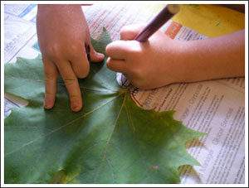
ABCDERT
BRACTED
BRACTED: adj. DESCRIBING A LEAFLIKE PLANT PART (BRACT, BRACTS) also adj. BRACTEAL
Speak “ing-less?”
BRACT
BRACTS
BRACTED
no “-ing” form
Notes:
.

Slide 24
TRACED K
ACDEKRT
ONE WORD
Notes:
.

Slide 25
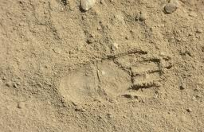
ACDEKRT
_
TRACKED
TRACKED: v. FOLLOWED THE MARKS LEFT BY AN ANIMAL, PERSON OR VEHICLE (TRACK, TRACKS, TRACKING)
Notes:
.

Slide 26
TRACED S
ACDERST
TWO WORDS
Notes:
.

Slide 27
ACDERST
REDACTS: v. EDITS BEFORE PUBLICATION (REDACT, REDACTED, REDACTING)
_
REDACTS
SCARTED
_
AFTER HE REDACTS ANY UNDESIRABLE TEXT, THE EDITOR MAKES SURE THE ORIGINAL GRAPHICS DO NOT APPEAR DAMAGED OR SCARTED.
SCARTED: v. SCRATCHED (SCART, SCARTS, SCARTING)
DATERS + C CATERS + D TRACED + S
Notes:
DATERS: “DID IT TWICE IN BED WITH PICKY FORMER LOVER”
CATERS: “HE SELLS DRINKS AT YOUR PARTY”
TRACED: “OH, FUN NOTEBOOKS”

Slide 28
TRACED
THAT’S IT!
WHAT WAS THAT MNEMONIC PHRASE?
Notes:
.

Slide 29
TRACED
OH, FUN NOTEBOOKS
Notes:
TRACED: “OH, FUN NOTEBOOKS”

Slide 30
TRACED
BINGOES WORTH REVIEWING:
CORDATE CERATED
FRACTED BRACTED
CURATED REDACTS
TRADUCE SCARTED
Notes:
.

Slide 31
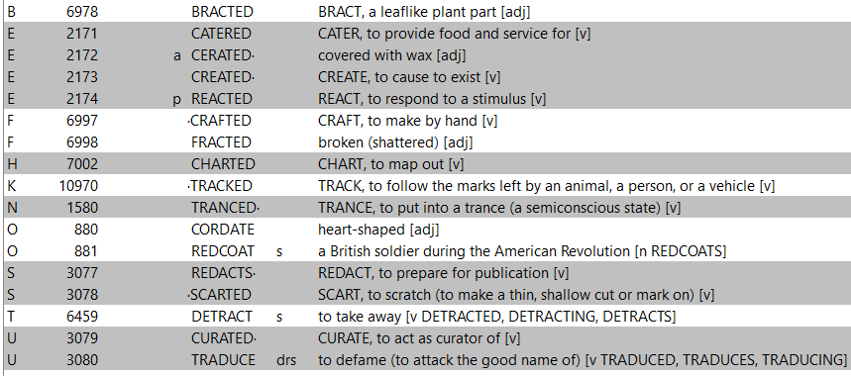
TRACED
Notes:
.

Slide 32
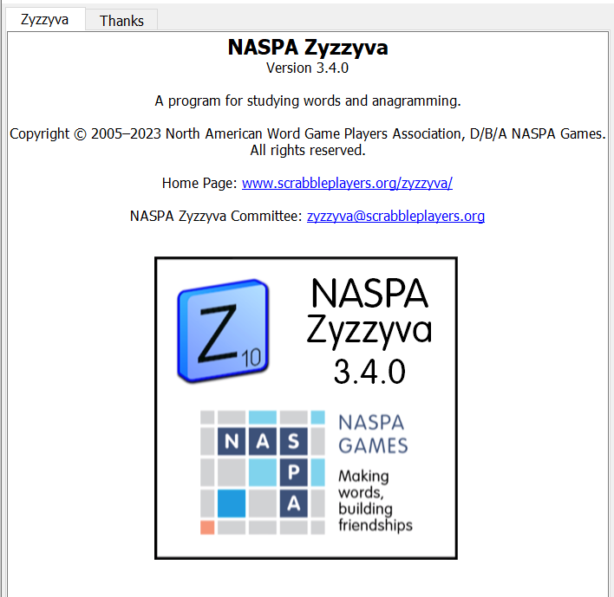
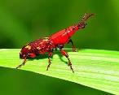
SEND suggestions or requests for additional PowerPoint slide shows to: williamrsnoddy@gmail.com
“Hey, Bill…”
Notes:
.

Slide 33
THE END!
Notes:
.

