Slide 1
OK to “Enable Content”
AENORT
No new words from NWL23 or WOW24
Notes:
.

Slide 2
OK to “Enable Content”
AENORT
IF the above alphagram does NOT show numbered Scrabble tiles,
then make sure you are viewing your downloaded version in the PowerPoint app
Notes:
.

Slide 3
OK to “Enable Content”
AENORT
Use PowerPoint or Keynote in FULL SCREEN “SLIDE SHOW” mode on your LAPTOP or DESKTOP for best results
When you see the “ESCAPE KEY” ICON check speaker notes for additional information by hitting the escape key
Notes:
.

Slide 4
AENORT
OF THE TWO “SIXES” WHICH IS THE BEST BINGO STEM FOR THIS ALPHAGRAM?
Notes:
.

Slide 5
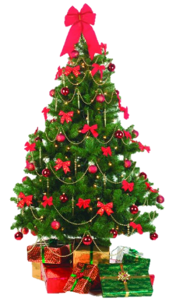
AENORT
ORNATE
ATONER IS ALSO GOOD, BUT COULD BE CONFUSED WITH THE STEM ATONES
Notes:
ATONES: “TIP CUP, LUV, RID GUILT”

Slide 6
ORNATE
WHAT MNEMONIC PHRASE
CAN WE ASSOCIATE
WITH THIS BINGO STEM?
Notes:
.

Slide 7
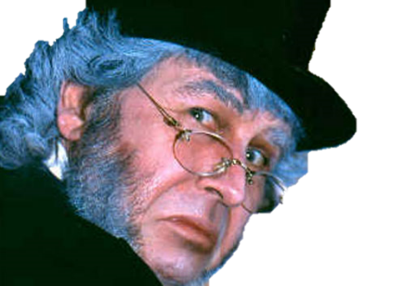
ORNATE
HUMBUG, CHUMPS! BUNG!
Notes:
ORNATE: “HUMBUG, CHUMPS! BUNG!”

Slide 8
ORNATE H
AEHNORT
ONE WORD
Notes:
.

Slide 9
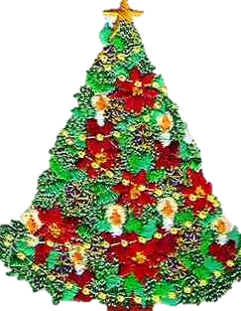
AEHNORT
_
ANOTHER
ANOTHER: adj. ONE MORE
NOTHER: adj. DIFFERENT
Notes:
.

Slide 10
ORNATE U
AENORTU
ONE WORD
Notes:
.

Slide 11
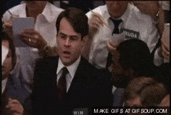
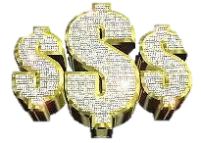
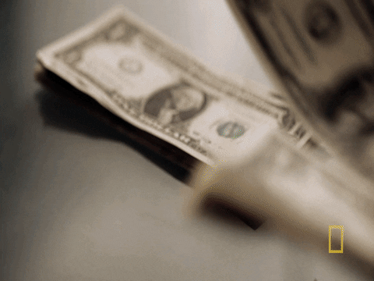
AENORTU
OUTEARN
S
OUTEARN: v. TO SURPASS IN EARNING
OUTEARNS, OUTEARNED, OUTEARNING
NATURE + O ORNATE + U
Notes:
NATURE: “VISIT GOD’S SCHOOL”
ORNATE: “HUMBUG, CHUMPS! BUNG!”

Slide 12
ORNATE M
AEMNORT
ONE WORD
Notes:
.

Slide 13
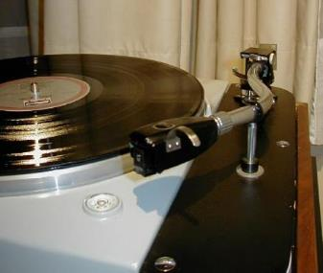
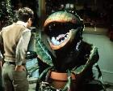
AEMNORT
TONEARM
S
TONEARMS HAS 3 ANAGRAMS:
MONSTERA & ONSTREAM & STOREMAN
Notes:
.

Slide 14
ORNATE B
ABENORT
TWO WORDS
Notes:
.

Slide 15
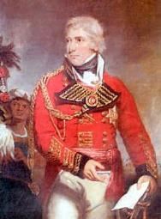
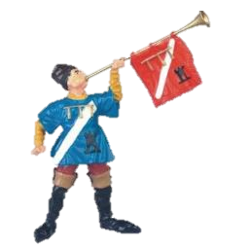
ABENORT
BARONET
REBOANT
S
BARONET: THE HOLDER OF A RANK BELOW THAT OF A BARON
REBOANT: adj. RESOUNDING LOUDLY
Notes:
.

Slide 16
ORNATE G
AEGNORT
ONE WORD
Notes:
.

Slide 17
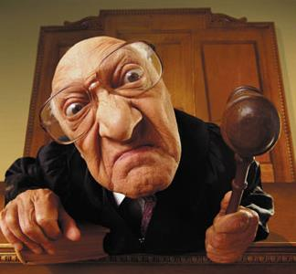
AEGNORT
HOOK/S?
S
NEGATOR
Y
NEGATOR: ONE THAT NEGATES OR NULLIFIES (also NEGATER/S)
NEGATORY: adj. EXPRESSING NEGATION, NULLIFICATION
NEGATORS ANAGRAMS TO:
GARNET + O ORNATE + G
[ESTRAGON]
STRANGE + O ATONERS + G
Notes:
GARNET: “WONDROUSLY PUFFY MINERAL”
ORNATE: “HUMBUG, CHUMPS! BUNG!”
STRANGE: “WEIRD FOG LAMPS”
ATONERS: “FRUMPS BEING NICE”
Eights: DRAGONET, ESTRAGON, FRONTAGE, NEGATORS, NEGATORY, NEGATRON, OUTRANGE, TETRAGON

Slide 18
ORNATE C
ACENORT
ONE WORD
Notes:
.

Slide 19
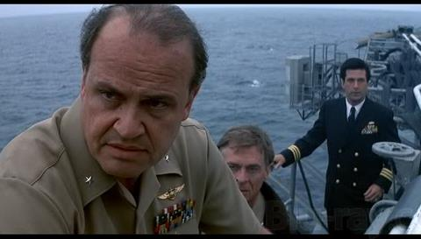
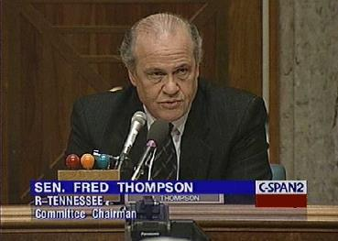
ACENORT
S
ENACTOR
Y
ENACTOR: ONE THAT ENACTS, OR MAKES INTO LAW
(ENACTOR CAN ONLY BE SPELLED THIS WAY)
HOOK/S?
CORNEA + T ORNATE + C
ENACTORS
ENACTORY
AN ACTOR ENACTOR!
Notes:
ENACTORY: adj. PERTAINING TO THE ENACTMENT OF LAW
Fred Thompson was an American politician and movie actor. Shift + F5 to return to full screen
CORNEA: “GOOD DOTS TOLD MOOD”
ORNATE: “HUMBUG, CHUMPS! BUNG!”

Slide 20
ORNATE P
AENOPRT
THERE ARE THREE!
Notes:
.

Slide 21
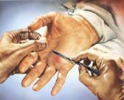
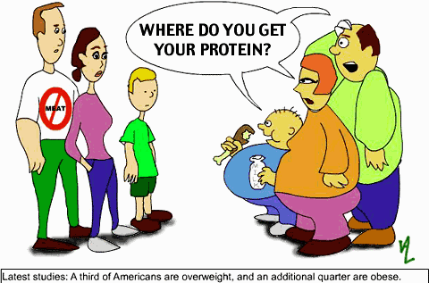
AENOPRT
OPERANT
PRONATE
PROTEAN
OPERANT: ONE THAT OPERATES
S
D
PRONATE: v. TO TURN THE PALM DOWNWARD OR BACKWARD
S
_
S
PRONATED PRONATES PRONATING
PROTEAN: A PROTEIN
PROTEAN?
Notes:
PROTEID/S, PROTEIDE/S ALSO DEFINED AS PROTEINS
PROTEA: AN EVERGREEN SHRUB (pl. PROTEAS)

Slide 22
ORNATE S
AENORST
THERE ARE FOUR!
Notes:
.

Slide 23
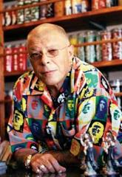
AENORST
_
_
ATONERS
SANTERO
SENATOR
TREASON
S
SANTERO: A PRIEST OF SANTERIA, A CARIBBEAN RELIGION
S
_
S
DESPITE THE ATONERS IN THE GROUP, THE SENATOR IN CHARGE RECOMMENDED THAT THE SANTERO BE CHARGED WITH TREASON.
ATONES + R ASTERN + O TONERS + A TRONAS + E REASON + T ORATES + N ORNATE + S {ATONERS +?}
HOOK/S?
Notes:
ATONES: “TIP CUP, LUV, RID GUILT” ASTERN: “MAN WORKING OUT DEVELOPS THICK BONE”
TONERS: “HARD BICEPS AND LEGS MAKE FOR TOUGH MEN” TRONAS: “THE TONY PUMICE”
REASON: “BIG LECTURES TRIUMPH” ORATES: “ADAMANT PREACHER GARBLES”
ORNATE: “HUMBUG, CHUMPS! BUNG!” ATONERS: “FRUMPS BEING NICE”

Slide 24
ORNATE N
AENNORT
ONE WORD
Notes:
.

Slide 25
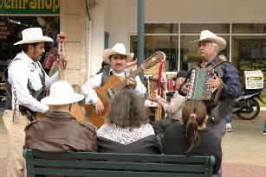
AENNORT
NORTENA
S
NORTENA: A MUSIC STYLE OF NORTHERN MEXICO AND TEXAS
HOOK/S?
NORTENAS! [ ]
RESONANT!
NORTENAS
also NORTENO/S: INHABITANT/S OF NORTHERN MEXICO
Notes:
.

Slide 26
ORNATE
THAT’S IT!
WHAT WAS THAT
MNEMONIC PHRASE?
Notes:
.

Slide 27
ORNATE
HUMBUG, CHUMPS! BUNG!
Notes:
ORNATE: “HUMBUG, CHUMPS! BUNG!”

Slide 28
ORNATE
DIFFICULT BINGOS INCLUDED:
ENACTOR OPERANT REBOANT PROTEAN SANTERO NORTENA
Notes:
.

Slide 29
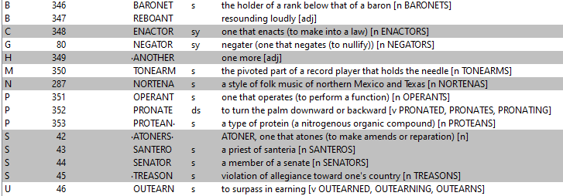
ORNATE ?
Notes:
.

Slide 30
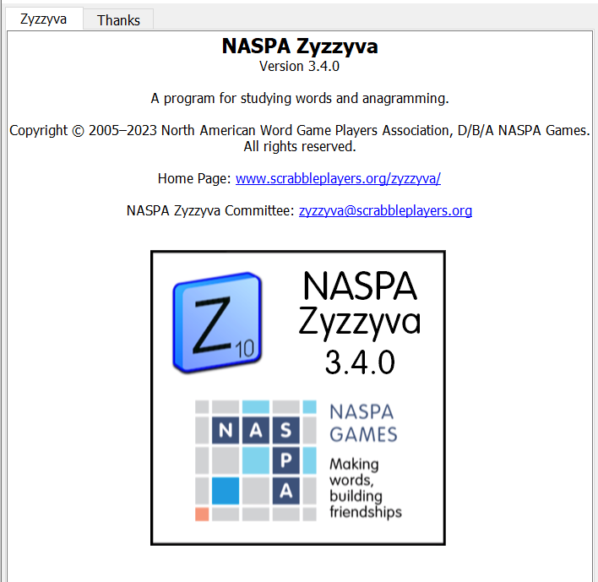
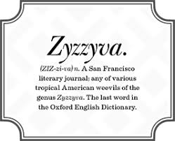
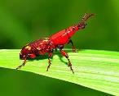
SEND suggestions or requests for additional PowerPoint slide shows to: williamrsnoddy@gmail.com
“Hey, Bill…”
Notes:
.

Slide 31
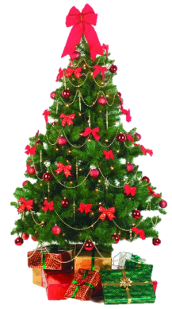
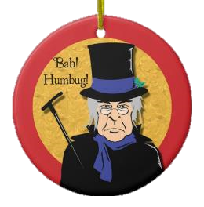
THE END!
Notes:
.

