Slide 1
AELLST
There are no new words
from NWL23 or WOW24
Notes:
.

Slide 2
AELLST
IF the above alphagram does NOT show numbered Scrabble tiles,
then make sure you are viewing your downloaded version in the PowerPoint app
Notes:
.

Slide 3
AELLST
Use PowerPoint or Keynote in FULL SCREEN “SLIDE SHOW” mode on your LAPTOP or DESKTOP for best results
When you see the “ESCAPE KEY” ICON check speaker notes for additional information by hitting the escape key
Notes:
.

Slide 4
AELLST
OF THE TWO “SIXES”
WHAT BINGO STEM
CAN BE CREATED
FOR THIS ALPHAGRAM?
Notes:
.

Slide 5
SALLET
WHAT MNEMONIC PHRASE CAN WE ASSOCIATE WITH THIS BINGO STEM?
STELLA IS THE OTHER WORD
Notes:
.

Slide 6
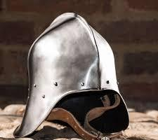
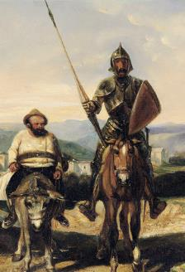
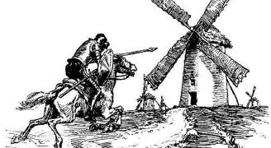
SALLET
BIG MYTHIC DIMWIT IS SPRY
SALLET: A LIGHT MEDIEVAL HELMET
Notes:
SALLET: “BIG MYTHIC DIMWIT IS SPRY”

Slide 7
OR
Notes:
.

Slide 8
STELLA
WHAT MNEMONIC PHRASE WOULD WE ASSOCIATE WITH THIS BINGO STEM?
SALLET IS THE OTHER WORD
Notes:
.

Slide 9
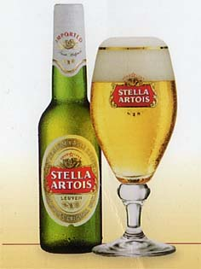
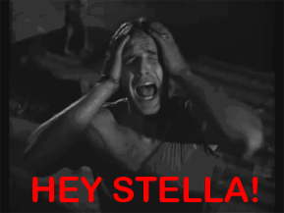
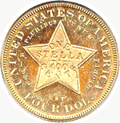
STELLA
CRISP, DIRTY WIT IS MY BIRTHRIGHT
Notes:
STELLA: “CRISP, DIRTY WIT IS MY BIRTHRIGHT”

Slide 10
SALLET B
ABELLST
ONE WORD
Notes:
.

Slide 11
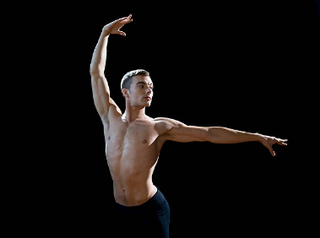
ABELLST
BALLETS
_
BALLETS: pl. of BALLET, TYPE OF CLASSICAL DANCE
Notes:
.

Slide 12
SALLET I
AEILLST
TWO WORDS
Notes:
.

Slide 13
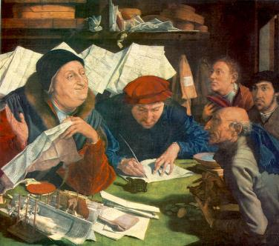
AEILLST
TAILLES
TALLIES
TALLIES: COUNTS (TALLY, TALLIED, TALLYING)
_
S
_
TAILLES: pl. of TAILLE, AN OLD FRENCH TAX
AN OLD FRENCH TAX COLLECTOR HAS MANY TAILLES THAT HE TALLIES.
HOOK/S?
TAILLE TOOK AN S FOR TAILLES, THEN TAILLES TAKES AN S FOR TAILLESS!!
SALTIE + L SALLET + I
Notes:
SALTIE: “FIZZ BLOCKS DRIVING SHIP”
SALLET: “BIG MYTHIC DIMWIT IS SPRY”

Slide 14
SALLET G
AEGLLST
ONE WORD
Notes:
.

Slide 15
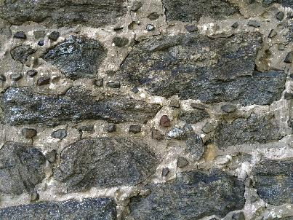
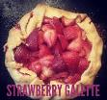
AEGLLST
GALLETS
_
GALLETS: v. FILLS IN MORTAR JOINTS WITH STONE CHIPS (GALLET, GALLETED, GALLETING)
GALETTE/S: A FLAT ROUND CAKE, PASTRY
Notes:
.

Slide 16
SALLET M
AELLMST
ONE WORD
Notes:
.

Slide 17
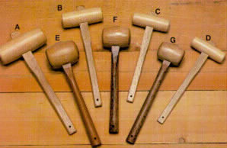
AELLMST
MALLETS
_
MALLETS: pl. of MALLET, A TYPE OF HAMMER
Notes:
.

Slide 18
SALLET Y
AELLSTY
ONE WORD
Notes:
.

Slide 19
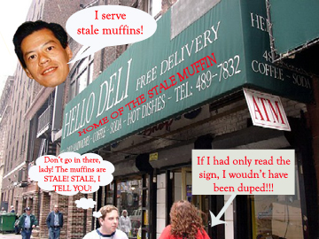
AELLSTY
STALELY
STALELY: adv. RELATING TO SOMETHING NOT FRESH (STALE, STALER, STALEST)
SAY TELL!
Notes:
.

Slide 20
SALLET T
AELLSTT
ONE WORD
Notes:
.

Slide 21
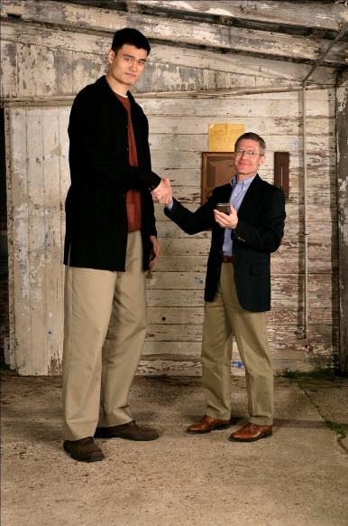
AELLSTT
TALLEST
TALLEST: THE MOST TALL, HAVING THE MOST HEIGHT (TALL, TALLER)
Notes:
.

Slide 22
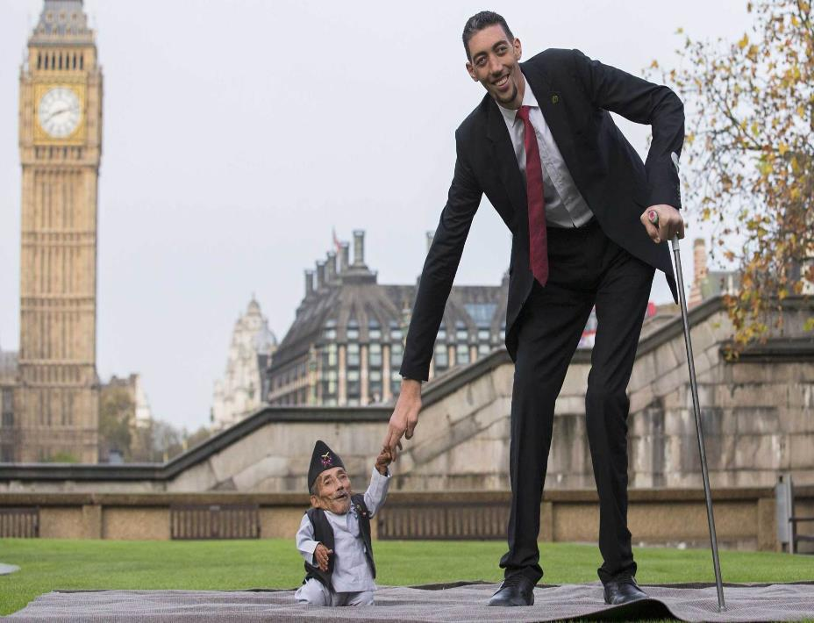
Notes:
.

Slide 23
SALLET H
AEHLLST
ONE WORD
Notes:
.

Slide 24
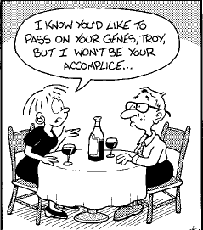
AEHLLST
LETHALS
_
LETHALS: pl. of LETHAL, A DEATH-CAUSING GENETIC DEFECT (adv. LETHALLY)
Notes:
.

Slide 25
SALLET C
ACELLST
ONE WORD
Notes:
.

Slide 26
ACELLST
CALLETS
_
CALLETS: pl. of CALLET, A PROSTITUTE
CASTLE + L SALLET + C
Notes:
CASTLE: “HUMAN PLAYS BESIDE ROOK”
SALLET: “BIG MYTHIC DIMWIT IS SPRY”

Slide 27
SALLET D
ADELLST
ONE WORD
Notes:
.

Slide 28
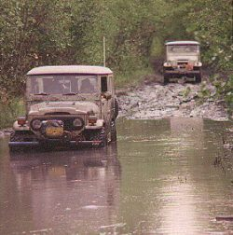
ADELLST
STALLED
STALLED: STOPPED THE PROGRESS OF (STALL, STALLS, STALLING)
SALTED + L SALLET + D
Notes:
SALTED: “SPRINKLED SODIUM CHLORIDE ON THE COB”
SALLET: “BIG MYTHIC DIMWIT IS SPRY”

Slide 29
SALLET W
AELLSTW
ONE WORD
Notes:
.

Slide 30
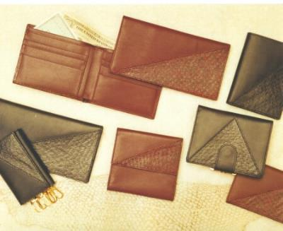
AELLSTW
WALLETS
_
WALLETS: pl. of WALLET, A FLAT FOLDING CASE
Notes:
.

Slide 31
SALLET S
AELLSST
TWO WORDS
Notes:
.

Slide 32
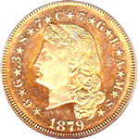
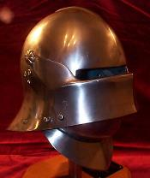
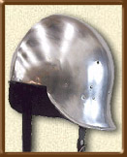
AELLSST
SALLETS
STELLAS
_
SALLETS: pl. of SALLET, A MEDIEVAL HELMET
_
STELLAS: pl. of STELLA, A FORMER U.S.A. COIN
STEALS + L SALLET+ S
Notes:
STEALS: “DARE ABUSIVE EX-THIEF TO COMPLY”
SALLET: “BIG MYTHIC DIMWIT IS SPRY”

Slide 33
SALLET P
AELLPST
ONE WORD
Notes:
.

Slide 34
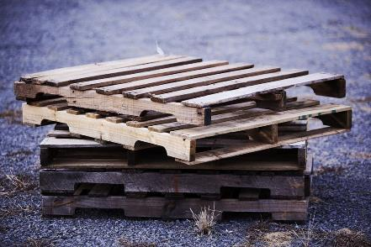
AELLPST
PALLETS
_
PALLETS: v. PLACES ON PLATFORMS FOR STORAGE OR MOVING (PALLET, PALLETED, PALLETING)
No double “T” option for PALLETED or PALLETING
Notes:
PALETTE/S: board on which an artist mixes colors PALLETTE/S: piece of armor protecting the armpit Shift + F5 to return to full screen PALET/S: small bract, a leaflike plant part

Slide 35
SALLET R
AELLRST
ONE WORD
Notes:
.

Slide 36
AELLRST
STELLAR
_
SALTER + L SALLET + R
STELLAR: PERTAINING TO THE STARS
Notes:
You can “stall” but you cannot be “one who stalls.” Shift + F5 to return to full screen
SALTER: “FIVE ICKY LUNCHES DO BUMP UP WEIGHT”
SALLET: “BIG MYTHIC DIMWIT IS SPRY”

Slide 37
SALLET
THAT’S IT! THE DIFFICULT BINGOS:
CALLETS
GALLETS
LETHALS
TAILLES
Notes:
.

Slide 38
SALLET
WHAT WAS THAT MNEMONIC PHRASE?
Notes:
.

Slide 39
SALLET
BIG MYTHIC DIMWIT IS SPRY
SALLET: A LIGHT MEDIEVAL HELMET
Notes:
SALLET: “BIG MYTHIC DIMWIT IS SPRY”

Slide 40
OR
Notes:
.

Slide 41
STELLA
CRISP, DIRTY WIT IS MY BIRTHRIGHT
Notes:
.

Slide 42
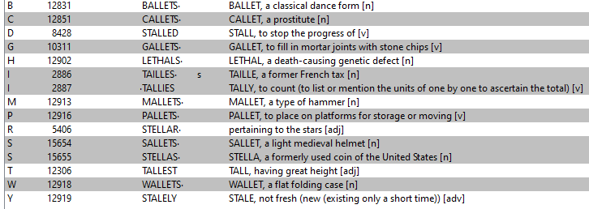
SALLET
Notes:
.

Slide 43
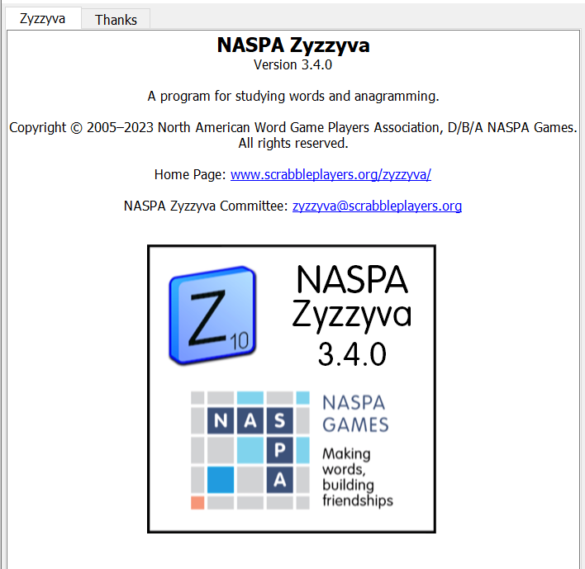
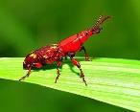
SEND suggestions or requests for additional PowerPoint slide shows to: williamrsnoddy@gmail.com
“Hey, Bill…”
Notes:
.

Slide 44
THE END
Notes:
.

