Slide 1
AENRTU
No new words from NWL23 or WOW24
Notes:
.

Slide 2
AENRTU
IF the above alphagram does NOT show numbered Scrabble tiles,
then make sure you are viewing your downloaded version in the PowerPoint app
Notes:
.

Slide 3
AENRTU
Use PowerPoint or Keynote in FULL SCREEN “SLIDE SHOW” mode on your LAPTOP or DESKTOP for best results
When you see the “ESCAPE KEY” ICON check speaker notes for additional information by hitting the escape key
3
Notes:
.

Slide 4
AENRTU
WHAT IS THE BINGO STEM FOR THIS ALPHAGRAM?
Notes:
.

Slide 5
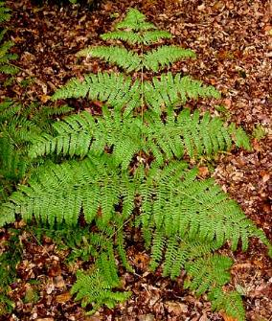
AENRTU
NATURE
NATURE IS THE ONLY GOOD WORD
Notes:
.

Slide 6
NATURE
WHAT MNEMONIC PHRASE CAN WE ASSOCIATE WITH THIS BINGO STEM?
Notes:
.

Slide 7
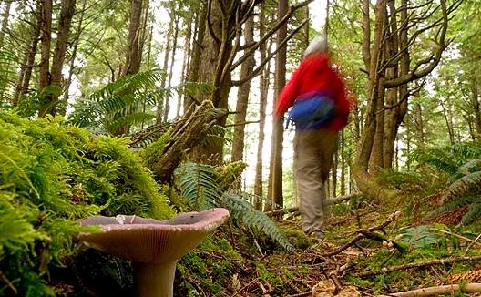
NATURE
VISIT GOD’S SCHOOL
Notes:
NATURE: “VISIT GOD’S SCHOOL”

Slide 8
NATUREV
AENRTUV
ONE WORD
Notes:
.

Slide 9
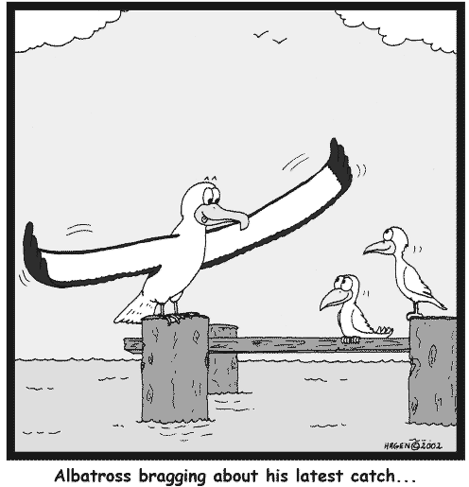
AENRTUV
VAUNTER
S
VAUNTER: ONE THAT VAUNTS, OR BRAGS (VAUNT, VAUNTED, VAUNTING)
Also adj.’s VAUNTY VAUNTIE VAWNTIE
“boastful”
HOOK/S?
VAUNTERS
None of these adjectives “compare”
NATURES + V
Notes:
NATURES: “THESE DO BECOME EVIL”

Slide 10
NATURE
I
AEINRTU
THERE ARE FOUR!
Notes:
.

Slide 11
AEINRTU
D
RUINATE
TAURINE
URANITE
URINATE
RETINA + U UNITER + A
NATURE + I
S
S
S
D
S
THEY CAN SIMPLY RUINATE YOU FROM THE UROLOGICAL STANDPOINT: BOTH TAURINE AND URANITE CAN BE FOUND IN KIDNEY STONES, WHICH CAUSE SEVERE PAIN AND BLEEDING WHEN YOU URINATE.
HOOK/S?
Notes:
adj. URANITIC. URINATOR can only be spelled this way.
Shift + F5 to return to full screen
RETINA: “THE RED PUPIL PREFERS MUCH WINKING”
UNITER: “GRABBED MORE VOTES”
NATURE: “VISIT GOD’S SCHOOL”

Slide 12
NATURE
S
AENRSTU
TWO WORDS
Notes:
.

Slide 13
AENRSTU
_
NATURES
SAUNTER
S
IN ORDER TO ANSWER ONE OF NATURES DAILY CALLS WITH NO PROBLEM, THE PHARMACIST RECOMMENDED THIS LAXATIVE SO ONE COULD SIMPLY SAUNTER CONFIDENTLY TO THE BATHROOM.
TUNERS + A ASTERN + U NATURE + S
HOOK/S?
Notes:
TUNERS: “FINE OLD PIANOS BECOME RIGHT”
ASTERN: “MAN WORKING OUT DEVELOPS THICK BONE”
NATURE: “VISIT GOD’S SCHOOL”
Yeah, NATURES is the plural of NATURE and not the possessive but this was the best I could do.
AND YES, serutan* IS NATURES SPELLED BACKWARDS Shift + F5 to return to full screen

Slide 14
NATURE T
AENRTTU
ONE WORD
Notes:
.

Slide 15
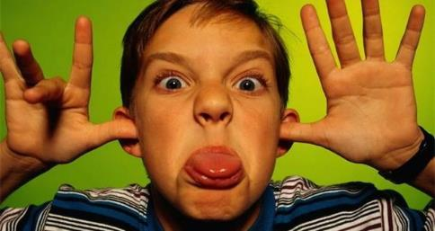
AENRTTU
TAUNTER
S
TAUNTER: ONE THAT TAUNTS, OR CHALLENGES OR REPROACHES SARCASTICALLY (TAUNT, TAUNTED, TAUNTING)
HOOK/S?
TAUNTERS
NATURES + T
Notes:
NATURES: “THESE DO BECOME EVIL”

Slide 16
NATURE G
AEGNRTU
ONE WORD
Notes:
.

Slide 17
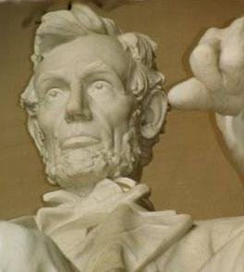
AEGNRTU
GAUNTER
GAUNT GAUNTER GAUNTEST
GARNET + U NATURE + G
Notes:
GARNET: “WONDROUSLY PUFFY MINERAL”
NATURE: “VISIT GOD’S SCHOOL”

Slide 18
NATURE O
AENORTU
ONE WORD
Notes:
.

Slide 19
AENORTU
OUTEARN
S
OUTEARN: v. TO SURPASS IN EARNING
(OUTEARNS, OUTEARNED, OUTEARNING)
HOOK/S?
OUTEARNS
ORNATE + U NATURE + O
Notes:
ORNATE: “HUMBUG, CHUMPS! BUNG!”
NATURE: “VISIT GOD’S SCHOOL”
OUTEARNS = ATONERS + U, TONSURE + A, EARS-OUT + N, NATURES + O

Slide 20
NATURE D
ADENRTU
THERE ARE FOUR!
Notes:
.

Slide 21
ADENRTU
S
DAUNTER: ONE THAT DAUNTS OR INTIMIDATES
DAUNTER
NATURED
UNRATED
UNTREAD
_
STICKY
S
UNTREAD: TO RETRACE OR TREAD BACK
(UNTREADS, UNTROD, UNTRODDEN, UNTREADING)
Notes:
NATURES + D =DAUNTERS, TRANSUDE, UNTREADS

Slide 22
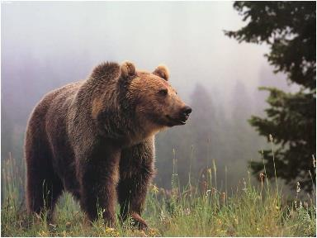
ADENRTU
DAUNTER
NATURED
UNRATED
UNTREAD
A MALE BEAR WAS QUITE THE DAUNTER, AND SOMEWHAT ILL-NATURED. THE FEMALE, FEARING THE SCENARIO SEEN IN THIS UNRATED THOUGHT BALLOON, DECIDED TO QUICKLY UNTREAD HER STEPS.
UNREAD + T NATURE + D
Notes:
UNREAD: “MY DITZ SKIPS SCHOOL”
NATURE: “VISIT GOD’S SCHOOL”

Slide 23
NATURE C
ACENRTU
TWO WORDS
Notes:
.

Slide 24
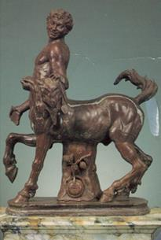
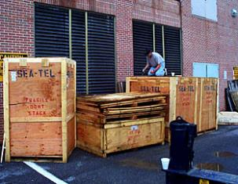
ACENRTU
CENTAURUNCRATE
S
Y
D
S
CENTAUR: A MYTHOLOGICAL CREATURE
CENTAURS plus CENTAURY, A MEDICINAL HERB (CENTAURIES)
THIS NEWLY-ARRIVED STATUE OF A BRONZE ROMAN CENTAUR WILL BE DIFFICULT FOR THE HISTORY MUSEUM WORKERS TO UNCRATE.
HOOK/S?
Notes:
UNTRACED IS A GOOD ADJECTIVE, BUT YOU CANNOT DROP THE D (D’ only way…)
NATURES + C: CENTAURS, RECUSANT, UNCRATES
Shift + F5 to return to full screen

Slide 25
NATURE H
AEHNRTU
THERE ARE THREE!
Notes:
.

Slide 26
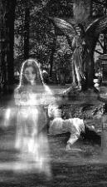
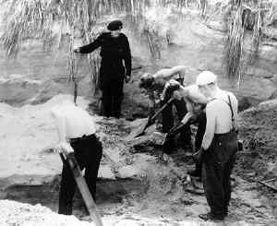
AEHNRTU
C
S
HAUNTER
UNEARTH
URETHAN
S
E
S
URETHAN: A CHEMICAL COMPOUND OFTEN FOUND IN PLASTIC
ALSO URETHANE/S
FEARING A HAUNTER, THE GRAVE ROBBERS QUIETLY UNEARTH THE CASKET USING ONLY THEIR LITTLE URETHAN SHOVELS!
HOOK/S?
Notes:
A CHAUNTER IS ONE THAT CHANTS, SO CHAUNT, CHAUNTS, CHAUNTED, CHAUNTING!
Shift + F5 to return to full screen

Slide 27
NATURE L
AELNRTU
ONE WORD
Notes:
.

Slide 28
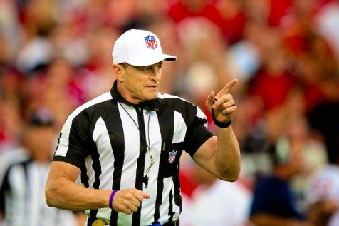
AELNRTU
NEUTRAL
S
NEUTRAL: n. ONE THAT IS IMPARTIAL
HOOK/S?
NEUTRALS
NATURES + L
Notes:
NEUTRAL IS ALSO A N. MEANING ONE THAT IS IMPARTIAL, SO TAKES AN S FOR NEUTRALS. renault* IS A BRAND NAME ANAGRAM.
NATURES: “THESE DO BECOME EVIL”
Shift + F5 to return to full screen

Slide 29
NATURE
THAT’S IT!
WHAT WAS THAT MNEMONIC PHRASE?
Notes:
.

Slide 30
NATURE
VISIT GOD’S SCHOOL
Notes:
.

Slide 31
NATURE
DIFFICULT BINGOS INCLUDED:
VAUNTER
DAUNTER
UNTREAD
CENTAUR
UNCRATE
URETHAN
Notes:
.

Slide 32
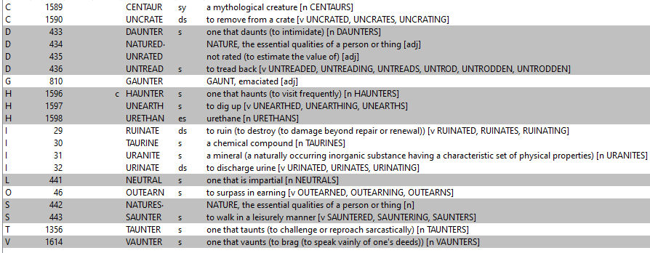
NATURE
Notes:
.

Slide 33
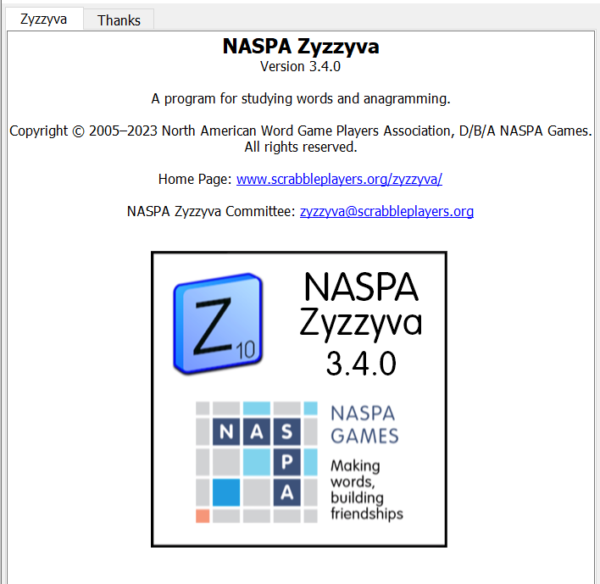
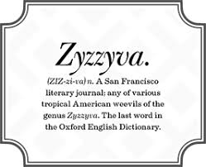
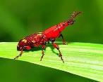
SEND suggestions or requests for additional PowerPoint slide shows to: williamrsnoddy@gmail.com
“Hey, Bill…”
Notes:
.

Slide 34
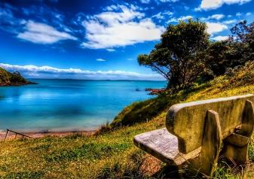
THE END!
Notes:
.

