Slide 1
ADENRU
No new words from NWL23 or WOW24
Notes:
.

Slide 2
ADENRU
IF the above alphagram does NOT show numbered Scrabble tiles,
then make sure you are viewing your downloaded version in the PowerPoint app
Notes:
.

Slide 3
ADENRU
Use PowerPoint or Keynote in FULL SCREEN “SLIDE SHOW” mode on your LAPTOP or DESKTOP for best results
When you see the “ESCAPE KEY” ICON check speaker notes for additional information by hitting the escape key
3
Notes:
.

Slide 4
ADENRU
WHAT BINGO STEM
CAN BE CREATED
FROM THIS ALPHAGRAM?
Notes:
.

Slide 5
ADENRU
UNREAD
(THERE ARE NO OTHER GOOD WORDS)
Notes:
.

Slide 6
UNREAD
WHAT MNEMONIC PHRASE
CAN BE ASSOCIATED
WITH THIS BINGO STEM?
Notes:
.

Slide 7
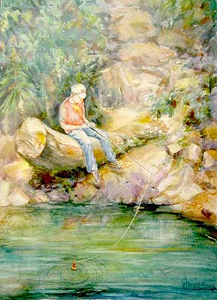
UNREAD
MY DITZ SKIPS SCHOOL
Notes:
UNREAD: “MY DITZ SKIPS SCHOOL”

Slide 8
UNREAD M
ADEMNRU
THERE ARE FOUR!
Notes:
.

Slide 9
ADEMNRU
DURAMEN: THE CENTRAL WOOD OF A TREE
DURAMEN
MANURED
MAUNDER
UNARMED
S
_
MANURED: v. TO FERTILIZE WITH ANIMAL EXCREMENT (MANURE, MANURED, MANURES, MANURING)
S
MAUNDER: TO TALK INCOHERENTLY (MAUNDER, MAUNDERS, MAUNDERED, MAUNDERING)
ADD ONE MORE “N” TO GET AN “8” :
UNDERMAN
Notes:
MAUNDER: 1) TO GRUMBLE 2) TO WANDER SLOWLY AND IDLY and/or 3) TO SPEAK INDISTINCTLY OR DISCONNECTEDLY
Shift + F5 to return to full screen

Slide 10
UNREAD Y
ADENRUY
ONE WORD
Notes:
.

Slide 11
ADENRUY
UNREADY
_
UNREADY UNREADIER UNREADIEST
Notes:
.

Slide 12
UNREAD D
ADDENRU
ONE WORD
Notes:
.

Slide 13
ADDENRU
DAUNDER
S
DAUNDER: TO STROLL LEISURELY, TO DANDER
(DAUNDER, DAUNDERS, DAUNDERED, DAUNDERING)
Notes:
.

Slide 14
UNREAD I
ADEINRU
TWO WORDS
Notes:
.

Slide 15
ADEINRU
UNAIRED
URANIDE
S
ALTHOUGH PLANS WERE UNAIRED, THIS USE OF URANIDE BECAME VERY “AIRED.”
RAINED + U UNREAD + I
Notes:
RAINED: “DAMP RAINS BROUGHT HAVOC”
UNREAD: “MY DITZ SKIPS SCHOOL”

Slide 16
UNREAD T
ADENRTU
THERE ARE FOUR!
Notes:
.

Slide 17
ADENRTU
S
DAUNTER
NATURED
UNRATED
UNTREAD
DAUNTER: ONE THAT DAUNTS OR INTIMIDATES
_
(D’ only form of this word)
STICKY
S
UNTREAD: TO RETRACE OR TREAD BACK
(UNTREADS, UNTROD, UNTRODDEN, UNTREADING)
Notes:
.

Slide 18
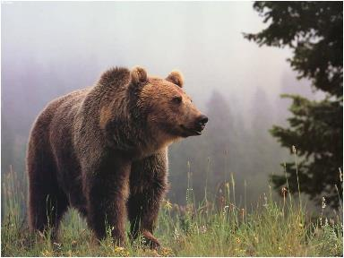
ADENRTU
DAUNTER
NATURED
UNRATED
UNTREAD
THIS MALE BEAR WAS QUITE THE DAUNTER, AND SOMEWHAT ILL- NATURED. THE FEMALE, FEARING THE SCENARIO SEEN IN THIS UNRATED THOUGHT BALLOON DECIDED TO QUICKLY UNTREAD HER STEPS.
NATURE + D UNREAD + T
Notes:
NATURE: “VISITS GOD’S SCHOOL”

Slide 19
UNREAD Z
ADENRUZ
ONE WORD
Notes:
.

Slide 20
ADENRUZ
UNRAZED
STICKY
D’ ONLY
(form of this word)
UNRAZED: adj. NOT RAZED, NOT TORN DOWN or NOT DEMOLISHED
Notes:
.

Slide 21
UNREAD S
ADENRSU
TWO WORDS
Notes:
.

Slide 22
ADENRSU
_
ASUNDER: adv. MEANING INTO PIECES
ASUNDER
DANSEUR
S
DANSEUR: A MALE BALLET DANCER
THE PASSIONS COULD NOT BE TORN ASUNDER FOR THIS DANSEUR WHO WAS SUCH A WONDER.
SANDER + U UNREAD + S
Notes:
SANDER: “DEFT WHIZ KID’S DELIGHT: SPRUCE LUMBER”
UNREAD: “MY DITZ SKIPS SCHOOL”

Slide 23
UNREAD K
ADEKNRU
ONE WORD
Notes:
.

Slide 24
ADEKNRU
UNRAKED
STICKY
D’ ONLY
( D ONLY form of this word)
Notes:
.

Slide 25
UNREAD P
ADENPRU
ONE WORD
Notes:
.

Slide 26
ADENPRU
UNDRAPE
D
S
UNDRAPE UNDRAPED UNDRAPES UNDRAPING
UNDRAPED [ ]
UNDERPAD
Notes:
.

Slide 27
UNREAD C
ACDENRU
THERE ARE TWO!
Notes:
.

Slide 28
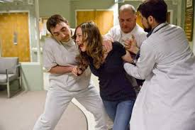
ACDENRU
DURANCE
UNCARED
S
DURANCE: n. RESTRAINT BY PHYSICAL FORCE
UNCARED: adj. NOT PROPERLY TAKEN CARE OF
DANCER + U UNREAD + C
also UNCARING
Notes:
DANCER: “A POSH TUTU LIKELY”
UNREAD: “MY DITZ SKIPS SCHOOL”

Slide 29
UNREAD H
ADEHNRU
ONE WORD
Notes:
.

Slide 30
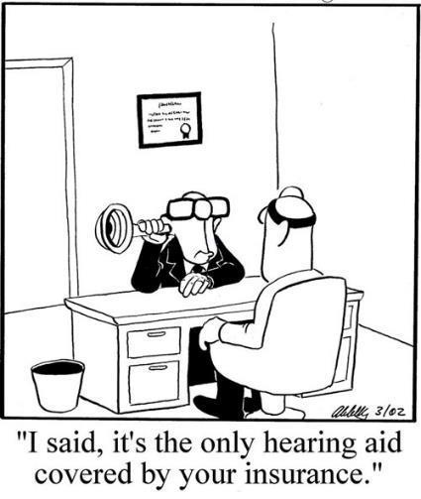
ADEHNRU
UNHEARD
STICKY
Notes:
.

Slide 31
UNREAD O
ADENORU
ONE WORD
Notes:
.

Slide 32
ADENORU
RONDEAU
X
RONDEAU: A SHORT POEM OF FIXED FORM
HOOK/S?
TODAY’S POEM
THE ONLY HOOK IS X FOR RONDEAUX
DOE-RAN + U UNREAD + O
Notes:
DOE-RAN: “CLIMB UP GRID”
UNREAD: “MY DITZ SKIPS SCHOOL”

Slide 33
UNREAD L
ADELNRU
TWO WORDS
Notes:
.

Slide 34
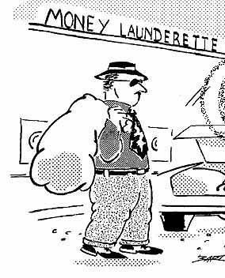
ADELNRU
S
LAUNDER
LURDANE
S
LAUNDER LAUNDERS LAUNDERED LAUNDERING
COULD HE LAUNDER MONEY HERE? THIS LURDANE THOUGHT HE COULD.
$$
LURDANE: SAME AS LURDAN, A STUPID OR LAZY PERSON
Notes:
.

Slide 35
UNREAD
THAT’S IT! BINGOS WORTH A REVIEW:
DANSEUR DAUNDER
DURAMEN DURANCE
LURDANE MAUNDER
URANIDE UNCARED
Notes:
.

Slide 36
UNREAD
WHAT WAS THAT MNEMONIC PHRASE?
Notes:
.

Slide 37
UNREAD
MY DITZ SKIPS SCHOOL
Notes:
.

Slide 38
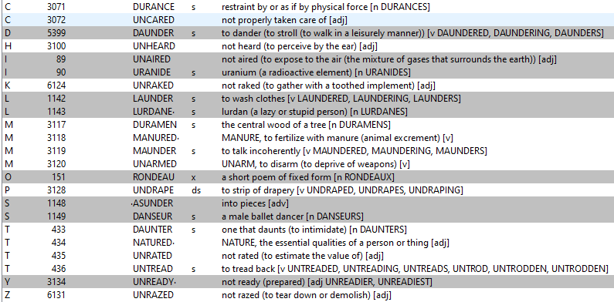
UNREAD
Notes:
.

Slide 39
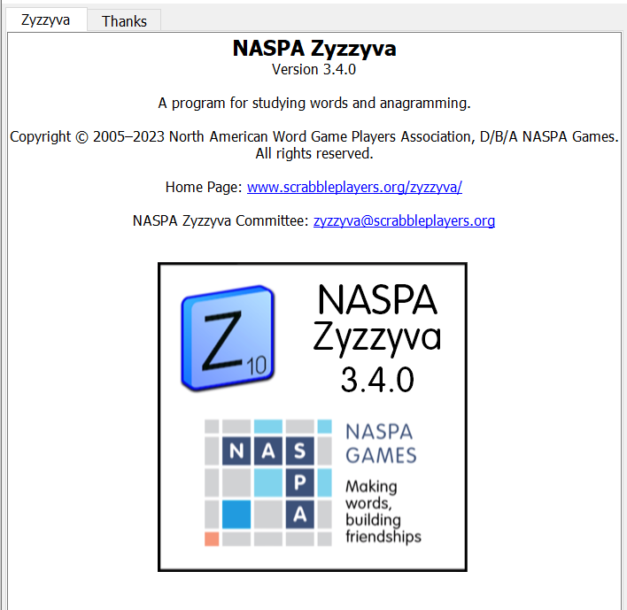
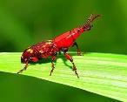
SEND suggestions or requests for additional PowerPoint slide shows to: williamrsnoddy@gmail.com
“Hey, Bill…”
Notes:
.

Slide 40
THE END
Notes:
.

