Slide 1
EEIMRS
Nothing new from NASPA’s NWL23 or WGPO’s WOW24 word lists.
Notes:
.

Slide 2
EEIMRS
IF the above alphagram does NOT show numbered Scrabble tiles,
then make sure you are viewing your downloaded version in the PowerPoint app
Notes:
.

Slide 3
EEIMRS
Use PowerPoint or Keynote in FULL SCREEN “SLIDE SHOW” mode on your LAPTOP or DESKTOP for best results
When you see the “ESCAPE KEY” ICON check speaker notes for additional information by hitting the escape key
Notes:
.

Slide 4
EEIMRS
WHAT SIX-LETTER WORD
FROM THIS ALPHAGRAM
CAN BE USED AS A BINGO STEM?
Notes:
.

Slide 5
EEIMRS
REMISE
REMISE: TO GIVE, GRANT, OR RELEASE A CLAIM , TO DEED
NO OTHER 6-LETTER WORDS FROM THIS ALPHAGRAM.
Notes:
.

Slide 6
REMISE
WHAT MNEMONIC PHRASE CAN BE ASSOCIATED WITH THIS BINGO STEM?
Notes:
.

Slide 7
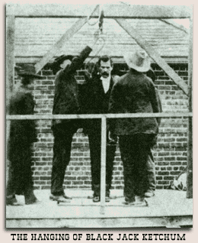
REMISE
CHAPS HANG TEXAS BADMAN
Notes:
the phrase doesn’t “connect well” with REMISE but has been in use for many years
REMISE: “CHAPS HANG TEXAS BADMAN”

Slide 8
REMISE C
CEEIMRS
ONE WORD
Notes:
.

Slide 9
CEEIMRS
MERCIES
Notes:
.

Slide 10
REMISE H
EEHIMRS
ONE WORD
Notes:
.

Slide 11
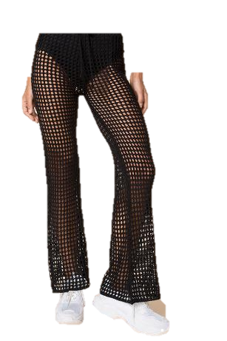
EEHIMRS
MESHIER
MESHY
MESHIER
MESHIEST
Notes:
.

Slide 12
REMISE A
AEEIMRS
Notes:
.

Slide 13
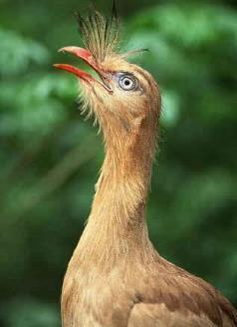
AEEIMRS
SEAMIER
SERIEMA
SEAMIER: MORE SEAMY, MORE UNPLEASANT (SEAMY, SEAMIEST)
S
“THE SEAMIER SERIEMA”
SERIEMA : A BRAZILIAN BIRD
WITH BOTH THE APPEARANCE AND THE MATING CALL BEING SEAMIER THAN MOST OTHER BIRDS IN THE RAIN FOREST, THE SERIEMA WAS NOT A BIG VOTE-GETTER FOR THE “NATIONAL BIRD OF BRAZIL” CONTEST.
EASIER + M REMISE + A
Notes:
EASIER: *LeT MaiD WiPe FLooR (*CoNSoNaNTS oNLY)
REMISE: “CHAPS HANG TEXAS BADMAN”

Slide 14
REMISE P
EEIMPRS
SEVEN WORDS
Notes:
.

Slide 15
EEIMPRS
EMPIRES
EMPRISE
EPIMERS
IMPRESE
PREMIES
PREMISE
SPIREME
Notes:
.

Slide 16
EEIMPRS
EMPIRES
EMPRISE
EPIMERS
IMPRESE
PREMIES
PREMISE
SPIREME
EMPIRES: pl. of EMPIRE, A MAJOR POLITICAL UNIT
EMPRISE: AN ADVENTUROUS UNDERTAKING (also EMPRIZE/S)
EPIMERS: pl. of EPIMER, A TYPE OF SUGAR COMPOUND (adj. EPIMERIC)
IMPRESE: A TYPE OF EMBLEM (also IMPRESA, IMPRESAS)
PREMIES: pl. of PREMIE, AN INFANT BORN PREMATURELY (ALSO PREEMIE, PREEMIES)
PREMISE: v. TO STATE IN ADVANCE (PREMISES, PREMISED, PREMISING)
SPIREME: A FILAMENT FORMING PART OF A CELL NUCLEUS DURING MITOSIS (also SPIREM, SPIREMS)
Notes:
.

Slide 17
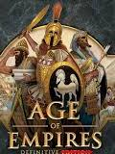
EEIMPRS
HOOK/S?
_
EMPIRES
EPIMERS
EMPRISE
IMPRESE
PREMIES
PREMISE
SPIREME
_
S
S
_
_
D
S
_
S
Notes:
SPIREM same as SPIREME
Shift + F5 to return to full screen

Slide 18
REMISE S
EEIMRSS
THERE ARE THREE!
Notes:
.

Slide 19
EEIMRSS
MERISES
MESSIER
REMISES
STICKY
_
P
MERISES: pl. of MERISIS, WHICH MEANS A GROWTH RESULTING FROM CELL DIVISION
HOOK/S?
PREMISES
Notes:
.

Slide 20
REMISE N
EEIMNRS
ONE WORD
Notes:
.

Slide 21
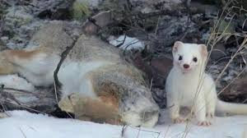
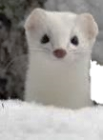
EEIMNRS
ERMINES
_
DO YOU SPEAK “ING-LESS?”
ERMINE
ERMINED
ERMINES
But no “–ing”
SERINE + M REMISE + N
Notes:
SERINE: “VEXT, PETER CHEWS VEG, FEELS REDEEMED”
REMISE: “CHAPS HANG TEXAS BADMAN”

Slide 22
REMISE G
EEGIMRS
THERE ARE THREE!
Notes:
.

Slide 23
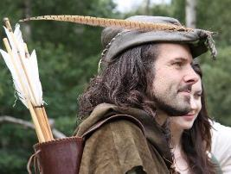
EEGIMRS
_
EMIGRES
REGIMES
REMIGES
EMIGRES: pl. of ÉMIGRÉ, AN EMIGRANT
_
STICKY
REMIGES: pl. of REMEX (!) A FLIGHT FEATHER OF A BIRD’S WING (adj. REMIGIAL)
ONE OF THE EMIGRES FROM REGIMES OF PRINCE JOHN AND THE SHERIFF OF NOTTINGHAM HAD ONE OR MORE REMIGES IN HIS CAP.
Notes:
.

Slide 24
REMISE T
EEIMRST
THERE ARE FIVE!
Notes:
.

Slide 25
EEIMRST
MEISTER
METIERS
REEMITS
RETIMES
TRISEME
S
_
METIERS: pl. of METIER, A VOCATION
_
_
TRISEME: A TYPE OF METRICAL FOOT (adj. TRISEMIC)
S
MEISTER: ONE WHO IS KNOWLEDGEABLE ABOUT A SPECIFIED SUBJECT
MISTER + E RETIES + M REMISE + T
Notes:
MISTER: “LEFT BOOK OUT ON PARK BENCH”
RETIES: “SHACKLED, MAZE PREVENTS ESCAPE”
REMISE: “CHAPS HANG TEXAS BADMAN”

Slide 26
REMISE E
EEEIMRS
ONE WORD
Notes:
.

Slide 27
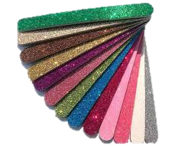
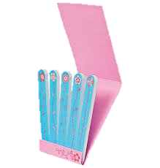
EEEIMRS
EMERIES
EMERIES: pl. of EMERY, A GRANULAR CORUNDUM, A HARD MINERAL
Notes:
.

Slide 28
REMISE X
EEIMRSX
TWO WORDS
Notes:
.

Slide 29
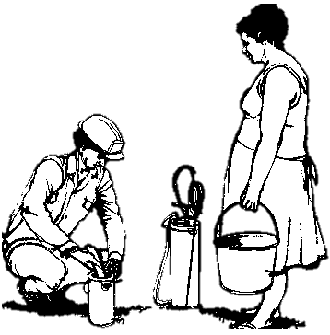
EEIMRSX
MIREXES
REMIXES
P
MIREXES: pl. of MIREX, AN INSECTICIDE
PREPARING MIREXES, HE REMIXES.
HOOK/S?
PREMIXES
Notes:
.

Slide 30
REMISE B
BEEIMRS
THERE ARE THREE!
Notes:
.

Slide 31
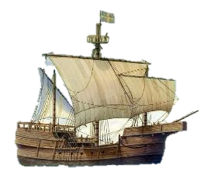
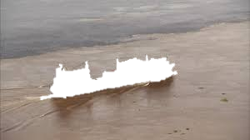
BEEIMRS
BEMIRES: v. SOILS WITH MUD (BEMIRE, BEMIRED, BEMIRING)
BEMIRES
BERIMES
BIREMES
_
_
BERIMES: COMPOSES IN RHYME (BERIME, BERIMED, BERIMING also BERHYME/S/D/ING)
_
BIREMES: pl. of BIREME, AN ANCIENT GALLEY
Notes:
.

Slide 32
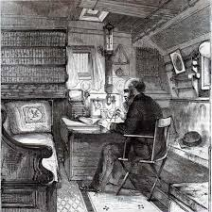
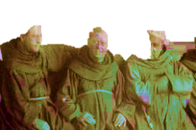
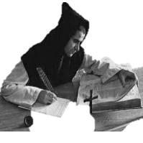
IN THESE GOD-FORSAKEN TIMES
THE OLD SHIP IN THE MUD BEMIRES
THE POET IN THE HOLD BERIMES
IN THE MIDST OF THOUGHTFUL FRIARS.
A DOOMED SHIP? WELL, SO IT SEEMS
THIS ONE OF SEVERAL OLD BIREMES.
Notes:
.

Slide 33
REMISE D
DEEIMRS
ONE WORD
Notes:
.

Slide 34
DEEIMRS
REMISED
P
_
REMISED: RELINQUISHED A CLAIM TO, SURRENDERED BY DEED.
HOOK/S?
PREMISED
Notes:
.

Slide 35
REMISE M
EEIMMRS
ONE WORD
Notes:
.

Slide 36
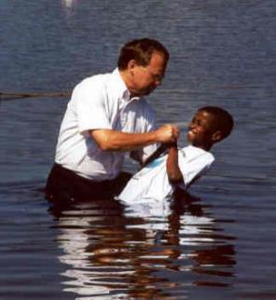
EEIMMRS
IMMERSE
D
S
IMMERSE: v. TO PLUNGE INTO A LIQUID (IMMERSING)
HOOK/S?
IMMERSED IMMERSES
Also
IMMERGE IMMERGED IMMERGES IMMERGING
Notes:
.

Slide 37
REMISE
THAT’S IT! BINGOES WORTH REVIEWING:
BEMIRES BERIMES
BIREMES EMPRISE
EPIMERS IMPRESE
MERISES MIREXES
PREMIES REMIGES
SERIEMA SPIREME
TRISEME MEISTER
Notes:
.

Slide 38
REMISE
WHAT WAS THAT MNEMONIC PHRASE?
Notes:
.

Slide 39
REMISE
CHAPS HANG TEXAS BADMAN
Notes:
REMISE: “CHAPS HANG TEXAS BADMAN”

Slide 40
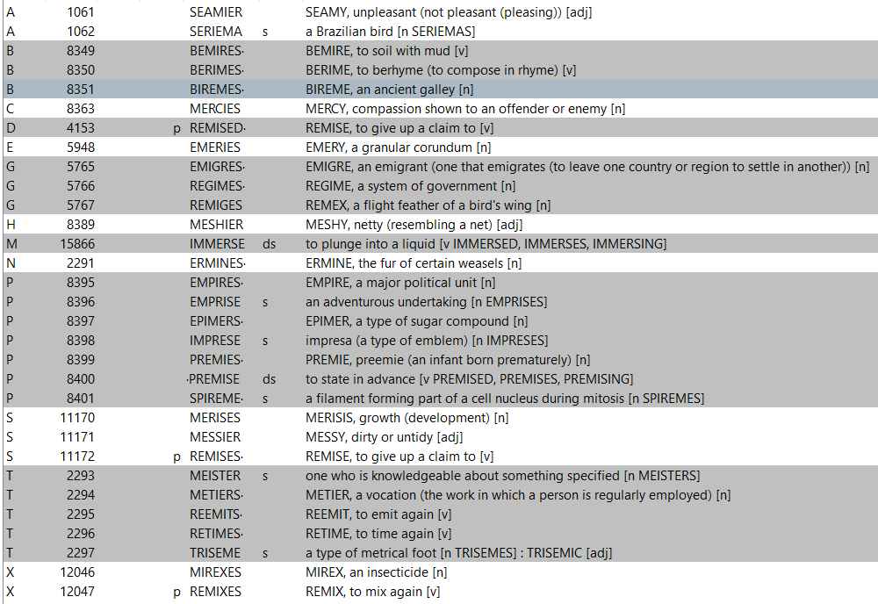
REMISE
Notes:
.

Slide 41
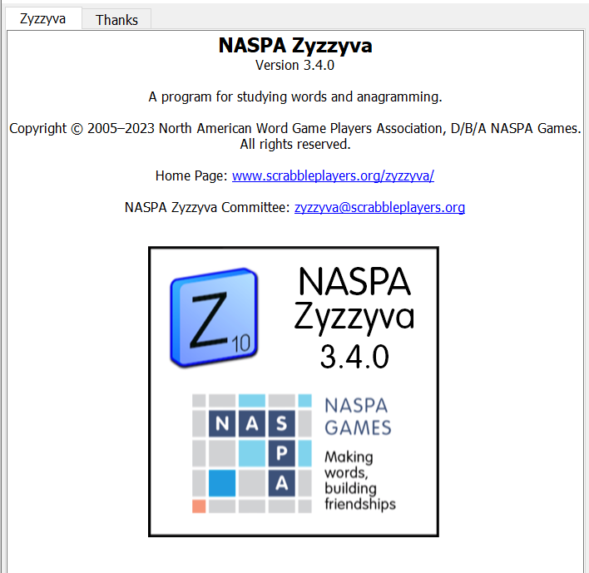
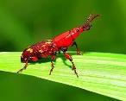
SEND suggestions or requests for additional PowerPoint slide shows to: williamrsnoddy@gmail.com
“Hey, Bill…”
Notes:
.

Slide 42
THE END
REMISE
HANG
TEXAS
CHAPS
BADMAN
Notes:
.

