Slide 1
ACDENR
Nothing new from NASPA’s NWL23 or WGPO’s WOW24 word lists.
Notes:
.

Slide 2
ACDENR
IF the above alphagram does NOT show numbered Scrabble tiles,
then make sure you are viewing your downloaded version in the PowerPoint app
Notes:
.

Slide 3
ACDENR
Use PowerPoint or Keynote in FULL SCREEN “SLIDE SHOW” mode on your LAPTOP or DESKTOP for best results
When you see the “ESCAPE KEY” ICON check speaker notes for additional information by hitting the escape key
Notes:
.

Slide 4
ACDENR
OF 4 SIX-LETTER WORDS WHAT IS THE BEST BINGO STEM FOR THIS ALPHAGRAM?
Notes:
.

Slide 5
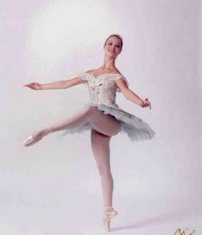
ACDENR
DANCER
Also CEDARN (adj. RELATING TO CEDAR) and NACRED (adj. FROM NACRE, THE PEARLY INTERNAL LAYER OF CERTAIN SHELLS) and CRANED (v. STRETCHED OUT ONE’S NECK)
Notes:
.

Slide 6
DANCER
WHAT MNEMONIC PHRASE CAN WE ASSOCIATE WITH THIS BINGO STEM?
Notes:
.

Slide 7
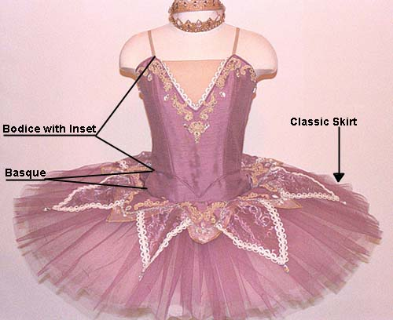
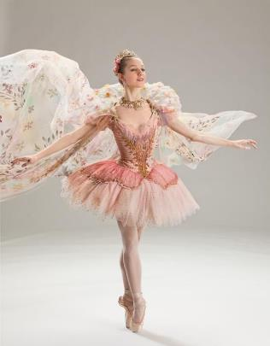
DANCER
A POSH TUTU LIKELY
Notes:
.

Slide 8
DANCER A
AACDENR
ONE WORD
Notes:
.

Slide 9
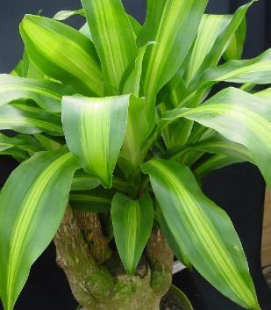
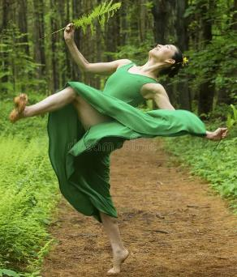
AACDENR
DRACENA
S
DRACENA: A TROPICAL PLANT
(DRACENAS and DRACAENA/S)
Notes:
.

Slide 10
DANCER P
ACDENPR
ONE WORD
Notes:
.

Slide 11
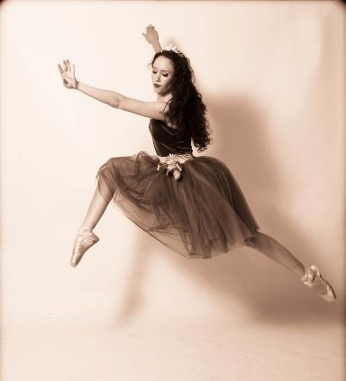
ACDENPR
PRANCED
_
Notes:
.

Slide 12
DANCER O
ACDENOR
ONE WORD
Notes:
.

Slide 13
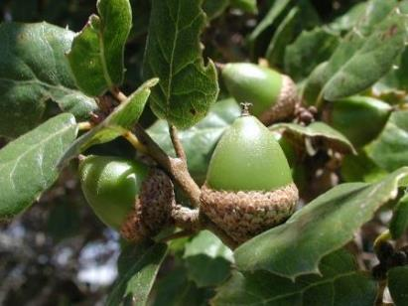
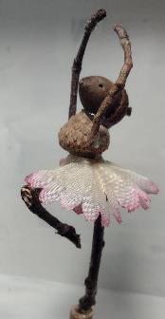
ACDENOR
ACORNED
_
ACORNED: adj. PERTAINING TO ACORNS
NO, ACORNED DOESN’T TAKE AN S HOOK, BUT ACORNED + S MAKES AN “8”:
ENDOSARC
CORNEA + D, DOE-RAN + C, DANCER + O
CORNED: v. TO PRESERVE WITH SALT (CORN, CORNS, CORNING)
Notes:
CORNEA: “GOOD DOTS TOLD MOOD”
DOE-RAN: “CLIMB UP GRID”
DANCER: “A POSH TUTU LIKELY”

Slide 14
DANCER S
ACDENRS
ONE WORD
Notes:
.

Slide 15
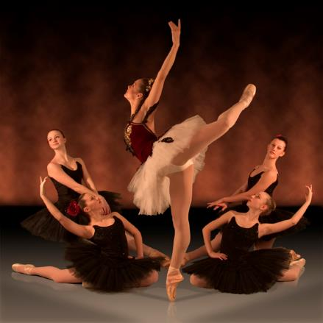
ACDENRS
DANCERS
_
SANDER + C DANCER + S
Notes:
SANDER: “DEFT WHIZ KID’S DELIGHT: SPRUCE LUMBER”
DANCER: “A POSH TUTU LIKELY”

Slide 16
DANCER H
ACDEHNR
TWO WORDS
Notes:
.

Slide 17
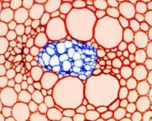
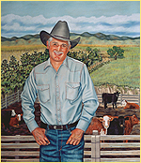
ACDEHNR
ENDARCH
RANCHED
Y
B
C
ENDARCH: adj. FORMED FROM THE CENTER OUTWARD
HOOK/S?
BRANCHED CRANCHED ENDARCHY
Notes:
RANCHED: (RANCH, RANCHES, RANCHED, RANCHING) TO WORK ON A RANCH
ENDARCH OF OR RELATING TO A XYLEM DEVELOPING TOWARD THE CENTER.
CRANCHED: CRUNCHED, OR CRAUNCHED!
Shift + F5 to return to full screen

Slide 18
DANCER T
ACDENRT
ONE WORD
Notes:
.

Slide 19
ACDENRT
_
TRANCED
DECANT + R TRACED + N DANCER + T
TRANCED: PUT INTO A TRANCE OR SEMI-CONCIOUS STATE
TRANCE, TRANCES, TRANCED, TRANCING
Notes:
DECANT: “POUR US ONE, EH?”
TRACED: “OH, FUN NOTEBOOKS”
DANCER: “A POSH TUTU LIKELY”

Slide 20
DANCER U
ACDENRU
THERE ARE TWO!
Notes:
.

Slide 21
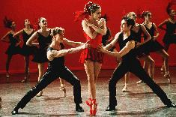
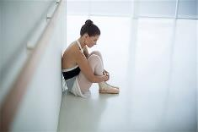
ACDENRU
DURANCE
UNCARED
S
DURANCE: n. RESTRAINT BY PHYSICAL FORCE
UNCARED: adj. NOT PROPERLY TAKEN CARE OF
UNREAD + C DANCER + U
Notes:
NO WORD unraced*
UNREAD: “MY DITZ SKIPS SCHOOL”
DANCER: “A POSH TUTU LIKELY”

Slide 22
DANCER L
ACDELNR
ONE WORD
Notes:
.

Slide 23
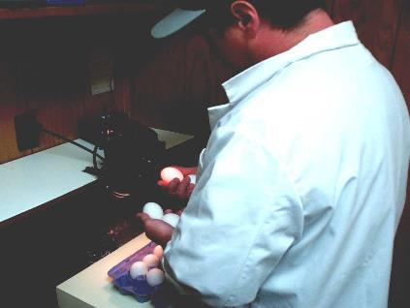
ACDELNR
CANDLER
_
S
CANDLER: ONE THAT CANDLES, OR EXAMINES EGGS IN FRONT OF A LIGHT
CANDLE, CANDLES, CANDLED, CANDLING, CANDLER, CANDLERS
Notes:
.

Slide 24
DANCER I
ACDEINR
THERE ARE TWO!
Notes:
.

Slide 25
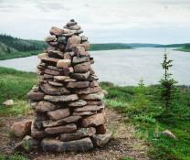
ACDEINR
CAIRNED
DANCIER
DANCIER: MORE DANCEY, SUITABLE FOR DANCING (DANCIEST)
CAIRNED: adj. RELATING TO A CAIRN, A HEAP OF STONES USED AS A MARKER; CAIRNS, BUT NOT cairning* (also adj. CAIRNY which does not compare)
RAINED + C DANCER + I
(CARN, CARNS, KARN, KARNS, NOUNS ONLY NO OTHER FORMS)
Notes:
RAINED: “DAMP RAINS BROUGHT HAVOC”
DANCER: “A POSH TUTU LIKELY”

Slide 26
DANCER K
ACDEKNR
ONE WORD
Notes:
.

Slide 27
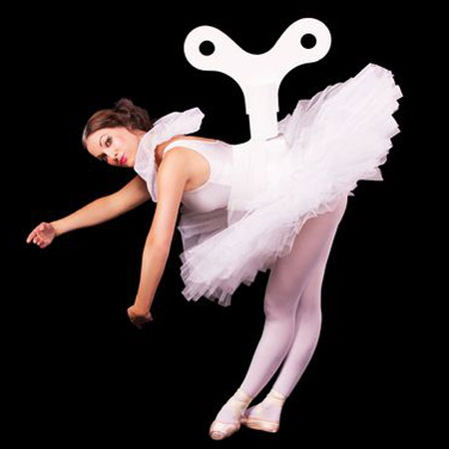
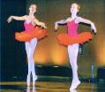
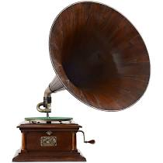
ACDEKNR
_
CRANKED
Notes:
.

Slide 28
DANCER E
ACDEENR
ONE WORD
Notes:
.

Slide 29
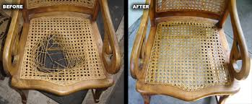
ACDEENR
_
RECANED
Notes:
.

Slide 30
DANCER Y
ACDENRY
ONE WORD
Notes:
.

Slide 31
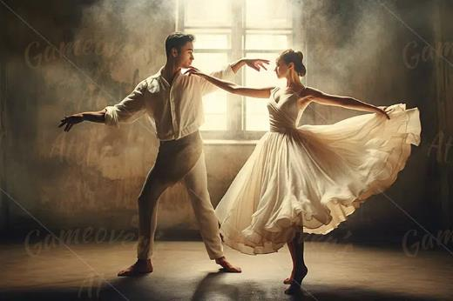
ACDENRY
ARDENCY
ARDENCY: ARDOR, OR INTENSITY OF EMOTION (pl. ARDENCIES [INCREASED]
Notes:
.

Slide 32
DANCER
BINGOES WORTH REVIEWING:
ENDARCH CAIRNED CANDLER DURANCE ARDENCY ACORNED DRACENA DANCIER UNCARED
Notes:
.

Slide 33
DANCER
WHAT WAS THAT MNEMONIC PHRASE?
Notes:
.

Slide 34
DANCER
A POSH TUTU LIKELY
Notes:
.

Slide 35
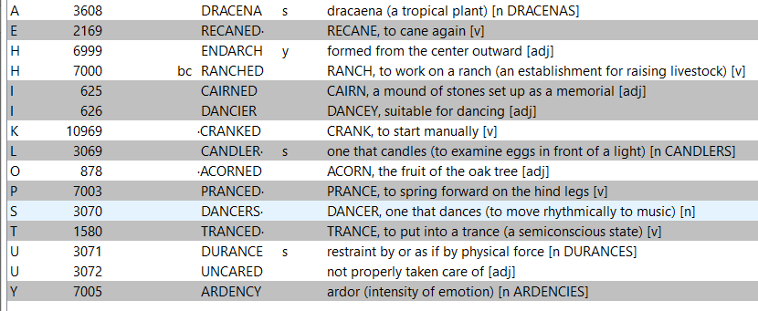
DANCER
Notes:
.

Slide 36
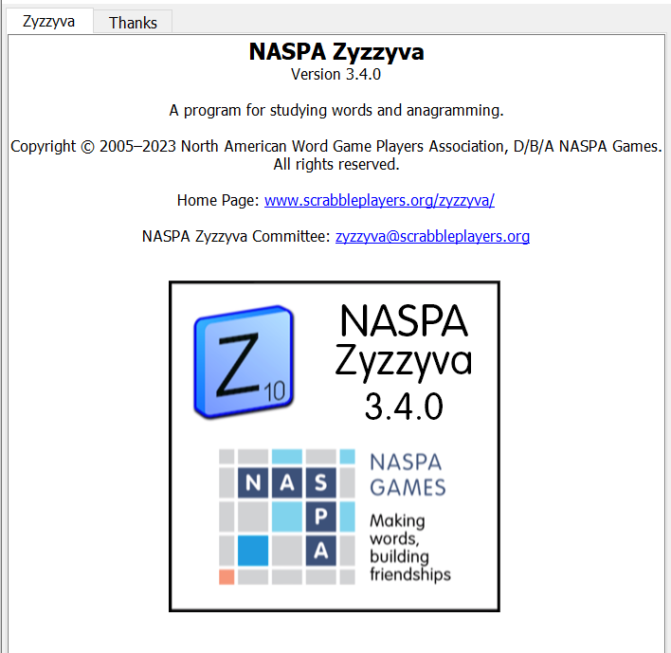
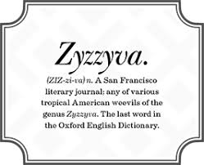
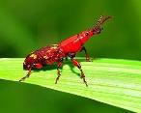
SEND suggestions or requests for additional PowerPoint slide shows to: williamrsnoddy@gmail.com
“Hey, Bill…”
Notes:
.

Slide 37
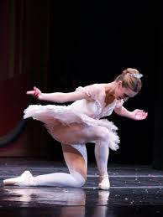
THE END
Notes:
.

