Slide 1
AEPPRS
Nothing new from NASPA’s NWL23 or WGPO’s WOW24 word lists.
Notes:
.

Slide 2
AEPPRS
IF the above alphagram does NOT show numbered Scrabble tiles,
then make sure you are viewing your downloaded version in the PowerPoint app
Notes:
.

Slide 3
AEPPRS
Use PowerPoint or Keynote in FULL SCREEN “SLIDE SHOW” mode on your LAPTOP or DESKTOP for best results
When you see the “ESCAPE KEY” ICON check speaker notes for additional information by hitting the escape key
Notes:
.

Slide 4
AEPPRS
OF THE TWO GOOD “SIXES” WHAT IS THE BINGO STEM FROM THIS ALPHAGRAM?
Notes:
.

Slide 5
AEPPRS
PAPERS
SAPPER IS THE ONLY OTHER WORD ON THIS RACK
Notes:
.

Slide 6
PAPERS
WHAT MNEMONIC PHRASE CAN WE ASSOCIATE WITH THIS BINGO STEM?
Notes:
.

Slide 7
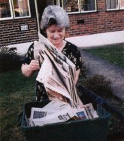
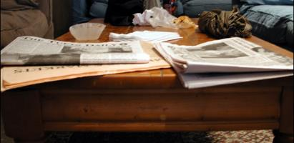
PAPERS
ZEE HOUSEWIFERY
ACCUMULATIONS
Notes:
PAPERS: “ZEE HOUSEWIFERY ACCUMULATIONS”

Slide 8
PAPERS Z
AEPPRSZ
ONE WORD
Notes:
.

Slide 9
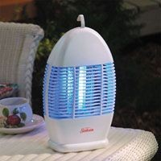
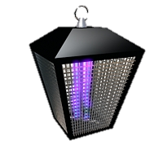
AEPPRSZ
_
ZAPPERS
Notes:
.

Slide 10
PAPERS E
AEEPPRS
ONE WORD
Notes:
.

Slide 11
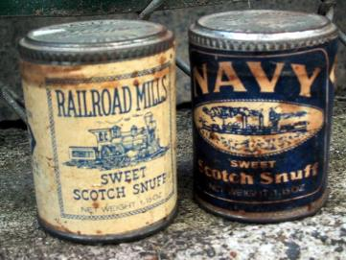
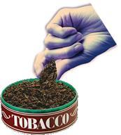
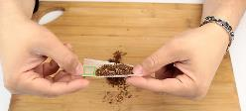
AEEPPRS
RAPPEES
_
RAPPEES: pl. of RAPPEE, A STRONG SNUFF
RAPPEE
RAPPEE
PAPERS ‘E DON’T NEED, WITH RAPPEES.
Notes:
Considering a small pic of a cigarette being rolled with papers, and an orange X over it.

Slide 12
PAPERS H
AEHPPRS
ONE WORD
Notes:
.

Slide 13
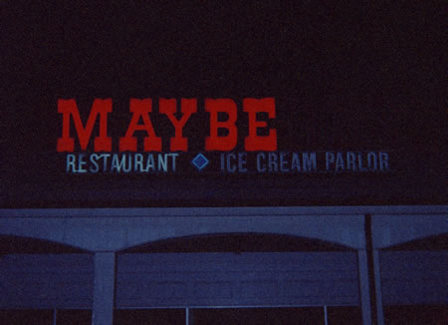
AEHPPRS
PERHAPS
STICKY
MAYBE… MAYBERRY?
PERHAPS.
Notes:
.

Slide 14
PAPERS O
AEOPPRS
ONE WORD
Notes:
.

Slide 15
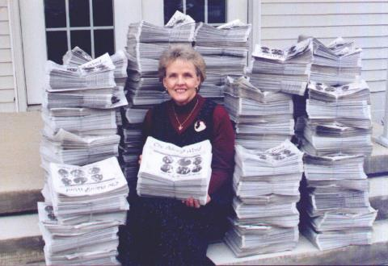
AEOPPRS
APPOSER
_
S
APPOSER: ONE THAT APPOSES, OR PLACES SIDE BY SIDE
APPOSE
APPOSED
APPOSES
APPOSING
Notes:
.

Slide 16
PAPERS U
AEPPRSU
ONE WORD
Notes:
.

Slide 17
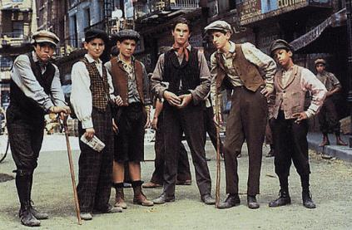
AEPPRSU
PAUPERS
_
PAUPERS: v. (!) REDUCES TO POVERTY (PAUPER, PAUPERED, PAUPERING)
“PAPERS U DELIVER”, SAID THE MANAGER WHO PAUPERS EVERY PAPERBOY.
Notes:
.

Slide 18
PAPERS S
AEPPRSS
THERE ARE TWO!
Notes:
.

Slide 19
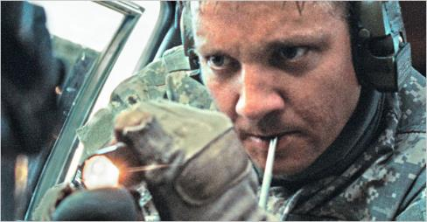
AEPPRSS
APPRESS
APPRESS: v. TO PRESS CLOSE TO SOMETHING
SAPPERS
_
SAPPERS: pl. of SAPPER, A MILITARY ENGINEER
APPRESS
APPRESSED
APPRESSES
APPRESSING
Notes:
.

Slide 20
PAPERS W
AEPPRSW
ONE WORD
Notes:
.

Slide 21
AEPPRSW
SWAPPER
S
Notes:
.

Slide 22
PAPERS I
AEIPPRS
TWO WORDS
Notes:
.

Slide 23
AEIPPRS
D
APPRISE: v. TO NOTIFY
APPRISE
SAPPIER
R
S
APPRISED APPRISER
APPRISES APPRISING
SAPPIER: MORE SILLY (SAPPY, SAPPIEST)
MOST PAPERS CONTAIN MOVIE REVIEWS THAT APPRISE READERS OF NEW RELEASES WITH SAPPIER PLOTS.
ALSO APPRIZED APPRIZER/S
APPRIZES APPRIZING
PRAISE + P PAPERS + I
Notes:
PRAISE: “LET APPROVED MEN WATCH US”
PAPERS: “ZEE HOUSEWIFERY ACCUMULATIONS”

Slide 24
PAPERS F
AEFPPRS
ONE WORD
Notes:
.

Slide 25
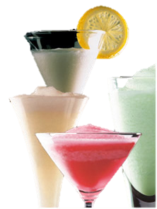
AEFPPRS
FRAPPES
_
FRAPPES: pl. of FRAPPE, A PARTIALLY FROZEN DRINK
Notes:
.

Slide 26
PAPERS R
AEPPRRS
ONE WORD
Notes:
.

Slide 27
AEPPRSY
C
RAPPERS
_
T
W
HOOK/S?
CRAPPERS TRAPPERS WRAPPERS
Notes:
.

Slide 28
PAPERS Y
AEPPRSY
TWO WORDS
Notes:
.

Slide 29
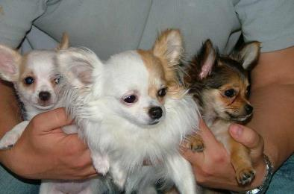
AEPPRSY
_
_
PREPAYS
YAPPERS
THIS NEW PET OWNER PREPAYS THE BREEDER BEFORE PICKING UP HIS YAPPERS.
_
S
Notes:
.

Slide 30
PAPERS A
AAEPPRS
ONE WORD
Notes:
.

Slide 31
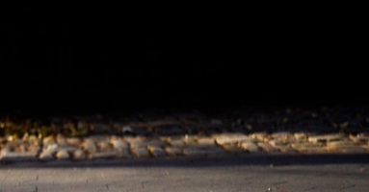
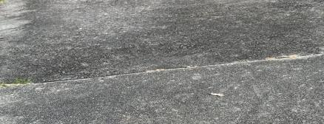
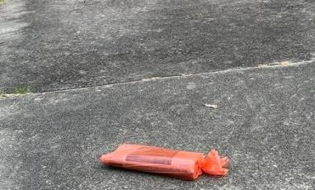
AAEPPRS
APPEARS
_
Notes:
.

Slide 32
PAPERS C
ACEPPRS
ONE WORD
Notes:
.

Slide 33
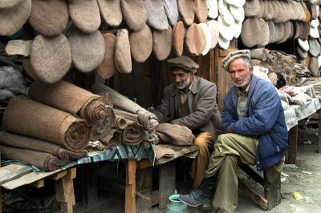
ACEPPRS
CAPPERS
_
CAPPERS: pl. of CAPPER, A CAPMAKER
Notes:
.

Slide 34
PAPERS M
AEMPPRS
THERE ARE THREE!
Notes:
.

Slide 35
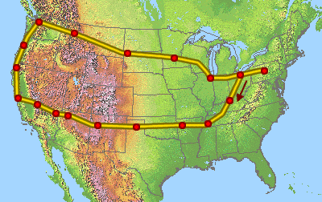
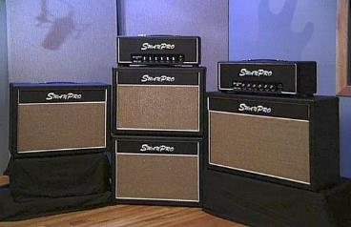
AEMPPRS
_
MAPPERS
PAMPERS
PREAMPS
_
_
PREAMPS: pl. of PREAMP, AN AMPLIFIER
ROCK BAND MANAGERS ARE EXCELLENT TOUR MAPPERS. EACH ONE PAMPERS THE BAND’S EQUIPMENT, ESPECIALLY THE IMPORTANT PREAMPS.
Notes:
.

Slide 36
PAPERS L
AELPPRS
THERE ARE THREE!
Notes:
.

Slide 37
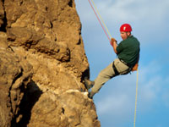
AELPPRS
C
_
RAPPELS: v. DESCENDS FROM A STEEP HEIGHT BY MEANS OF A ROPE RAPPEL RAPPELED RAPPELING RAPPELLED RAPPELLING
LAPPERS
RAPPELS
SLAPPER
F
S
_
_
S
LAPPERS: v. CURDLES (LAPPER, LAPPERED, LAPPERING) also LOPPER, LOPPERS, LOPPERED, LOPPERING
THE YOGURT DRINK IN HIS BACK POCKET LAPPERS AS THIS MAN RAPPELS, HARDLY A KNEE SLAPPER FOR A THIRSTY CLIMBER!
HOOK/S?
CLAPPERS FLAPPERS SLAPPERS
Notes:
.

Slide 38
PAPERS T
AEPPRST
ONE WORD
Notes:
.

Slide 39
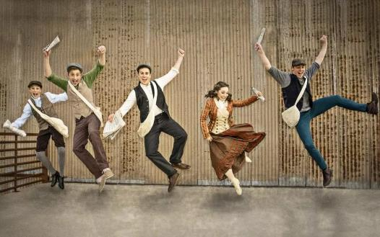
AEPPRST
TAPPERS
_
Notes:
.

Slide 40
PAPERS N
AENPPRS
TWO WORDS
Notes:
.

Slide 41
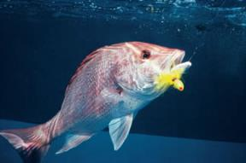
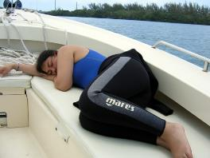
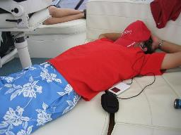
AENPPRS
K
HOOK/S?
_
NAPPERS
SNAPPER
s
KNAPPERS SNAPPERS
_
S
THESE FISHERMEN TURNED INTO NAPPERS, SO THEY DIDN’T CATCH A SINGLE SNAPPER!
Notes:
KNAPPERS: pl. of KNAPPER, ONE THAT KNAPS OR STRIKES SHARPLY; KNAP, KNAPS, KNAPPED, KNAPPING
Shift + F5 to return to full screen

Slide 42
PAPERS
THAT’S IT! WHAT WAS THAT MNEMONIC PHRASE?
Notes:
.

Slide 43
PAPERS
ZEE HOUSEWIFERY
ACCUMULATIONS
Notes:
.

Slide 44
PAPERS
BINGOS WORTH REVIEWING:
RAPPEES YAPPERS
APPOSER PREAMPS
SAPPERS RAPPELS
FRAPPES LAPPERS
PREPAYS APPRESS
Notes:
.

Slide 45
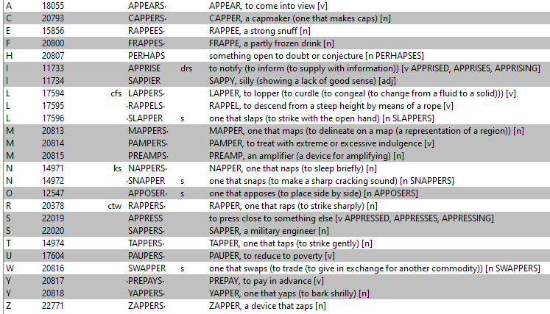
PAPERS
Notes:
.

Slide 46
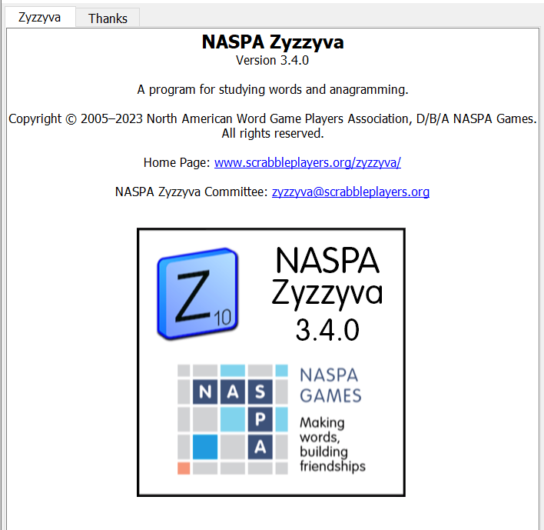
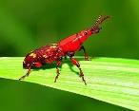
SEND suggestions or requests for additional PowerPoint slide shows to: williamrsnoddy@gmail.com
“Hey, Bill…”
Notes:
.

Slide 47
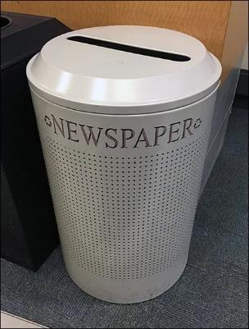
THE END!
Notes:
.

