Slide 1
ADGINR
Notes:
Nothing new from NWL23 or WOW24

Slide 2
ADGINR
IF the above alphagram does NOT show numbered Scrabble tiles,
then make sure you are viewing your downloaded version in the PowerPoint app
Notes:
.

Slide 3




ADGINR
Use PowerPoint or Keynote in FULL SCREEN “SLIDE SHOW” mode on your LAPTOP or DESKTOP for best results
When you see the “ESCAPE KEY” ICON check speaker notes for additional information by hitting the escape key
Notes:
.

Slide 4
ADGINR
OF THE TWO “SIXES”
WHAT BINGO STEM
CAN BE CREATED
FOR THIS ALPHAGRAM?
Notes:
.

Slide 5
ADGINR
dARING
THE OTHER GOOD WORD IS GRADIN (ONE OF A SERIES OF STEPS, also GRADINE/S)
Notes:
.

Slide 6
DARING
WHAT MNEMONIC PHRASE
CAN WE ASSOCIATE
WITH THIS BINGO STEM?
WHAT WOULD BE DARING?
Notes:
.

Slide 7
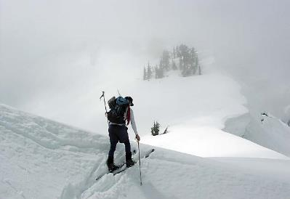

DARING
TO BOLDLY SKI DOWN ICY SLOPE IN FOG
Notes:
DARING: “TO BOLDLY SKI DOWN ICY SLOPE IN FOG”

Slide 8
DARING
T
ADGINRT
TWO WORDS
Notes:
.

Slide 9
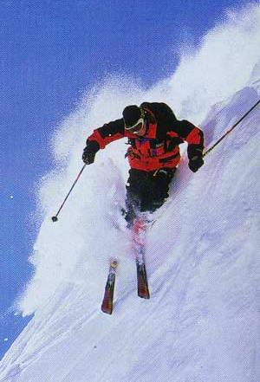
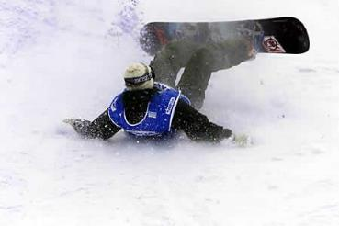
ADGINRT
DARTING
TRADING
S
HOOK/S?
HE WAS SEEN DARTING DOWN A BLACK DIAMOND SLOPE AFTER TRADING HIS SNOWBOARD FOR A PAIR OF SKIS.
RATING + D DARING + T
Notes:
RATING: “I MISCOPIED WEAK FOE’S RATING”
DARING: “TO BOLDLY SKI DOWN ICY SLOPE IN FOG”

Slide 10
DARING
B
ABDGINR
TWO WORDS
Notes:
.

Slide 11
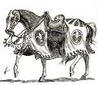
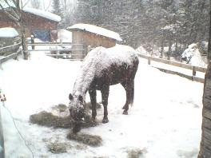
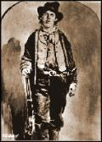

ABDGINR
BARDING: ARMORING A HORSE
BARDING
BRIGAND
(BARD, BARDS, BARDE, BARDES, BARDED, BARDING)
S
BRIGAND: BANDIT
THE SNOW COVERED THE HORSE, ALMOST AS IF NATURE WERE BARDING IT WITH ARMOR. THE BRIGAND DIDN’T EVEN BLANKET THE ANIMAL.
Notes:
.

Slide 12
DARING
O
ADGINOR
ONE WORD
Notes:
.

Slide 13
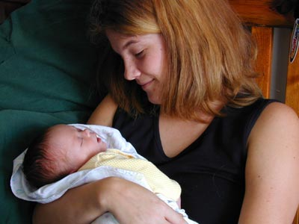
ADGINOR
ADORING
ORDAIN + G DARING + O
Notes:
ORDAIN: “GENT BLESSED STEEPLE”
DARING: “TO BOLDLY SKI DOWN ICY SLOPE IN FOG”

Slide 14
DARING
L
ADGILNR
TWO WORDS
Notes:
.

Slide 15
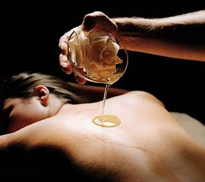
ADGILNR
DARLING
LARDING
S
DARLING…LARDING
adv. DARLINGLY
(LARD, LARDED, LARDING)
13
Notes:
.

Slide 16
DARING
D
ADDGINR
ONE WORD
Notes:
.

Slide 17
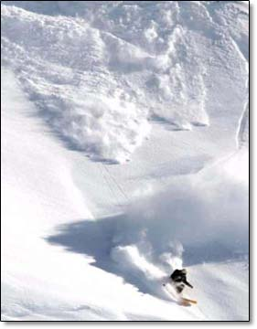

ADDGINR
RADDING
B
_
RADDING: FEARING (RAD, RADS, RADDED)
FOUR FRONT HOOKS FOR RAD?
BRAD GRAD ORAD TRAD
D’ BOLDLY DARING , RADDING NOTHING.
Notes:
.

Slide 18
DARING
Y
ADGINRY
TWO WORDS
Notes:
.

Slide 19
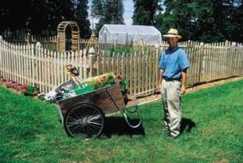
ADGINRY
_
DRAYING
YARDING
DRAYING: TRANSPORT BY A DRAY A LOW, STRONG CART (DRAY, DRAYED, DRAYING)
YARDING: TO PUT IN A YARD ADJACENT TO A BUILDING (YARD, YARDED, YARDING)
HE IS DRAYING GEAR FOR YARDING!
Notes:
.

Slide 20
DARING
S
ADGINRS
TWO WORDS
Notes:
.

Slide 21
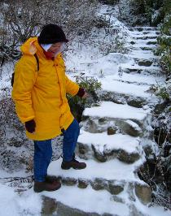
ADGINRS
DARINGS
GRADINS
_
DARINGS: pl. of DARING, BRAVERY
_
GRADINS: pl. of GRADIN, A STEP IN A SERIES (also GRADINE/S)
AFTER DARINGS ON THE SLOPES, IT ALSO TAKES BRAVERY TO BOLDLY ASCEND THE ICY GRADINS TO THE LODGE!
GRAINS + D DARING + S
Notes:
GRAINS: “AVOID BACON, GO TO CHEAP HOMINY”
DARING: “TO BOLDLY SKI DOWN ICY SLOPE IN FOG”

Slide 22
DARING
K
ADGIKNR
ONE WORD
Notes:
.

Slide 23
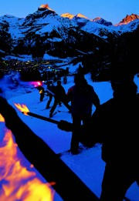
ADGIKNR
DARKING
DARKING: DARKENING (DARK, DARKS, DARKED, DARKING)
also
DARKLE
DARKLED
DARKLES
DARKLING
DARKLINGS
Notes:
.

Slide 24
DARING
I
ADGIINR
ONE WORD
Notes:
.

Slide 25
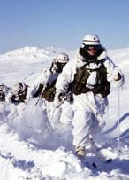
ADGIINR
RAIDING
B
_
HOOK/S?
RAIDING DOES NOT TAKE AN S, DOES BRAIDING?
YES, BRAIDINGS IS A GOOD WORD
Notes:
.

Slide 26
DARING
W
ADGINRW
TWO WORDS
Notes:
.

Slide 27



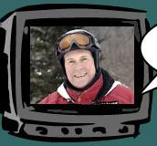

ADGINRW
DRAWING
WARDING
S
A
S
HOOK/S?
DRESSED IN DOWN AND DRAWING ON HIS POWER TO CONTROL THE WEATHER (NONE) THE “SKIING WEATHERMAN” IS DARING HIS PUBLIC TO BELIEVE HE IS WARDING OFF BAD CONDITIONS.
DRAWINGS AWARDING SWARDING
Notes:
SWARDING: v. COVERING WITH TURF (SWARD, SWARD, SWARDED)
Shift + F5 to return to full screen

Slide 28
DARING
N
ADGINNR
ONE WORD
Notes:
.

Slide 29
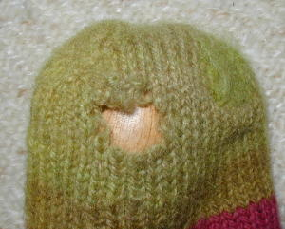
ADGINNR
DARNING
S
HOOK/S?
DARNINGS
Notes:
.

Slide 30
DARING
C
ACDGINR
ONE WORD
Notes:
.

Slide 31
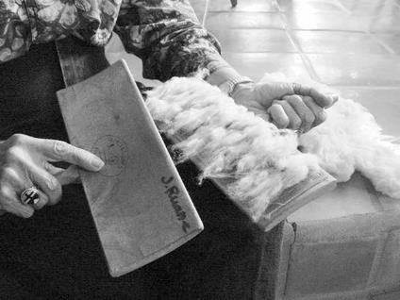
ACDGINR
CARDING
S
CARDING: THE PROCESS OF COMBING AND CLEANING COTTON FIBERS (CARD, CARDS, CARDED, AND ONE CAN BE A CARDER)
HOOK/S?
CARDINGS
Notes:
CARDING 1: to place or fasten on or by means of a card 2: to provide with a card 3: to list or record on a card 4: SCORE *a golfer carding a 75* 5: to ask for identification (as in a bar) “we all got carded” 6: to cleanse, disentangle, and collect together (as fibers) by the use of cards preparatory to spinning SO………CARD, CARDS, CARDED, CARDING, CARDINGS, CARDER and CARDERS!
Shift + F5 to return to full screen

Slide 32
DARING
P
ADGINPR
ONE WORD
Notes:
.

Slide 33
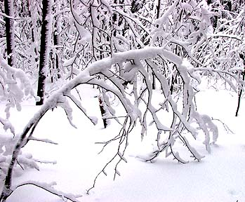
ADGINPR
_
DRAPING
IF YOU ARE DARING ENOUGH TO BOLDLY SKI DOWN ICY SLOPE IN FOG, YOU MAY FIND A SNOW-LADEN TREE DRAPING OVER THE TRAIL.
Notes:
.

Slide 34
DARING
E
ADEGINR
FOUR WORDS
Notes:
.

Slide 35
ADEGINR
DERAIGN
GRADINE
GRAINED
READING
S
DERAIGN: TO DISPUTE A CLAIM
S
GRADINE: ONE OF A SERIES OF STEPS
_
GRAINED: FORMED INTO SMALL PARTICLES
BDT
S
BREADING, DREADING, TREADING: none take a rear S hook
REGINA + D, DANGER + I, RAINED + G, DARING + E
Notes:
REGINA: “PERFECT ANGEL BEHEADS MEN THAT GAZE AND WAVE”
DANGER: protiles* or ‘POITRELS’ or “PILOT SEES PERIL”
RAINED: “DAMP RAINS BROUGHT HAVOC”
DARING: “TO BOLDLY SKI DOWN ICY SLOPE IN FOG”

Slide 36
DARING
F
ADFGINR
ONE WORD
Notes:
.

Slide 37

ADFGINR
FARDING
FARDING: APPLYING COSMETICS TO (FARD, FARDS, FARDED, FARDING)
I AM IN A FOG AS TO WHY SHE SPENT TIME FARDING HER FACE, THEN DARING TO WEAR A SKI MASK LIKE THIS!
Notes:
.

Slide 38
DARING
G
ADGGINR
TWO WORDS
Notes:
.

Slide 39
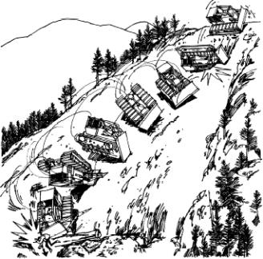
ADGGINR
_
GRADING
NIGGARD
HOOK/S?
S
NIGGARD: v. TO ACT STINGILY
(NIGGARDS, NIGGARDED, NIGGARDING)
WHEN GRADING SKI RUNS, YOU HAVE TO HAVE SOMEONE DARING ENOUGH TO USE HEAVY EQUIPMENT ON A STEEP SLOPE, AND A COMPANY WHO WILL NOT NIGGARD WHEN PROVIDING THE BEST QUALITY INDUSTRIAL GEAR.
Notes:
NIGGARD noun: A mean, stingy person. adjective: Stingy. Also adjective: NIGGARDLY
This word has nothing to do with the N-word, however, similarity in sounds has led to people objecting to it. It's seen more often in its adjectival form, niggardly, as in: "Japan has the world's second-largest economy, yet its promised $200m so far is niggardly." (The Economist). In the US, the word has become “radioactive” and its use has led to controversy.
Shift + F5 to return to full screen

Slide 40
DARING
THAT’S IT! THE DIFFICULT BINGOS:
BARDING BRIGAND
RADDING GRADINE
FARDING NIGGARD
DARKING GRADINS
Notes:
.

Slide 41
DARING
WHAT WAS THAT MNEMONIC PHRASE?
Notes:
.

Slide 42
DARING
TO BOLDLY SKI DOWN ICY SLOPE IN FOG
Notes:
,

Slide 43
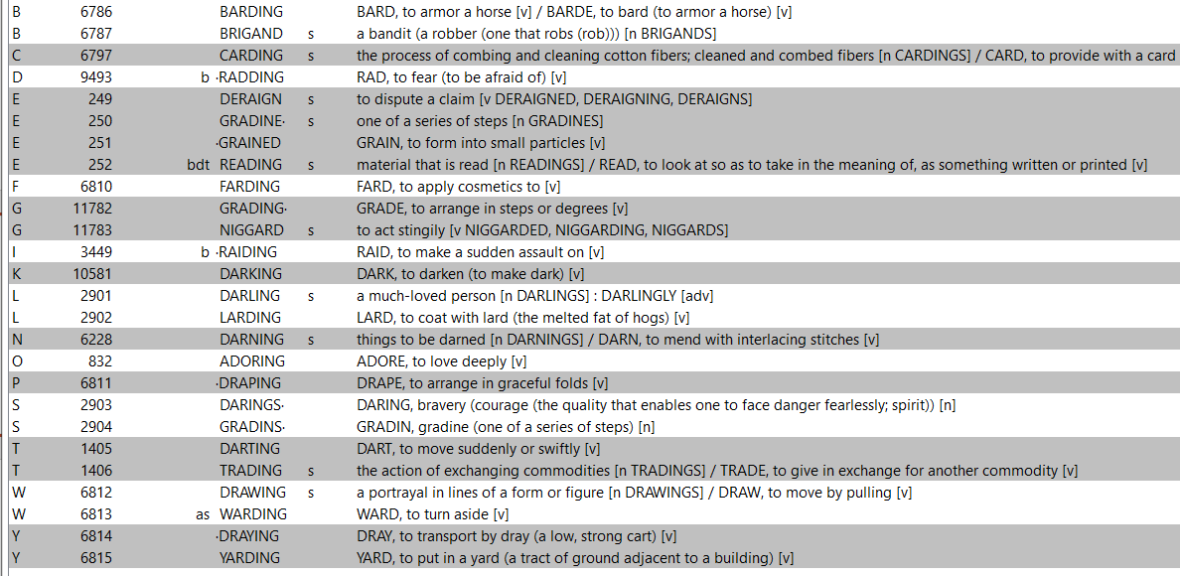
DARING
Notes:
.

Slide 44


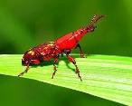
SEND suggestions or requests for additional PowerPoint slide shows to: williamrsnoddy@gmail.com
“Hey, Bill…”
Notes:
.

Slide 45
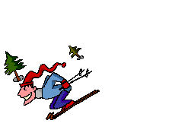
THE END
Notes:
.

