Slide 1
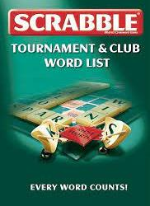
New Sevens from NWL23
Updated! So delete previous versions!
Notes:
.

Slide 2
SEVENS
IF the above word does NOT show numbered Scrabble tiles,
then make sure you view your downloaded version in PowerPoint or KeyNote
Use PowerPoint or Keynote in FULL SCREEN “SLIDE SHOW” mode on your LAPTOP or DESKTOP for best results
When you see the “ESCAPE KEY” ICON check speaker notes for additional information by hitting the escape key
Notes:
.

Slide 3
Striking through the words that were covered in previous lists and PowerPoint shows.
ABYEING ADULTED AEDESES AGENDER AHADITH ALTCOIN AMIRITE ANGSTED ASSHATS ASSLESS ASSWIPE BACKEND BIRRIAS BIRTHER BLIMPED BLUEWAY BODYCAM BOHUNKS BONSAIS BORICUA BOTOXED BOTOXES BOUGIER BOUJIER BOURGIE BROIEST BUCKRAS CAMGIRL CATHING CELLIES CERIMAN CHANNAS CHATBOT CHICHAS CHIPLET CHROMIS COHESIN CORIVAL COSPLAY COTIJAS CRINGEY CRYPSES CRYPSIS CRYPTID CUBESAT CUCKING DASHCAM DEADASS DEBOARD DEGORGE DELEAFS DEMONYM DOGPILE DOXINGS DOXXING DUKKAHS DUMBASS EELINGS EGGCORN EKUELES EMAILER EMPATHS EMPINGS EPIGYNA EPIGYNE FANARTS FATBERG FECESES FINTECH FLAVEDO FRANCOS FUGLIER FURRIES FUSUMAS FUTSALS GANKING GEEKING GEOSMIN GEOTAGS GIRLIES GLAMPED GLAMPER GNETUMS GOETTAS GOYISHE GREYOUT GULESES GUMMIES HANGULS HAPTICS HEISHIS HOASCAS HOGLETS HUCKING HUNKEYS HUNKIES INKINGS IXNAYED JAKESES JAMOKES JANKIER JEGGING JESUITS JOLLOFS JUICERY KANAKAS KAYFABE KETTLED KEYTARS KHARIFS KOBOCHA KRATOMS KUMBAYA LAGGIER LARPERS LARPING LEAFERS LIPOING MAITAKE MALTMAN MALTMEN MASKNES MATCHAS MEADERY MEETUPS MEIKLER MELINJO MELTIER MIDDEST MODDERS MODDEST MODDING MOFONGO MULATTO NAMASTE NEONICS NOOBIES NOOKIES NUTBALL OMAKASE ONESIES OUNCERS OXGALLS PANTSED PANTSES PEEPALS PICKNEY PIROGIS PLUSHIE POMMIES POOFIER PREHIRE PRENEED PREPPER PRONING PUNKING RAPINIS REALIAS REDBUSH REDNECK REPOSTS RETCONS REWATCH SENRYUS SHARTED SHEENEY SHEENIE SHEGETZ SHICKSA SHIKSAS SHIKSEH SHIKSES SHIVING SHIVVED SHOULDA SITCHES SIZEISM SIZEIST SLUSHEE SLUSHIE SNARKED SPAZZED SPAZZES SPONCON STANNED STIMMED STUFFIE SWOLEST TABESES TASERED THINGIE UNMUTED UNMUTES UNPAIRS UNVAXED VAQUITA VAXXING VERBING WALIEST WALLIER YEETING ZAATARS ZEDONKS ZEEDONK ZONKEYS ZOODLES ZOOMERS
Notes:
.

Slide 4
?
A D D E L T U
ONE WORD
Notes:
.

Slide 5
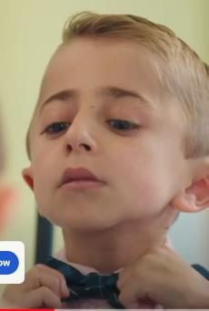
ADULTED
ADULTED: v. DID THINGS CHARACTERISTIC OF A MATURE INDIVIDUAL (ADULTING)
Notes:
.

Slide 6
?
A D E E E S S
ONE WORD
Notes:
.

Slide 7
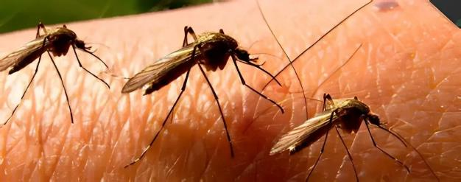
AEDESES
AEDESES: NWL23 pl. of AEDES, A GENUS OF MOSQUITOES
Notes:
.

Slide 8
?
A D E E G N R
SIX WORDS
Notes:
.

Slide 9
You could play
DRS
D
ANGERED
DERANGE
ENRAGED
_
GRENADE
S
or
GRANDEE
S
But why not play
_
AGENDER
AGENDER: adj. NOT HAVING GENDER
Notes:
.

Slide 10
?
A A D H H I T
ONE WORD
Notes:
.

Slide 11
_
AHADITH
AHADITH: n. A RECORD OF THE SAYINGS OF MUHAMMED
(also HADITH/S but apparently AHADITH does not take an S)
Notes:
.

Slide 12
?
A C I L N O T
ONE WORD
Notes:
.

Slide 13
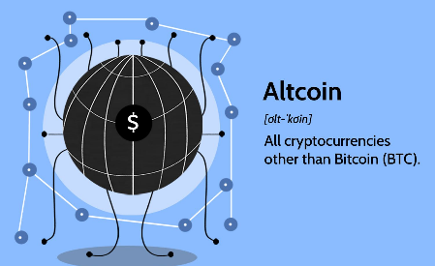
ALTCOIN
S
ALTCOIN: AN ALTERNATIVE CRYPTOCURRENCY
Notes:
.

Slide 14
?
A E I I M R T
TWO WORDS
Notes:
.

Slide 15
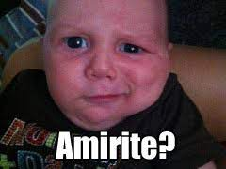
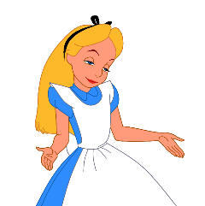
You could play
AIRTIME
S
AIRTIME: n. THE TIME WHEN A BROADCAST BEGINS
But why not play
AMIRITE
AMIRITE: interj. “AM I RIGHT” (also AMIRIGHT)
Notes:
Amirite is an internet slang spelling of the rhetorical tag question am I right?
Shift + F5 to return to full screen

Slide 16
?
A D E G N S T
THREE WORDS
Notes:
.

Slide 17
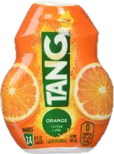
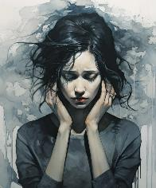
You could play
DANGEST
DANGEST: MOST WRETCHED, NASTY, ACCURSED
_
or
STANGED
STANGED: v. PAST TENSE OF STANG,
TO STING (STANGS, STANGED, STANGING)
ANGSTED
Instead play:
ANGSTED: v. EXPERIENCED ANXIETY (ANGSTING)
Notes:
TANGED: v. PROVIDED WITH A PUNGENT FLAVOR (TANG, TANGS, TANGING)
Shift + F5 to return to full screen

Slide 18
?
A E L S S S S
ONE WORD
Notes:
.

Slide 19
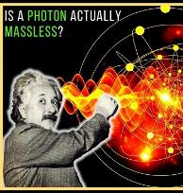
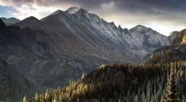
M P
ASSLESS
ASSLESS: NOT COVERING THE BUTTOCKS
MASSLESS: adj. HAVING NO MASS
PASSLESS: adj. INCAPABLE OF BEING TRAVELLED OVER OR THROUGH
Notes:
.

Slide 20
?
A E I P S S W
ONE WORD
Notes:
.

Slide 21
ASSWIPE
S
ASSWIPE: A DETESTABLE PERSON
Notes:
.

Slide 22
?
A B C D E K N
ONE WORD
Notes:
.

Slide 23
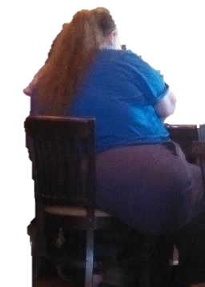
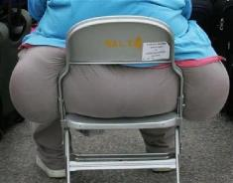
BACKEND
S
BACKEND: A PART OF SOFTWARE NOT DIRECTLY ACCESSIBLE TO THE USER
?
Notes:
.

Slide 24
?
B E H I R R T
TWO WORDS
Notes:
.

Slide 25
You could play
REBIRTH
P
S
But why not play
BIRTHER
S
BIRTHER: n. A TYPE OF CONSPIRACY THEORIST
Notes:
.

Slide 26
?
B D E I L M P
ONE WORD
Notes:
.

Slide 27
BLIMPED
_
BLIMPED: NWL23 verb ATE EXCESSIVELY (BLIMPING)
Notes:
.

Slide 28
?
A B E L U W Y
ONE WORD
Notes:
.

Slide 29
BLUEWAY
S
BLUEWAY: A WATER ROUTE RESERVED FOR NONMOTORIZED CRAFT
Notes:
.

Slide 30
?
A B C D M O Y
ONE WORD
Notes:
.

Slide 31
BODYCAM
S
BODYCAM: A VIDEO CAMERA MOUNTED ON THE FRONT OF A BODY
Notes:
.

Slide 32
?
A B I N O S S
TWO WORDS
Notes:
.

Slide 33
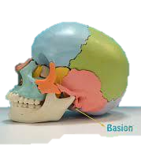
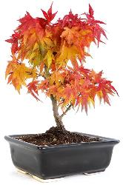
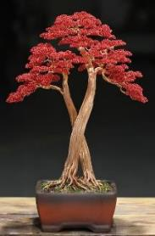
You could play
BASIONS
_
BASIONS: pl. of BASION, A PART OF THE SKULL
But why not play
BONSAIS
_
BONSAIS: NWL23 pl. of BONSAI, A POTTED SHRUB THAT HAS BEEN DWARFED
Notes:
.

Slide 34
?
A B C I O R u
TWO WORDS
Notes:
.

Slide 35
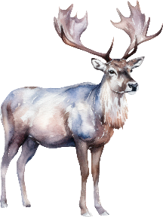
You could play
CARIBOU
S
CARIBOU: A LARGE DEER
But why not play
BORICUA
S
BORICUA: A NATIVE OF PUERTO RICO
Notes:
.

Slide 36
?
B D E O O T X
ONE WORD
Notes:
.

Slide 37
BOTOXED
BOTOXED: INJECTED BOTULINUM TOXIN (BOTOX, BOTOXES, BOTOXING)
Notes:
.

Slide 38
?
B E G I O R U
TWO NEW WORDS
Notes:
.

Slide 39
Both of these are new from NWL 23!
_
BOUGIER
BOUGIE: n. A WAX CANDLE with pl. BOUGIES
BOUGIER: adj. MORE PRETENDING TO BE WEALTHY (BOUGIE, BOUGIEST)
R
BOURGIE
S
BOURGIE: 1) n. ONE WHO PRETENDS TO BE WEALTHY (pl. BOURGIES)
2) adj. PRETENDING TO BE WEALTHY (BOURGIER, BOURGIEST)
Notes:
.

Slide 40
?
B E I J O R U
ONE WORD

Slide 41
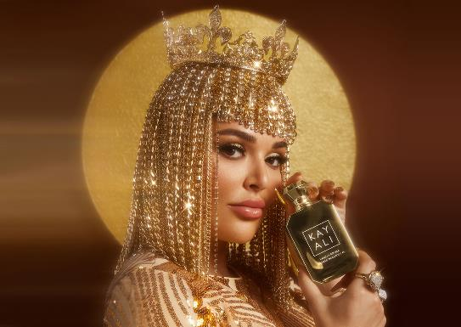
BOUJIER
STICKY
BOUJIER: MORE OSTENTATIOUS ABOUT RECENT WEALTH (BOUJEE, BOUJIEST)
Notes:
.

Slide 42
?
A C G I L M R
ONE WORD
Notes:
.

Slide 43
CAMGIRL
S
CAMGIRL: A WOMAN PAID TO POSE ON A WEBCAM FOR ENTERTAINMENT
Notes:
.

Slide 44
?
A C E I M N R
TWO WORDS
Notes:
.

Slide 45
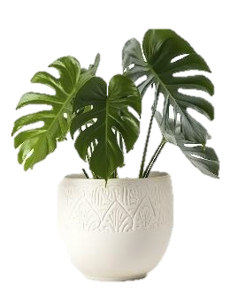
You could play
CARMINE
S
CARMINE: A VIVID RED COLOR
But why not play
CERIMAN
S
CERIMAN: A TROPICAL AMERICAN PLANT
(also called MONSTERA/S)
Notes:
.

Slide 46
?
A B C H O T T
ONE WORD
Notes:
.

Slide 47
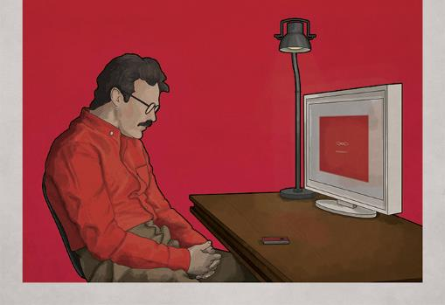
CHATBOT
S
CHATBOT: A BOT DESIGNED TO CONVERSE WITH HUMANS
Notes:
.

Slide 48
?
C E H I L P T
ONE WORD
Notes:
.

Slide 49
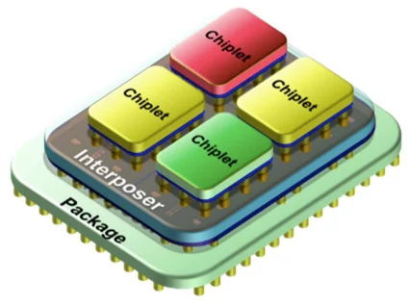
CHIPLET
S
CHIPLET: A SMALL INTEGRATED CIRCUIT LIMITED IN FUNCTION
Notes:
.

Slide 50
?
C H I M O R S
TWO WORDS
Notes:
.

Slide 51
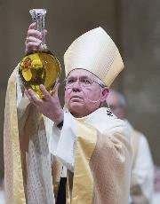
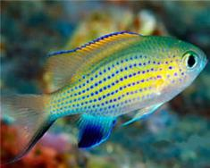
You could play
CHRISOM
S
CHRISOM: A CONCENTRATED OIL (also CHRISM/S, adj. CHRISMAL)
But why not play
CHROMIS
CHROMIS: A DAMSELFISH (CHROMIS is both singular & plural)
Notes:
.

Slide 52
?
C E H I N O S
ONE WORD
Notes:
.

Slide 53
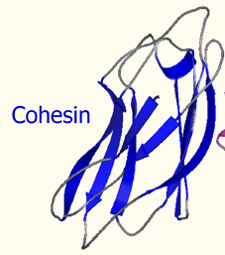
COHESIN
S
COHESIN: A TYPE OF PROTEIN COMPLEX
Notes:
.

Slide 54
?
A C I L O R V
ONE WORD
Notes:
.

Slide 55
CORIVAL
S
CORIVAL: A MUTUAL RIVAL
ALABAMA AND GEORGIA TECH WOULD HAVE GEORGIA AS A CORIVAL
Notes:
.

Slide 56
?
A C L O P S Y
TWO WORDS
Notes:
.

Slide 57
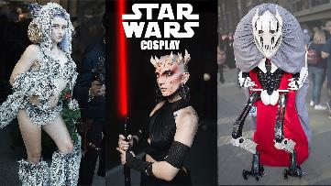
You could play
CALYPSO
S
CALYPSO: AN IMPROVISED WEST INDIAN SONG
(two plurals CALYPSOS and CALYPSOES)
But why not play
COSPLAY
S
COSPLAY: v. TO DRESS UP AS A FICTIONAL CHARACTER
COSPLAY
COSPLAYS
COSPLAYED
COSPLAYING
Notes:
.

Slide 58
?
A C I J O S T
ONE WORD
Notes:
.

Slide 59
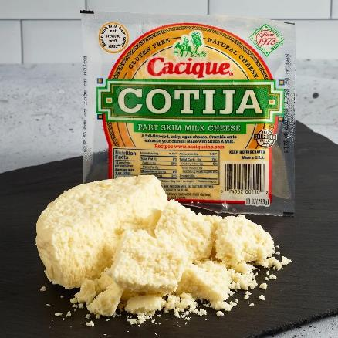
COTIJAS
_
COTIJAS: NWL23 pl. of COTIJA, A MEXICAN CHEESE
Notes:
.

Slide 60
?
C E P R S S Y
TWO WORDS
Notes:
.

Slide 61
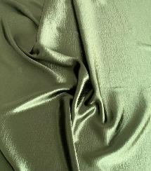
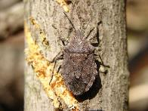
You could play
CYPRES: A LEGAL DOCTRINE (pl. CYPRESES)
CYPRESS
_
CYPRESS: A THIN FABRIC (pl. CYPRESSES)
But why not play
CRYPSES
CRYPSES: NWL23 pl. of CRYPSIS, AN ABILITY TO HIDE (also NWL23 pl. CRYPSISES)
Notes:
crypsis noun, plural crypsis and crypsises, adjective cryptic - particularly coloration and pattern that causes an insect to resemble an inedible object, such as a rock, plant, or bird dropping. Shift + F5 to return to full screen

Slide 62
?
C I P R S S Y
ONE WORD
Notes:
.

Slide 63
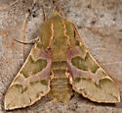
CRYPSIS
CRYPSIS: n. AN ABILITY TO HIDE
(NWL23 plurals: CRYPSES and CRYPSISES)
Notes:
crypsis noun, plural crypses, adjective cryptic - particularly coloration and pattern that causes an insect to resemble an inedible object, such as a rock, plant, or bird dropping. Shift + F5 to return to full screen

Slide 64
?
C D I P R T Y
ONE WORD
Notes:
.

Slide 65
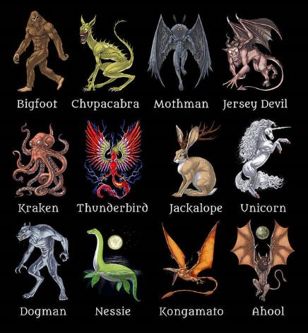
CRYPTID
S
CRYPTID: n. AN ANIMAL WHOSE REALITY IS IN DOUBT
Notes:
.

Slide 66
?
A B C E S T U
ONE WORD
Notes:
.

Slide 67
CUBESAT
S
CUBESAT: n. A TYPE OF SMALL, CUBIC, ARTIFICIAL SATELLITE
Notes:
.

Slide 68
?
A A C D H M S
ONE WORD
Notes:
.

Slide 69
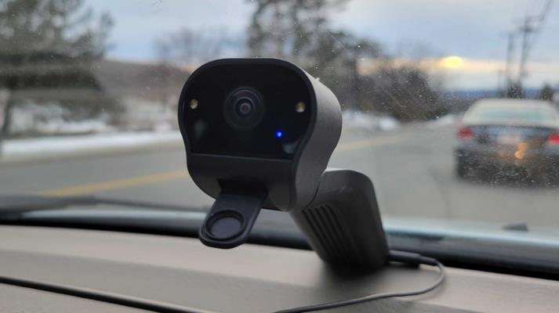
DASHCAM
S
DASHCAM: n. A VIDEO CAMERA MOUNTED ON A DASHBOARD
Notes:
.

Slide 70
?
A A D D E S S
ONE WORD
Notes:
.

Slide 71
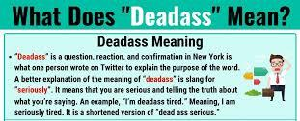
DEADASS
DEADASS: adv. SERIOUSLY (not a noun)
Notes:
"I deadass forgot to set my alarm, and now I'm late for work."
"Are you deadass telling me you aced that exam without studying at all?"
"I'm deadass tired after working a double shift yesterday."
"He deadass said he'd be here by 8 PM, but it's almost 9, and he's still not here."
"She deadass told me she's quitting her job and moving to a different city."
"I deadass can't believe you ate the last slice of pizza without asking!"
"Did you see that movie? It was deadass hilarious!"
"I'm deadass serious about starting a fitness routine this year."
"I deadass thought I had my keys, but now I can't find them anywhere."
"This pizza joint is deadass the best in town; you have to try it!"
Keep in mind that the use of "deadass" may vary in different dialects and regions, and it's considered informal and colloquial.
Shift + F5 to return to full screen

Slide 72
?
A B D D E O R
THREE WORDS
Notes:
.

Slide 73
You could play
BOARDED
BOARDED: v. TOOK MEALS FOR A FIXED PRICE
ROADBED
or
S
ROADBED: n. THE FOUNDATION FOR A RAILROAD TRACK
Instead play:
DEBOARD
S
DEBOARD: v. TO LEAVE A VEHICLE (DEBOARDED, DEBOARDING)
Notes:
.

Slide 74
?
D E E G G O R
ONE WORD
Notes:
.

Slide 75
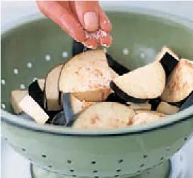
D
DEGORGE
S
DEGORGE: v. TO USE SALT TO EXTRACT MOISTURE BEFORE COOKING (DEGORGING)
Notes:
.

Slide 76
?
D E M M N O Y
ONE WORD
Notes:
.

Slide 77
DEMONYM
S
DEMONYM: n. A NAME GIVEN TO A GEOGRAPHICAL GROUP OF PEOPLE
TOKYOITES
ASHEVILLIANS
LONDONERS
SEATTLEITES
Notes:
"She was born and raised in Tokyo, making her a Tokyoite, which is the demonym for residents of Tokyo.“
"The demonyms 'Londoner' and 'Liverpudlian' refer to people from London and Liverpool, respectively."
"As a resident of Seattle, she proudly identifies with the demonym 'Seattleite.'"

Slide 78
?
D E G I L O P
ONE WORD
Notes:
.

Slide 79
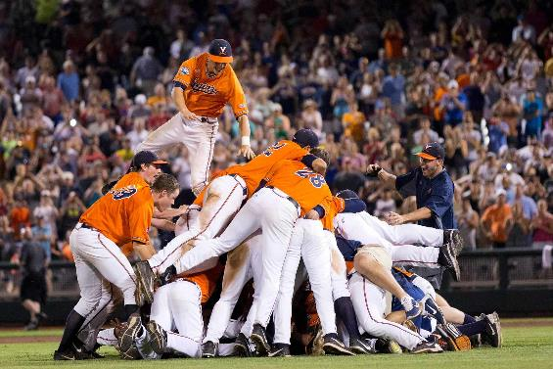
D
DOGPILE
S
DOGPILE: v. TO FIGHT OR CELEBRATE BY FORMING A HEAP OF PEOPLE (DOGPILING)
Notes:
.

Slide 80
?
A B D M S S U
ONE WORD
Notes:
.

Slide 81
DUMBASS
DUMBASS: n. AN IDIOT, A MENTALLY DEFICIENT PERSON (pl. DUMBASSES)
Notes:
.

Slide 82
?
E e g I l n s
TWO WORDS
Notes:
.

Slide 83
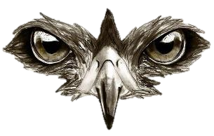
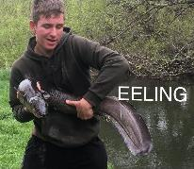
You could play
SEELING
_
SEELING: v. STITCHING THE EYES OF A FALCON CLOSED DURING TRAINING
F H P R
But why not play
EELINGS
_
EELINGS: NWL23 pl. of EELING, THE ACTIVITY OF CATCHING EELS
Notes:
.

Slide 84
?
C E G G O R N
ONE WORD
Notes:
.

Slide 85
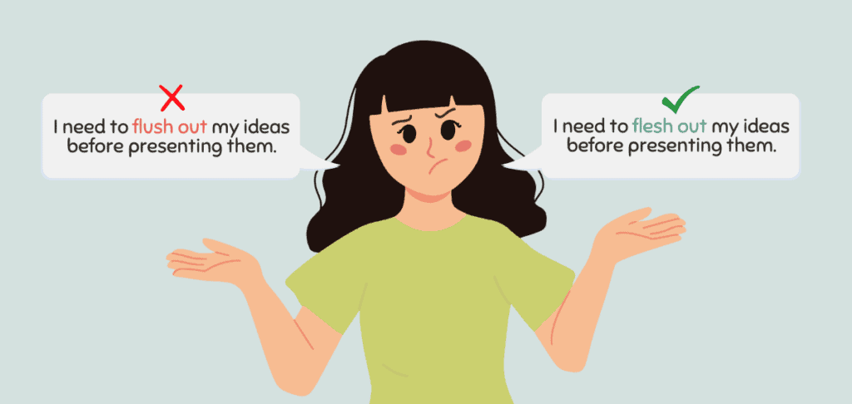
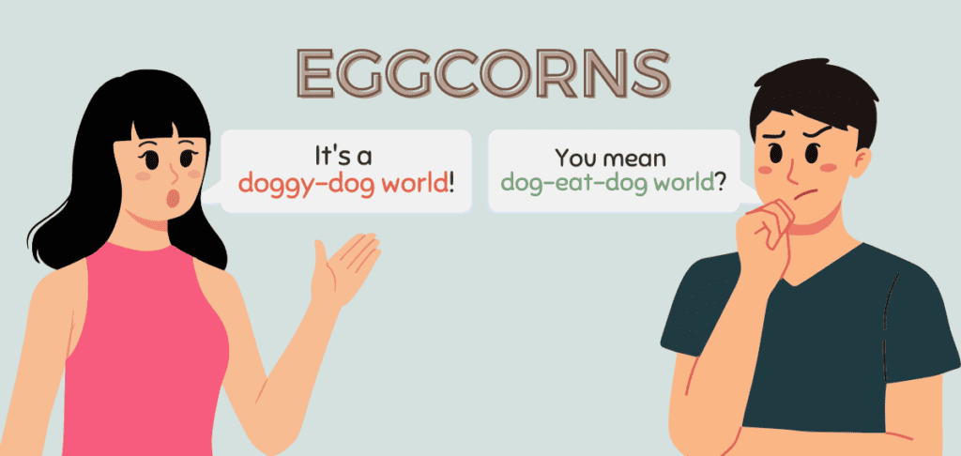
EGGCORN
S
EGGCORN: n. A MISHEARD, MISSPOKEN, OR MISPRONOUNCED HOMOPHONE
“Really, I am NOT homophonic.”
Notes:
EGGCORNS are typically more closely related to misspoken or mispronounced homophones rather than misheard ones.
"She always thought the phrase was 'for all intensive purposes,' but it's actually 'for all intents and purposes'—a classic eggcorn.“
"Instead of saying 'nip it in the bud,' he consistently said 'nip it in the butt,' unknowingly using an eggcorn.“
"Some people mistakenly say 'old-timer's disease' instead of 'Alzheimer's disease,' and this mispronunciation qualifies as an eggcorn.“
"Many people use 'escape goat' instead of ‘a scapegoat,' creating an unintentional eggcorn that mixes up the meaning."

Slide 86
?
E E E L K S U
ONE WORD
Notes:
.

Slide 87
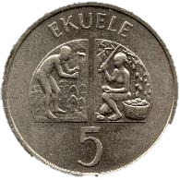
EKUELES
_
EKUELES: new pl. of EKUELE, A FORMER MONETARY UNIT OF EQUATORIAL GUINEA (also EKPWELE/S)
Notes:
.

Slide 88
?
A E E I L M R
TWO WORDS
Notes:
.

Slide 89
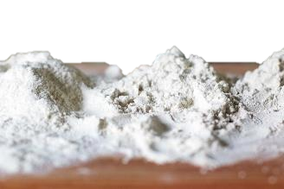
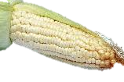
You could play
MEALIE: n. AN EAR OF CORN (pl. MEALIES).
MEALIER
_
MEALIER: adj. MORE MEALY, SOFT, DRY, AND FRIABLE (MEALIEST)
But why not play
EMAILER
R
_
S
EMAILER: ONE THAT SENDS MESSAGES BY COMPUTER
Notes:
.

Slide 90
?
A E G I N P Y
ONE WORD
Notes:
.

Slide 91
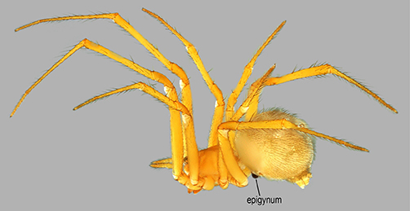
EPIGYNA
EPIGYNA: one pl. of EPIGYNUM, THE EXTERNAL REPRODUCTIVE ORGAN OF A FEMALE SPIDER (also pl. EPIGYNUMS and EPIGYNE/S)
Notes:
.

Slide 92
?
E E G I N P Y
ONE WORD
Notes:
.

Slide 93
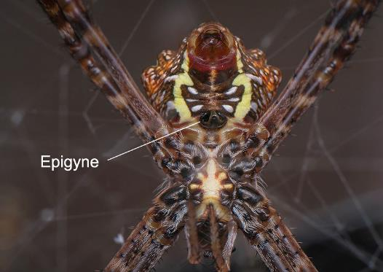
EPIGYNE
S
EPIGYNE: THE EXTERNAL REPRODUCTIVE ORGAN OF A FEMALE SPIDER (pl. EPIGYNES plus EPIGYNUM/S and EPIGYNA)
Notes:
.

Slide 94
?
E G I I L R S
ONE WORD
Notes:
.

Slide 95
_
GIRLIES
T
GIRLIES: n. the pl. of GIRLIE, A GIRL OR A WOMAN
GIRLIE: also adj. MORE LIKE A GIRL OR A WOMAN, GIRLY (GIRLIER, GIRLIEST)
Notes:
.

Slide 96
?
A E G L M P R
ONE WORD
Notes:
.

Slide 97
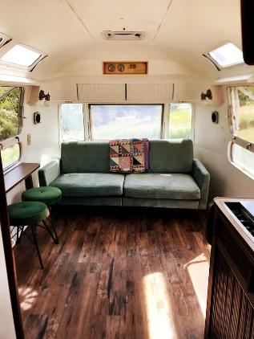
GLAMPER
S
GLAMPER: n. ONE THAT GLAMPS, CAMPS IN LUXURY
Notes:
.

Slide 98
?
E G H I O S Y
ONE WORD
Notes:
.

Slide 99
_
GOYISHE
GOYISHE: adj. PERTAINING TO NON-JEWISH PERSONS
Notes:
.

Slide 100
?
E G O R T U Y
ONE WORD
Notes:
.

Slide 101
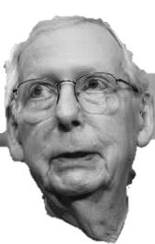
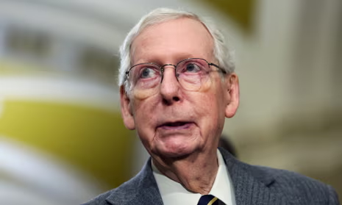
GREYOUT
S
GREYOUT: n. A PARTIAL MENTAL BLACKOUT (also GRAYOUT/S)
Notes:
.

Slide 102
?
E E G L S S U
ONE WORD
Notes:
.

Slide 103
GULESES
GULESES: new pl. of GULES, THE COLOR RED
Notes:
.

Slide 104
?
E G I M M S U
ONE WORD
Notes:
.

Slide 105
GUMMIES
T
STICKY
GUMMIES: pl. of GUMMY, A TYPE OF CANDY
Notes:
.

Slide 106
?
A G H L N S U
ONE WORD
Notes:
.

Slide 107
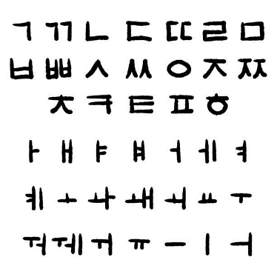
HANGULS
_
HANGULS: new pl. of HANGUL, THE KOREAN ALPHABETIC SCRIPT
Notes:
.

Slide 108
?
A c h I p s t
TWO WORDS
Notes:
.

Slide 109
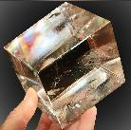
You could play
SPATHIC
SPATHIC: adj. RESEMBLING THE LUSTROUS MINERAL SPAR (SPARRY, SPARRIER, SPARRIEST)
But why not play
HAPTICS
_
HAPTICS: n. THE SCIENCE OF THE SENSE OF TOUCH
HAPTIC and HAPTICAL: adj.’s PERTAINING TO TOUCH
Notes:
.

Slide 110
?
E H H I I S S
ONE WORD
Notes:
.

Slide 111
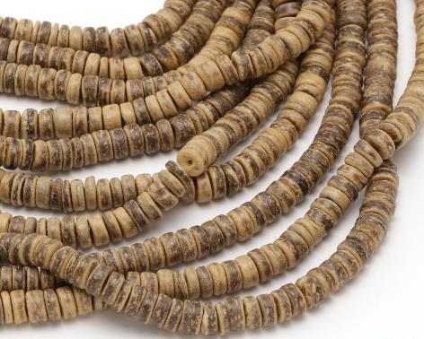
HEISHIS
_
HEISHIS: pl. of HEISHI, A TINY BEAD MADE FROM A SHELL
Notes:
.

Slide 112
?
G I I K N N S
TWO WORDS
Notes:
.

Slide 113
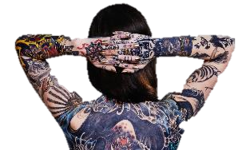
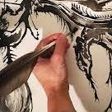
You could play
SINKING
_
SINKING: v. MOVING TO A LOWER LEVEL
But why not play
INKINGS
P
_
INKINGS: pl. of n. INKING, A TATTOO
INKING: also v. MARKING WITH INK (INK, INKS, INKED)
PINKING: n. A METHOD OF CUTTING OR DECORATING (pl. PINKINGS)
Notes:
.

Slide 114
?
E G G G I J N
ONE WORD
Notes:
.

Slide 115
JEGGING
_
S
JEGGING: n. A LEGGING MADE TO RESEMBLE DENIM
EGGING: v. INCITING OR URGING (EGG, EGGS, EGGED)
Notes:
EGGING does not take a rear S hook. Shift + F5 to return to full screen

Slide 116
?
A E E J K S S
ONE WORD
Notes:
.

Slide 117
JAKESES
JAKESES: NWL23 pl. of JAKES, AN OUTHOUSE
Notes:
.

Slide 118
?
A B E F G R T
ONE WORD
Notes:
.

Slide 119
FATBERG
S
FATBERG: n. A LARGE MASS OF FAT IN A SEWER
Notes:
.

Slide 120
?
C E E E F S S
ONE WORD
Notes:
.

Slide 121
FECESES
FECESES: NWL23 pl. of FECES, ANAL BODILY WASTE
ARE YOU $#!++!%@ ME?
THIS WORD DID NOT NEED ANOTHER PLURAL!
Notes:
.

Slide 122
?
C E F H I N T
ONE WORD
Notes:
.

Slide 123
FINTECH
S
FINTECH: n. EMERGENT FINANCIAL TECHNOLOGY
Notes:
.

Slide 124
?
A D E F L O V
ONE WORD
Notes:
.

Slide 125
FLAVEDO
S
FLAVEDO: n. THE PART OF A CITRUS FRUIT CONTAINING THE ZEST
Notes:
.

Slide 126
?
E F I R R S U
THREE WORDS
Notes:
.

Slide 127
You could play
FRISEUR
S
FRISEUR: A HAIRDRESSER
SURFIER
or
SURFIER: adj. MORE ABOUNDING IN BREAKING WAVES (SURFY, SURFIEST)
Instead play:
FURRIES
T
FURRIES: pl. of FURRY, A CREATURE COVERED IN FUR
Notes:
.

Slide 128
?
A F M S S U U
ONE WORD
Notes:
.

Slide 129
FUSUMAS
_
FUSUMAS: newly added pl. of FUSAMA, A SLIDING PARTITION IN A JAPANESE HOUSE
Notes:
.

Slide 130
?
E E G G I K N
ONE WORD
Notes:
.

Slide 131
GEEKING
GEEKING: NWL23 verb DISCUSSING A HIGHLY TECHNICAL SUBJECT
(GEEK, GEEKS, and the adj. GEEKED were good previously)
Notes:
.

Slide 132
?
E G I M N O S
ONE WORD
Notes:
.

Slide 133
GEOSMIN
S
GEOSMIN: n. A VOLATILE ORGANIC COMPONENT OF PETRICHOR, AN EARTHY ODOR.
Notes:
.

Slide 134
?
C E I J R U Y
ONE WORD
Notes:
.

Slide 135
JUICERY
_
JUICERY: n. A STORE THAT SELL JUICES (pl. JUICERIES)
Notes:
,

Slide 136
?
A A B E F K Y
ONE WORD
Notes:
.

Slide 137
KAYFABE
S
KAYFABE: n. A COLLECTIVE PRETENSE OF SINCERITY.
PROFESSIONAL WRESTLING IS AN EXAMPLE OF KAYFABE, WITH THE PRETENSE THAT THE ACTION, RIVALRIES, ETC. IS AUTHENTIC
Notes:
.

Slide 138
?
D E E K L T T
ONE WORD
Notes:
.

Slide 139
KETTLED
_
KETTLED: v. CORRALED PROTESTERS (KETTLE, KETTLES, KETTLING)
Notes:
.

Slide 140
?
A B C H K O O
ONE WORD
Notes:
.

Slide 141
KOBOCHA
S
KOBOCHA: n. A JAPANESE PUMPKIN OR SQUASH (also KABOCHA/S)
Notes:
.

Slide 142
?
A A B K M U Y
ONE WORD
Notes:
.

Slide 143
KUMBAYA
KUMBAYA: adj. PERTAINING TO A BELIEF THAT PEOPLE CAN LIVE IN HARMONY WITH EACH OTHER
Notes:
.

Slide 144
?
A A E I K M T
ONE WORD
Notes:
.

Slide 145
MAITAKE
S
MAITAKE: n. AN EDIBLE FUNGUS
Notes:
.

Slide 146
?
A A L M M N T
ONE WORD
Notes:
.

Slide 147
MALTMAN
MALTMAN: n. ONE THAT MAKES MALT, GERMINATED GRAIN (pl. MALTMEN, also MALTSTER/S)
Notes:
.

Slide 148
?
A E L M M N T
ONE WORD
Notes:
.

Slide 149
MALTMEN
MALTMEN: pl. of MALTMAN, ONE THAT MAKES MALT, GERMINATED GRAIN (also MALTSTER/S)
Notes:
.

Slide 150
?
A D E E M R Y
ONE WORD
Notes:
.

Slide 151
MEADERY
MEADERY: n. A PLACE WHERE MEAD IS MADE (pl. MEADERIES)
Notes:
.

Slide 152
?
E E I K L M R
ONE WORD
Notes:
.

Slide 153
MEIKLER
_
MEIKLER: NWL23 adj. LARGER, MORE MEIKLE
(MEIKLEST [STEMLIKE])
Notes:
.

Slide 154
?
E I J L M N O
ONE WORD
Notes:
.

Slide 155
MELINJO
S
MELINJO: n. A GNETUM TREE
Notes:
.

Slide 156
?
E E I L M R T
ONE WORD
Notes:
.

Slide 157
MELTIER
MELTIER: adj. MORE MELTY, RESEMBLING A MELTED SOLID (MELTIEST)
Notes:
.

Slide 158
?
F G M N O O O
ONE WORD
Notes:
.

Slide 159
MOFONGO
S
MOFONGO: n. A PUERTO RICAN PLANTAIN DISH
THAT MOFONGO DOWN TO DA RESTAURANT
Notes:
.

Slide 160
?
A L M O T T U
ONE WORD
Notes:
.

Slide 161
MULATTO
S
MULATTO: n. A PERSON OF WHITE AND BLACK ANCESTRY
THIS ATLANTA RAPPER GOES BY THE NAME “MULATTO.”
Notes:
.

Slide 162
?
A A E M N S T
ONE WORD
Notes:
.

Slide 163
NAMASTE
S
NAMASTE: n. A SOUTH ASIAN GREETING
Notes:
.

Slide 164
?
A B L L N T U
ONE WORD
Notes:
.

Slide 165
NUTBALL
S
NUTBALL: n. AN ODD PERSON
Notes:
.

Slide 166
?
A A E K M O S
ONE WORD
Notes:
.

Slide 167
OMAKASE
S
OMAKASE: n. A MENU WHOSE DISHES ARE CHOSEN BY A CHEF
Notes:
The word OMAKASE, meaning 'I leave it up to you',^{[3]} is most commonly used when dining at Japanese restaurants
where the customer leaves it up to the chef to select and serve seasonal specialties. Shift + F5 to return to full screen

Slide 168
?
A D E N P S T
THREE WORDS
Notes:
.

Slide 169
You could play
_
pedants
PEDANTS: pl. of PEDANT, ONE WHO FLAUNTS KNOWLEDGE (adj. PEDANTIC, n. PEDANTRY, PEDANTRIES)
_
or
pentads
PENTADS: pl. of PENTAD, A GROUP OF 5
pantsed
Instead play:
PANTSED: v. PULLED DOWN ONE’S PANTS (PANTS, PANTSES, PANTSING)
Notes:
.

Slide 170
?
C E I K N P Y
ONE WORD
Notes:
.

Slide 171
PICKNEY
S
PICKNEY: n. A PRE-TEEN CHILD, USUALLY CARRIBEAN
Notes:
.

Slide 172
?
G I I O P R S
ONE WORD
Notes:
.

Slide 173
PIROGIS
_
PIROGIS: NWL23 pl. of PIROGI, A SMALL DUMPLING WITH A FILLING (also PIEROGI, PIEROGIES and PIEROGIS plus PYROGY & PYROGIES and don’t forget PYROHY & PYROHIES)
Notes:
,

Slide 174
?
E H I L P S U
ONE WORD
Notes:
.

Slide 175
R
PLUSHIE
S
PLUSHIE: n. A STUFFED TOY COVERED IN PLUSH
also
PLUSHY
PLUSHIER
PLUSHIEST
PLUSHILY
Notes:
.

Slide 176
?
E F I O O P R
ONE WORD
Notes:
.

Slide 177
POOFIER
POOFIER: MORE POOFY (POOFIEST)
Notes:
.

Slide 178
?
E E H I P R R
ONE WORD
Notes:
.

Slide 179
PREHIRE
_
PREHIRE: adj. only “BEFORE HIRING”
Notes:
.

Slide 180
?
D E E E N R P
TWO WORDS
Notes:
.

Slide 181
You could play
PREENED
PREENED: v. TO SMOOTH OR CLEAN WITH THE BEAK OR TONGUE
But why not play
PRENEED
PRENEED: adj. BEFORE A NEED
Notes:
.

Slide 182
?
E E P P P R R
ONE WORD
Notes:
.

Slide 183
PREPPER
S
PREPPER: n. A PREPARER
Notes:
.

Slide 184
?
A I I N P R S
TWO WORDS
Notes:
.

Slide 185
You could play
GS
ASPIRIN
ASPIRIN: n. A PAIN RELIEVER
But why not play
RAPINIS
_
RAPINIS: NWL pl. of RAPINI, AN EDIBLE PLANT
Also RAPPINI/S
Notes:
.

Slide 186
?
A A E I L R S
TWO WORDS
Notes:
.

Slide 187
You could play
AERIALS
_
AERIALS: pl. of AERIAL, AN ANTENNA
But why not play
REALIAS
_
REALIAS: NWL23 pl. of REALIA, OBJECTS USED BY A TEACHER TO ILLUSTRATE EVERYDAY LIVING
Notes:
.

Slide 188
?
B D E H R S U
TWO WORDS
Notes:
.

Slide 189
You could play
Brushed Metal
BRUSHED
_
BRUSHED: v. TOUCHED LIGHTLY
But why not play
REDBUSH
REDBUSH: A SOUTH AMERICAN EVERGREEN SHRUB (also ROOIBOS with pl. ROOIBOSES)
Notes:
.

Slide 190
?
C D E E K N R
ONE WORD
Notes:
.

Slide 191
REDNECK
S
REDNECK: AN UNSOPHISTICATED RURAL WHITE PERSON
Notes:
,

Slide 192
?
A C E H R T W
TWO WORDS
Notes:
.

Slide 193
You could play
WATCHER
S
WATCHER: n. ONE THAT WATCHES
But why not play
REWATCH
REWATCH: v. TO WATCH AGAIN (REWATCHED, REWATCHES, REWATCHING)
Notes:
.

Slide 194
?
E N R S S U Y
ONE WORD
Notes:
.

Slide 195
SENRYUS
_
SENRYUS: NWL23 pl. of SENRYU, A JAPANESE POEM
Notes:
,

Slide 196
?
E E E H N S Y
ONE WORD
Notes:
.

Slide 197
SHEENEY
S
SHEENEY: A DISPARAGING TERM FOR A JEWISH PERSON
Notes:
,

Slide 198
?
E E E H I N S
ONE WORD
Notes:
.

Slide 199
RS
SHEENie
SHEENIE: A PERSON OF JEWISH RELIGION OR DESCENT
SHEENY: SHINY (SHEENIER, SHEENIEST)
Notes:
,

Slide 200
?
E E G H S T Z
ONE WORD
Notes:
.

Slide 201
SHEGETZ
SHEGETZ: A JEWISH BOY WHO DOES NOT OBSERVE JEWISH PRECEPTS (pl. SHKOTZIM)
Notes:
,

Slide 202
?
A C H I K S S
ONE WORD
Notes:
.

Slide 203
SHICKSA
S
SHICKSA: A JEWISH FEMALE WHO DOES NOT OBSERVE JEWISH PRECEPTS (also SHIKSA/S, SHIKSE/S, and SHIKSEH/S)
Notes:
,

Slide 204
?
E H H I K S S
TWO WORDS
Notes:
.

Slide 205
You could play
SHEIKHS
_
SHEIKHS: pl. of SHEIKH, ARAB CHIEFS (also SHEIK/S)
But why not play
SHIKSEH
_
S
SHIKSEH: n. A JEWISH FEMALE WHO DOES NOT OBSERVE JEWISH PRECEPTS (also SHICKSA/S SHIKSE/S, SHIKSA/S and SHIKSE/S)
Notes:
.

Slide 206
?
A D H L O S U
ONE WORD
Notes:
.

Slide 207
SHOULDA
_
SHOULDA: SHOULD HAVE
Notes:
,

Slide 208
?
E I I M S S Z
ONE WORD
Notes:
.

Slide 209
SIZEISM
S
SIZEISM: DISCRIMINATION BASED ON SIZE
Notes:
,

Slide 210
?
E I I S S T Z
TWO WORDS
Notes:
.

Slide 211
You could play
SIZIEST
SIZIEST: adj. MOST SIZY, VISCID (SIZIER)
But why not play
SIZEIST
S
SIZEIST: n. ONE WHO PRACTICES SIZEISM
Notes:
.

Slide 212
?
E H I L S S U
ONE WORD
Notes:
.

Slide 213
RS
SLUSHIE
SLUSHIE: A CONFECTION CONSISTING OF FLAVORED SEMISOLID ICE
Also SLUSHY, SLUSHIER, SLUSHIEST as well as SLUSHEE/S
Notes:
,

Slide 214
?
E E H L S S U
TWO WORDS
Notes:
.

Slide 215
You could play
HUELESS
HUELESS: adj. WITHOUT A HUE, WITHOUT COLOR
But why not play
SLUSHEE
S
SLUSHEE: n. A CONFECTION CONSISTING OF FLAVORED SEMISOLID ICE
Notes:
.

Slide 216
?
A D E K N R S
TWO WORDS
Notes:
.

Slide 217
You could play
DARKENS
_
DARKENS: v. MAKES DARK (DARKEN, DARKENED, DARKENING)
But why not play
SNARKED
_
SNARKED: v. CRITICIZED HURTFULLY (SNARK, SNARKS, SNARKING)
NARKED: v. SPIED OR INFORMED (NARK, NARKS, NARKING)
Notes:
.

Slide 218
?
C N N O O P S
ONE WORD
Notes:
.

Slide 219
SPONCON
S
SPONCON: A SPONSOR-PLACED CONTENT ITEM
Notes:
Content posted usually by an ”influencer” on social media that looks like a typical post but for which the poster has been paid to advertise a product or service. Shift + F5 to return to full screen

Slide 220
?
E F F I S T U
ONE WORD
Notes:
.

Slide 221
RS
STUFFIE
STUFFIE: n. A STUFFED TOY
also
STUFFY
STUFFIER
STUFFIEST
Notes:
,

Slide 222
?
A B E E S S T
ONE WORD
Notes:
.

Slide 223
TABESES
TABESES: NWL23 pl. of TABES, A SYPHILITIC DISEASE
Notes:
,.

Slide 224
?
A D E E R S T
FIVE WORDS
Notes:
.

Slide 225
You could play
DERATES
DEAREST
S
_
_
REDATES
SEDATER
P
_
Instead play:
TASERED
TASERED: NWL23 v. STUNNED USING FIRED ELECTRIFIED DARTS
(TASER, TASERS, TASERING)
Notes:
.

Slide 226
?
E G H I I N T
TWO WORDS
Notes:
.

Slide 227
You could play
NIGHTIE
S
NIGHTIE: A NIGHTGOWN
But why not play
THINGIE
S
THINGIE: n. SOMETHING WHOSE NAME IS UNKNOWN OR FORGOTTEN (also THINGY)
Notes:
.

Slide 228
?
A D E N U V X
ONE WORD
Notes:
.

Slide 229
UNVAXED
UNVAXED: adj. UNVACCINATED (also UNVAXXED) “-D only”
Notes:
,

Slide 230
?
A A I Q T U V
TWO WORDS
Notes:
.

Slide 231
You could play
AQUAVIT
S
AQUAVIT: A SCANDINAVIAN LIQUOR
But why not play
VAQUITA
S
VAQUITA: n. ONE OF A SPECIES OF PORPOISE
Notes:
.

Slide 232
?
A E I L L R W
ONE WORD
Notes:
.

Slide 233
WALLIER
_
WALLIER: NWL23 comparative adj. MORE WALLY, MORE STURDY (WALLIEST)
WALLIE: n. A VALET (pl. WALLIES)
also WALY: NWL comp. adj. VISUALLY PLEASING (WALIER, WALIEST) & WALY: n. SOMETHING VISUALLY PLEASING (pl. WALIES)
Notes:
,

Slide 234
Wow, what fortitude you have!!
Remember there are other PowerPoint shows available for the new words!
www.ashevillescrabble.com on the Study page
For new sevens, there is an additional PowerPoint show emphasizing the differences between NWL23 and WOW24!
I’m quite sure these are not quite perfect, so please email suggestions to williamrsnoddy@gmail.com
Notes:
.

